Slide 1

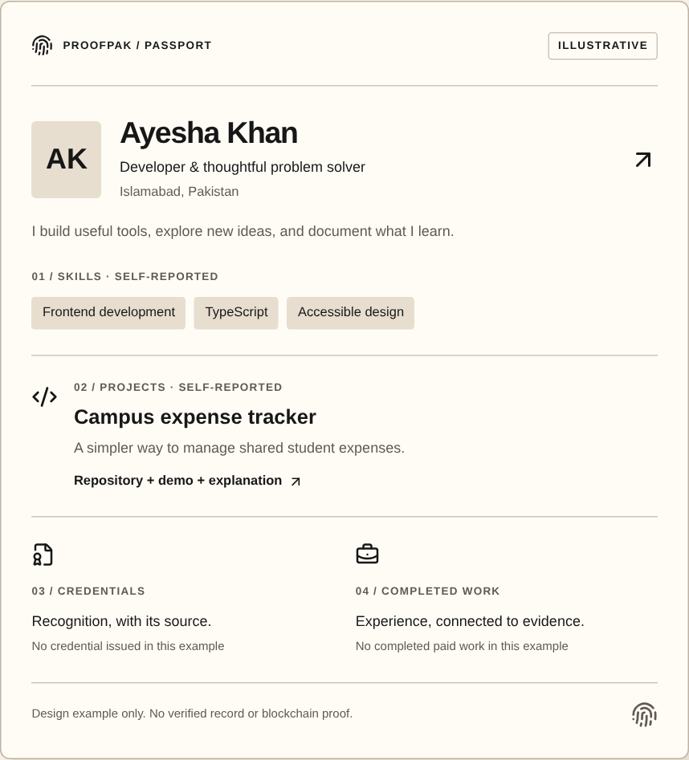
ProofPak
ProofPak
Prove your skills.
Get work.
Build your reputation.
One place to show your skills, prove your work,
find opportunities, and get paid.
SAMPLE PASSPORT
Notes:
ProofPak helps you prove your skills, get work, and build your reputation. It starts with one Skill Passport connecting your work, evidence, opportunities, and achievements.
Actual website MarketingPassport component: explicitly illustrative, no genuine issued award or blockchain proof. Website Arial retained. User palette used exactly; screenshots preserve website colors.

Slide 2
Your work is everywhere.
Your proof shouldn’t be.
Projects
Scattered evidence
CV
Code + demos
Across files and websites.
Skills
Experience
Repeated effort
Certificates
Evidence
Send the same proof again.
Different issuers
Difficult verification
Links + emails
Check the source and status.
Notes:
When you apply for work, your CV is one file, your projects live elsewhere, and certificates sit in email. You collect the same evidence again. Employers still need to understand the source of each claim and the work behind it. The problem is not a lack of work. It is a scattered professional record.
Conceptual editable illustration, not customer research or unemployment statistics. Difficult verification means assessing source/status, not a claim that blockchain proves skills.

Slide 3
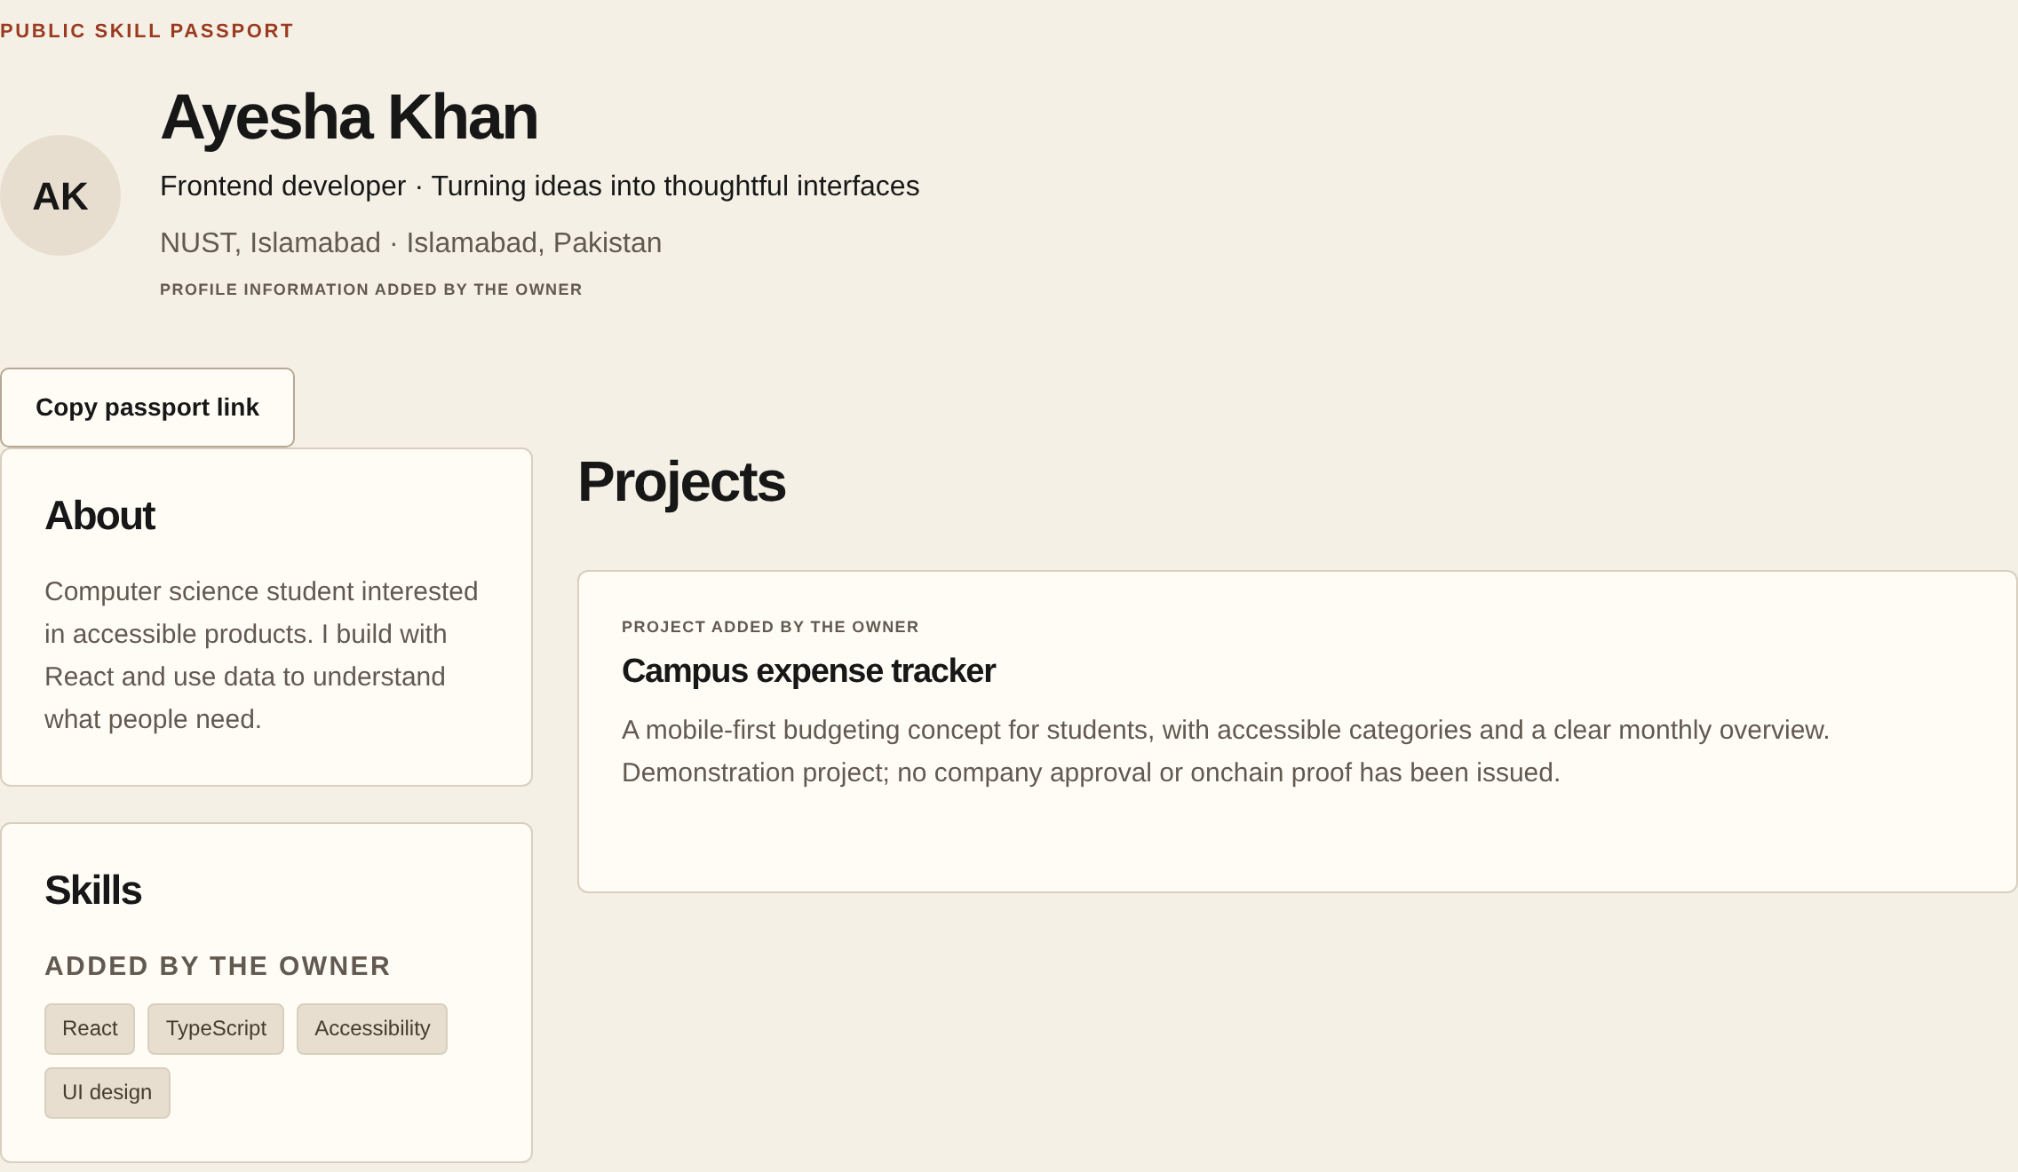
One Skill Passport.
A complete picture of your work.
Show your
skills.
Prove your
work.
Build your
reputation.
RUNNING APP · DEMO DATA
Notes:
Here is the actual running Passport with demo data. Show your skills and practical projects. Prove your work with supporting evidence and credentials from authorized organizations. Build your reputation as your record grows. Your own claims remain separate from issued credentials. You control what to publish, then share one place that gives people the full picture.
Public demo Passport from the actual running application. No real user, issued credential or completed paid work is claimed. Self-reported profile/project claims and organization-issued credentials remain distinct. User controls publication.

Slide 4
From your first project
to a growing reputation.
01
02
03
04
05
Create your
Passport
Show your
work
Find
opportunities
Complete
the work
Grow your
reputation
Skills, projects
and experience.
Projects, evidence,
achievements.
Challenges +
paid projects.
Submit work.
Get feedback.
Complete milestones.
Completed work +
separately issued
credentials.
Milestone reviews + devnet test-USDC payments.
Credentials issued separately by authorized organizations.
Notes:
Create your Passport with skills, projects and experience. Show your work with projects and evidence. Find a challenge or paid project. Submit work, get feedback, and complete the agreed milestones. Paid projects can include milestone payments using test USDC on devnet. Then grow your record with completed work and separately issued credentials. An authorized organization issues the credential; payment never creates one automatically.
Timing target: 29 seconds. Source: docs/PAYMENTS-MVP.md; CREDENTIALS-WALLETS-DELIVERY.md. Acceptance/publication are separate recipient choices. No escrow or guaranteed payment. All five steps form a left-to-right workflow; stage 5 is dark for visual emphasis.

Slide 5
Two important jobs for Solana.
Credential integrity
Milestone payments
Check whether recorded data changed.
Send test USDC for approved work.
→
→
→
→
Credential
Digital
fingerprint
Solana record
Approved
milestone
Wallet
payment
Transaction
receipt
Low fees. Fast settlement. Publicly checkable records.
DEVNET · TEST USDC | Record integrity does not independently prove skill.
Notes:
Solana does two useful jobs. A credential can have a digital fingerprint recorded onchain, letting someone check whether that record changed. This checks integrity, not whether the skill claim is true. For approved project milestones, connected wallets can send test USDC and produce a checkable receipt. Low fees, fast settlement, and public records fit both jobs. The current implementation is devnet only, not real-money mainnet payments.
credential-proof.ts; payment-chain.ts; payments.ts. Devnet/test-token implementation; no finalized live broadcast independently verified. Fingerprint detects record changes, not truth of skill or real-world issuer identity. Fast/low-cost are design rationale, not a measured benchmark. No genuine Solana logo was locally available; a neutral editable network icon is used, not an invented logo.

Slide 6
More than a CV.
More than a job platform.
Today
With ProofPak
CVs
One professional record
Claims on a page.
→
Skills, evidence and completed work.
Certificate tools
Clear sources
Awards stored apart.
Your claims and issued credentials.
Work platforms
Reputation that grows
Work stays elsewhere.
Each achievement adds context.
Carry your work forward into the next opportunity.
Notes:
ProofPak is different because the record carries forward. A CV lists claims, a certificate tool holds awards, and a work platform holds jobs. ProofPak connects skills, evidence, opportunities and completed work. Each new project or credential gives the next person more context, instead of making you start from zero. That is how a professional record can build reputation over time.
Positioning comparison, not an exhaustive competitor feature audit or first-of-kind claim. One record connects opportunities to evidence and completed work; reputation is the intended benefit, not a verified score or guaranteed hiring outcome.

Slide 7
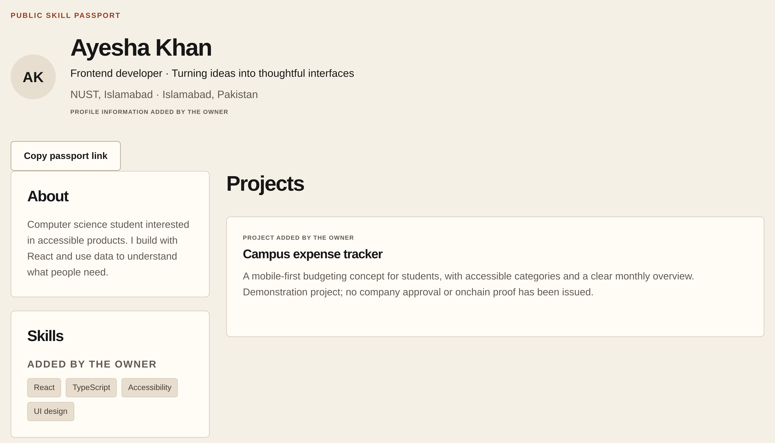
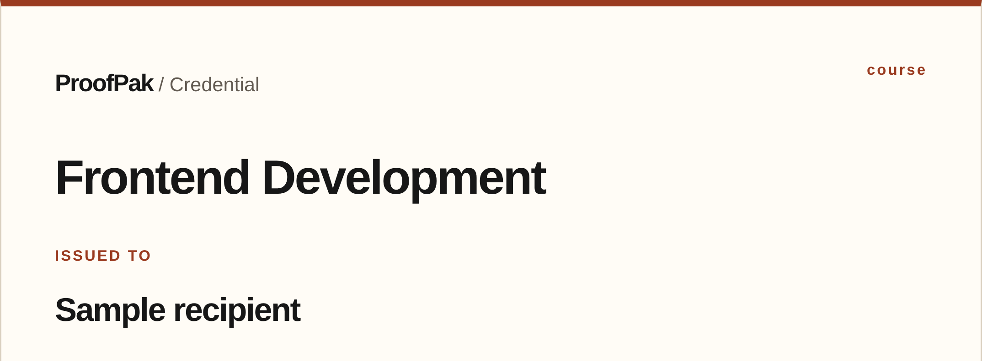
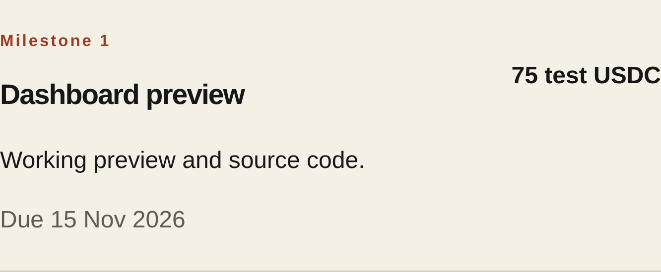
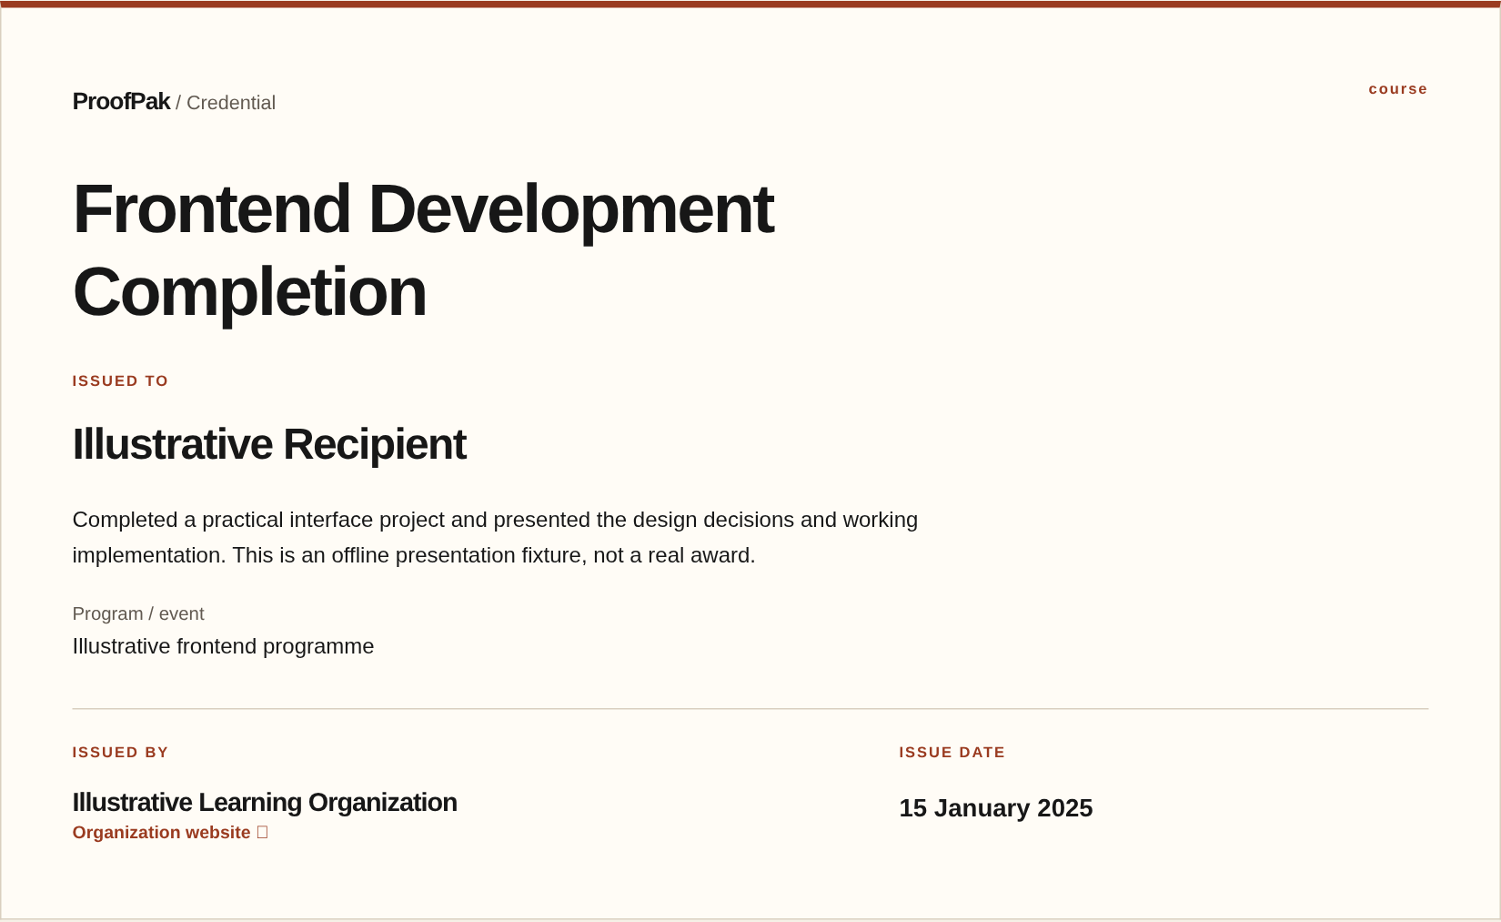
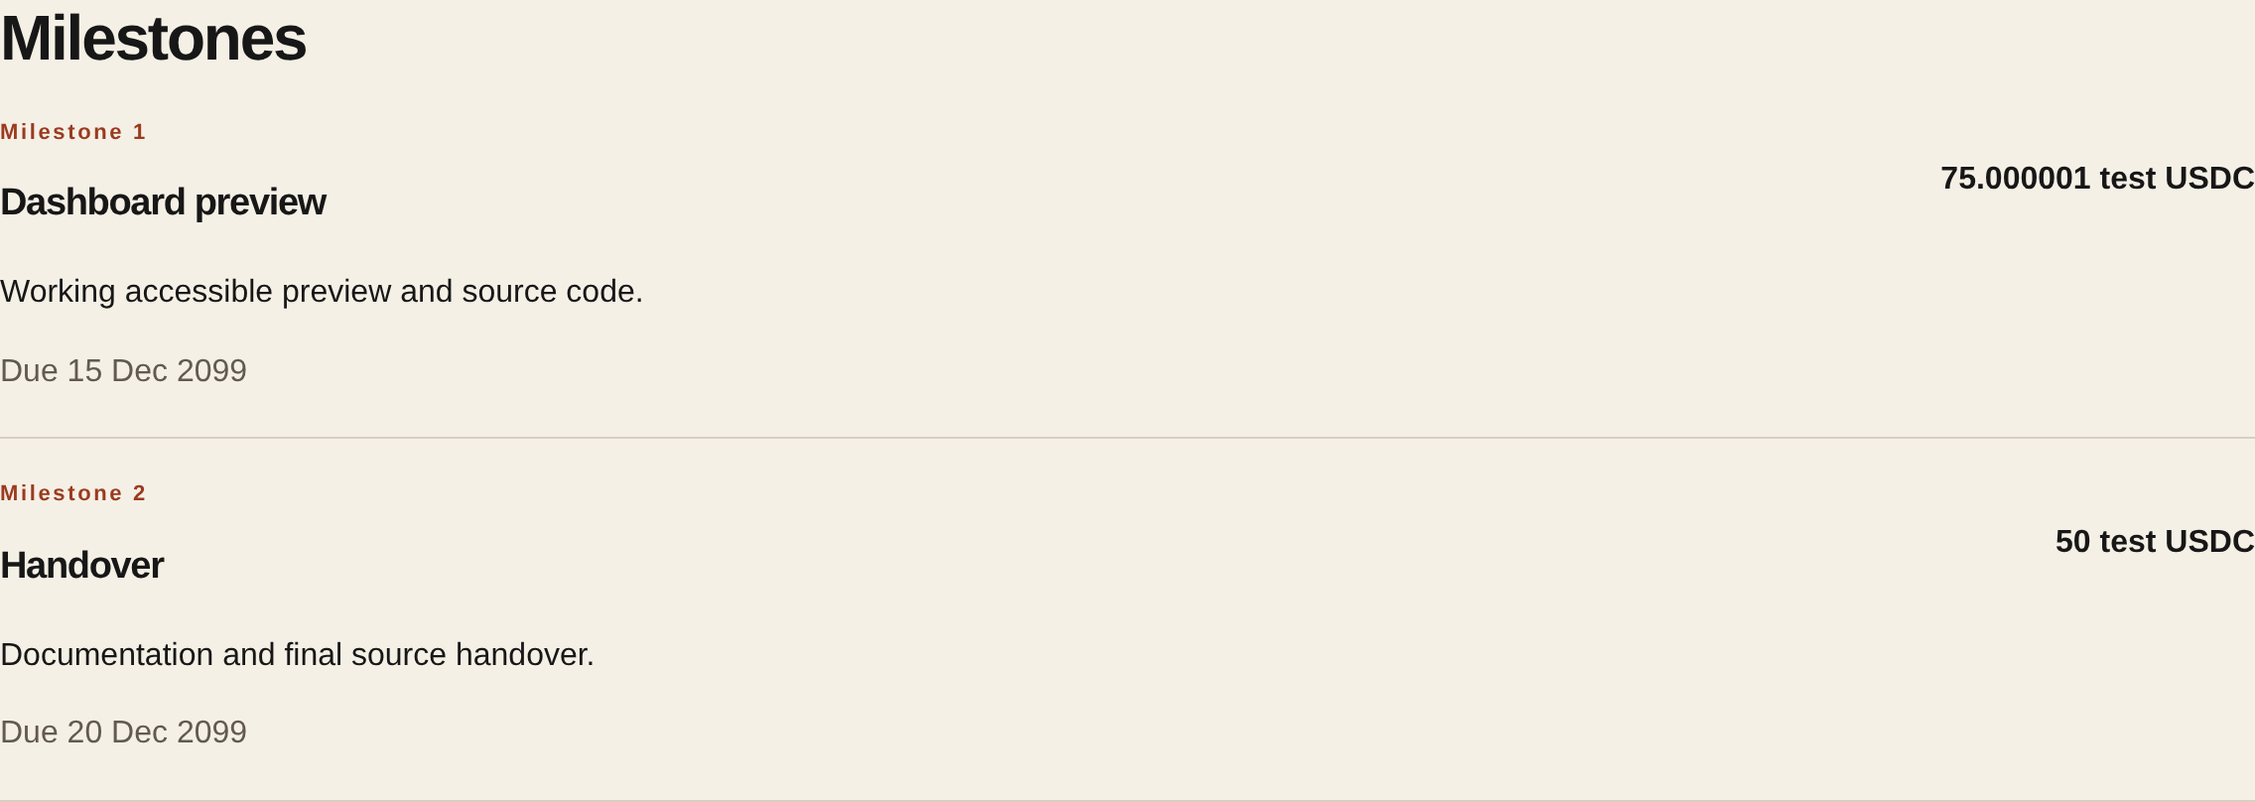
A working product.
Ready for real-user testing.
Skill Passport
Issued Credentials
Paid Projects
Sample data · isolated product captures
Notes:
This is a working product, not just an idea. The Passport connects profile and project evidence. Organizations can separately issue credentials. Paid projects support agreed milestones, work reviews and devnet payment logic. These are genuine product components shown with clearly labeled sample data. The MVP has passed local and automated checks. Hosted accounts, actual wallet linking, and real wallet-to-devnet journeys still need complete acceptance testing.
The main capture is the running application public demo Passport. Supporting images are the unchanged repository CredentialDetail and ProjectMilestoneHeading components, rendered with the app’s compiled CSS in an isolated React rendering harness. Inputs are explicitly illustrative: Sample recipient; no real issuer authorization, credential publication, proof, verified skill, wallet or transaction. Milestone: round 75 test USDC, planned 15 November 2026; not paid or approved. No source or DOM edits, database writes, production changes, or real activities. Capture crops focus on the certificate title/recipient and one milestone, omitting private/status panels and nonessential details. Prior validation: 60 unit tests, 112 demo/fixture browser tests, local PostgreSQL workflow/privacy suites, lint/typecheck/build passed. No live E2E inference. The pre-existing Next.js security advisory remains outside this task.

Slide 8
Starting with Pakistan’s skilled talent.
Students
Freelancers
Show work beyond a CV.
Keep evidence of delivery.
Pakistan first.
Developers
& graduates
Organizations
Start with students, developers,
freelancers, and organizations
that need a better way to show
and assess skills.
Show projects.
Find opportunities.
Find talent.
Issue recognition.
Notes:
Start with students, developers, freelancers and organizations in Pakistan that need a better way to show and assess skills. These groups can test both sides of the product in focused local pilots. The aim is to learn whether a Passport is useful for the next opportunity, before expanding.
Audience and market-entry thesis, not validated demand or confirmed pilots. No market statistic or customer activity asserted. The Pakistan outline is the existing Natural Earth geographic locator; source remains the prior review report and original notes.

Slide 9
Free for individuals.
Paid services for businesses.
Individuals
Organizations
Free basic tools
Potential paid tools
Build a Skill Passport
Issue credentials
Share your profile
Find practical talent
Discover opportunities
Manage opportunities
Future option: project transaction fees, subject to validation and applicable rules.
Notes:
Our proposed model starts free for individuals: a basic Skill Passport and sharing. Organizations could pay for useful credential, hiring and opportunity tools. That puts revenue around team needs while keeping it easy for talent to start. Later, project transaction fees may be an option, subject to validation and applicable rules. These are business hypotheses, not current revenue or announced prices.
Business-model proposal only. No pricing, billing implementation, existing revenue, paying customer or current transaction fee is asserted. Free basic passport, sharing and discovery are the intended individual proposition.

Slide 10
Start with communities.
Grow through real use.
Reach
Pilot
Grow
→
→
Developer + education
communities in Pakistan.
Focused trials with
companies and issuers.
Completed journeys,
repeat use and feedback.
Founder advantage
Experience building developer communities,
educational workshops and hackathons in Pakistan.
Notes:
Reach early users through developer and education communities in Pakistan. Run a focused pilot with an interested company or credential issuer. Then measure completed journeys, repeat use, and feedback before expanding. The founder brings experience building developer communities, educational workshops and hackathons in Pakistan. That is an execution advantage, not a claim that those communities are ProofPak customers or partners.
Founder experience supplied explicitly by the user in this brief; not independently verified against biographical sources. Communities/institutions are not presented as confirmed customers or partners. Reach, Pilot and Grow are planned actions, not existing traction.

Slide 11

ProofPak
Your work should
build your
reputation.
Projects
Achievements
Skill
Passport
One Skill Passport that grows
with every project and achievement.
Prove your skills. Get work.
Build your reputation.
Opportunities
Notes:
Your work should build your reputation. One Skill Passport can grow with every project and achievement, while connecting you to your next opportunity. That is the direction for ProofPak: a professional record that keeps the context of your work, rather than losing it between platforms. Prove your skills. Get work. Build your reputation.
Next steps, not visible roadmap: complete real-user testing, run focused company and issuer pilots, and expand only after feedback. Mainnet payments and wider portability remain future releases requiring separate validation and approval. The layered Passport is an editable conceptual illustration, not an app screenshot or a verified credential. No record count, score or activity is implied by the graphic. Genuine website fingerprint asset and established five-color palette retained.

