Slide 1

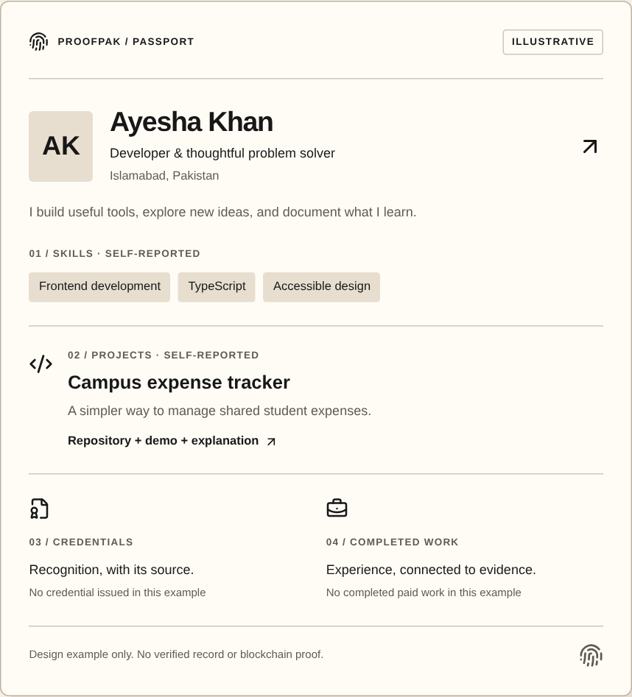
PROOFPAK
SOLANA HACKATHON · SKILL PASSPORT
01 / 11
ProofPak
Prove your skills. Get work.
Build your reputation.
One place to show your skills, prove your work,
find opportunities, and get paid.
ACTUAL WEBSITE · ILLUSTRATIVE PROFILE
Notes:
ProofPak is one place to show your skills, prove your work, find opportunities, and get paid. We start with a Skill Passport that grows with you.
Target: 12 seconds. Screenshot: existing website marketing component, explicitly illustrative; not a real user or award.

Slide 2
PROOFPAK
THE PROBLEM
02 / 11
Your work is everywhere.
Your proof shouldn’t be.
01
Send it all again
Project links
CV
The same evidence, every time.
02
Hard to judge
Evidence emails
Who issued it? Is it current?
Certificates
03
Claims without context
A CV rarely shows completed work.
Scattered files. Repeated effort.
Notes:
Think about applying for your next role. Your CV is one file, project links are somewhere else, and certificates sit in email. You collect and send the same evidence again. The employer still has to ask who issued it and what work you actually completed. Good work gets lost between all those places.
Target: 25 seconds. Diagram represents common user activities; no market statistics or research findings are claimed.

Slide 3
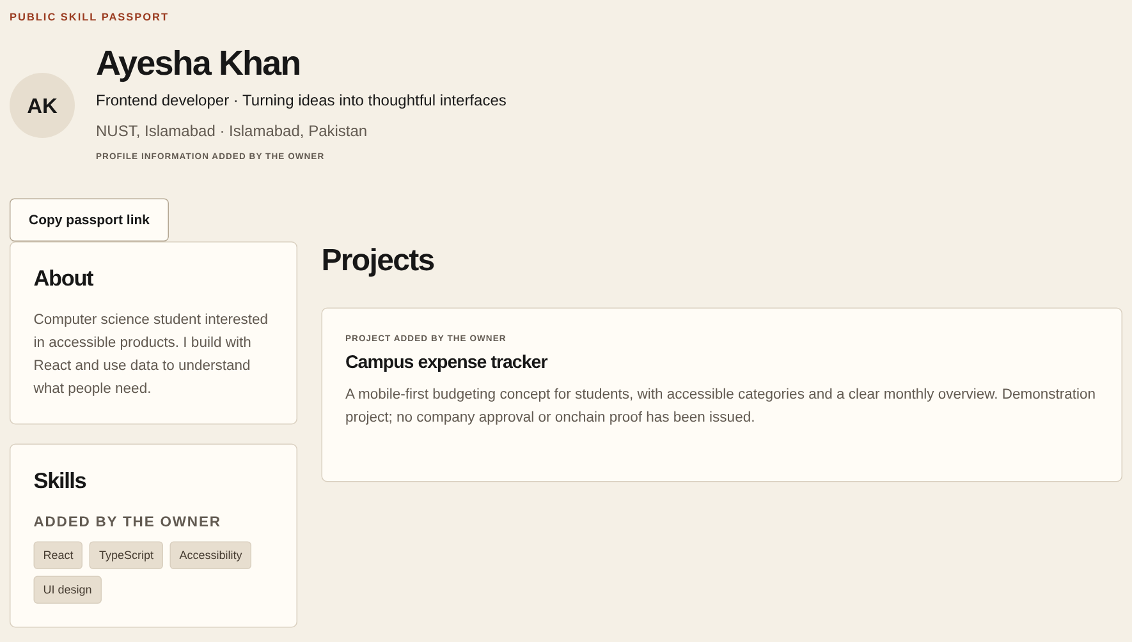
PROOFPAK
THE SOLUTION
03 / 11
One Skill Passport.
A complete picture of your work.
Show
Skills, projects, experience.
Prove
Evidence + issued credentials.
Grow
Opportunities + work history.
RUNNING APP · DEMO PASSPORT
Notes:
ProofPak brings that picture into one shareable Skill Passport. Show your skills, projects and experience. Add evidence, while keeping your own claims separate from organization-issued credentials. Then find opportunities and build a record of completed work. This is the actual running product with demo data. You choose what to make public and share.
Target: 25 seconds. Source: src/components/passport-view.tsx; src/lib/credential-actions.ts. Demo screenshot contains no issued credential or blockchain proof.

Slide 4
PROOFPAK
THE JOURNEY
04 / 11
From showing your skills
to building your reputation.
1
→
2
→
3
→
4
→
5
Create a
Passport
Show
Work
Find an
Opportunity
Complete
Work
Add an
achievement
Your starting point
Projects + evidence
Challenges + projects
Submit + review
Separately issued
Paid projects: agreed milestones → work review → payment
Authorized organizations issue credentials separately. A payment does not create a credential.
Notes:
Start by creating your Passport and adding work with supporting evidence. Find a challenge or paid project that fits. For paid projects, both sides agree on milestones before the work starts. Submit your work, receive a review, and use the supported payment flow. An authorized organization may separately issue a credential. A payment never creates one automatically. Each step can add context to your growing professional record.
Target: 30 seconds. Source: docs/PAYMENTS-MVP.md; docs/CREDENTIALS-WALLETS-DELIVERY.md. Credential acceptance and publication require separate recipient choices. No guaranteed payment, escrow or automatic work-to-credential claim.

Slide 5
PROOFPAK
WHY SOLANA
05 / 11
Two important jobs for Solana.
01
02
Credential integrity
Milestone payments
Record a digital fingerprint.
Check whether the record changed.
Connected wallets send test USDC
for approved project milestones.
Credential → fingerprint → Solana
Approved work → transfer → receipt
Low costs. Fast settlement. Public transaction records.
DEVNET ONLY · TEST TOKENS · LIVE END-TO-END VALIDATION STILL PENDING
Notes:
Solana does two specific jobs. First, selected credentials can have a digital fingerprint recorded onchain, so a verifier can check whether the recorded data changed. That does not prove the skill or the issuer’s real-world identity. Second, connected company wallets can send test USDC for approved milestones. Solana fits because costs are low, settlement is fast, and transactions are publicly checkable. Today, this is devnet only.
Target: 30 seconds. Source: src/lib/credential-proof.ts; src/lib/payment-chain.ts; src/lib/payments.ts. Solana design rationale, not a measured latency or fee benchmark. No live broadcast or real-money transfer has been independently verified. Authorized-on-ProofPak does not establish legal identity.

Slide 6
PROOFPAK
THE DIFFERENCE
06 / 11
More than a CV.
More than a job platform.
TODAY
WITH PROOFPAK
CV + separate project links
One shareable
professional record.
→
Certificates in email
Work history left behind
Each new achievement adds context.
Notes:
The difference is the connection. Today, your CV, evidence, certificates and opportunities live apart. ProofPak brings them into one professional record. We are not claiming to invent each feature. We connect them, so each new achievement can strengthen your reputation.
Target: 18 seconds. Positioning comparison, not a competitive feature audit or a world-first claim.

Slide 7
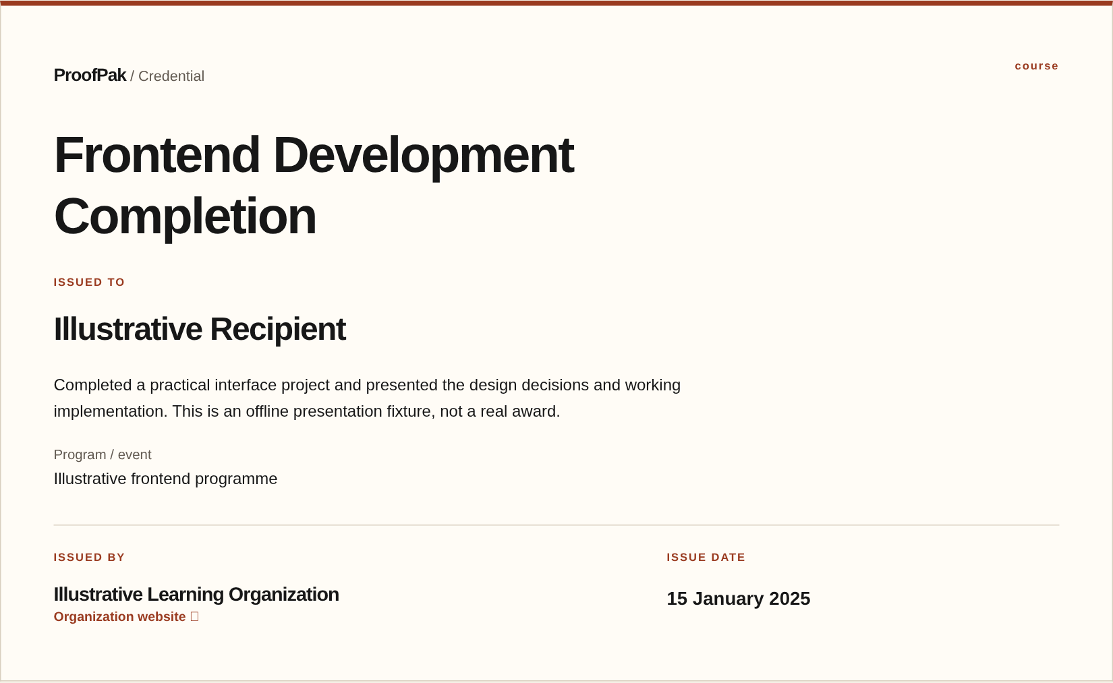
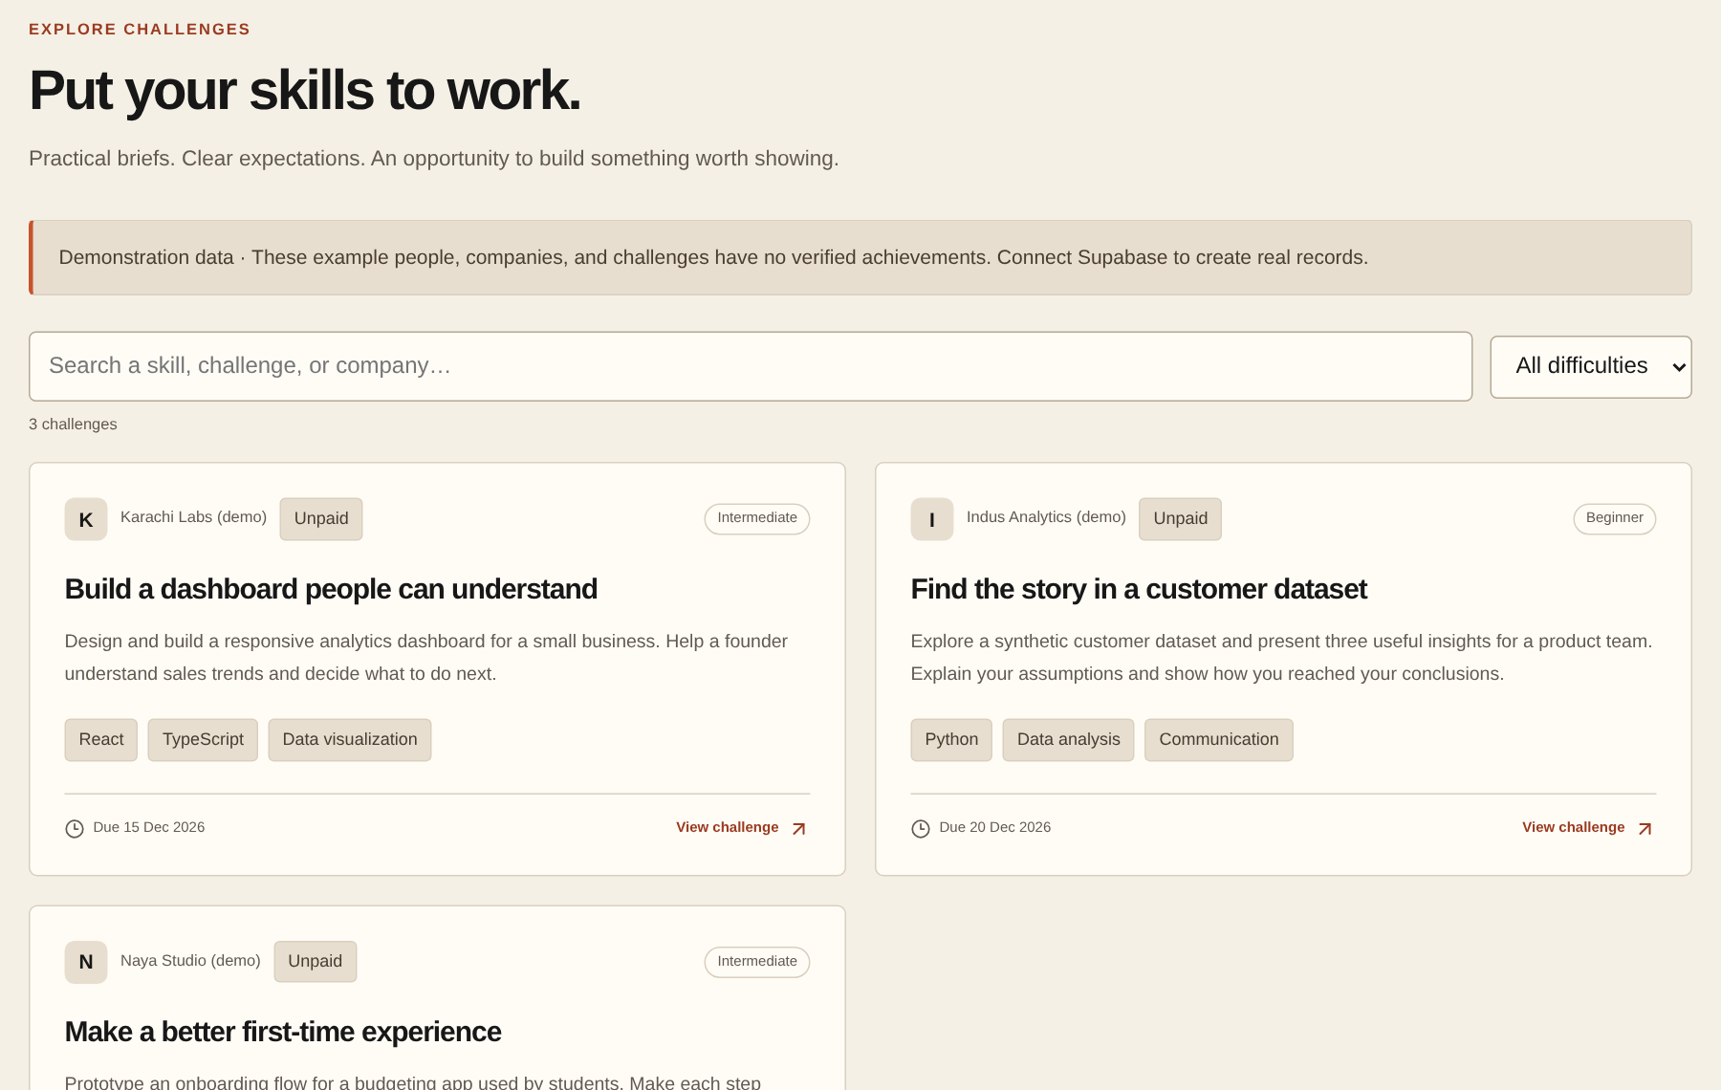
PROOFPAK
PRODUCT STATUS
07 / 11
Built and ready for real-world testing.
Skill Passport
Credential presentation
Challenges
Also implemented: milestones, wallet ownership checks, devnet receipts.
Actual app captures · demo data + offline credential fixture
TESTED: 60 unit tests + 112 browser tests + local database rules
PENDING: hosted account journeys + real wallet-to-devnet acceptance tests
Notes:
We have built the Passport, credential presentation, opportunities, paid-project milestones, wallet ownership checks, and devnet payment receipts. These are genuine app captures, with demo or offline fixture data clearly labeled. Our checks passed sixty unit tests, one hundred and twelve browser tests, and local database rules. Hosted account journeys and real wallet-to-devnet transactions still need end-to-end testing.
Target: 25 seconds. Current onboarding evidence: npm test 60 passed; Playwright 112 passed; actual migration/local PostgreSQL suites passed; lint/typecheck/production build passed. Screenshots: /talent/ayesha-khan demo; /test-ui?fixture=credential offline fixture, not a real award; /challenges demo. Build reported Next.js security advisory; unchanged retry succeeded. No live credential/payment proof claimed.

Slide 8
PROOFPAK
INITIAL MARKET
08 / 11
Starting with Pakistan’s skilled talent.
A focused
first market.
01
Students & graduates
Build a first professional record.
02
Developers & freelancers
Start where practical work
needs a clearer professional record.
Show practical work and progress.
03
Companies & training teams
Assess evidence and issue recognition.
Notes:
We start in Pakistan with a focused audience: students building their first record, developers and freelancers showing practical work, and organizations that want clearer evidence. Our first goal is to learn whether these groups return to the same Passport as their work grows. This is an initial market choice, not a claim of existing adoption.
No market-size statistic, confirmed customer or partner is asserted. Founder community experience was not independently documented; omitted.

Slide 9
PROOFPAK
PROPOSED BUSINESS MODEL
09 / 11
Free for talent.
Built for organizations.
Organizations
INDIVIDUALS
Free basic
Skill Passport
Potential paid tools for issuance,
challenges, hiring and opportunities.
Create. Share. Build your record.
Later: possible project transaction fees
Subject to validation and applicable rules.
Notes:
Our proposed starting model keeps a basic Passport and sharing free for individuals. Organizations could pay for useful tools around credential issuance, challenges, hiring and opportunity management. A future transaction-based revenue stream is possible, subject to validation and applicable rules. These are proposals. We are not claiming existing revenue, prices or paying customers.
Business model is a hypothesis, not implemented billing or a financial forecast.

Slide 10
PROOFPAK
ADOPTION PLAN
10 / 11
Start with communities.
Grow through real use.
1
Invite
Students, developers and professionals
through relevant communities.
2
Pilot
Interested training teams and companies.
Start with a small, agreed use case.
3
Test
Real issuance, applications and
the complete work workflow.
4
Improve
Use feedback, then add
more issuers and employers.
Notes:
First, invite a small group through relevant existing communities. Second, recruit interested companies and training teams for focused pilots, without calling them partners before they agree. Third, test real issuance, applications and a complete work journey. Fourth, improve what breaks before expanding. We will use feedback and completed workflows to decide the next step, rather than broad launch claims.
All activities are proposed. Founder experience in community building, education programs and hackathons was not independently confirmed, so no personal track record is asserted.

Slide 11
PROOFPAK
VISION
11 / 11
Your work should build
your reputation.
A Skill Passport that grows with every
project, credential, and achievement.
Next
Then
Later
Long term
Real-user testing
Company + issuer pilots
More credentials + payments
Portable professional evidence
Future mainnet payments require separate validation and release approval.
ProofPak
Prove your skills. Get work. Build your reputation.
Notes:
Our vision is a Skill Passport that grows with every project, credential and achievement. Next comes real-user testing, then focused company and issuer pilots. Later, we can expand credentials, opportunities and payment support. Mainnet is a future release, not today’s devnet product. Long term, professional evidence should travel across platforms, professions and countries. ProofPak: prove your skills, get work, build your reputation.
Roadmap only; no mainnet implementation or commitment to guaranteed payments. Bounties are not represented as a separate implemented workflow.

