Slide 1

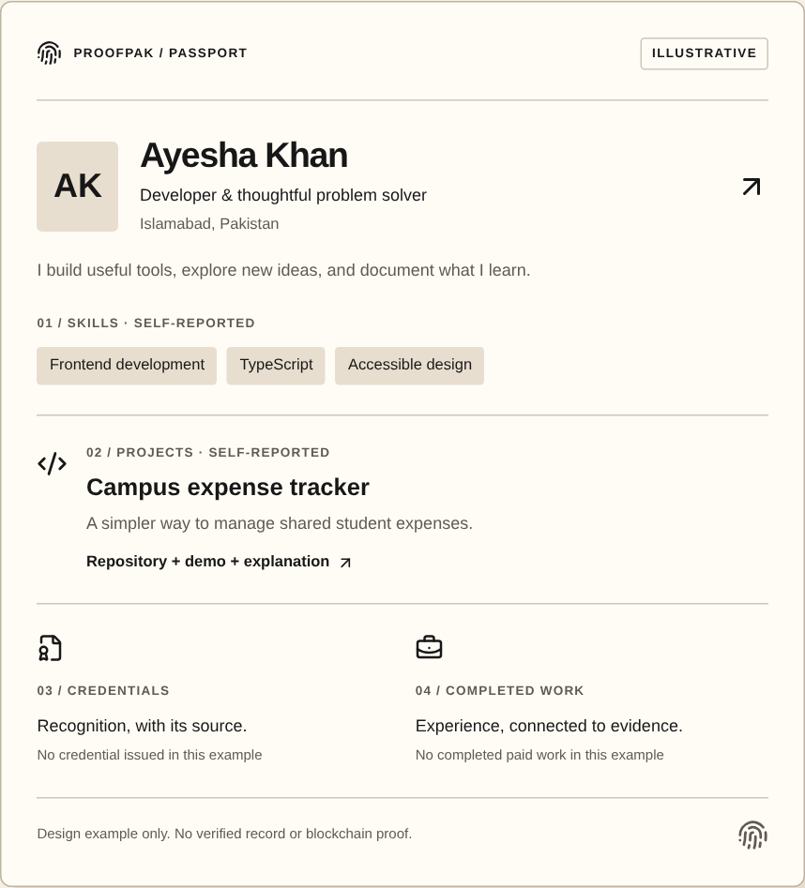
ProofPak
ProofPak
Prove your skills.
Get work.
Build your reputation.
One professional record.
From skills to paid work.
ACTUAL WEBSITE · ILLUSTRATIVE PROFILE
01
Notes:
ProofPak helps you prove your skills, get work, and build your reputation. It starts with one Skill Passport connecting your work, evidence, opportunities, and achievements.
Reference / accuracy notes (not spoken): Website marketing screenshot is illustrative, not a real user or issued award. Node/website typography Arial; genuine site mark.

Slide 2
Your work is everywhere.
Your proof shouldn’t be.
Projects
CV
Collect it again.
Code + demos
Skills
Experience
Explain the source.
Certificates
Evidence
Different issuers
Links + emails
Prove what you did.
02
Notes:
When you apply for work, your CV is one file, your projects live elsewhere, and certificates sit in email. You collect the same evidence again. Employers still need to understand the source of each claim and the work behind it. The problem is not a lack of work. It is a scattered professional record.
Reference / accuracy notes (not spoken): Conceptual native diagram. No unemployment, market-size or user-study claims.

Slide 3
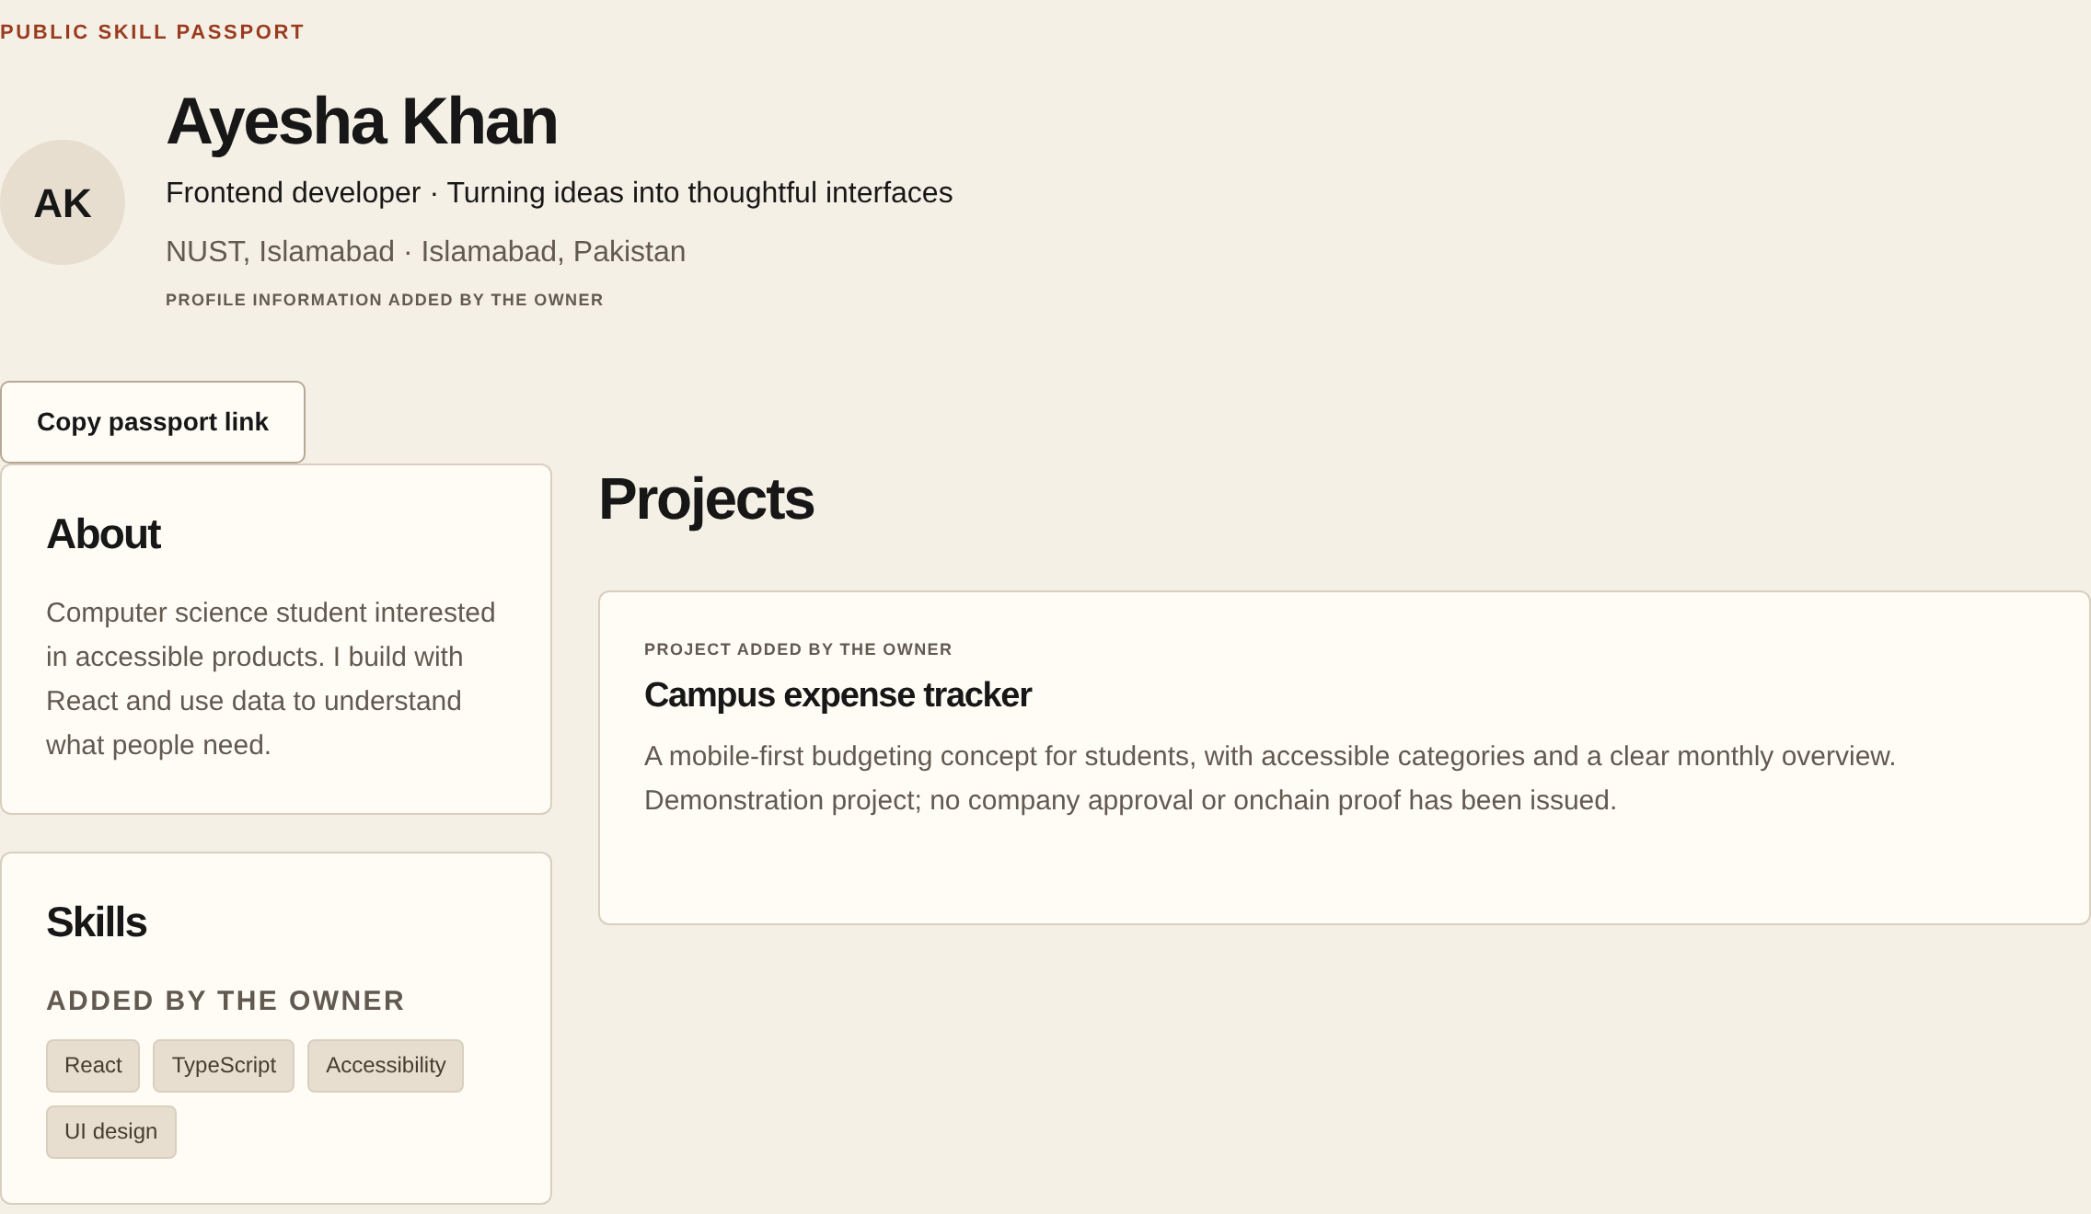
Meet your Skill Passport.
Show
your skills.
Prove
your work.
Build
your reputation.
RUNNING APP · DEMO DATA
03
Notes:
Here is the actual running Passport with demo data. Show your skills and practical projects. Prove your work with supporting evidence and credentials from authorized organizations. Build your reputation as your record grows. Your own claims remain separate from issued credentials. You control what to publish, then share one place that gives people the full picture.
Reference / accuracy notes (not spoken): src/components/passport-view.tsx; credential-actions.ts. Demo data; no verified achievement. Shared evidence remains subject to host access controls.

Slide 4
Turn work into
a growing reputation.
→
→
Create a Passport
Show work
Find an opportunity
↓
Milestones. Reviews.
Supported payments.
←
Build your reputation
Complete the work
Credentials are issued separately by authorized organizations.
04
Notes:
Create your Passport, then add work and evidence. Find a challenge or paid project that fits. For a paid project, agree on milestones before starting, submit your work, and receive a review. Supported payments are part of that work flow. An authorized organization can separately issue a credential, which the recipient chooses to accept and publish. Payment itself never creates a credential.
Reference / accuracy notes (not spoken): docs/PAYMENTS-MVP.md; CREDENTIALS-WALLETS-DELIVERY.md. No escrow or guaranteed payment. Final achievement step includes separate issuance and consent, not an automatic payment effect.

Slide 5
Two jobs. One fast network.
Keep credential records checkable.
→
→
Credential
Digital fingerprint
Solana check
Move milestone payments.
→
→
Approved milestone
Wallet payment
Transaction receipt
Low fees. Fast settlement. Public receipts.
DEVNET · TEST USDC · Record integrity does not prove skill.
05
Notes:
Solana does two useful jobs. A credential can have a digital fingerprint recorded onchain, letting someone check whether that record changed. This checks integrity, not whether the skill claim is true. For approved project milestones, connected wallets can send test USDC and produce a checkable receipt. Low fees, fast settlement, and public records fit both jobs. The current implementation is devnet only, not real-money mainnet payments.
Reference / accuracy notes (not spoken): credential-proof.ts; payment-chain.ts; payments.ts. No actual broadcast verified. Fast/low-cost design rationale, not measured performance. Organization approval does not establish legal identity.

Slide 6
Don’t start from zero
with every opportunity.
SEPARATE TOOLS
ONE CONNECTED RECORD
CVs list claims
Skills + evidence
+ opportunities
+ completed work
Certificates show awards
→
Work platforms hold jobs
First project
First credential
Next opportunity
Stronger reputation
06
Notes:
ProofPak is different because the record carries forward. A CV lists claims, a certificate tool holds awards, and a work platform holds jobs. ProofPak connects skills, evidence, opportunities and completed work. Each new project or credential gives the next person more context, instead of making you start from zero. That is how a professional record can build reputation over time.
Reference / accuracy notes (not spoken): Positioning comparison, not an exhaustive competitor audit or claim to have invented features. Timeline conceptual, not user traction.

Slide 7
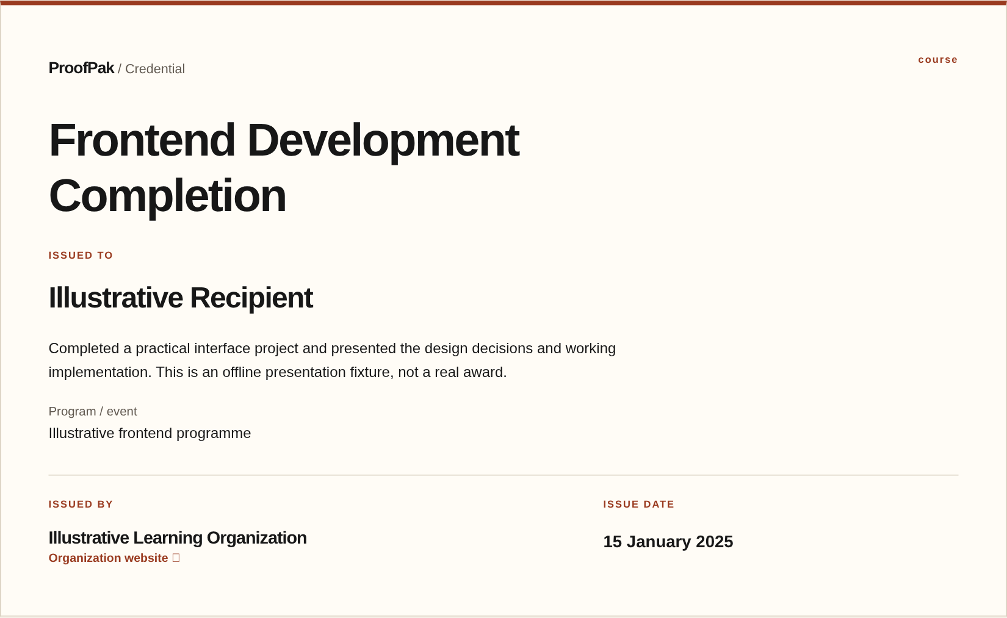
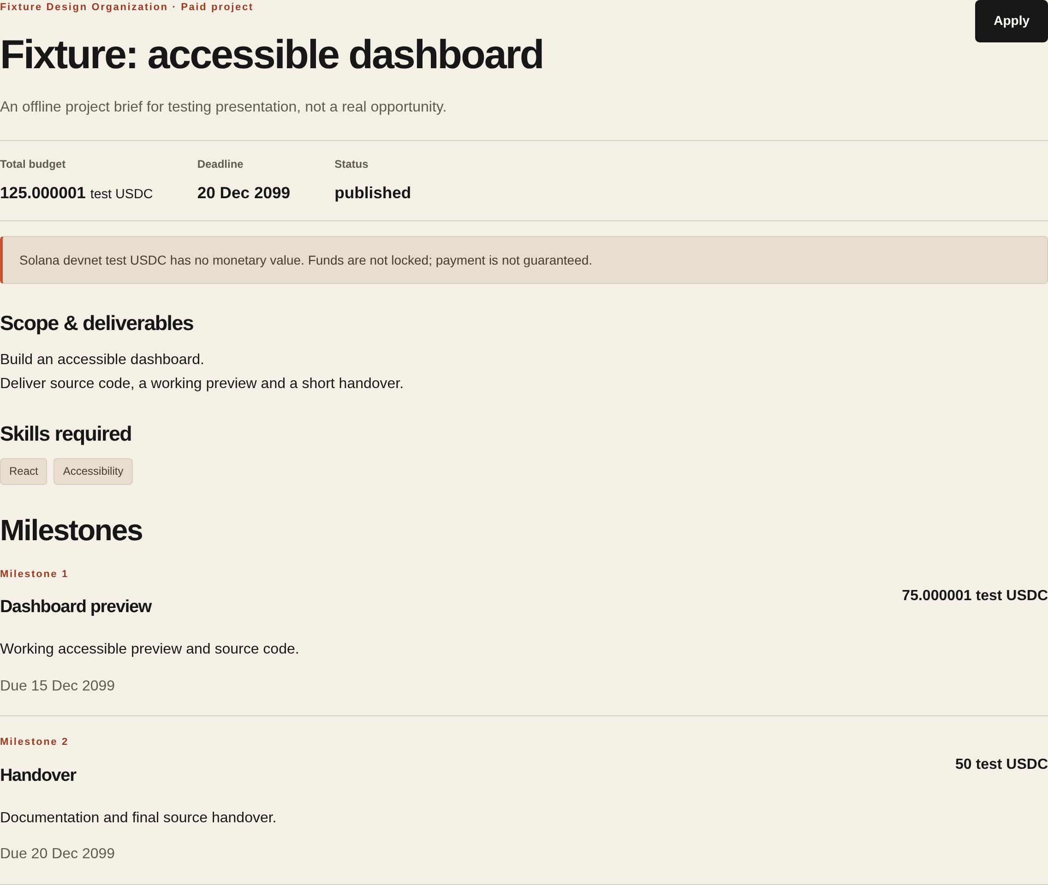
A working MVP.
A full product journey.
IMPLEMENTED IN CODE
Credential presentation
Paid-project milestones
Skill Passport
07
Demo / offline fixture captures
Notes:
This is more than an idea. The MVP includes Passport publication, evidence, credential issuance and acceptance, opportunity applications, agreed milestones, work reviews, wallet ownership checks, and devnet receipt logic. These are actual product captures, using demo and offline fixture data. The implementation has passed local and automated checks. The next important step is real-user testing, including hosted accounts and real wallet-to-devnet journeys.
Reference / accuracy notes (not spoken): 60 unit tests, 112 browser tests, actual local PostgreSQL migrations/workflow/privacy checks, lint/typecheck/build passed in onboarding. Not real hosted E2E or actual token broadcast. Screenshot main: demo public profile; supporting: actual credential and project brief test components, no real award/payment. Next.js 16.4.0 security advisory remains. Live deployment inaccessible from environment (HTTP403).

Slide 8
Pakistan is our starting point.
Practical work is the common ground.
Start with a
professional
record.
Students & graduates
Developers & freelancers
Show early work.
Carry evidence forward.
Learn in focused local pilots
before expanding.
Companies
Training organizations
Find practical talent.
Issue useful recognition.
08
Notes:
Pakistan gives us a focused place to begin. We can test one shared journey: a student or graduate showing early work, a developer or freelancer carrying evidence forward, and an organization looking for practical talent or issuing recognition. The plan is to learn in small local pilots before expanding. We are choosing a starting market, not claiming that we already have adoption.
Reference / accuracy notes (not spoken): No Pakistan population, graduate, freelancer or market-size statistic included because independently sourced current statistics were not available in supplied material. Geographic focus and audiences are proposed strategy, not demand validation.

Slide 9
Free to build a record.
Paid tools where teams get value.
Individuals
Organizations
Free
Potential paid tools
Basic Skill Passport
+ sharing
Credentials
Hiring
Opportunities
Future option: project transaction fees — subject to validation and applicable rules.
09
Notes:
Our proposed model starts free for individuals: a basic Skill Passport and sharing. Organizations could pay for useful credential, hiring and opportunity tools. That puts revenue around team needs while keeping it easy for talent to start. Later, project transaction fees may be an option, subject to validation and applicable rules. These are business hypotheses, not current revenue or announced prices.
Reference / accuracy notes (not spoken): No billing implementation, paying customers, forecasts or current transaction fees asserted.

Slide 10
One community. One pilot.
A reason to come back.
START IN PAKISTAN
01
→
Developer communities
Education programs
Interested organizations
Recruit a pilot
02
One issuer or company
Complete a journey
↑
Work + review + recognition
04
↓
Improve & repeat
03
Invite a small cohort around
one practical challenge or project.
←
Reuse the record
Use feedback to refine
Share it for the next role
10
Notes:
Start with a small cohort through developer communities and education programs in Pakistan. Recruit one interested issuer or company around a practical challenge or project. Help the group complete the journey: work, review, and separate recognition where appropriate. Then test whether people share that record for their next opportunity. Use the feedback to improve and repeat before inviting more organizations. This is a pilot plan, not a partnership announcement.
Reference / accuracy notes (not spoken): No confirmed customers, partnerships or adoption. Founder experience with communities, workshops and hackathons was not independently documented and therefore is not asserted. No numerical pilot target is presented as a commitment.

Slide 11
ProofPak
Your work should
build your reputation.
A Skill Passport that grows with every
project, credential, and achievement.
Next: real-user testing → company + issuer pilots → wider support
ProofPak
Prove your skills. Get work.
Build your reputation.
11
Notes:
Your work should build your reputation. Our vision is a Skill Passport that grows with every project, credential and achievement. Next, we will test with real users, then run focused company and issuer pilots. Wider credential and payment support comes later. Mainnet remains a future step requiring separate validation. ProofPak: prove your skills, get work, build your reputation.
Reference / accuracy notes (not spoken): Future roadmap only. Current payment implementation is devnet/test tokens. Portability across platforms, professions and countries is a long-term direction, not an existing integration.

