Slide 1
Enhancer prediction through multi-omics integration
Robin W. Yeo, PhD
Biological Data Scientist

Slide 2
What are enhancers?

Slide 3
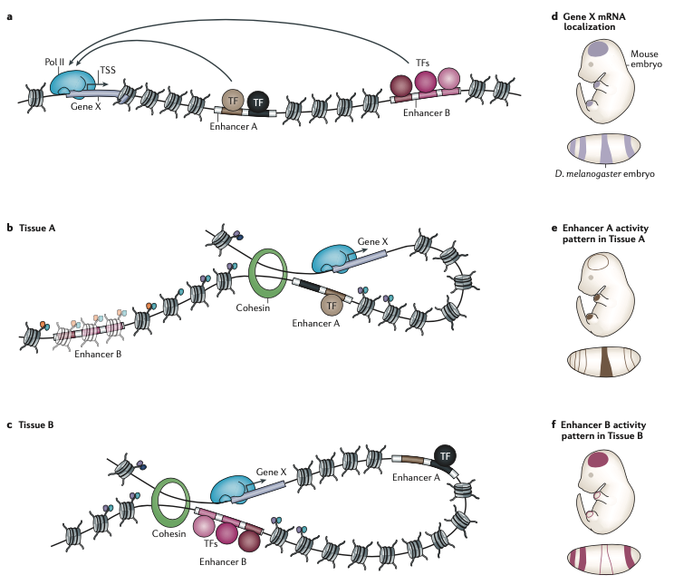
Basic biology of transcriptional enhancers
Nucleated cells contain identical genomes yet differentiate into multiple cellular lineages during development through differential epigenetic regulation
Different cell types have differential gene expression profiles despite all possessing (and expressing) identical transcriptional machinery (e.g. RNA Polymerase II, etc) which is recruited to core promoters around the TSS
Transcriptional machinery is often insufficient to drive gene expression in the absence of more distal functional DNA regions known as cis-regulatory elements
Cis-regulatory elements, such as enhancers, contain short DNA motifs that act as binding sites for sequence-specific transcription factors (TFs)
TF binding to enhancers serve to recruit co-activators/co-repressors that drive differential gene expression in a cell-type specific manner

Slide 4
Characteristics of transcriptional enhancers
Enhancers share a set of common characteristics:
DNA sequence is non-coding and contains TF binding motifs
Located at any distance (up to megabases away) from their TSS making identification challenging
DNA is accessible and devoid of nucleosomes
Nucleosomes around enhancer contain specific post-translational modifications (H3K4me1 and H3K27ac)
Enhancer activity is independent of sequence orientation
Exhibit higher evolutionary conservation than background sequences

Slide 5
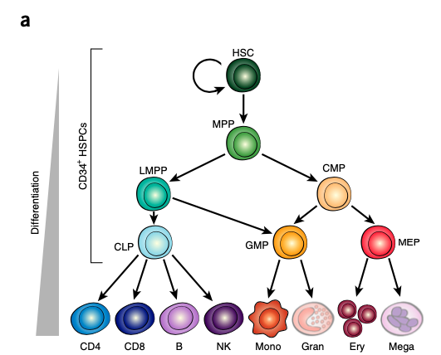
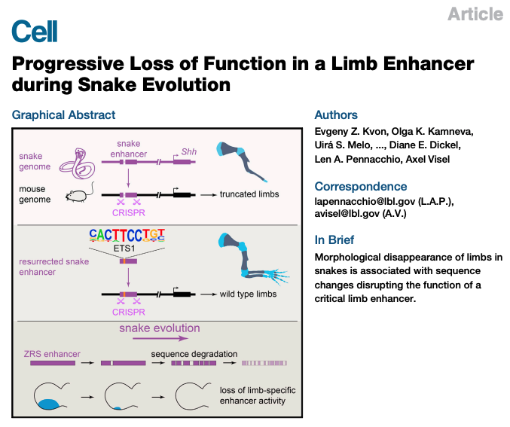
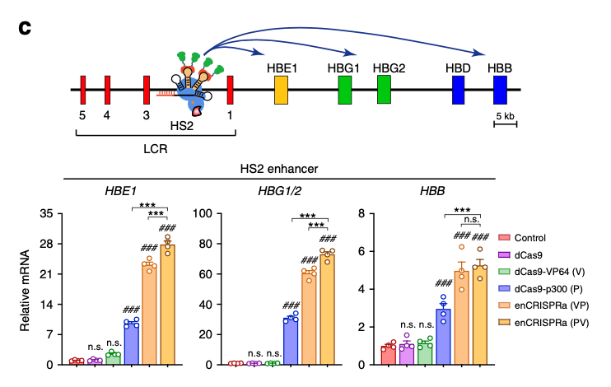
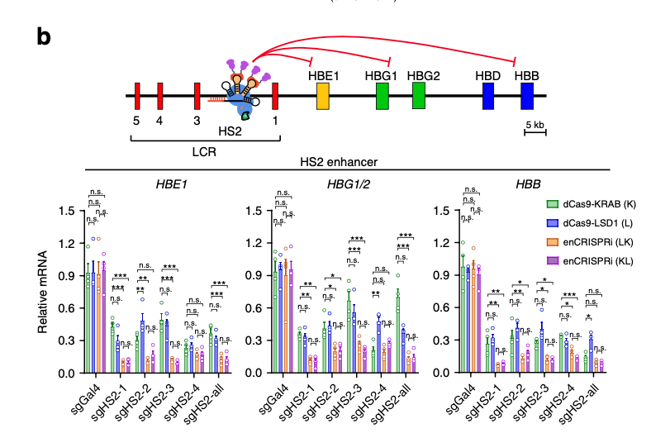
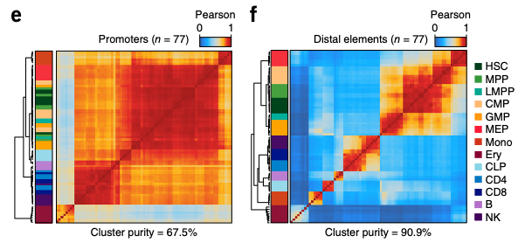
Why do we care about enhancers?
Enhancers are bound/regulated by TFs in a highly celltype-specific and spatiotemporally-specific manner allowing them to drive cellular lineage specification and development
Vast majority of enhancers remain unknown but contribute key roles in development, evolution, and disease
Many disease-associated SNPs occur in distal non-coding enhancers making them potential therapeutic targets
Targeting enhancers with SNPs can achieve allele-specific gene activation
Enhancers can regulate entire gene families or regulatory hubs making them attractive targets if there is a therapeutic desire to modulate entire gene families in a celltype-specific manner
HEK293T
(no B-globin expression)
K562
(constitutive B-globin expression)

Slide 6
How are enhancers experimentally identified?
Genomic methods
Functional methods

Slide 7
How are enhancers experimentally identified?
Genomic methods
Functional methods

Slide 8
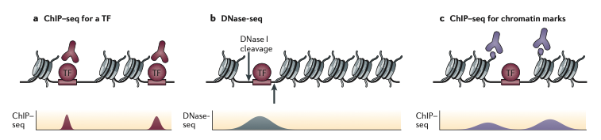
Genomic methods for enhancer identification
Since enhancer function is dependent upon TF binding, ChIP-seq against a known TF is a common way to identify enhancers via identification of TF binding sites
Since active enhancers are depleted of nucleosomes and contain accessible chromatin to be permissive to TF binding, DNAse-seq or ATAC-seq can be used to identify accessible DNA regions
Nucleosomes flanking enhancers carry specific, characteristic post-translational modifications which can be identified using ChIP-seq against histone marks (H3K4me1 and H3K27ac)
“The predictions of enhancers using histone marks is now widely used, for example, in the annotation of genome-wide functional elements by individual groups and international consortia, and it agrees well with enhancer activity assays.” (Shlyueva, Stampfel, & Stark)

Slide 9
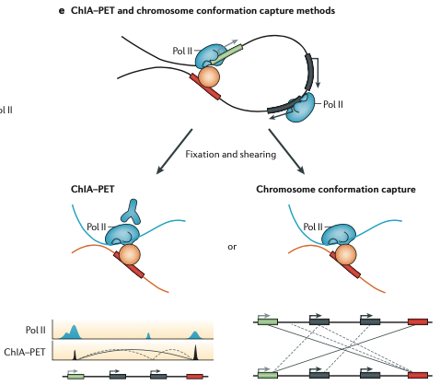
Genomic methods for enhancer identification
Problem: The above methods give no indication of which gene is being regulated by an enhancer!
Enhancers are physically brought into close spatial proximity with their target promoters to regulate gene expression. This can be exploited to identify enhancers and enhancer-gene relationships.
ChIA-PET and HiChIP essentially couple chromatin conformation capture technology (e.g. 3C,4C,5C,Hi-C) and ChIP-seq to identify enhancer-promoter interactions
These technologies simultaneously identify binding sites for proteins involved in the transcriptional machinery (via ChIP) and spatial proximity contacts (via Hi-C)
Common targets include:
Pol II
Cohesin
Mediator
H3K27ac

Slide 10
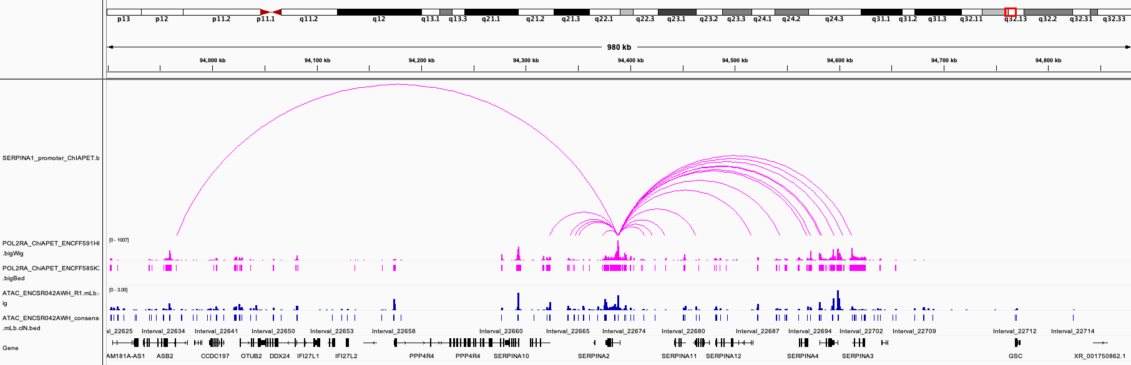
Example: Enhancer-promoter looping with RNA Polymerase II
Co-localization of accessible chromatin peaks (ATAC-seq) with POL2RA ChIA-PET can predict enhancer-promoter loops
HOWEVER, ChIA-PET/HiChIP datasets are pretty scarce making this an unreliable strategy

Slide 11
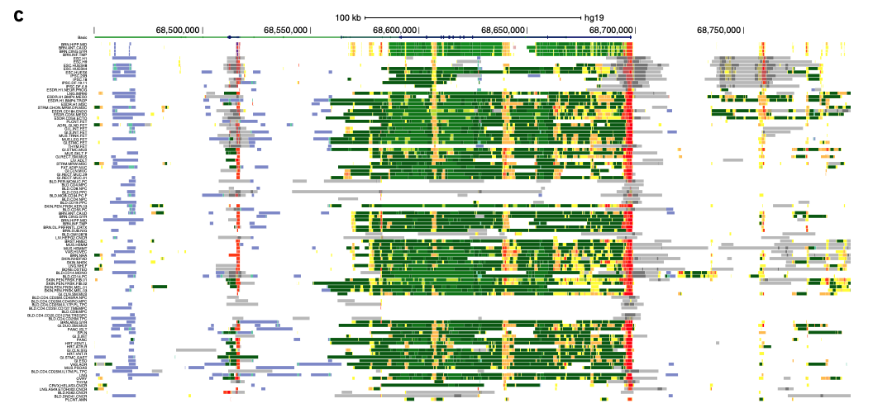
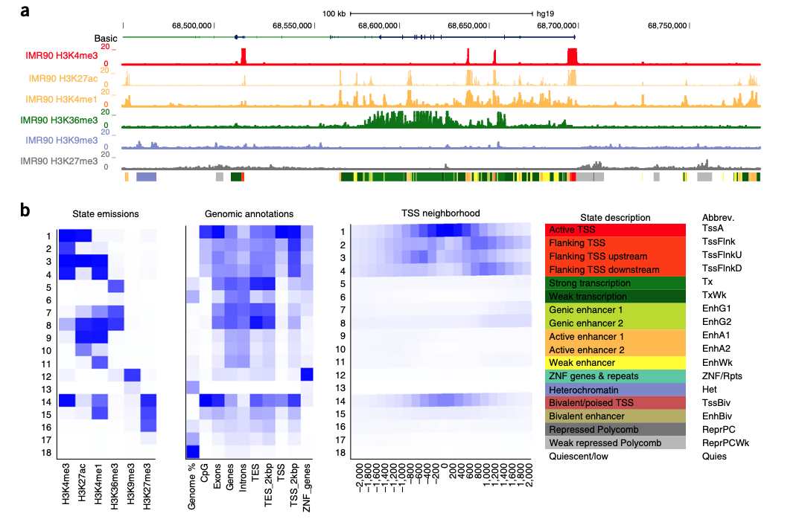
ChromHMM: Integrating multiple histone marks across diverse tissues into to annotate chromatin states genome-wide

Slide 12
How are enhancers experimentally identified?
Genomic methods
Functional methods

Slide 13
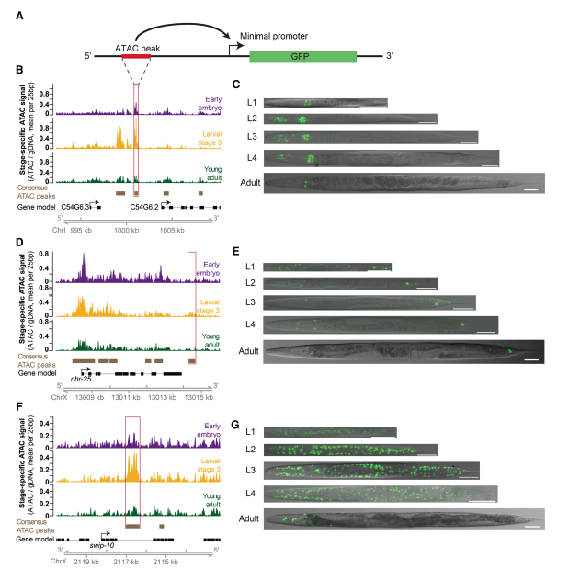
Functional methods for enhancer identification
Genomics-based methods indirectly predict enhancer regions based on specific known properties of cis-regulatory elements but these DNA sequences can also be directly tested for enhancer activity
Image-based enhancer identification:
DNA regions can be tested for for their ability to activate or enhance transcription by cloning the DNA region upstream from a minimal core promoter driving GFP
This activity, independent of the enhancer’s native sequence context, is the defining property of enhancers and is used as the gold standard in enhancer prediction
Image-based enhancer identification is frequently used in developmental biology to identify enhancers that drive lineage-specific cellular differentiation
Since these image-based enhancer identification experiments require generation of transgenic animals, they are not suitable for genome-wide enhancer screens

Slide 14
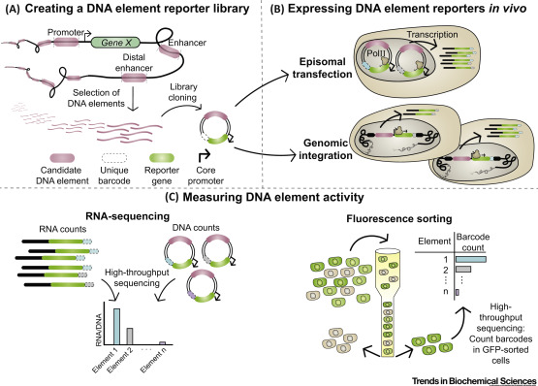
Functional methods for enhancer identification
Genome-wide functional enhancer screening:
Genome-wide enhancer testing can be accomplished with modern methods such as MPRAs (massively parallel reporter assays) or STARR-seq (self-transcribing active regulatory region sequencing)
Plasmid libraries containing putative enhancer regions upstream of a minimal promoter driving unique barcodes can be introduced to a celltype of interest and deep sequencing of barcodes can be used as readout of enhancer activity
However, these techniques have several limitations:
lack of native chromatin context
use of general promoter (instead of enhancer-specific promoter)
only applicable to certain celltypes that can be efficiently transduced

Slide 15
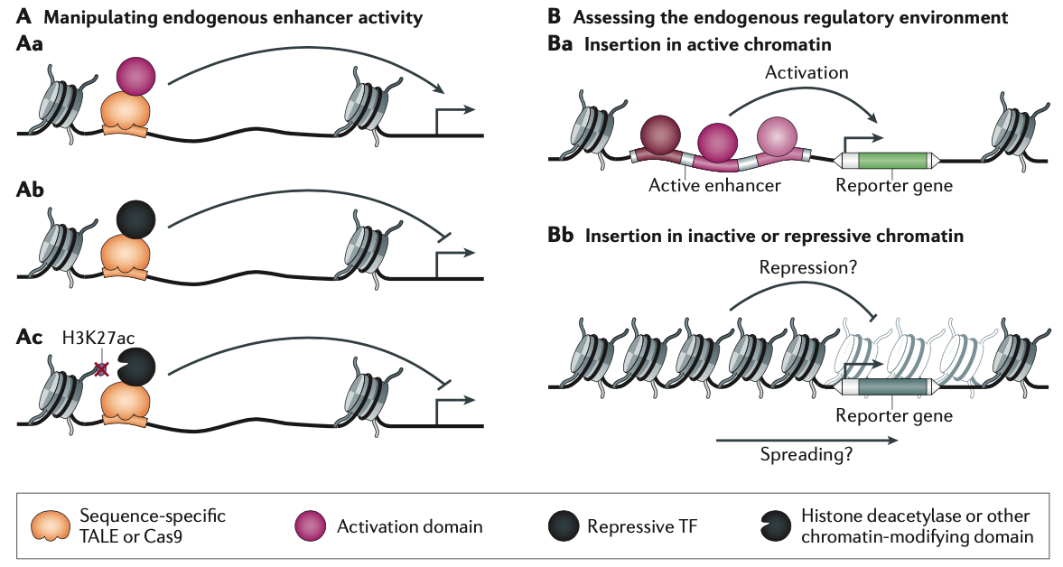
Manipulation of endogeneous enhancer activity
The CRISPR-Cas platform can be used to recruit transcription factors, transcriptional machinery, and/or co-activators to any locus in the genome to interrogate endogeneous enhancer activity (Figure A)
Reporter genes can selectively be inserted into enhancers in different chromatin states to assess functional activity (Figure B)

Slide 16
How can we predict functional enhancers in silico?

Slide 17
Developing a simple pipeline for enhancer identification using publicly available ENCODE data
Datasets:
Downloaded publicly available datasets from ENCODE:
-RNA-seq (gene expression)
-ATAC-seq/DNAse-seq (chromatin accessibility)
-H3K27ac ChIP-seq (enhancer activation histone mark)
-p300 ChIP-seq (TF involved in enhancer-mediated transcription)
-18 state ChromHMM annotation
Pipeline:
-First, I identified a large set of potential enhancers by looking at accessible chromatin peaks that are either intronic or distal/intergenic
-I then subset this list to only include peaks that overlap one of the 5 ”enhancer” annotations in the 18-state ChromHMM profile
-I further subset this list to only include peaks that overlap H3K27ac ChIP-seq peaks
-To maximize odds of correct enhancer-gene annotations, I then exclude any putative enhancer further than 10 kB from a TSS

Slide 18
Predicting enhancers is not straightforward
“Enhancers and their activity states cannot be reliably predicted from their DNA sequences or from chromatin features, nor can the important parts of the sequence of an enhancer be easily identified”
“Given the widespread use of histone modifications to predict enhancers, it is interesting that there is no consensus about which marks should be used. […] Generally, the rules used to predict enhancers seem to be driven by the availability of data sets”
“None of the known histone modifications correlates perfectly with enhancer activity, and even combinations of marks are not perfect predictors”
(Shlyueva, Stampfel, & Stark)

Slide 19
Including all possible data sources for enhancer prediction
Datasets:
Downloaded publicly available datasets from ENCODE:
-18 state ChromHMM annotation
-ATAC-seq (chromatin accessibility)
-H3K27ac ChIP-seq (enhancer histone mark)
-H3K4me1 ChIP-seq (enhancer histone mark)
-p300 ChIP-seq (histone acetyltransferase mark)
-Med1 ChIP-seq (Mediator – enhancer-promoter contact mark)
-Rad21 ChIP-seq (Cohesin – enhancer-promoter contact mark)
-POL2RA ChiA-PET (RNA Polymerase II – enhancer-promoter looping)
-hg38 20-way PhastCon scores (evolutionary conservation)
-H3K27me3 (enhancers should not carry this mark)

Slide 20
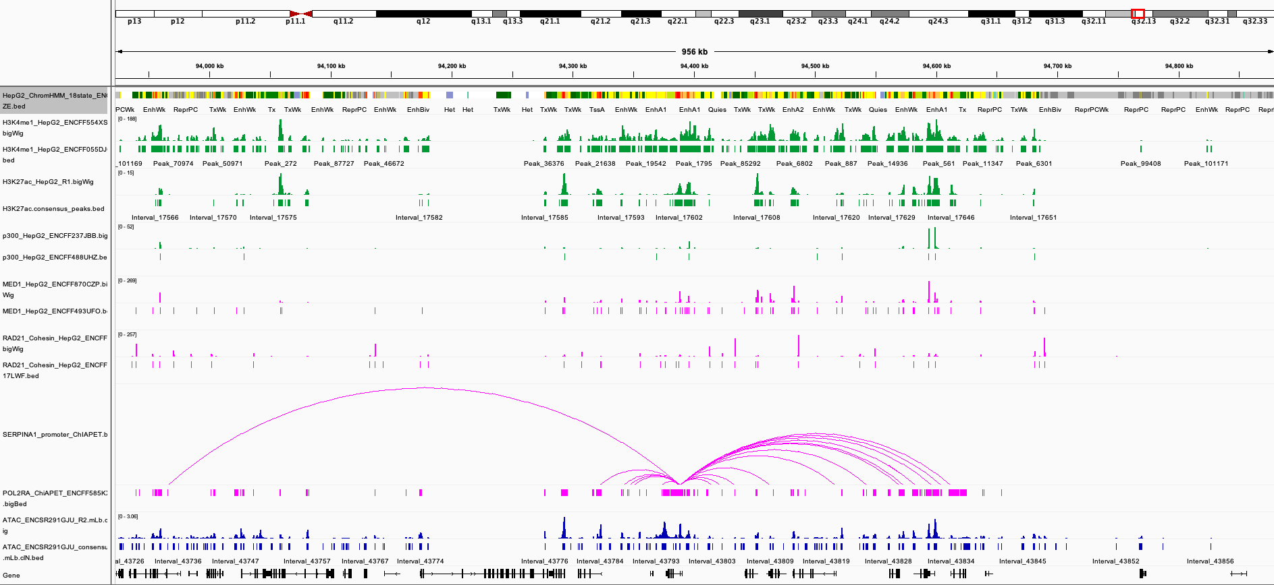
Including all possible data sources for enhancer prediction

