Slide 1

Anti-Money Laundering (AML) Fraud Detection
Robins Yadav
Feb 18, 2025

Slide 2

Table of Contents
Project Overview & Goals
Problem Statement
Exploratory Data Analysis (EDA)
Feature Engineering and Data Preprocessing
Model Development and Evaluation
Model Selection and Training
Performance Metrics
Deployment with GitHub Actions and AWS
User Interface (Streamlit)
Business Impact

Slide 3
Project Overview & Goals
Developed a Machine Learning system to detect potentially money laundering transactions, enhancing AML systems.
Addressed the challenge of high false positive and false negative rates in traditional AML systems.
Improved Precision & Recall compared to baseline methods.
Deployed the best model on AWS using Docker with ECR and EC2, and integrated into a CI/CD pipeline via GitHub Actions

Slide 4
Problem Statement
Problem: Money laundering is a massive financial problem (multi-billion dollar).
Challenge: Traditional AML systems suffer from High False Positive Rate and High False Negative Rate
Goal: Develop AI/ML system that significantly reduces both false positives and false negatives, improving efficiency and effectiveness.

Slide 5
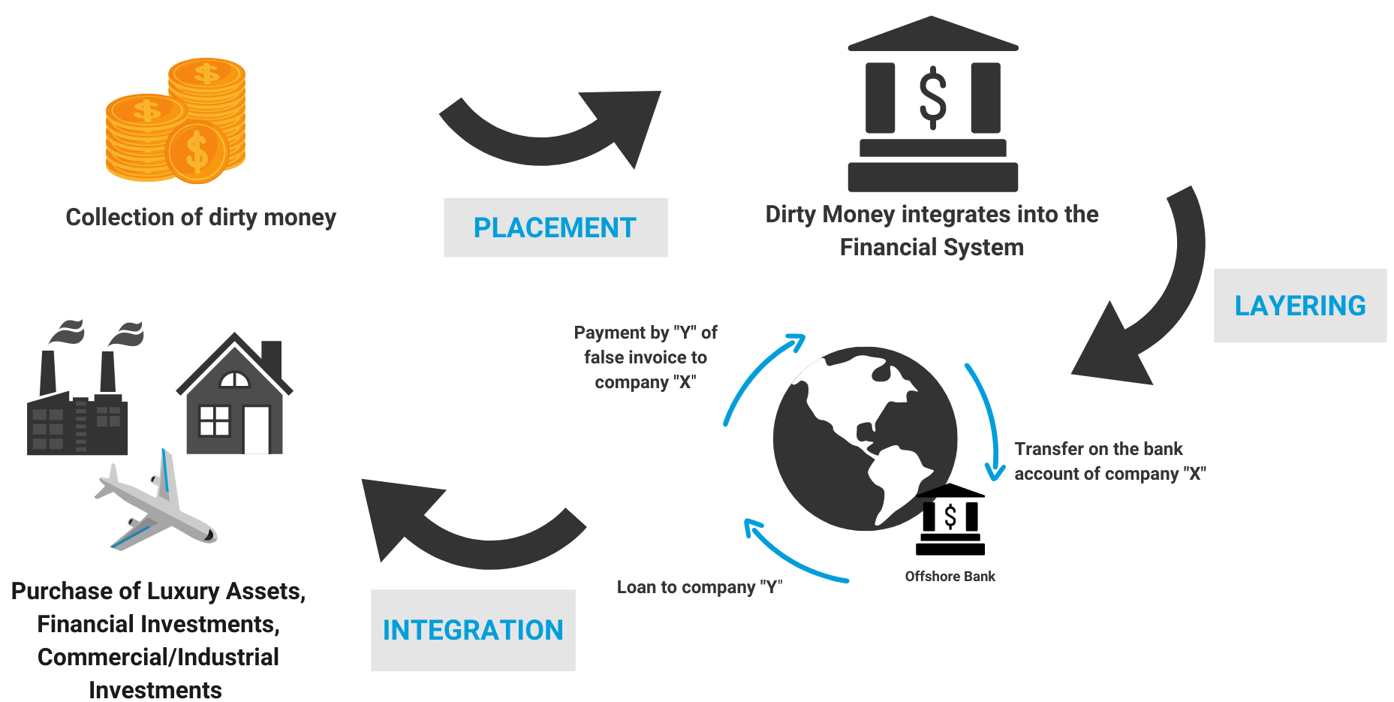
Problem Statement
Big Picture
Source: United Nations – Office on Drugs and Crime

Slide 6
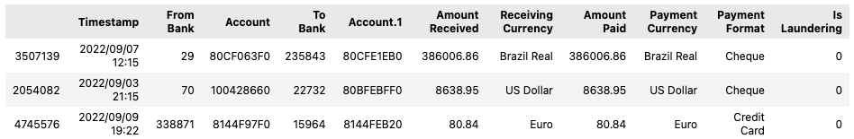
Exploratory Data Analysis (EDA)
Understanding the Data Structure and Content
Data source: IBM (Kaggle) – Research Paper [arXiv] on Jan 25, 2024 describing generation of data
Data loading and inspection
Data Shape and Size
Data Types
Check for duplicates
Missing Values
Data Statistics

Slide 7

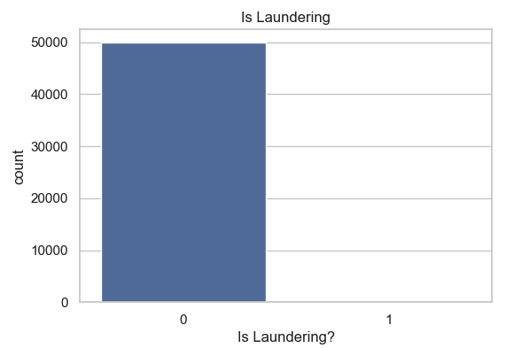
Exploratory Data Analysis (EDA)
Target Variable Analysis

Slide 8
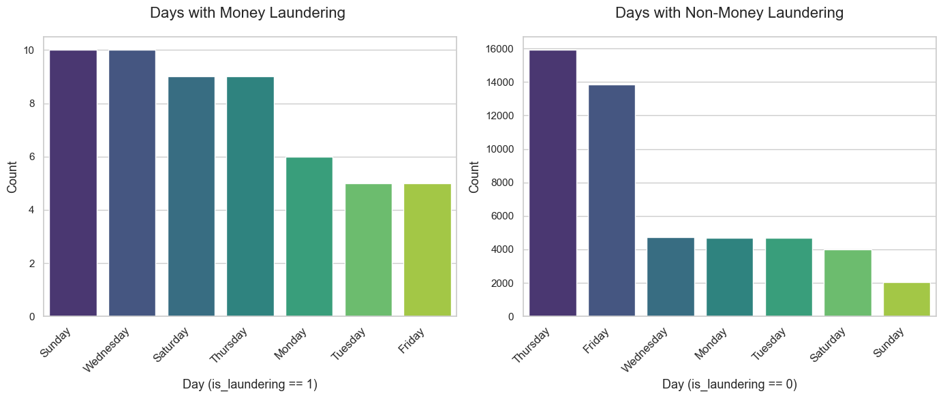
Exploratory Data Analysis (EDA)
Days in week where Money Laundering occurred

Slide 9
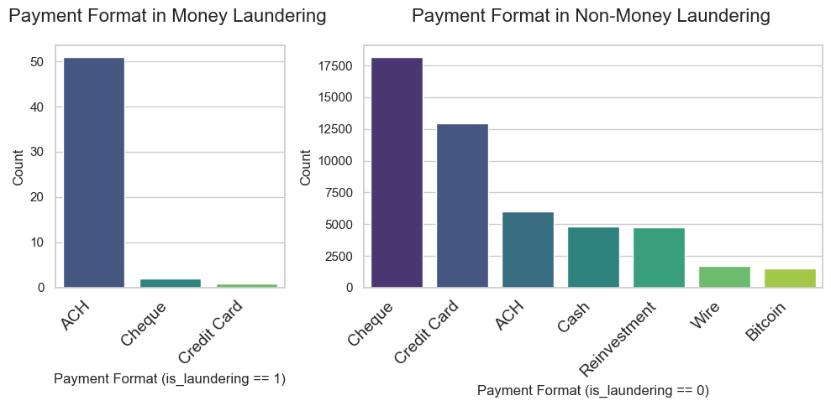
Exploratory Data Analysis (EDA)
Types of payment format in Money Laundering

Slide 10
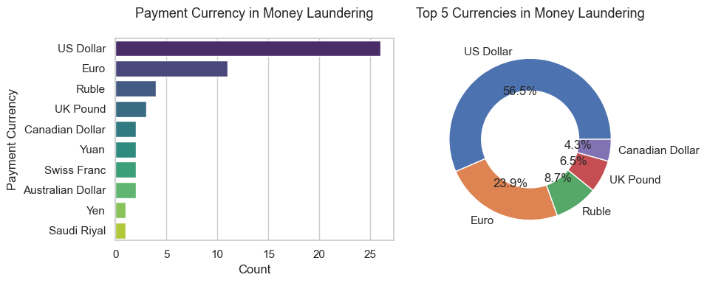
Exploratory Data Analysis (EDA)
Types of payment currency in Money Laundering

Slide 11
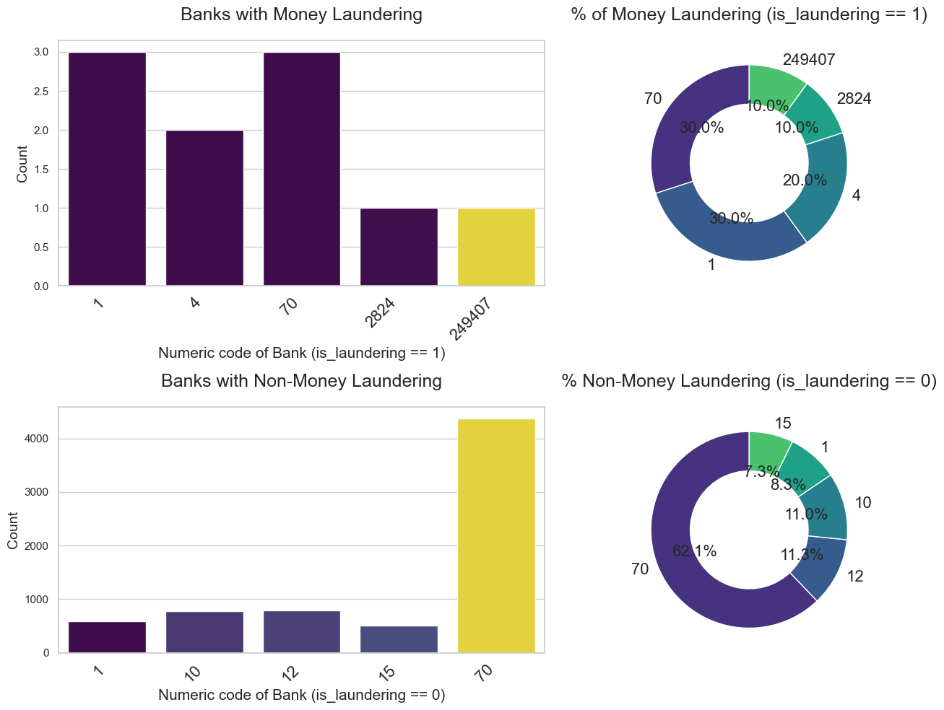
Exploratory Data Analysis (EDA)
Banks involves in Money Laundering

Slide 12
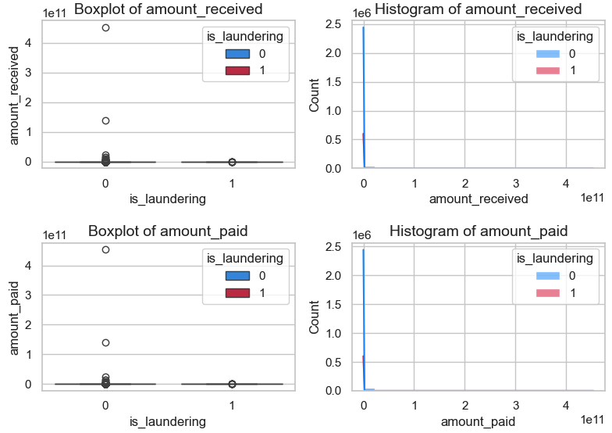
Exploratory Data Analysis (EDA)
Amount Received and Amount Paid

Slide 13

Feature Engineering and Data Preprocessing
Feature Selection: Numerical Features
Check Multicollinearity
VIF is used to assess the multicollinearity among the independent (predictor) variables
VIF = 1: No multicollinearity.
1 < VIF < 10: Moderate multicollinearity.
VIF > 10: High multicollinearity.
Conclusion: They are highly correlated therefore one of them need to be dropped
Feature Selection method: Recursive Feature Elimination, Feature Importance - ExtraTreesClassifier()

Slide 14
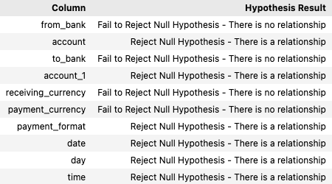
Feature Engineering and Data Preprocessing
Feature Selection: Categorical Features
Check Multicollinearity
Chi-square statistic is one way to show a relationship between two categorical variables.
Conclusion: Features like account, account_1, date, day, and time are important for model training and predictions

Slide 15
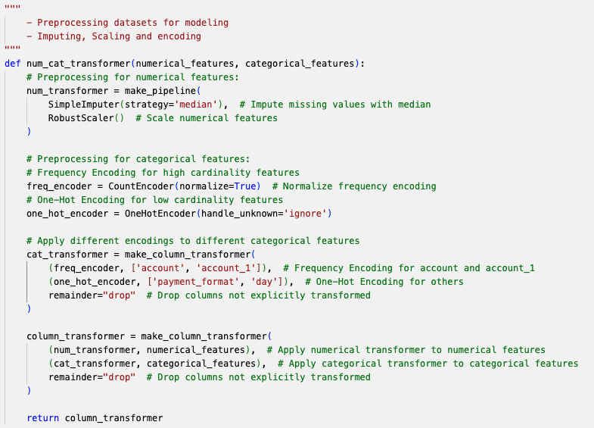
Feature Engineering and Data Preprocessing

Slide 16
Model Development and Evaluation
Model Selection and Training
Model selected: Random Forest, AdaBoost, XGBoost
Training: Cross-Validation, Hyperparameters Tunning (GridSearch)
Class Imbalance: SMOTE

Slide 17
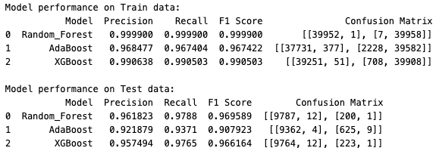
Model Development and Evaluation
Performance Metrics

Slide 18
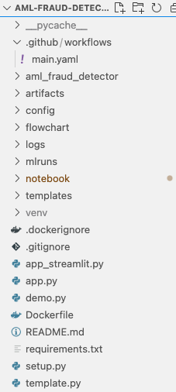
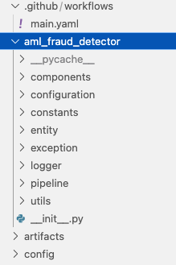
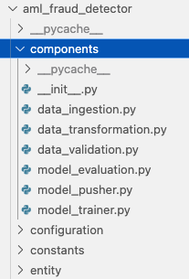
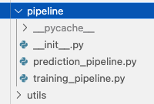
Deployment with GitHub Actions and AWS

Slide 19
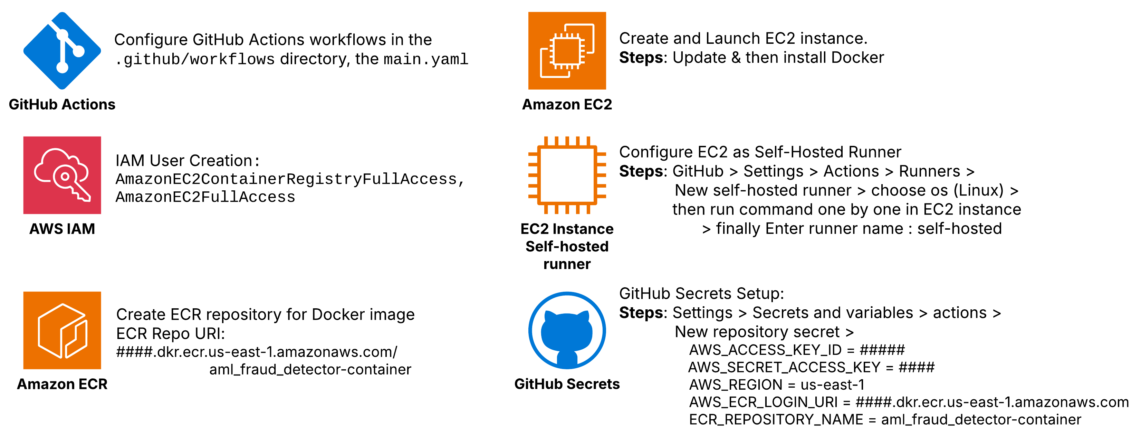
Deployment with GitHub Actions and AWS

Slide 20
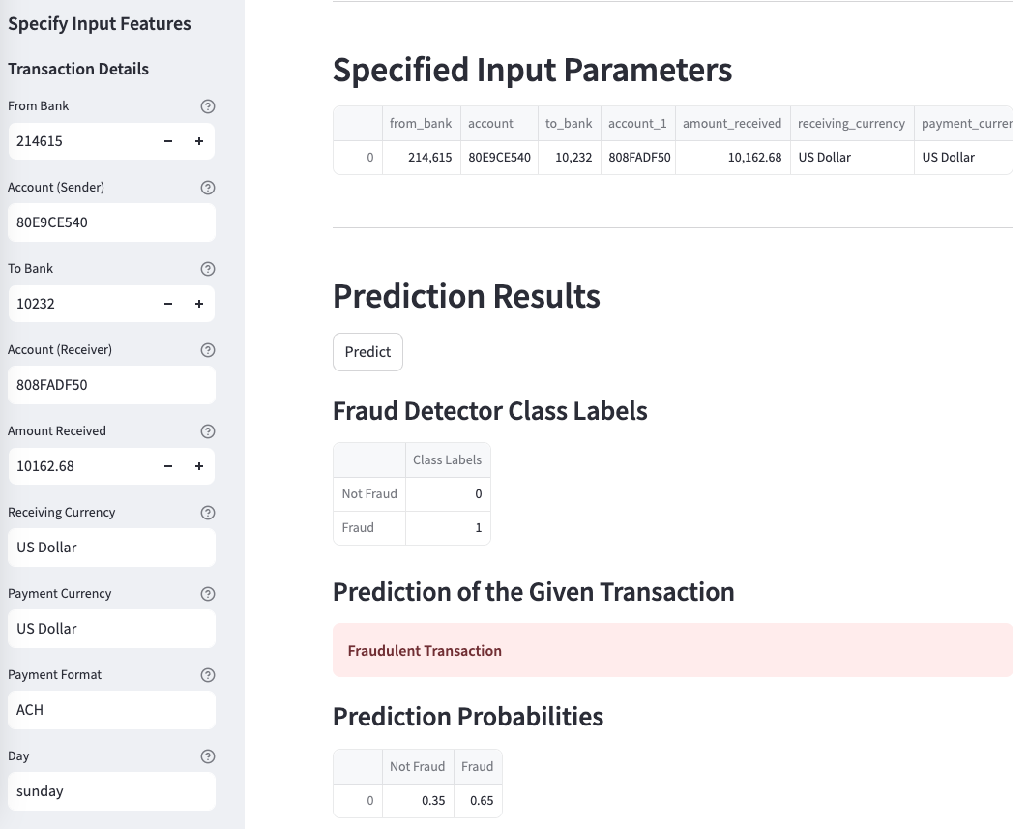
User Interface (Streamlit)

Slide 21
Business Impact
Reduced Financial Losses : Stops fraud and avoids fines by improving the detection of fraudulent transactions .
Enhanced Customer Trust : Fewer mistakes, happier customers.
Improved Operational Efficiency : Automating fraud detection using machine learning models , making it faster.
Follows the AML Rules: Keeps the company safe and trusted.

Slide 22
Thank You!

Slide 23
Questions?

