Slide 1
Introduction to Computation
Computers perform calculations
Calculations can only be performed based on what you tell the computer through a programming language.
Declarative knowledge Tell the computer a statement of fact. Python example:
x = 2
Informative knowledge
Tell the computer how to do something. Example: How to multiply 4 by 3:
“Start with 0
Add 4 to it.
Keep adding 4 a total of 3 times”

Slide 2
Introduction to Computation
Programming languages
How a computer is told what to do (i.e. using a set of instructions → an algorithm).
Syntax
The syntax of a language defines which strings of characters and symbols are “well formed”. Python example:
Syntactically correct: x = 3.2 + 3.2
Not syntactically correct: x = 3.2 plus 3.2
Semantics
This is what describes the meaning to a syntactically correct statement.
What does the line x = 3.2 + 3.2 mean to the computer?

Slide 3
Low vs High Level Programming Languages
Refers to where in the computer our programming language is meant to be interpreted.
Low level languages
Meant to be run on the machine level (i.e. rearranging memory registers – assembly code)
Efficient
Difficult to write and debug
High level languages
Employ abstractions so that the language makes sense to us humans
Easier to write and debug
Less efficient
Python is higher level than C

Slide 4
Interpreted vs Compiled languages
Compiled Languages
The source code is compiled into machine code all at once.
Because they are converted to machine code, they are typically more efficient than interpreted languages.
The code has to be compiled each time it is run on a new machine.
Programs written in compiled languages typically run faster compared to interpreted languages.
C, C++, and Java are all compiled languages

Slide 5
Interpreted vs Compiled languages
Interpreted Languages
Code for interpreted languages can be run (or interpreted) directly without compilation.
Each line of code can be interpreted (by the interpreter) and can be run individually.
Interpreted languages are typically easier to write and debug.
Languages like R, Python, and Matlab are all interpreted.

Slide 6
Functional vs Object Oriented Programming
Functional programming
These are programs that are comprised of various procedures and functions.
All the operations of the program are varied out by various functions.
The functions and methods of the program are critical part of the code.
Functional programs come down to data manipulation in a systematic manner.

Slide 7
Functional vs Object Oriented Programming
Object-oriented programming
This is a programming paradigm in which various data are abstracted into structures called objects.
Objects contain various data and information on their current states.
Operations and operations are performed by objects based on their interactions and can modify each objects state.
The data abstractions are critical parts of the code.
Object-oriented programs come down to a set of objects that keep track of various data about themselves and can perform various operations that may affect their state.

Slide 8
What is Python
A high-level, interpreted, object-oriented programming language
Python code is not compiled.
The programming (you) gives instructions (or “statements”, or “commands”) to the Python interpreter.
The interpreter also referred to as the shell.
The Python interpreter performs the operation based on the command.
A python program is a series of commands given to the interpreter.
To run Python code:
Give a series of Python statements to a Python shell.
Multiple statements can be saved into a .py file and then run with the interpreter.

Slide 9
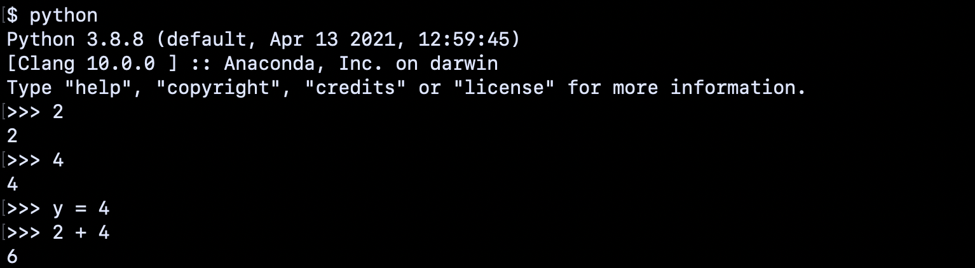
Python commands
Open the shell directly (for ex using python, ipython, or jupyter), and run each command line by line:

Slide 10
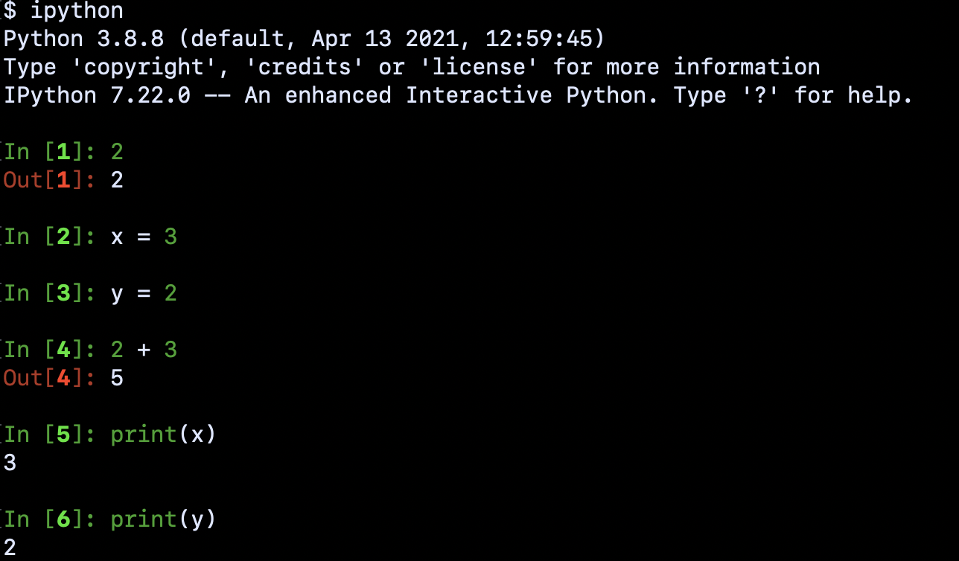
Python commands
Open the shell directly (for ex using python, ipython, or jupyter), and run each command line by line:

Slide 11
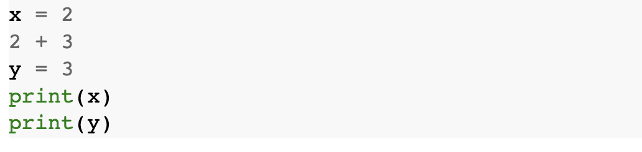
Python script
Python commands can be stored into a script, for example:
example_script.py
The entire script (which has 5 Python statements in it) can be run through the python shell in the terminal using:
python example_script.py

Slide 12
Objects in Python
Python programs work by manipulating objects that represent data.
Objects are either Scalar or Non-Scalar objects.
The object’s type defines what the object is able to do in a program.
Scalar objects are indivisible (they have no internal structure).
The square footage of an apartment can be represented as a scalar object.
Nonscalar objects might hold multiple types of information in them, and have their own internal structure.
An “apartment” object can hold information on the number of room, windows, square footage, etc.

Slide 13
Scalar objects
Four scalar objects in Python
int is used to represent integers. (-3, 2, 1, 1, 4839, etc)
float is used to represent real numbers. Literals of type float always include a decimal point (e.g., 3.0 or 3.17 or -28.72).
bool is used to represent the Boolean values True and False.
None is a type with a single value.
Use the type() function to get the type of an object
>>> type(2)
<class 'int'>

Slide 14
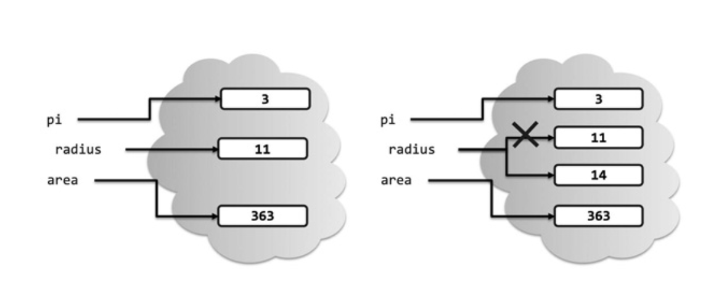
Variable assignments
In [2]: pi = 3
...: radius = 11
...: area = pi * (radius**2)
...: radius = 14
In [3]: radius
Out[3]: 14
In [4]: type(radius)
Out[4]: int
In [5]: area
Out[5]: 363
In [6]: type(area)
Out[6]: int
A variable is a name in Python.
An assignment statement assigns a name to an expression on the right of the =.
radius is bound to 11
radius is rebound

Slide 15
Reserve words
Cannot use these words for variable names.
and as assert async await
break class continue def del
elif else except False finally
for in from is global
lambda if nonlocal import None
not True or try pass while raise with return yield

Slide 16
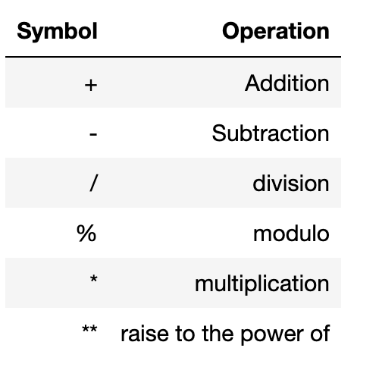
Arithmetic and Boolean Operators
Boolean operators
The primitive operators on type bool are and, or, and not:
a and b is True if both a and b are True, and False otherwise.
a or b is True if at least one of a or b is True, and False otherwise.
not a is True if a is False, and False if a is True.
An expression is a combination of operations, variables and function calls that is evaluated by the interpreter. The interpreter produces the result of the expression.

Slide 17
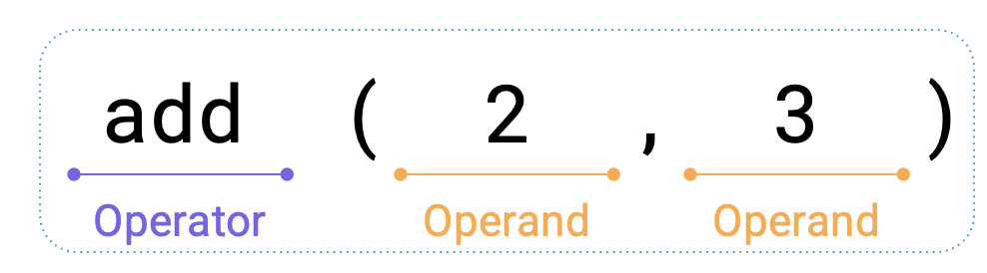
Expressions
Evaluation procedure for call expressions
First evaluate the operator (is also an expression).
Then evaluate the operands from left to right.
Apply the operator (i.e. a function) to the operands (arguments).

Slide 18
Expressions
add(add(6, mul(4, 6)), mul(3, 5))
add(add(6, mul(4, 6)), mul(3, 5))
add(add(6, mul(4, 6)), mul(3, 5))
add(add(6, 24) mul(3, 5))
add(30, mul(3, 5))
add(30, 15)
45

