Slide 1
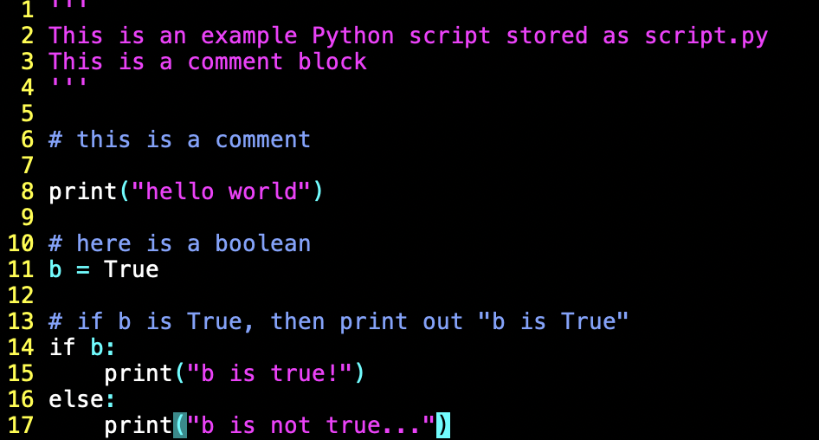
Python Syntax
Comments are ignored by the interpreter and are indicated by
  #
  Triple quotes for a comment block ‘’’ … ‘’’
Indentation is crucial. Code blocks are indicated by the indentation.
A tab is either 2 spaces or 4 spaces.
  You decide if you want to use 2 or 4 spaces but you must be consistent

Slide 2
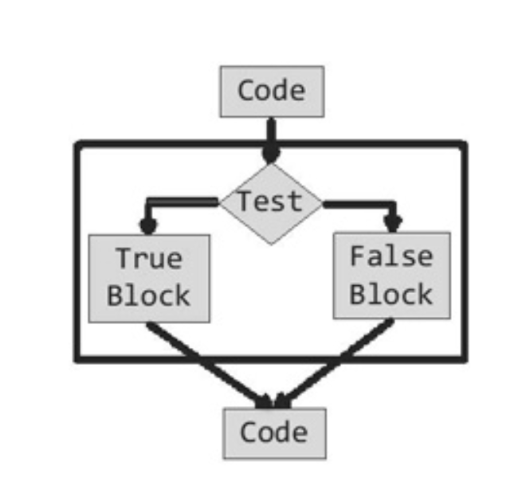
Program branching
A program is simply a sequence of statements.
A branch in a program is one that might execute different sequences of statements based on some condition.
if True:
print(“true”)

Slide 3
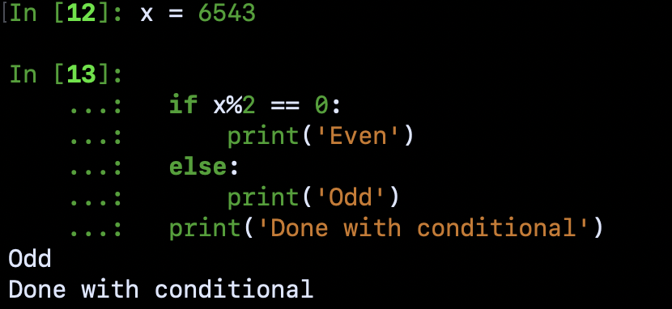
Program branching
A program is simply a sequence of statements.
A branch in a program is one that might execute different sequences of statements based on some condition.
if True:
print(“true”)
else:
print(“wasn’t true”)
print(“continuing with program”)

Slide 4
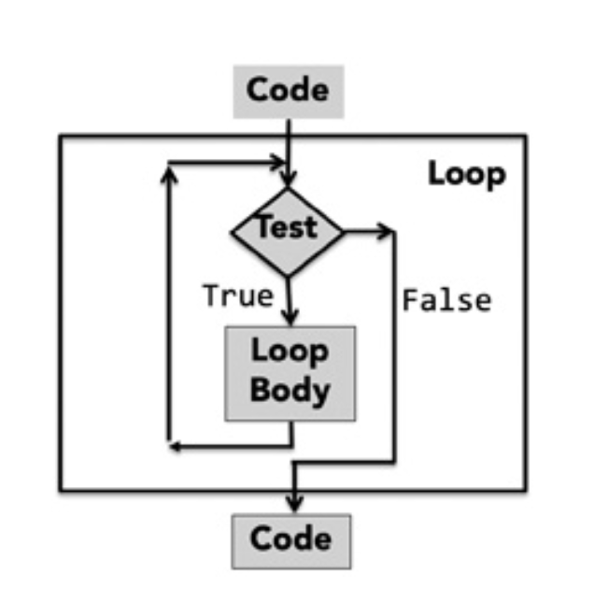
Loops
An iteration is used when a portion of code is to be repeated many times.
A generic looping mechanism is comprised of
A test statement that evaluates to either True or False.
If it evaluates to True, the loop body will execute and execution goes back to the top of the loop.
If it evaluates the False, the code continues execution after the loop.

Slide 5
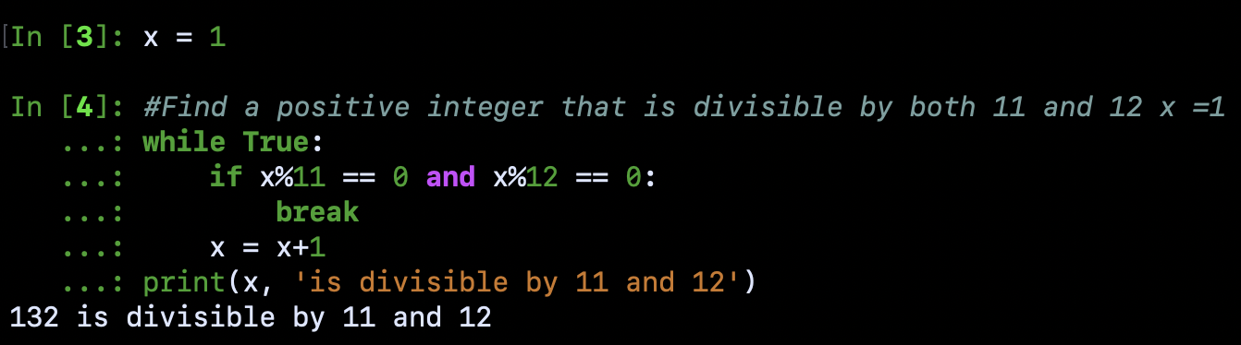
while Loops

Slide 6
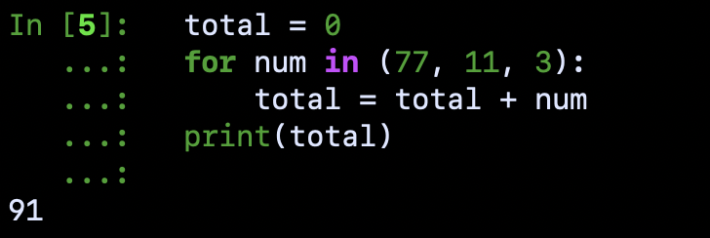

for Loops
For loop syntax:
for num in sequence:
code block
Code reads just like how you would describe this in words: “for each of the numbers in the sequence, execute the following code block”.
In Python, (77, 11, 3) is an object called a tuple (a sequence of numbers).
This loop takes each number in the tuple, and adds it to the total variable.

Slide 7
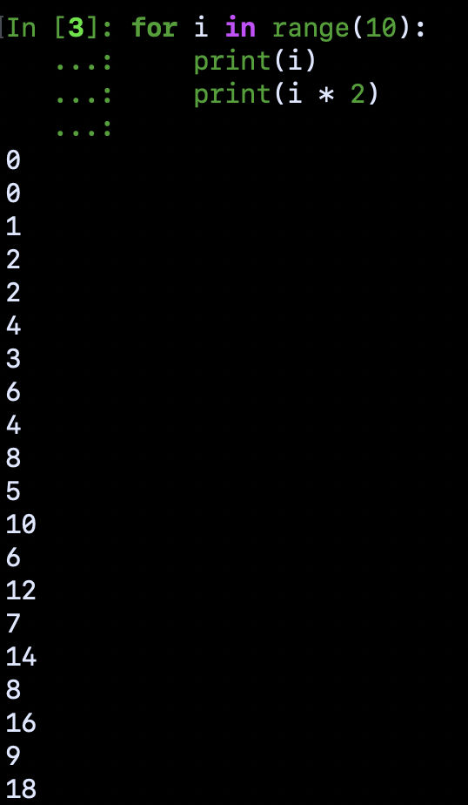
for Loops
For loop syntax:
for num in sequence:
code block
Code reads just like how you would describe this in words: “for each of the numbers in the sequence, execute the following code block”.
In Python, range is a built-in function that returns a sequence of integers.
range(start, stop, step)

Slide 8
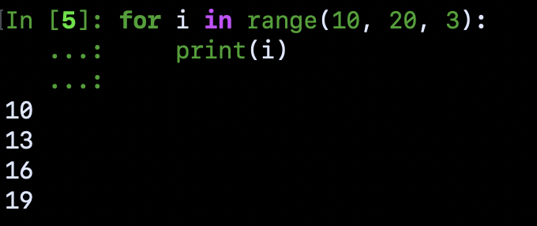
for Loops
For loop syntax:
for num in sequence:
code block
Code reads just like how you would describe this in words: “for each of the numbers in the sequence, execute the following code block”.
In Python, range is a built-in function that returns a sequence of integers.
range(start, stop, step)

