Slide 1
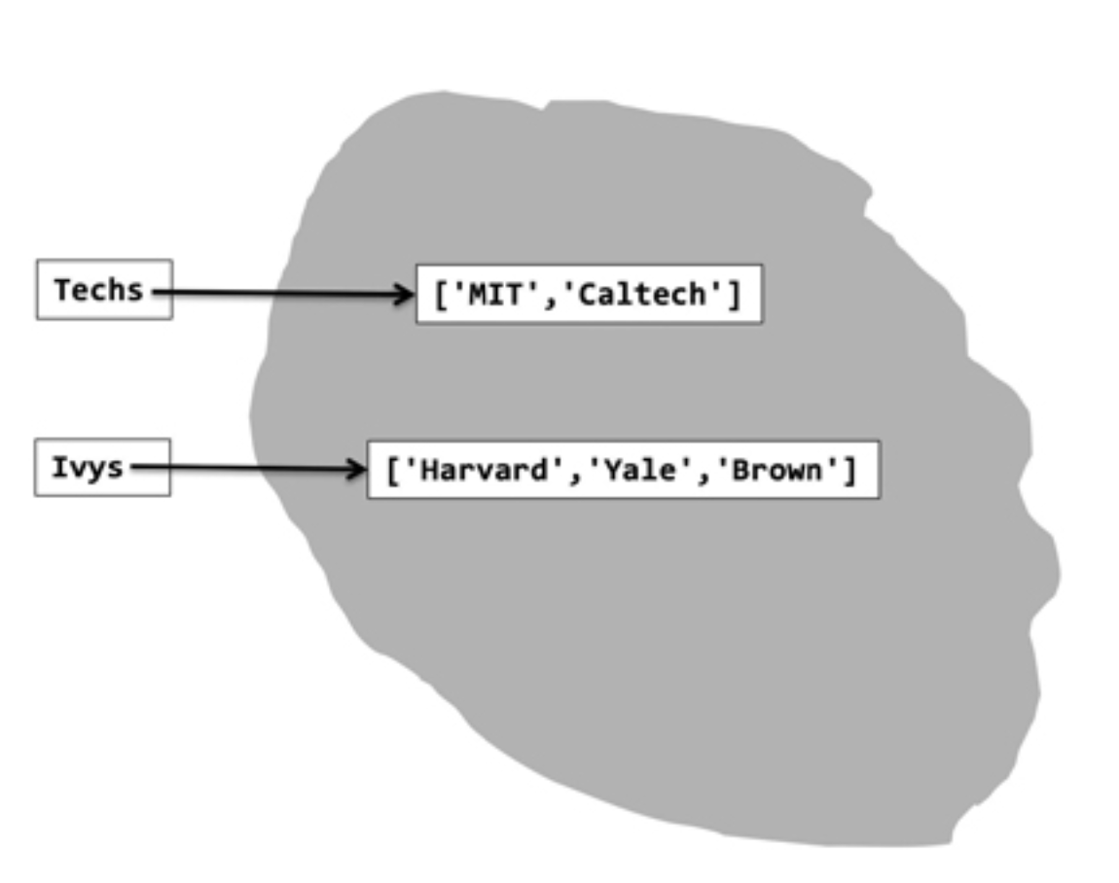
Mutability
Techs = ['MIT', 'Caltech']
Ivys = ['Harvard', 'Yale', 'Brown’]

Slide 2
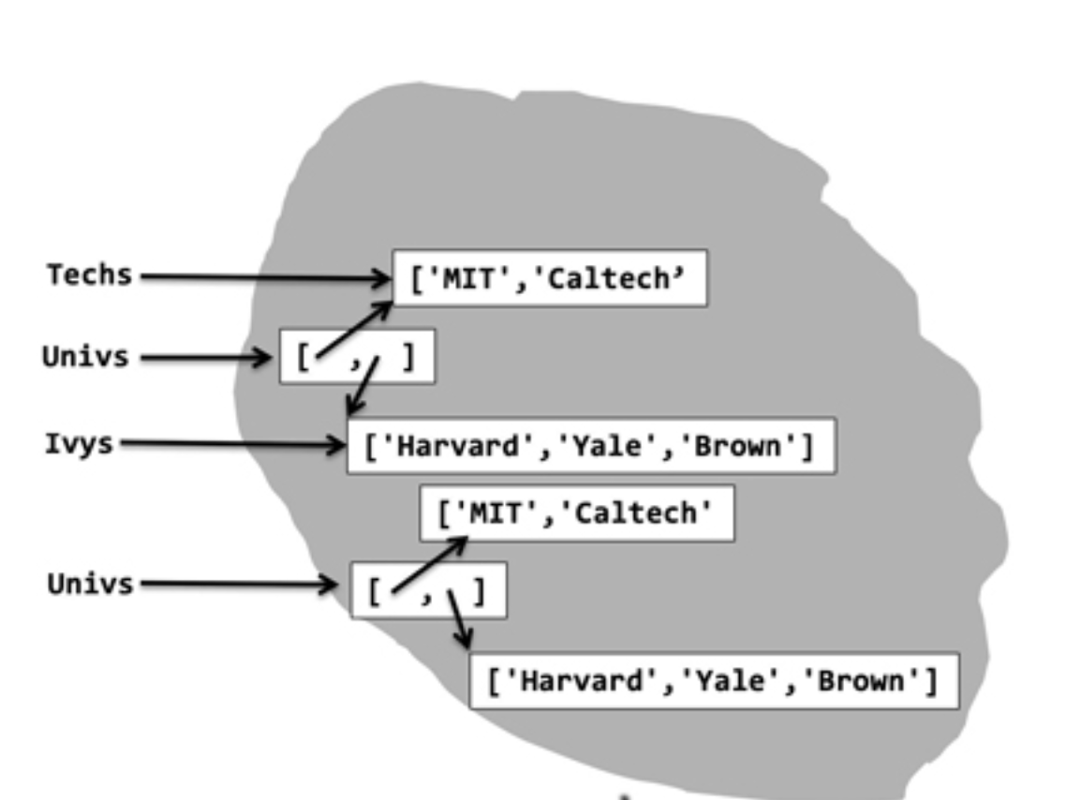
Mutability
Techs = ['MIT', 'Caltech']
Ivys = ['Harvard', 'Yale', 'Brown’]
Univs = [Techs, Ivys]
Univs1 = [['MIT', 'Caltech'], ['Harvard', 'Yale', 'Brown']]

Slide 3
Mutability
Techs = ['MIT', 'Caltech']
Ivys = ['Harvard', 'Yale', 'Brown’]
Univs = [Techs, Ivys]
Univs1 = [['MIT', 'Caltech'], ['Harvard', 'Yale', 'Brown’]]
Techs.append('RPI')

Slide 4
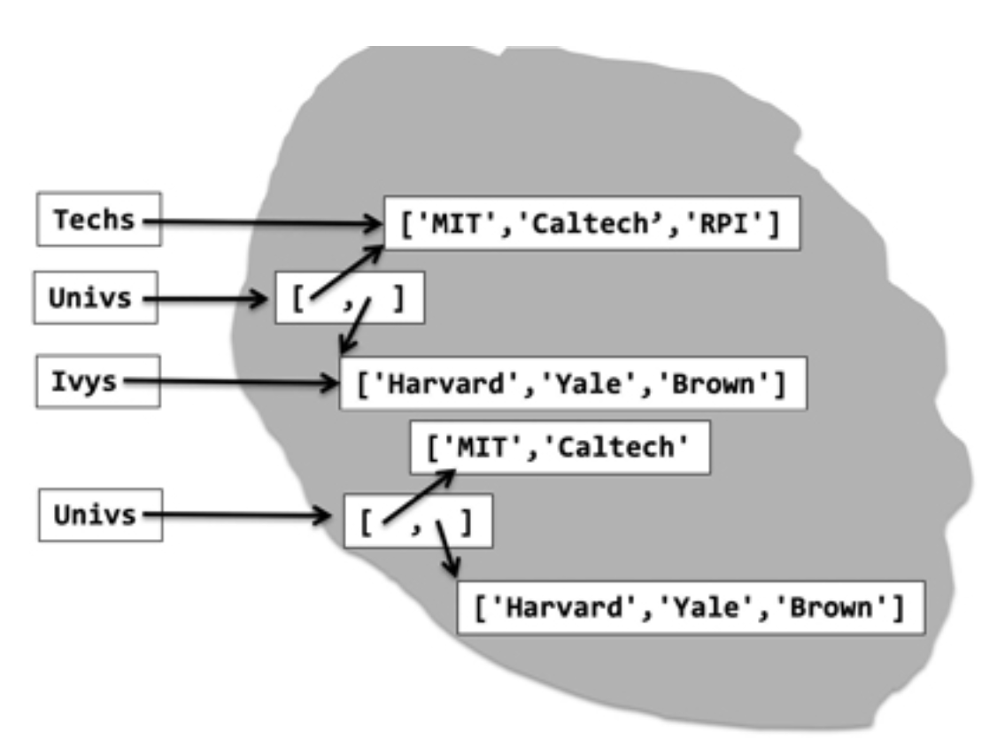
Mutability
Techs = ['MIT', 'Caltech']
Ivys = ['Harvard', 'Yale', 'Brown’]
Univs = [Techs, Ivys]
Univs1 = [['MIT', 'Caltech'], ['Harvard', 'Yale', 'Brown’]]
Techs.append('RPI')

