Slide 1
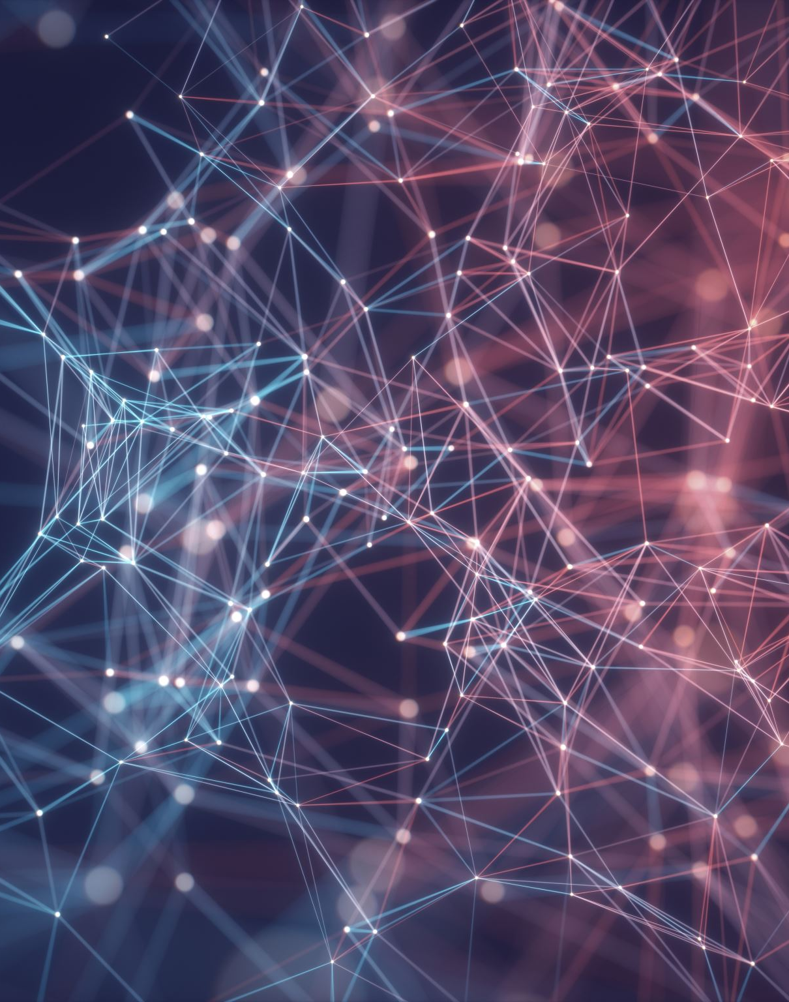
Recurrent Residual Convolutional Network based on U-Net (R2U-Net) for Medical Image Segmentation
Cognitive Computing and Artificial Intelligence 2020/2021
Roberto Pillitteri (1000012403)
Davide Lo Presti (1000008936)

Slide 2
Semantic Segmentation
Semantic Segmentation is an application of CNN, and consists of dividing an image into parts and classifying each pixel to understand which category they belong to.
It is often used on datasets of medical images, like in this paper.

Slide 3
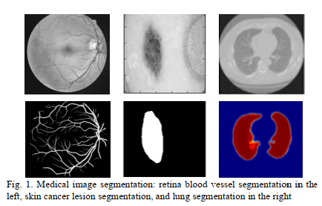

Slide 4
U-Net
U-Net is a very common architecture used for image segmentation. It consists of three «paths»:
Downsampling path, to reduce image’s size through convolutions;
Bottleneck, to process features of images;
Upsampling path, to increase image’s size through transposed convolutions.

Slide 5
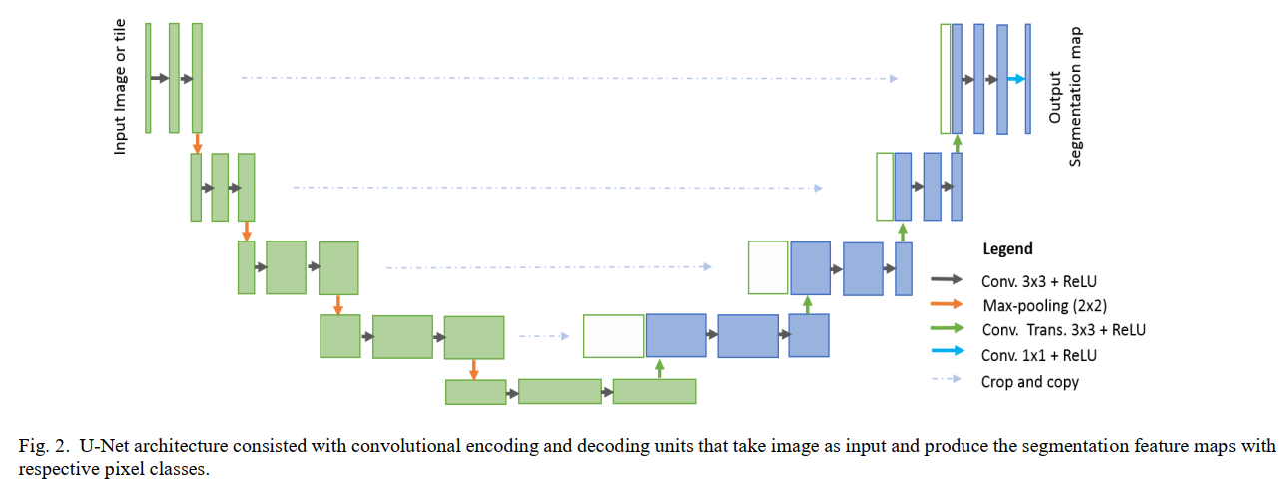

Slide 6
Main Problem and proposed variants
Vanishing gradient, which can be solved thanks to residual layers: a kind of connection between layers that make it easy to propagate the gradient.
So, the authors have proposed some variants of the standard U-Net, by adding residual layers and recurrent layers (t=3), which showed better performances.

Slide 7
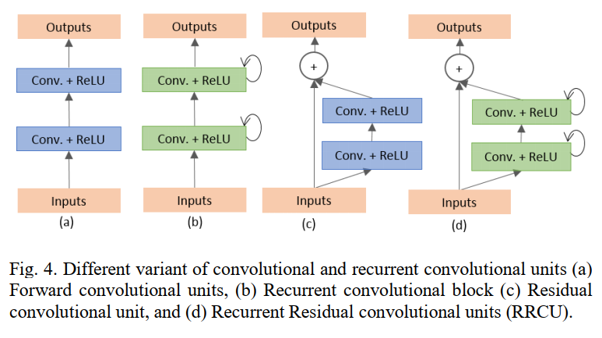

Slide 8
Datasets
TOPIC | DATASET NAME | DATASET SIZE | IMAGE SIZE | TRAINING-TEST
Blood Vessel | DRIVE | 40 | 565x584 | 20-20
Blood Vessel | STARE | 20 | 700x605 | «leave-one-out»
Blood Vessel | CHASE_DB1 | 28 | 999x960 | 20-8
Skin Cancer | ISIC (2017) | 2000 | 700x900 | 1600-400
Lung | LUNA16 | 534 | 512x512 | 70%-30%

Slide 9

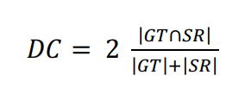


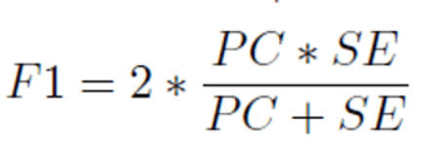

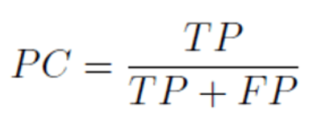
Quantitative Analysis Approaches

Slide 10
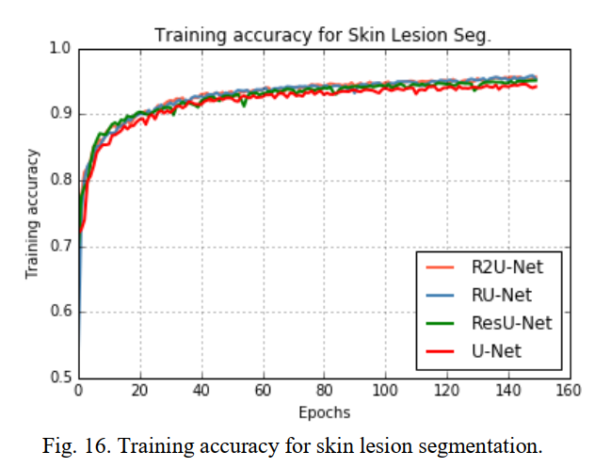
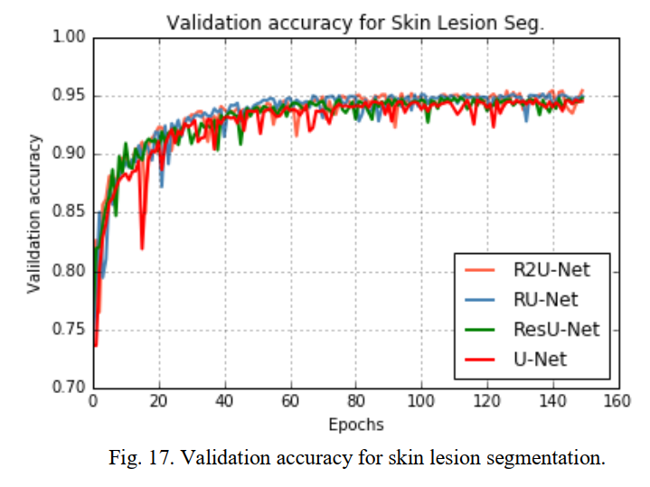
Results of Skin Cancer Segmentation

Slide 11
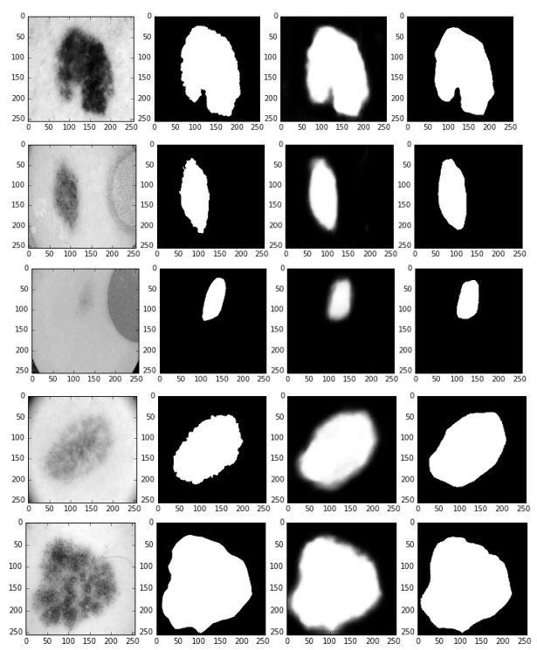
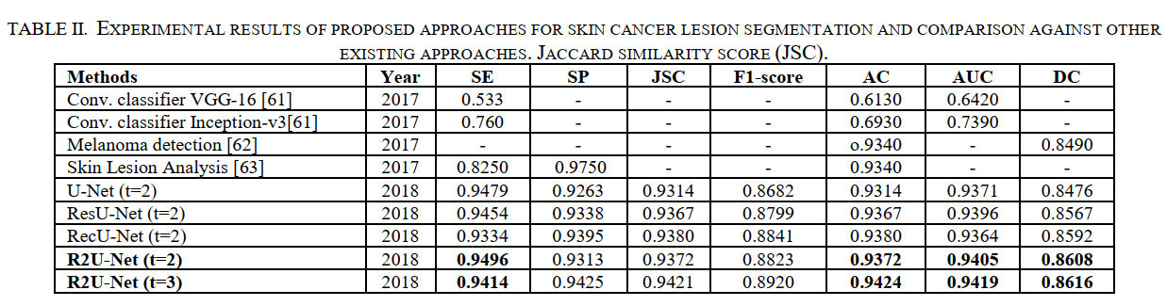
Results of Skin Cancer Segmentation

Slide 12
Code
network.py: defines the architectures with convolutional, recurrent and residual layers, and creates the classes U_Net and R2U_Net, which use them.
data_loader.py: uses the ImageFolder class to organize the dataset and perform resizing and data augmentation, then uses the DataLoader class to perform shuffling and work with mini-batches.
evaluation.py: defines all the functions to compute metrics.

Slide 13
Code
solver.py: takes the loaders as inputs and performs training on all dataset.
main.py: some parameters are configured and calls a Solver, by passing it the loaders.
misc.py: implements a progress bar.
dataset.py: some parameters are configured and splits dataset into training set, validation set and test set.

Slide 14
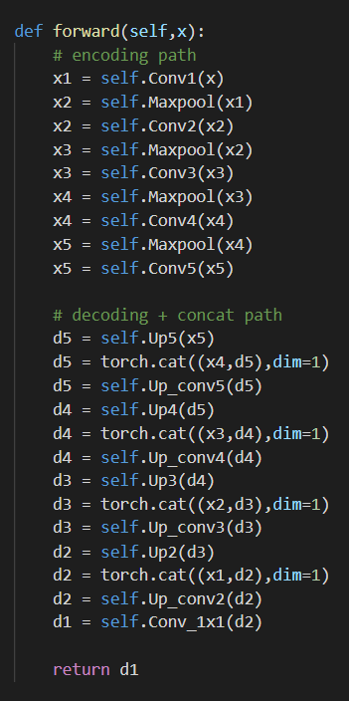
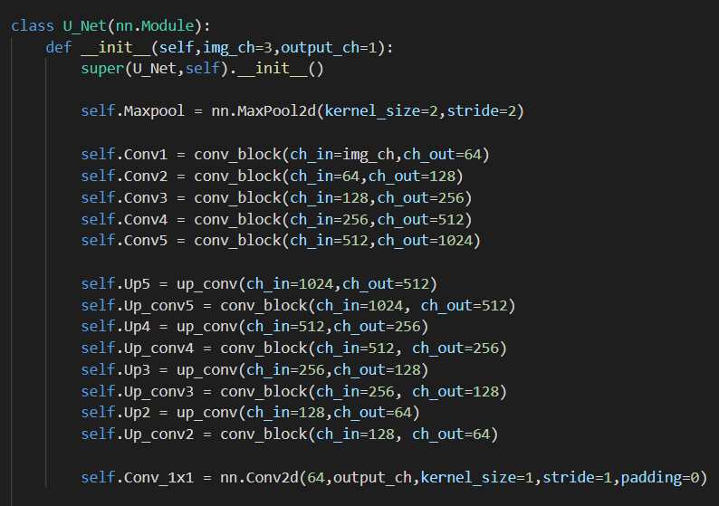
Code U-Net

Slide 15
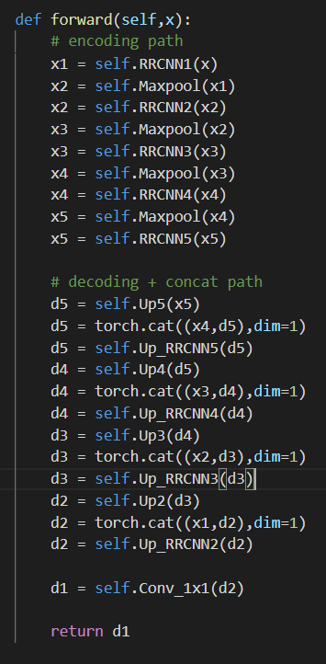
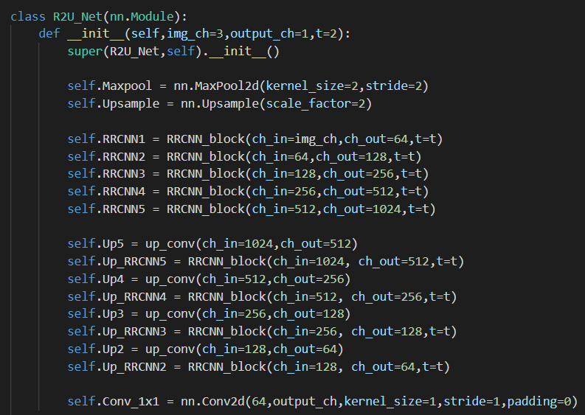
Code R2U-Net

Slide 16
Strengths and weaknesses
Everything treated in the article is supported by a huge number of bibliographic sources that make the argumentations more solid. ✅
The language is clear and helps the reader to understand what the topic is talking about. ✅
The experimental results demonstrate that the proposed model “R2U-Net” show better performance in segmentation tasks with the same number of network parameters when compared to existing methods including the U-Net. ✅

Slide 17
Strengths and weaknesses
There are many inconsistencies in code with regard to the paper. ❌
In some parts of the code, it tries to delete some variables without istantiating them first. ❌
The evaluation functions were wrong due to a new pytorch version. ❌
Some parameters are never taken, and some functions are never called. ❌

Slide 18
Strengths and weaknesses
The scripts are not well-organised are written in a confused way, and this makes the reading hard. ❌
The code is not documented. ❌
Instead of using a script which splits the dataset in three standard subset, they could have used the cross-validation technique. ❌

Slide 19
Our Project assignment
Due to tecnhical issues, we could not access to all the dataset, so we focused just on skin cancer’s one.
The task of replicating the results of the paper was very hard, because the authors used a GPU machine with 56Gb of RAM and an NVIDIA GEFORCE GTX-980 Ti, which is out of our league, so we had to reduce the image’s size to 64x64 pixels, the batch size to 1, the number of workers to 0, and the epochs amount to 50.

Slide 20
Our Project assignment
To discover the part of the code which take most time, we computed the times of each getitem, each backward and each forward function, for 1 epoch and 1250 samples:
Total time forward: 167.51840710639954 sec
Average time forward: 0.13401472568511963 sec
Total time backward: 304.59891057014465 sec
Average time backward: 0.24367912845611572 sec
Total time getitem: 88.1659905910492 sec
Average time getitem: 0.07053279247283936 sec

Slide 21
Our Project assignment
We experimented with the code and changed something:
In the DataLoader function, we shuffle the dataset for each epoch, only if mode is «train»;
In the evaluation functions, we fixed the problem of the zero metrics;
In the evaluation functions, we tried to decrease the threshold from 0,5 to 0,25.

Slide 22
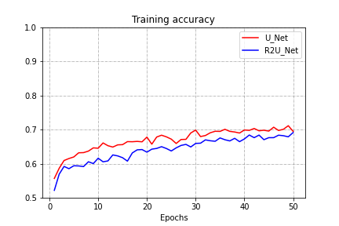
Our results (training accuracy)
Threshold=0.5

Slide 23
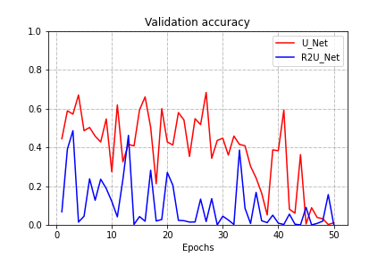
Our results (validation accuracy)
Threshold=0.5

Slide 24
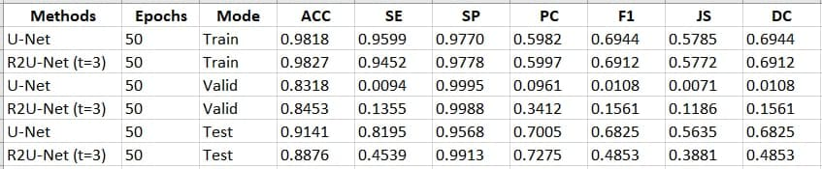
Our results (all metrics at epoch 50)
Threshold=0.5

Slide 25
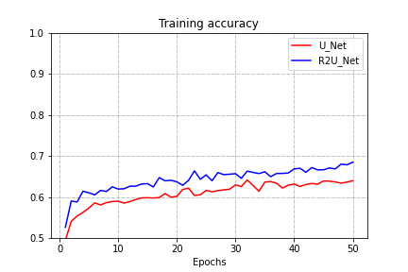
Our results (training accuracy)
Threshold=0.25

Slide 26
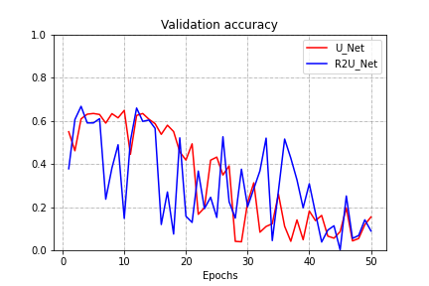
Our results (validation accuracy)
Threshold=0.25

Slide 27
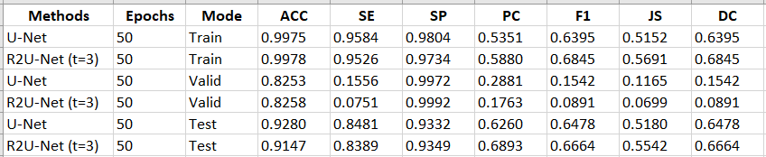
Our results (all metrics at epoch 50)
Threshold=0.25

Slide 28
Conclusions
It is noted that R2U_Net model should be better than U_Net model, but it is not our case because we made several simplifications.
After downgrading the threshold, we can see better performances in validation accuracy (expecially for R2U_Net), but worse performances in training accuracy.

Slide 29
Conclusions
In conclusion, our results do not match exactly the ones shown in the paper, we would have liked to get as close to them, but with what we had, we did everything we could, at the cost of the quality of images.
Despite this, we enjoyed working with these topics in a pratical context, which is the field of medicine.

