Slide 1
INTRODUCTION TO COMPUTING
Course Code: CCINCOM/L
Problem Solving and Data
Elizer Ponio Jr
Faculty
Department of Computer Science
College of Computing and Information Technologies (CCIT)
National University
Joseph Marvin R. Imperial
QUANTITATIVE METHODS
NU College of Computing and Information Technologies
Course Code: CCQUAMET

Slide 2

Numbers
Numbers give essential information. They have the benefit of giving a clear, precise and objective measure.
When the temperature is 30 degrees, you know exactly how hot it is; when a bar contains 450 grams of chocolate, you know exactly how big it is.
On the other hand, when you cannot measure something it is much more difficult to describe and understand. When you get a pain in your stomach it is very difficult to describe the kind of pain, how bad it is or how it makes you feel.
Numbers provide a way to quantify things.
Joseph Marvin R. Imperial
QUANTITATIVE METHODS
NU College of Computing and Information Technologies
Course Code: CCQUAMET

Slide 3
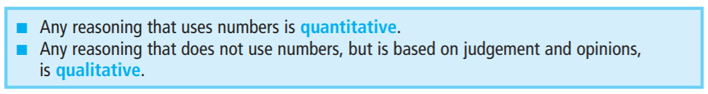
Numbers
So the first benefit of numbers is that they give a clear measure – and a second benefit is that you can use them in calculations.
If you buy three bars of chocolate that cost 30 pence each, you know the total cost is 90 pence.
If you pay for these with a £5 note you expect £4.10 in change.
If you start a 120 km journey at 12:00 and travel at 60 km an hour, you expect to arrive at 14:00.
Joseph Marvin R. Imperial
QUANTITATIVE METHODS
NU College of Computing and Information Technologies
Course Code: CCQUAMET

Slide 4
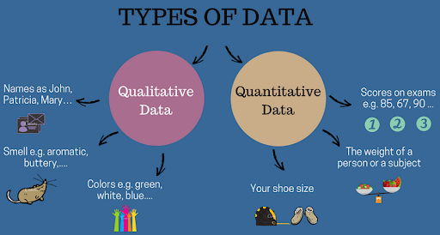
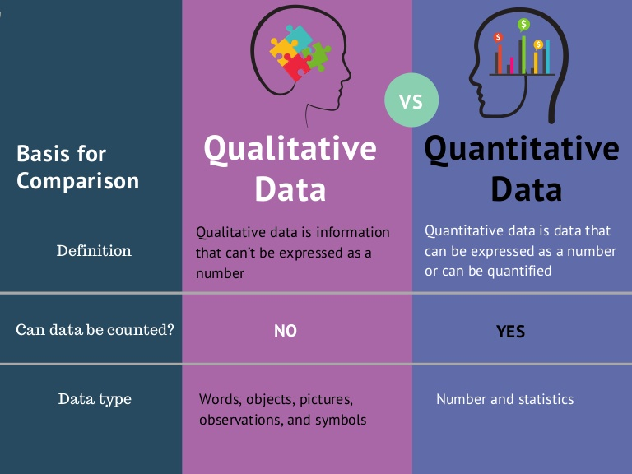
Types of Data
Joseph Marvin R. Imperial
QUANTITATIVE METHODS
NU College of Computing and Information Technologies
Course Code: CCQUAMET

Slide 5

Qualitative or Quantitative?
Joseph Marvin R. Imperial
QUANTITATIVE METHODS
NU College of Computing and Information Technologies
Course Code: CCQUAMET

Slide 6

Qualitative or Quantitative?
Joseph Marvin R. Imperial
QUANTITATIVE METHODS
NU College of Computing and Information Technologies
Course Code: CCQUAMET

Slide 7
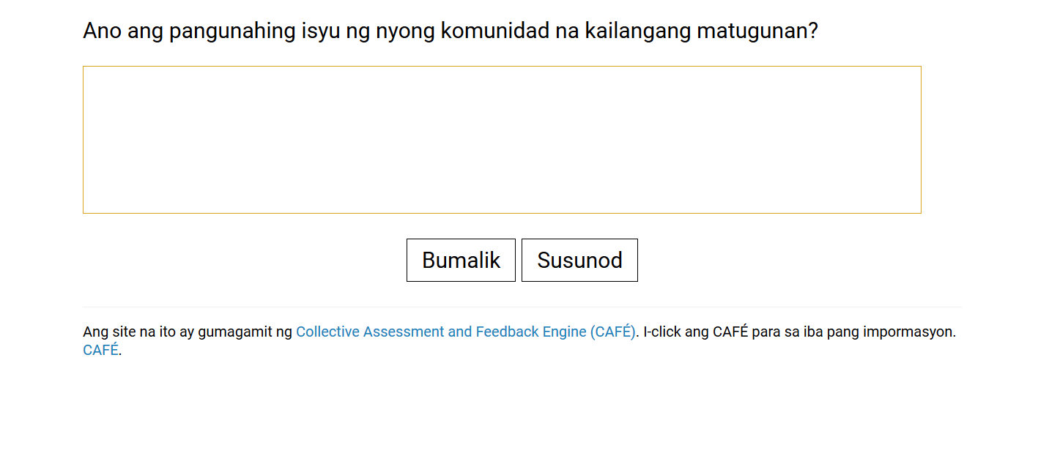
Qualitative or Quantitative?
Joseph Marvin R. Imperial
QUANTITATIVE METHODS
NU College of Computing and Information Technologies
Course Code: CCQUAMET

Slide 8
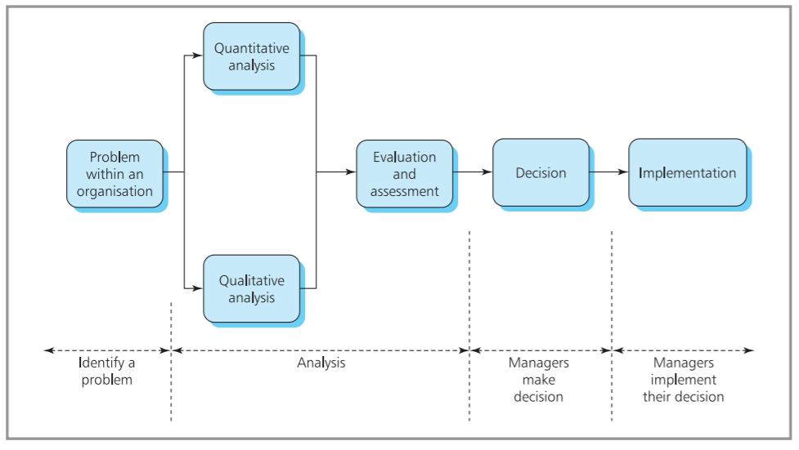
In reality, no problem is entirely quantitative and judgement, intuition, experience and other human skills are important. You can see this in areas such as industrial relations, negotiations, recruitment, setting strategic goals and personal relations. But even here managers should consider all available information before reaching their decisions – and quantitative methods often give valuable insights.
Joseph Marvin R. Imperial
QUANTITATIVE METHODS
NU College of Computing and Information Technologies
Course Code: CCQUAMET

Slide 9
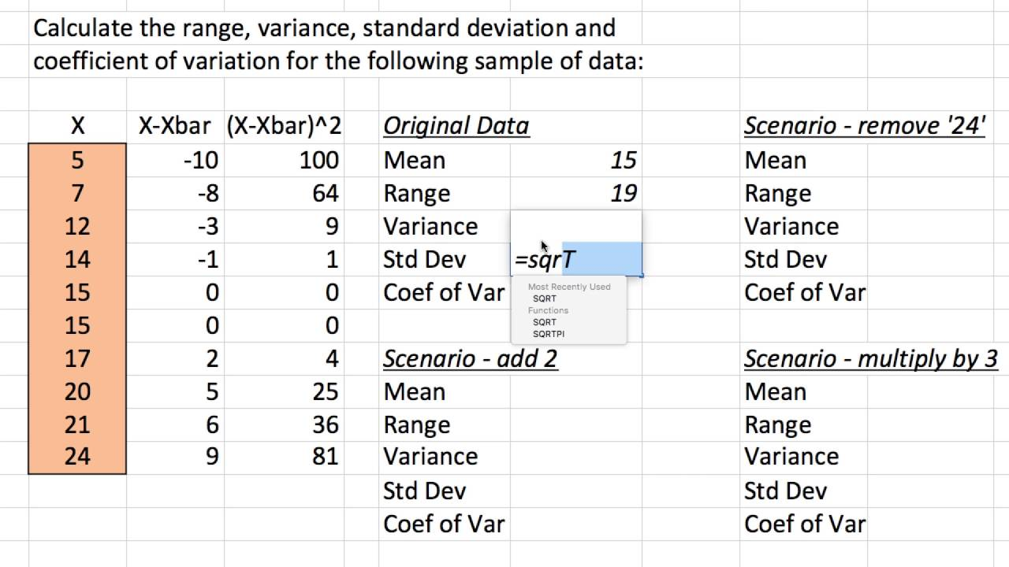
Focus: Quantitative Methods
With quantitative methods, we try to process, summarize, and visualize our data to help us make decisions.
Joseph Marvin R. Imperial
QUANTITATIVE METHODS
NU College of Computing and Information Technologies
Course Code: CCQUAMET

Slide 10
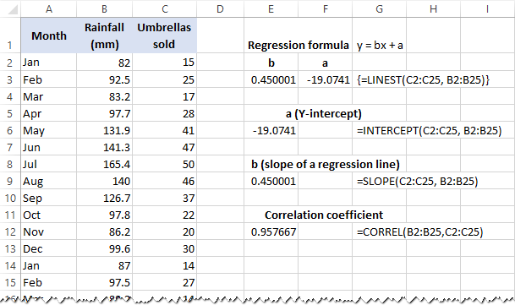
Focus: quantitative methods
Joseph Marvin R. Imperial
QUANTITATIVE METHODS
NU College of Computing and Information Technologies
Course Code: CCQUAMET

Slide 11
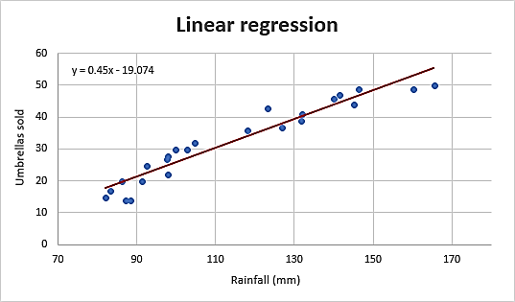
Focus: quantitative methods
Joseph Marvin R. Imperial
QUANTITATIVE METHODS
NU College of Computing and Information Technologies
Course Code: CCQUAMET

Slide 12
Focus: Quantitative Methods
Quantitative methods is a broad subject that includes many different approaches – but they all start with a model of a problem.
In this sense, a model is just a simplified representation of reality, and we are not talking about toys or games.
The main features of a model are:
it is a representation of reality.
it is simplified, with only relevant details included.
properties in reality are represented by other properties in the model.
Joseph Marvin R. Imperial
QUANTITATIVE METHODS
NU College of Computing and Information Technologies
Course Code: CCQUAMET

Slide 13
Building a model
Models have properties in reality represented by some kind of symbol. So, a symbolic model for the amount of value added tax payable is:
VAT = rate × sales
where the symbol ‘VAT’ in the model represents the amount of tax paid in reality, and the symbols ‘rate’ and ‘sales’ represent the actual rate of VAT and value of sales.
If a company sells a product for £300 a unit, a model of its income is:
income = number of units sold × selling price
income = number of units sold × 300
We can extend this model by finding the profit when it costs the company £200 to make each unit:
profit = number of units sold × (selling price − cost)
or profit = number of units sold × (300 − 200) = number of units sold × 100
Joseph Marvin R. Imperial
QUANTITATIVE METHODS
NU College of Computing and Information Technologies
Course Code: CCQUAMET

Slide 14
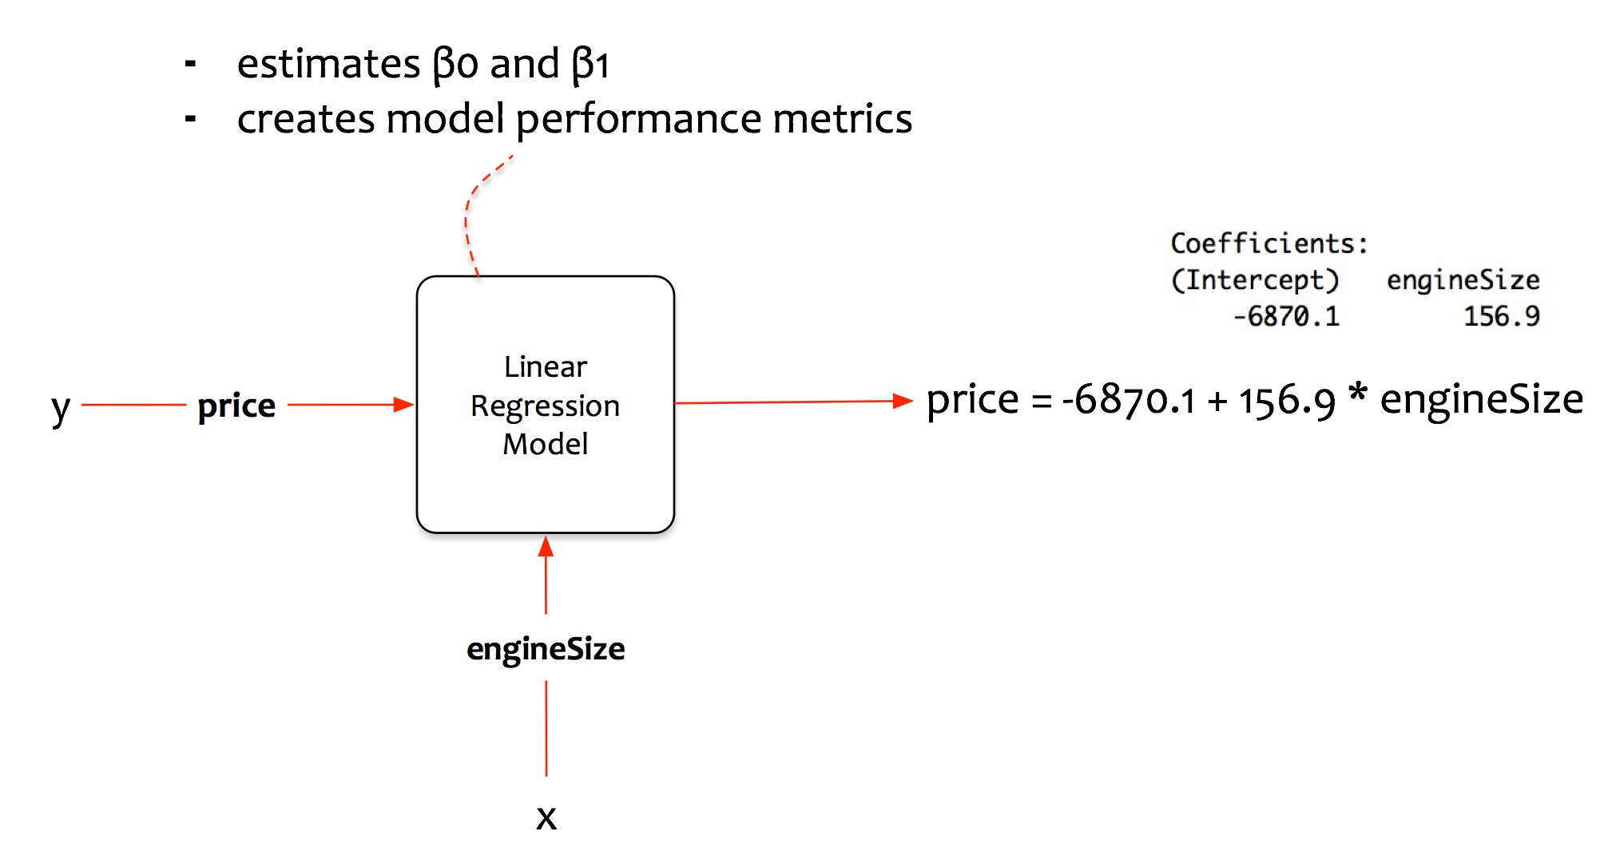
Building a model
Joseph Marvin R. Imperial
QUANTITATIVE METHODS
NU College of Computing and Information Technologies
Course Code: CCQUAMET

Slide 15
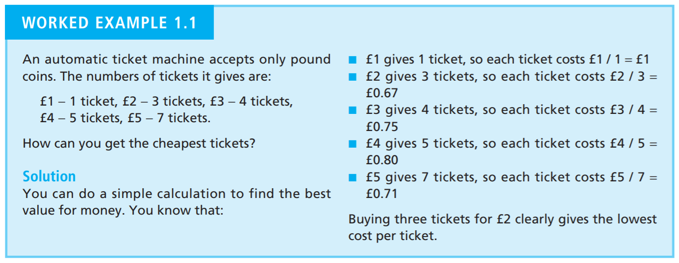
Example
Joseph Marvin R. Imperial
QUANTITATIVE METHODS
NU College of Computing and Information Technologies
Course Code: CCQUAMET

Slide 16
Example
Joseph Marvin R. Imperial
QUANTITATIVE METHODS
NU College of Computing and Information Technologies
Course Code: CCQUAMET

Slide 17
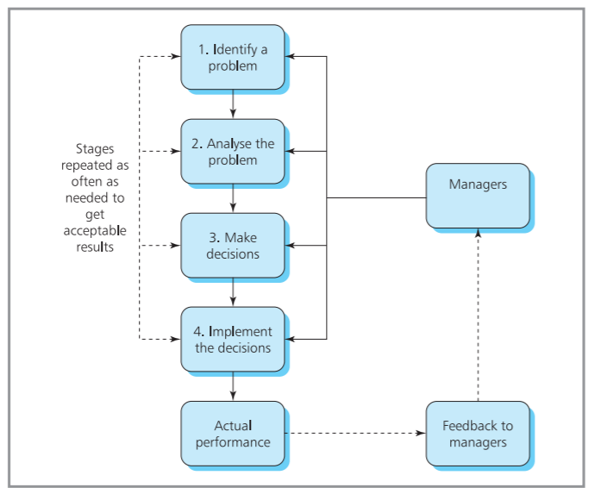
Stages in decision-making
Joseph Marvin R. Imperial
QUANTITATIVE METHODS
NU College of Computing and Information Technologies
Course Code: CCQUAMET

Slide 18
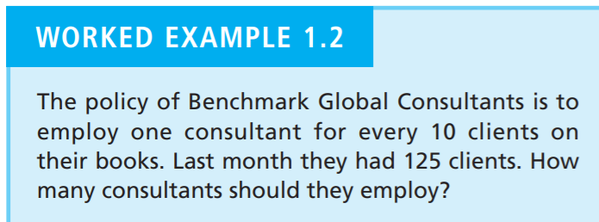
Example
Joseph Marvin R. Imperial
QUANTITATIVE METHODS
NU College of Computing and Information Technologies
Course Code: CCQUAMET

Slide 19
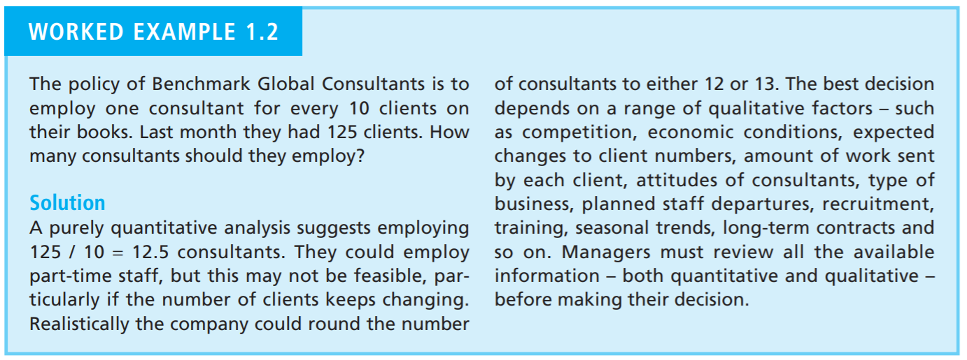
Example
Joseph Marvin R. Imperial
QUANTITATIVE METHODS
NU College of Computing and Information Technologies
Course Code: CCQUAMET

Slide 20
Stage 1. Identify the Problem
You should have a clear understanding of the problem you are tackling, its context and the requirements of its solution.
Do an initial investigation – looking at operations, identifying difficulties and recognising that there really is a problem.
Define the problem – adding details to the initial investigation, saying exactly what the problem is (and not just its symptoms), its context, scope, boundaries and any other relevant details.
Set objectives – identifying the decision-makers, their aims, improvements they want, effects on the organisation and measures of success.
Joseph Marvin R. Imperial
QUANTITATIVE METHODS
NU College of Computing and Information Technologies
Course Code: CCQUAMET

Slide 21
Stage 2. Analyze the Problem
At the end of this stage, you should have a clear understanding of your options and the consequences. For this you might:
Consider different approaches to solving the problem.
Check work done on similar problems and see if they can use the same approach.
Collect data needed by the model and analyse it.
Joseph Marvin R. Imperial
QUANTITATIVE METHODS
NU College of Computing and Information Technologies
Course Code: CCQUAMET

Slide 22
Stage 3. Make Decisions
This is where you consider the results from analyses, review all the circumstances and make your decisions. There are three steps:
Compare solutions, looking at all aspects of their performance.
Find solutions that best meet the decision-makers’ objectives.
Joseph Marvin R. Imperial
QUANTITATIVE METHODS
NU College of Computing and Information Technologies
Course Code: CCQUAMET

Slide 23
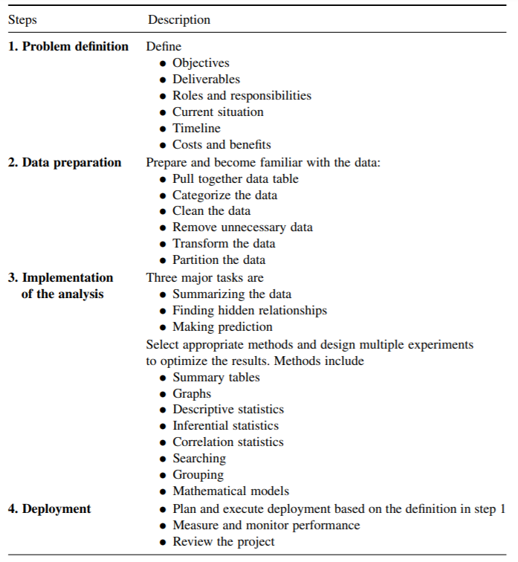
Joseph Marvin R. Imperial
QUANTITATIVE METHODS
NU College of Computing and Information Technologies
Course Code: CCQUAMET

Slide 24
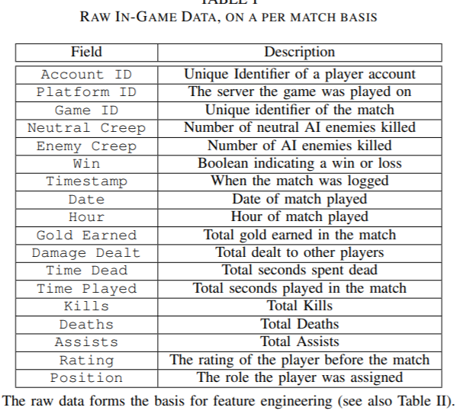
Example: Project
Data: 400,000 player longitudinal dataset generated by new players of the widely-played MOBA League of Legends
Possible Research Questions:
What variables/KPIs can be used to predict the individual/skill performance of players?
Is there a significant relationship the early learning rates and player performance (MMR) of new users after one year of playing League of Legends?
Joseph Marvin R. Imperial
QUANTITATIVE METHODS
NU College of Computing and Information Technologies
Course Code: CCQUAMET

Slide 25
Example: Project
Data: Suicide and socioeconomic information of 101 countries precollected from the World Health Organization (WHO) online database and United Nations Development Programme (UNDP)
Possible Research Questions:
What is the distribution of suicide incidents of Filipino people in terms of factors like sex, age group, and generation through the years?
In the Philippines, who is more in terms of sex? Are Filipino males more suicidal than females?
At which age group do Filipinos tend to be more suicidal? Is it at their teen years or during midlife?
How is the Philippines’ suicide landscape compared to the countries with similar Human Development Index (HDI)?
Is there a significant relationship between suicide rates in the Philippines against its annual unemployment rate?
Joseph Marvin R. Imperial
QUANTITATIVE METHODS
NU College of Computing and Information Technologies
Course Code: CCQUAMET

Slide 26
Business + quantitative methods?
Business problems almost invariably have some numerical features. To deal with these, managers need some appreciation of quantitative methods. This does not mean that they have to be expert mathematicians, but they must have a basic understanding of the principles.
Joseph Marvin R. Imperial
QUANTITATIVE METHODS
NU College of Computing and Information Technologies
Course Code: CCQUAMET

Slide 27
Data
Data are facts, statistics, and figures from which conclusions or references can be drawn. Such conclusions are important to the decision making of many professions and organizations.
For example, economists use conclusions drawn from the latest data on unemployment and inflation to help the government make policy decisions.
Accountants use sample data concerning a company’s actual sales revenues to assess whether the company’s claimed sales revenues are valid.
Together, the data that are collected for a particular study are referred to as a data set.
Joseph Marvin R. Imperial
QUANTITATIVE METHODS
NU College of Computing and Information Technologies
Course Code: CCQUAMET

Slide 28
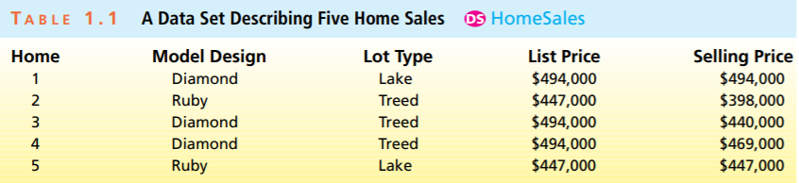
Data
Any dataset provides information about some group of individual elements, which may be people, objects, events, or other entities.
The information that a data set provides about its elements usually describes one or more characteristics of these elements.
Any characteristic or feature of an element is called a variable.
Joseph Marvin R. Imperial
QUANTITATIVE METHODS
NU College of Computing and Information Technologies
Course Code: CCQUAMET

Slide 29
Variables
If the possible measurements of the values of a variable are numbers that represent quantities, then the variable is said to be quantitative.
For example, the actual selling price of a home, the payment time of a bill, and the gasoline mileage of a car are all quantitative.
However, if we simply record into which of several categories an element falls, then the variable is said to be qualitative or categorical.
Examples of categorical variables include (1) a person’s gender, (2) the make of an automobile, (3) whether a person who purchases a product is satisfied with the product, and (4) the type of lot on which a home is built.
Joseph Marvin R. Imperial
QUANTITATIVE METHODS
NU College of Computing and Information Technologies
Course Code: CCQUAMET

Slide 30
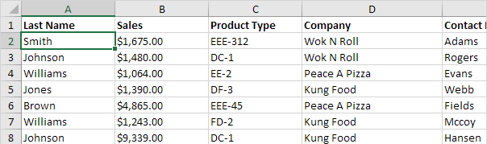
Which variables are qualitative and quantitative?
Joseph Marvin R. Imperial
QUANTITATIVE METHODS
NU College of Computing and Information Technologies
Course Code: CCQUAMET

Slide 31
Data Sources
The quality of the data is the single most important factor to influence the quality of the results from any analysis.
Surveys or Polls: A survey or poll can be useful for gathering data to answer specific questions. They are often used to elicit information on people’s opinions, preferences and behavior.
Experiments: Experiments measure and collect data to answer a specific question in a highly controlled manner. The data collected should be reliably measured, that is, repeating the measurement should not result in different values.
Observational and other studies: In certain situations it is impossible on either logistical or ethical grounds to conduct a controlled experiment. In these situations, a large number of observations are measured and care taken when interpreting the results.
Joseph Marvin R. Imperial
QUANTITATIVE METHODS
NU College of Computing and Information Technologies
Course Code: CCQUAMET

Slide 32
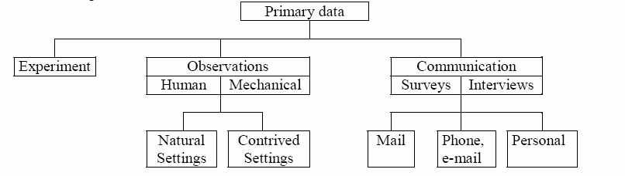
Data Sources
Joseph Marvin R. Imperial
QUANTITATIVE METHODS
NU College of Computing and Information Technologies
Course Code: CCQUAMET

Slide 33
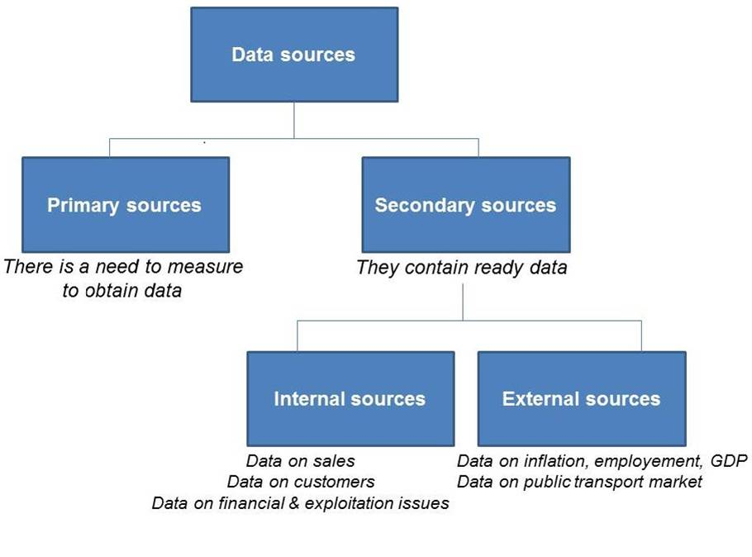
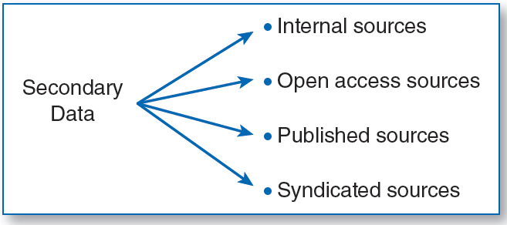
Types of Data
Primary data is new data collected by an organization itself for a specific purpose. Secondary data is existing data that was collected by other organizations or for other purposes
Joseph Marvin R. Imperial
QUANTITATIVE METHODS
NU College of Computing and Information Technologies
Course Code: CCQUAMET

Slide 34
Read case study on Hammerson and Partners
Joseph Marvin R. Imperial
QUANTITATIVE METHODS
NU College of Computing and Information Technologies
Course Code: CCQUAMET

Slide 35
References
https://www.earlyyearsresources.co.uk/images/real-life-numbers-photocards-p30838-2524386_image.jpg
https://cdn.slidesharecdn.com/ss_thumbnails/qualitativevsquantitativedata-infographic-180629141709-thumbnail-4.jpg?cb=1530281874
https://www.google.com.ph/url?sa=i&url=https%3A%2F%2Fmethods.sagepub.com%2Fbook%2Fessentials-of-marketing-research%2Fn3.xml&psig=AOvVaw2UbM0d645lN0F4gOGjFH17&ust=1607588981206000&source=images&cd=vfe&ved=0CAIQjRxqFwoTCKCo6eS9wO0CFQAAAAAdAAAAABAZ
Joseph Marvin R. Imperial
QUANTITATIVE METHODS
NU College of Computing and Information Technologies
Course Code: CCQUAMET

