Slide 1

Correlation
Presented by:
Elizer Ponio Jr.
Department of Computer Science
College of Computing and Information Technologies

Slide 2
Visualizing Relationships
It is usually more informative to explore the relationship between different continuous variables using a scatterplot.

Slide 3
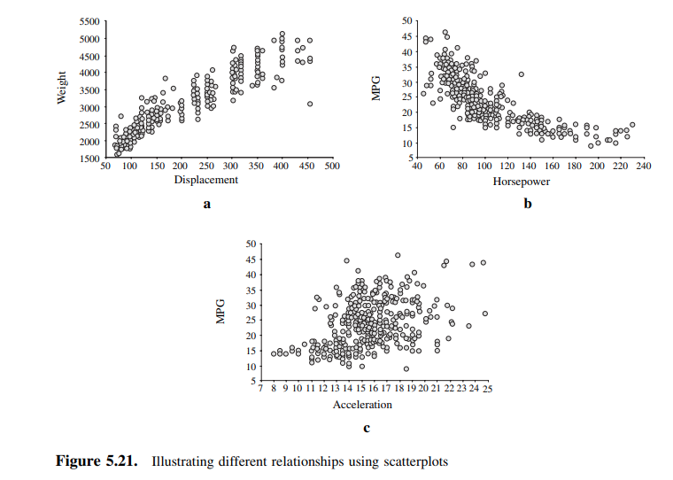
In a), there is a positive relationship between the two variables and from inspection appears to be linear.
In b), there is a negative relationship between the variables and it also appears to be non linear.
In c), it is difficult to see any relationship between the two variables.

Slide 4
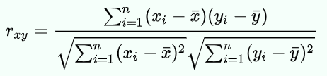
Correlation
Correlation measures the strength of the relationship between two variables. In other words, it tells you how closely two variables are related.
Sometimes called Pearson product-moment correlation
The formula used to calculate r is shown below:

Slide 5
Correlation
There are two types of correlation:
Positive correlation. This is when two variables move in the same direction. For example, as the price of a stock goes up, the number of shares traded also goes up.
Negative correlation. This is when two variables move in opposite directions. For example, as the price of a stock goes up, the number of shares traded goes down.

Slide 6
Correlation
Correlation is measured on a scale from -1 to +1.
A value of -1 means that the variables are perfectly negatively correlated.
A value of +1 means that the variables are perfectly positively correlated.
A value of 0 means that the variables are not correlated at all.

Slide 7
Correlation
Price of Fuel | Price of Water | Jeepney Fare
1 | 5 | 2
2 | 4 | 4
3 | 3 | 5
4 | 2 | 4
5 | 1 | 5

Slide 8
Correlation
 | Price of Fuel | Price of Water | Jeepney Fare
Price of Fuel | 1 | -1 | 0.77
Price of Water | -1 | 1 | -0.77
Jeepney Fare | 0.77 | -0.77 | 1

Slide 9
Positive Correlation
Price of Fuel | Jeepney Fare
1 | 2
2 | 4
3 | 5
4 | 4
5 | 5
Jeepney Fare (Y)
Price of Fuel

Slide 10
Negative Correlation
Price of Water | Jeepney Fare
5 | 2
4 | 4
3 | 5
2 | 4
1 | 5
Jeepney Fare (Y)
Price of Water

Slide 11
No Correlation
Price of Spare Parts | Price of Lubricant Oil
5 | 2
4 | 4
3 | 5
2 | 4
1 | 5
Price of Lubricant Oil (Y)
Price of Spare Parts

Slide 12
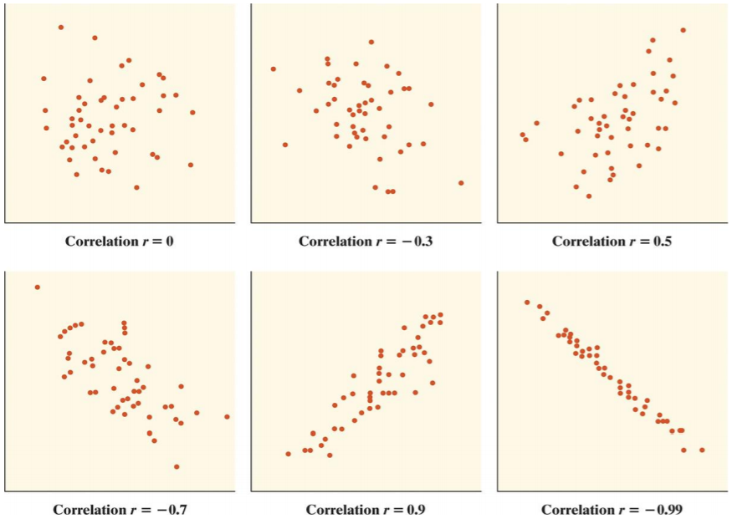

Slide 13
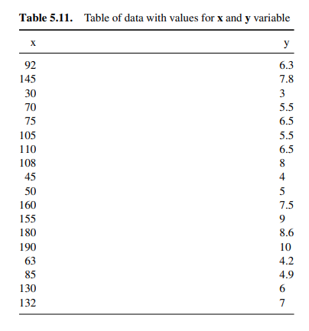
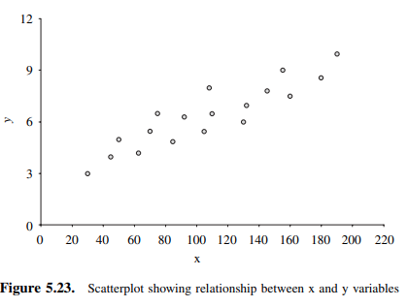

Slide 14
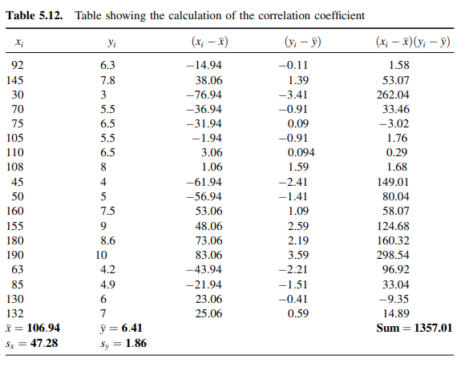

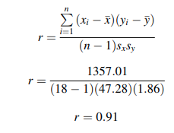

Slide 15
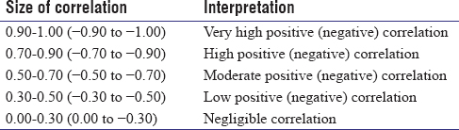

Slide 16
When describing relationships…
Four things must be reported to describe a relationship:
The strength of the relationship given by the correlation coefficient.
The direction of the relationship, which can be positive or negative based on the sign of the correlation coefficient.
The shape of the relationship, which must always be linear to computer a Pearson correlation coefficient.
Whether or not the relationship is statistically significant, which is based on the p-value.

Slide 17
Assumptions for Pearson Correlation
Level of measurement refers to each variable. For a Pearson correlation, each variable should be continuous.
Related pairs refers to the pairs of variables. Each participant or observation should have a pair of values. So if the correlation was between weight and height, then each observation used should have both a weight and a height value.

Slide 18
Assumptions for Pearson Correlation
3. Absence of outliers refers to not having outliers in either variable.
Having an outlier can skew the results of the correlation by pulling the line of best fit formed by the correlation too far in one direction or another. Typically, an outlier is defined as a value that is 3.29 standard deviations from the mean, or a standardized value of less than ±3.29.

Slide 19
Assumptions for Pearson Correlation
4. Your variables should be approximately normally distributed. In order to assess the statistical significance of the Pearson correlation, you need to have bivariate normality, but this assumption is difficult to assess, so a simpler method is more commonly used.

Slide 20
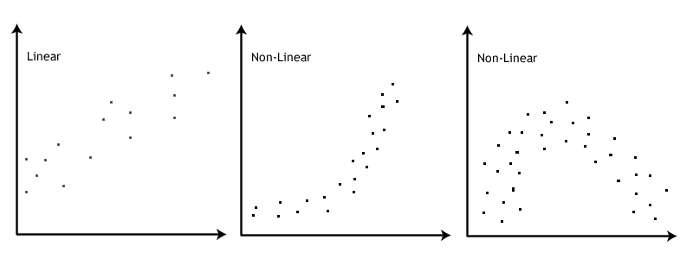
Assumption: No Outliers

Slide 21
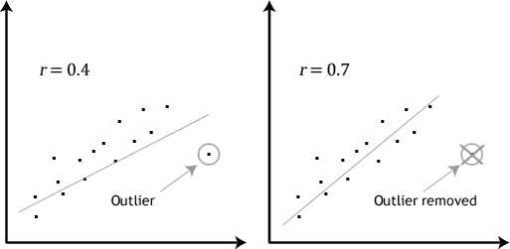
Assumption: No Outliers

Slide 22
Spearman’s rank-order correlation
The Spearman rank-order correlation coefficient (Spearman’s correlation) is a nonparametric measure of the strength and direction of association that exists between two variables measured on at least an ordinal scale.
Spearman’s correlation can be used when your two variables are not normally distributed.
It generates values ranging from -1.0 to +1.0.

Slide 23
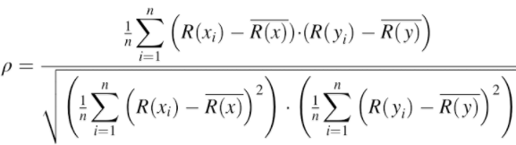

Spearman’s rank-order correlation
No tied ranks
With tied ranks

Slide 24
Spearman’s rank-order correlation
Your two variables should be measured on an ordinal, interval or ratio scale. Examples of ordinal variables include Likert scales (e.g., a 7-point scale from "strongly agree" through to "strongly disagree.
Your two variables represent paired observations. With 30 participants in the study, this means that there would be 30 paired observations.

Slide 25
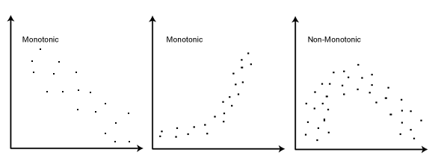
Spearman’s rank-order correlation
3. There is a monotonic relationship between the two variables. A monotonic relationship exists when either the variables increase in value together, or as one variable value increases, the other variable value decreases.

Slide 26
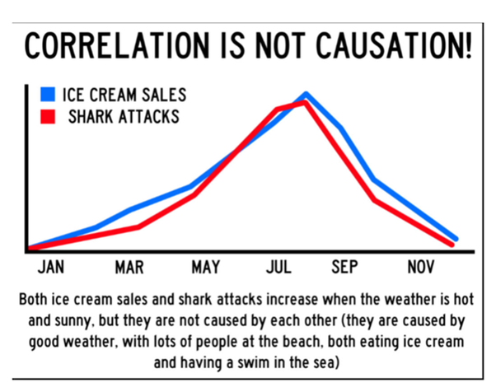
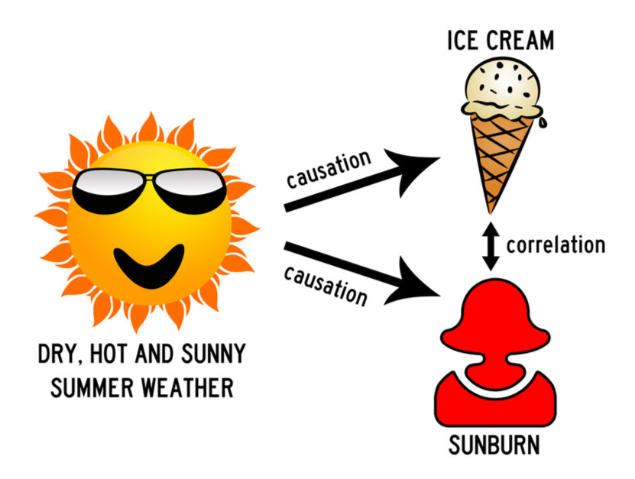
Correlation does not imply causation
The phrase refers to the inability to legitimately deduce a cause-and-effect relationship between two events or variables solely on the basis of an observed association or correlation between them.

Slide 27
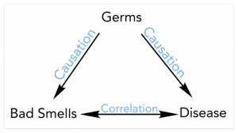
Correlation does not imply causation
Correlation is a statistical technique which tells us how strongly the pair of variables are linearly related and change together. It does not tell us why and how behind the relationship but it just says the relationship exists.

Slide 28
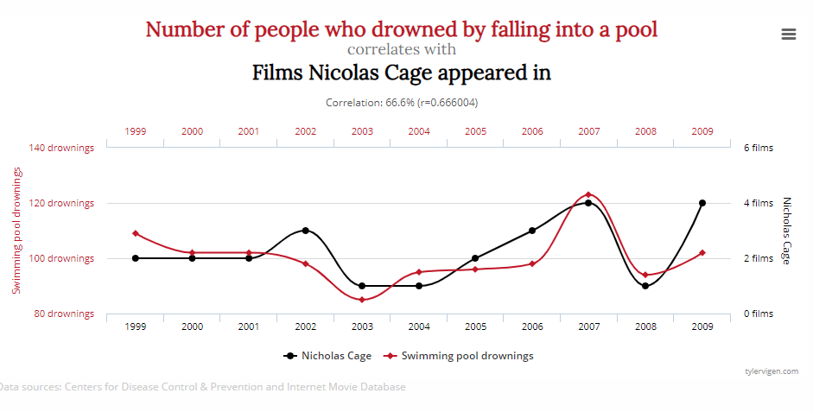
Correlation that does not make any sense

