Slide 1
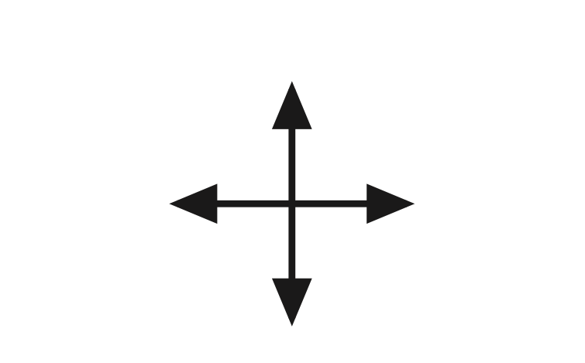
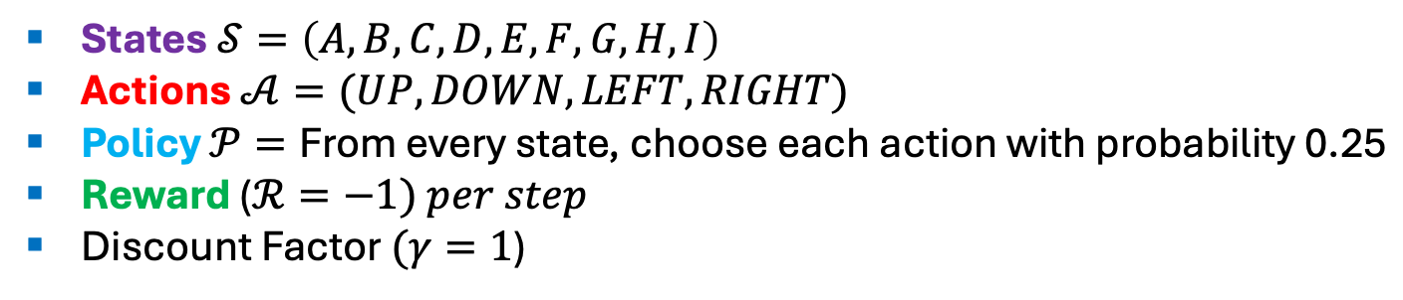
Exercise 4: 3x3 Gridworld
A | B | C
D | E | F
G | H | I
UP
LEFT
RIGHT
DOWN
States $𝒮=\left(A,B,C,D,E,F,G,H,I\right)$
Actions $𝒜=(UP, DOWN, LEFT, RIGHT)$
Policy $𝒫=\text{From} \text{every} \text{state}\text{, }\text{choose} \text{each} \text{action} \text{with} \text{probability}\text{ 0.25}$
Reward ($ℛ=−1) per step$
Discount Factor $(γ=1$)

Slide 2
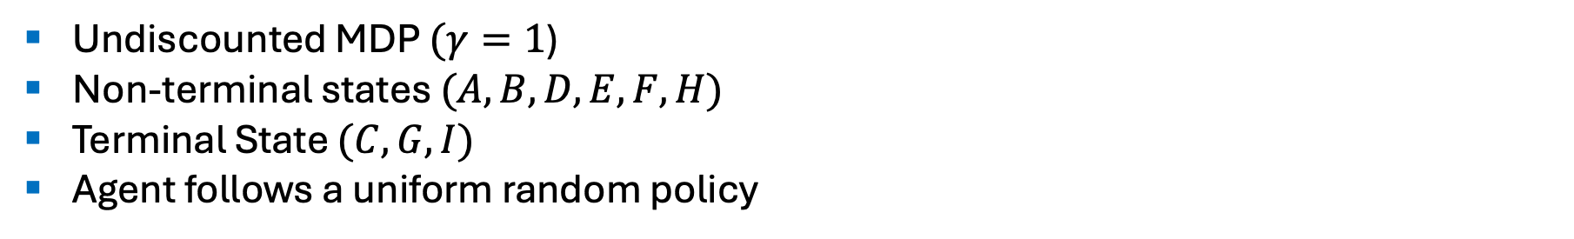
Exercise 4: 3x3 Gridworld
A | B | C
D | E | F
G | H | I
UP
LEFT
RIGHT
DOWN
Undiscounted MDP $(γ=1$)
Non-terminal states $(A,B,D,E,F,H)$
Terminal State $(C,G,I)$
Agent follows a uniform random policy

Slide 3
Exercise 4: 3x3 Gridworld
A | B | C
D | E | F
G | H | I
UP
LEFT
RIGHT
DOWN
Rules:
From each state, actions move you in that direction if possible, otherwise you stay in the same square.
Reward is -1 until the terminal state is reached.

Slide 4
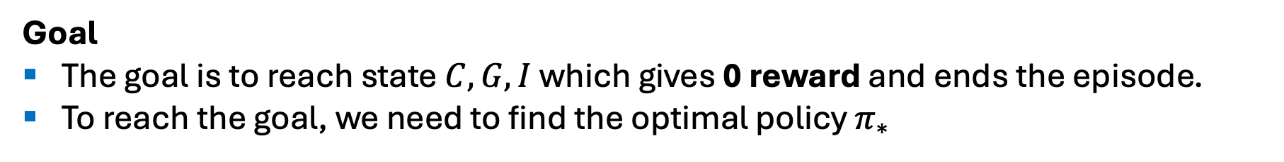
Exercise 4: 3x3 Gridworld
A | B | C
D | E | F
G | H | I
UP
LEFT
RIGHT
DOWN
Goal
The goal is to reach state $C,G,I$which gives 0 reward and ends the episode.
To reach the goal, we need to find the optimal policy $π_{∗}$

Slide 5


0 | 0 | 0
0 | 0 | 0
0 | 0 | 0
$$value functions at k=0$$
$$uniform random policy at k=0$$

Slide 6
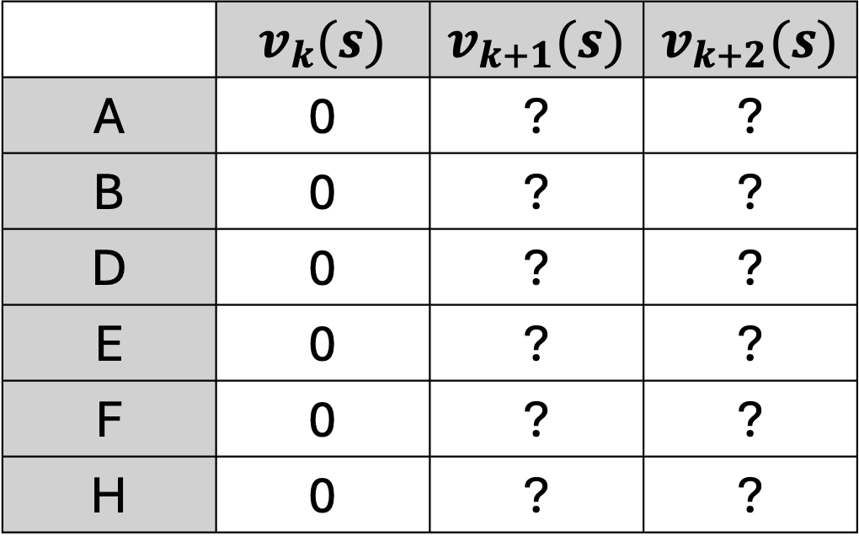
 | $$v_{k}(s)$$ | $$v_{k+1}(s)$$ | $$v_{k+2}(s)$$
A | 0 | ? | ?
B | 0 | ? | ?
D | 0 | ? | ?
E | 0 | ? | ?
F | 0 | ? | ?
H | 0 | ? | ?

Slide 7
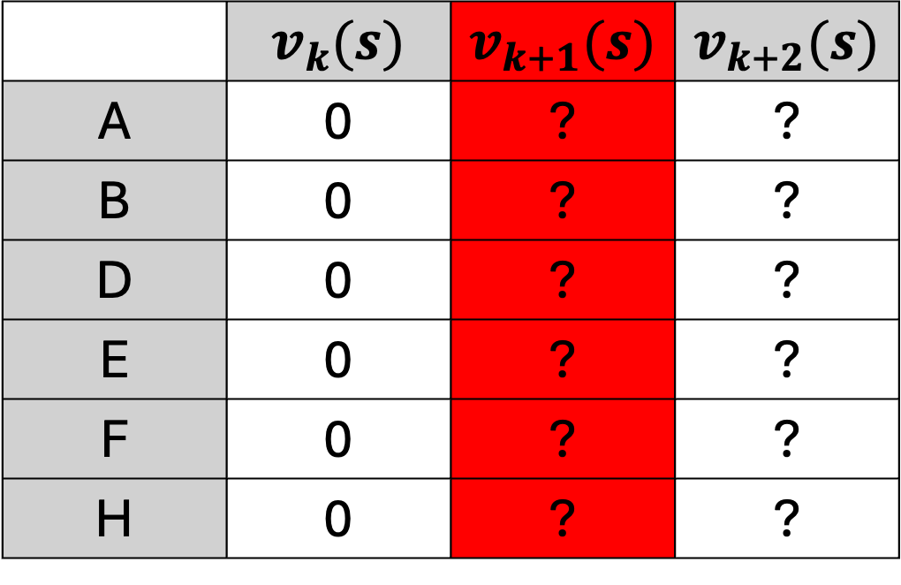
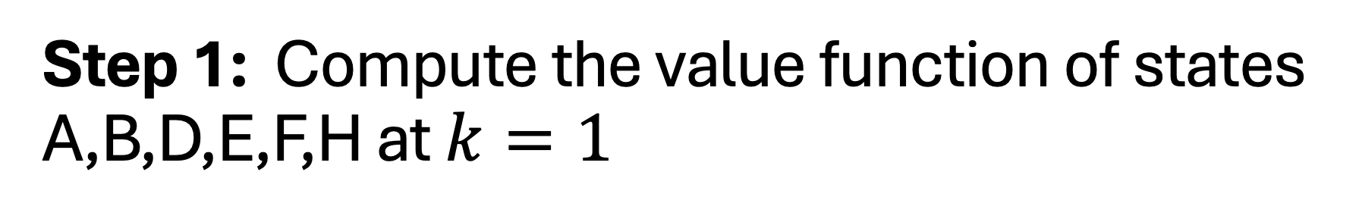
Step 1: Compute the value function of states A,B,D,E,F,H at $k=1$
 | $$v_{k}(s)$$ | $$v_{k+1}(s)$$ | $$v_{k+2}(s)$$
A | 0 | ? | ?
B | 0 | ? | ?
D | 0 | ? | ?
E | 0 | ? | ?
F | 0 | ? | ?
H | 0 | ? | ?

Slide 8

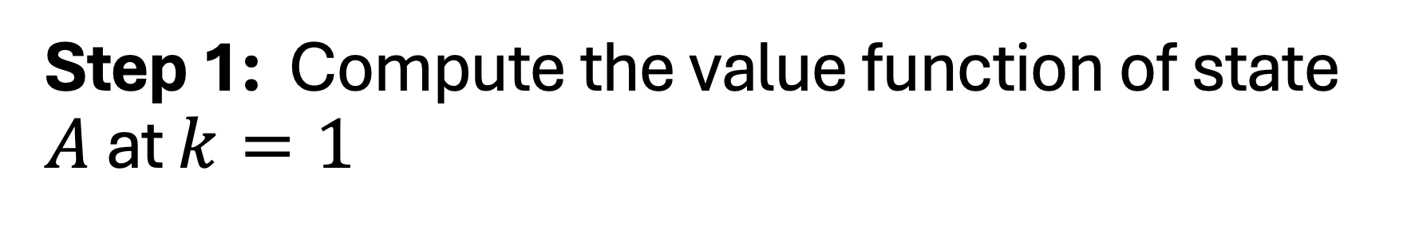

Step 1: Compute the value function of state $A$ at $k=1$
$$1. v_{k+1}\left(A\right)= ?$$
? | ? | 0
? | ? | ?
0 | ? | 0
$$k=1$$

Slide 9
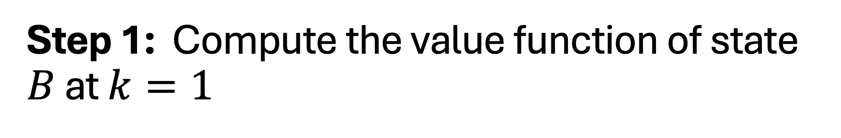

Step 1: Compute the value function of state $B$ at $k=1$
$$2. v_{k+1}\left(B\right)= ?$$
? | ? | 0
? | ? | ?
0 | ? | 0
$$k=1$$

Slide 10

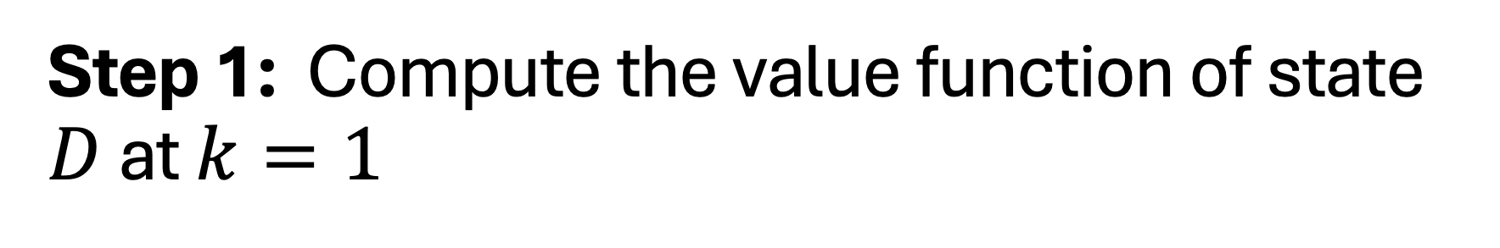

Step 1: Compute the value function of state $D$ at $k=1$
$$3. v_{k+1}\left(D\right)= ?$$
? | ?
? | ? | ?
 | ?
$$k=1$$

Slide 11
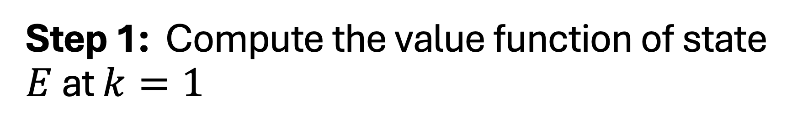

Step 1: Compute the value function of state $E$ at $k=1$
$$4. v_{k+1}\left(E\right)= ?$$
? | ?
? | ? | ?
 | ?
$$k=1$$

Slide 12
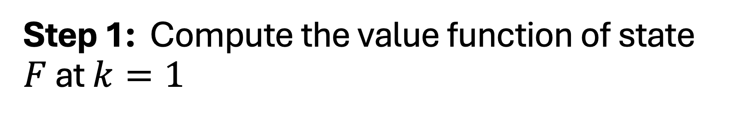

Step 1: Compute the value function of state $F$ at $k=1$
$$5. v_{k+1}\left(F\right)= ?$$
? | ?
? | ? | ?
 | ?
$$k=1$$

Slide 13
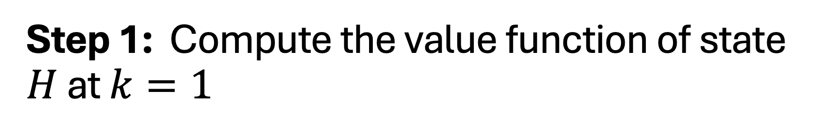

Step 1: Compute the value function of state $H$ at $k=1$
$$6. v_{k+1}\left(H\right)= ?$$
? | ?
? | ? | ?
 | ?
$$k=1$$

Slide 14
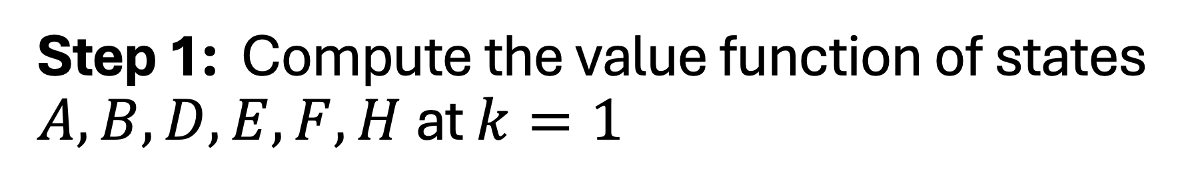

Step 1: Compute the value function of states $A,B,D,E,F,H$at $k=1$
? | ? | 0
? | ? | ?
0 | ? | 0
$$k=1$$
$$7. Put the new value functions in the 3x3 grid$$

Slide 15

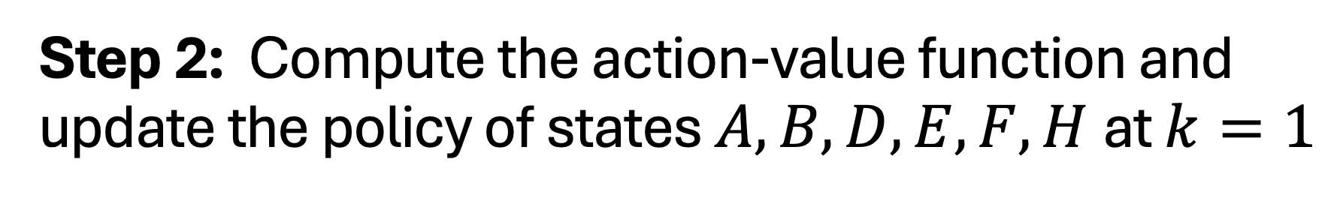
Step 2: Compute the action-value function and update the policy of states $A,B,D,E,F,H$at $k=1$
? | ?
? | ? | ?
 | ?
$$k=0$$
$$k=1$$

Slide 16
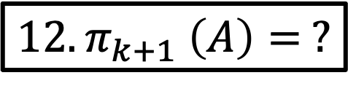
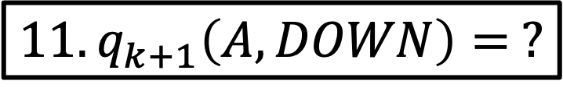
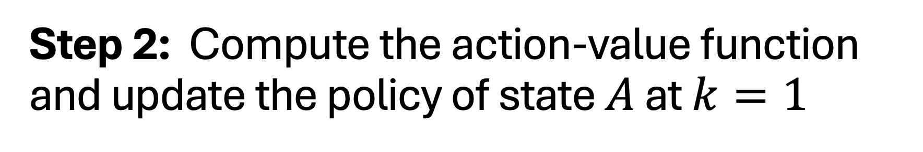
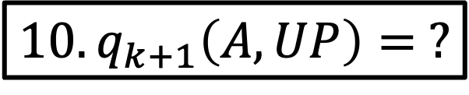
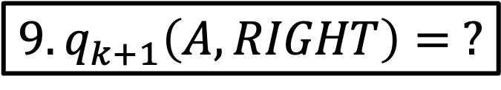
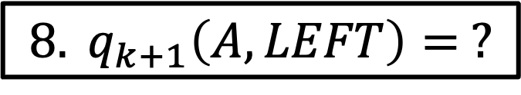
Step 2: Compute the action-value function and update the policy of state $A$ at $k=1$
$$8. q_{k+1}\left(A,LEFT\right)= ?$$
? | ?
? | ? | ?
 | ?
$$9.q_{k+1}\left(A,RIGHT\right)= ?$$
$$10.q_{k+1}\left(A,UP\right)= ?$$
$$11.q_{k+1}\left(A,DOWN\right)= ?$$
$${12. π}_{k+1} \left(A\right)= ?$$
$$k=1$$

Slide 17
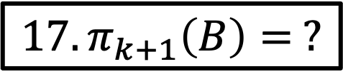
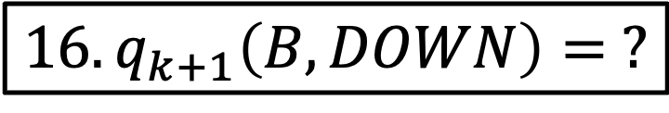
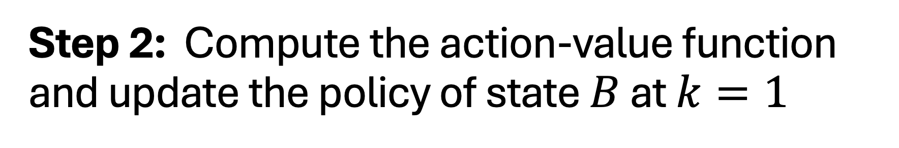
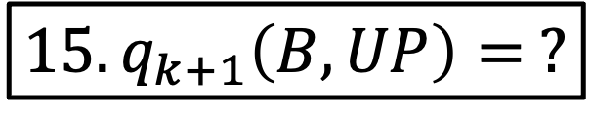
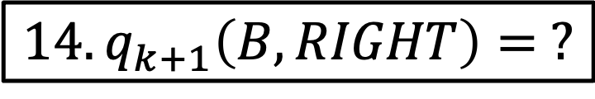
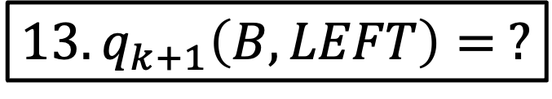
Step 2: Compute the action-value function and update the policy of state $B$ at $k=1$
$$13.q_{k+1}\left(B,LEFT\right)= ?$$
? | ?
? | ? | ?
 | ?
$$14.q_{k+1}\left(B,RIGHT\right)= ?$$
$$15. q_{k+1}\left(B,UP\right)= ?$$
$$16.q_{k+1}\left(B,DOWN\right)= ?$$
$${17. π}_{k+1}\left(B\right)= ?$$
$$k=1$$

Slide 18
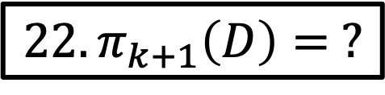
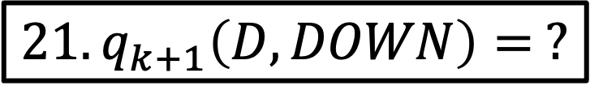
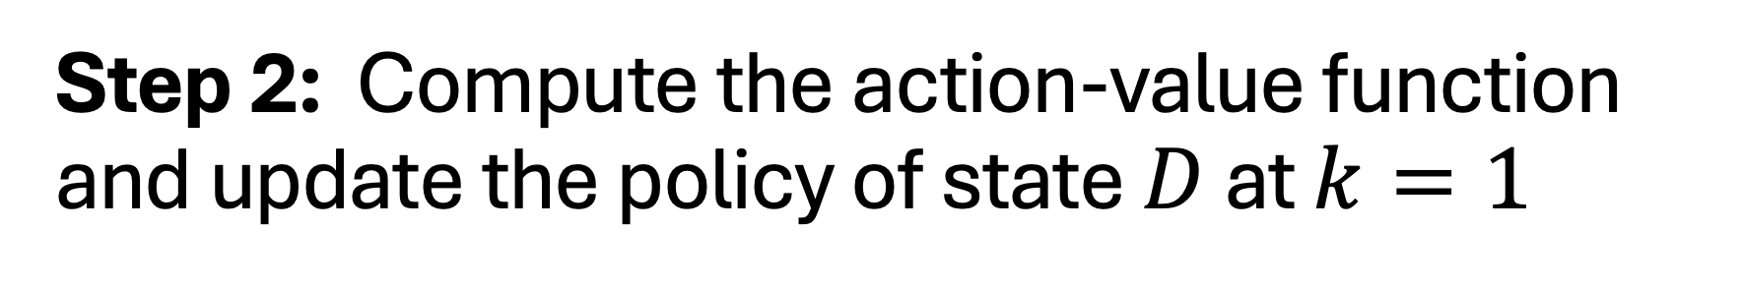
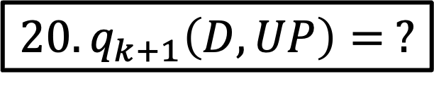
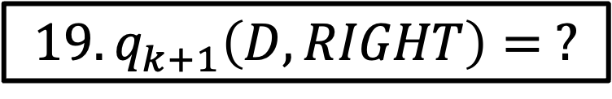
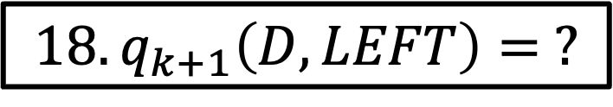
Step 2: Compute the action-value function and update the policy of state $D$ at $k=1$
$$18.q_{k+1}\left(D,LEFT\right)= ?$$
? | ?
? | ? | ?
 | ?
$$19.q_{k+1}\left(D,RIGHT\right)= ?$$
$$20.q_{k+1}\left(D,UP\right)= ?$$
$$21.q_{k+1}\left(D,DOWN\right)= ?$$
$${22. π}_{k+1}\left(D\right)= ?$$
$$k=1$$

Slide 19
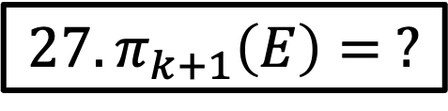
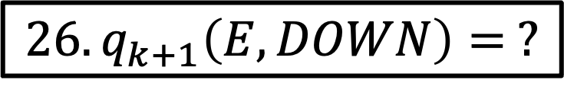
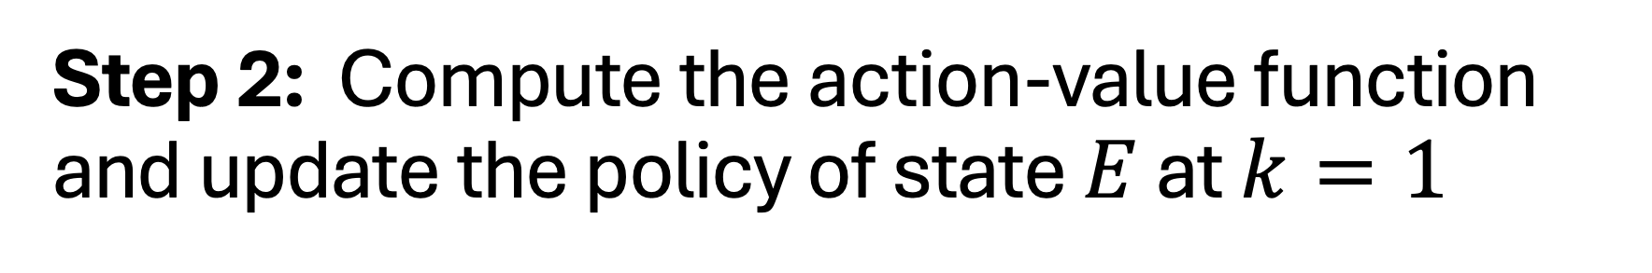
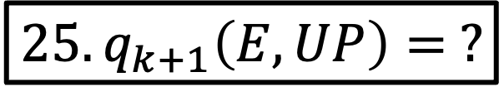
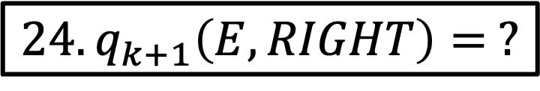
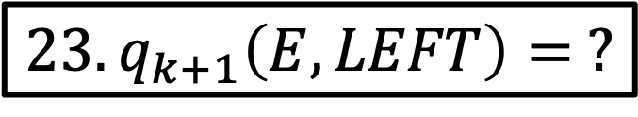
Step 2: Compute the action-value function and update the policy of state $E$ at $k=1$
$$23.q_{k+1}\left(E,LEFT\right)= ?$$
? | ?
? | ? | ?
 | ?
$$24.q_{k+1}\left(E,RIGHT\right)= ?$$
$$25.q_{k+1}\left(E,UP\right)= ?$$
$$26.q_{k+1}\left(E,DOWN\right)= ?$$
$${27. π}_{k+1}\left(E\right)= ?$$
$$k=1$$

Slide 20
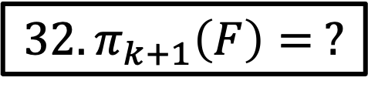
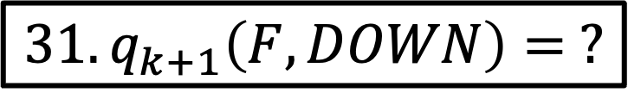
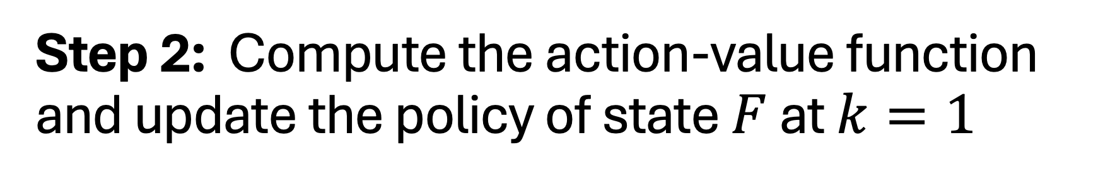
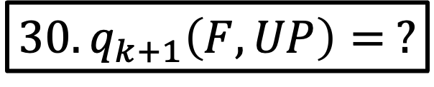
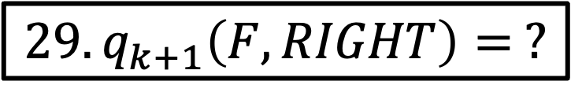
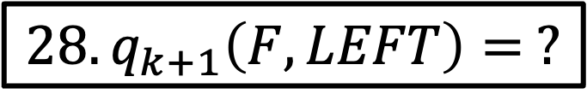
Step 2: Compute the action-value function and update the policy of state $F$ at $k=1$
$$28.q_{k+1}\left(F,LEFT\right)= ?$$
? | ?
? | ? | ?
 | ?
$$29.q_{k+1}\left(F,RIGHT\right)= ?$$
$$30.q_{k+1}\left(F,UP\right)= ?$$
$$31.q_{k+1}\left(F,DOWN\right)= ?$$
$${32. π}_{k+1}\left(F\right)= ?$$
$$k=1$$

Slide 21
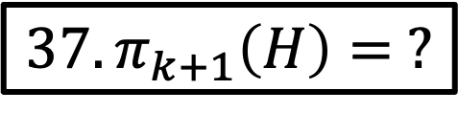
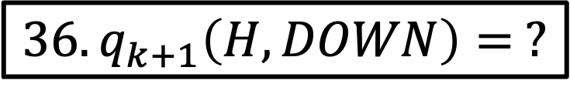
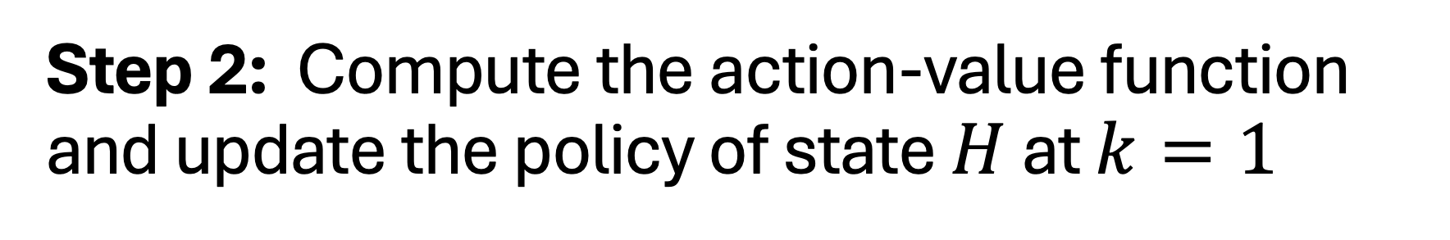
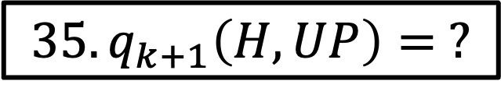
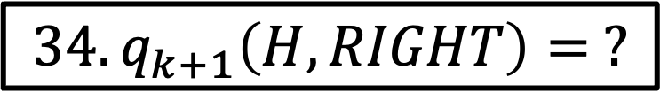

Step 2: Compute the action-value function and update the policy of state $H$ at $k=1$
$$33.q_{k+1}\left(H,LEFT\right)= ?$$
? | ?
? | ? | ?
 | ?
$$34.q_{k+1}\left(H,RIGHT\right)= ?$$
$$35.q_{k+1}\left(H,UP\right)= ?$$
$$36.q_{k+1}\left(H,DOWN\right)= ?$$
$${37. π}_{k+1}\left(H\right)= ?$$
$$k=1$$

Slide 22


Step 2: Compute the action-value function and update the policy of states $A,B,D,E,F,H$at $k=1$
? | ?
? | ? | ?
 | ?
$$k=0$$
$$k=0$$
$$38. Put the new policies in the 3x3 grid$$

Slide 23







Step 3: Use DP to find the optimal value function $v_{∗}$ of states $A,B,D,E,F,H$
$$39.v_{∗} \left(A\right)= ?$$
? | ?
? | ? | ?
 | ?
$${40. v}_{∗} \left(B\right)= ?$$
$${41.v}_{∗} \left(D\right)= ?$$
$${42.v}_{∗} \left(E\right)= ?$$
$${43.v}_{∗} \left(F\right)= ?$$
$${44.v}_{∗}\left(H\right)= ?$$

Slide 24







Step 3: Use DP to find the optimal action-value function $q_{∗}$ of states $A,B,D,E,F,H$
$$45.q_{∗}\left(A|𝒜\right)= ?$$
? | ?
? | ? | ?
 | ?
$${46. q}_{∗}\left(B|𝒜\right)= ?$$
$${47.q}_{∗}\left(D|𝒜\right)= ?$$
$${48.q}_{∗}\left(E|𝒜\right)= ?$$
$${49.q}_{∗}\left(F|𝒜\right)= ?$$
$${50.q}_{∗}\left(H|𝒜\right)= ?$$

Slide 25







Step 3: Use DP to find the optimal policy $π_{∗}$ of states $A,B,D,E,F,H$
51. $π_{∗}\left(A\right)= ?$
? | ?
? | ? | ?
 | ?
$${52 π}_{∗}\left(B\right)= ?$$
$$53. π_{∗}\left(D\right)= ?$$
$${54. π}_{∗} \left(E\right)= ?$$
$${55. π}_{∗} \left(F\right)= ?$$
$${56. π}_{∗} \left(H\right)= ?$$

Slide 26


Final Step: Map the optimal value function $v_{∗}$and the optimal policy $π_{∗}$
? | ? | 0
? | ? | ?
0 | ? | 0
? | ? | 0
? | ? | ?
0 | ? | 0
$$57. Put the optimal value functions in the 3x3 grid$$
$$58. Put the optimal policy in the 3x3 grid$$

