Slide 1
Exercise 5
Instructions
Play Blackjack in small groups. One student acts as the dealer, the others are players.
Use a fixed policy:
Hit if your total < 20, otherwise Stand.
For each episode (a full hand until win/loss/draw):
Record the sequence of states, actions, and rewards.
Compute MC updates (after the episode).
Compute TD(0) updates (during the episode).
Compare how the two methods update the value table.

Slide 2
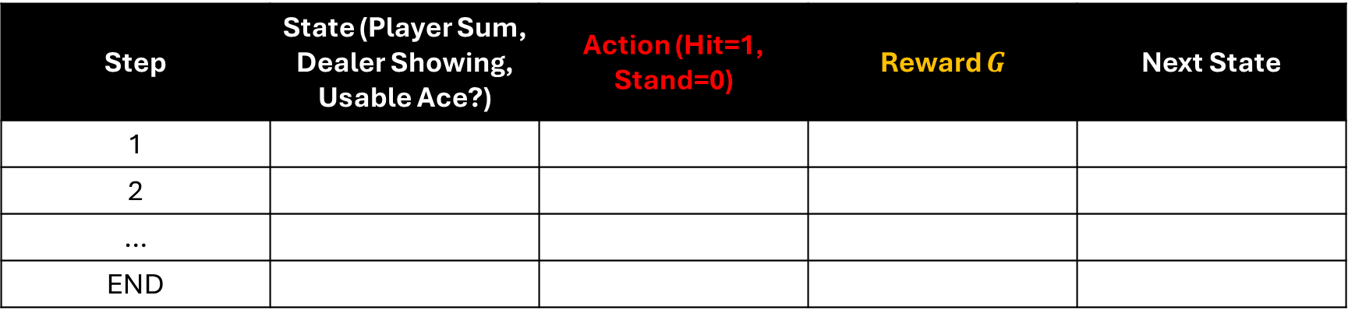
Part A: Record an Episode
Step | State (Player Sum, Dealer Showing, Usable Ace?) | Action (Hit=1, Stand=0) | Reward $G$ | Next State
1
2
…
END

Slide 3
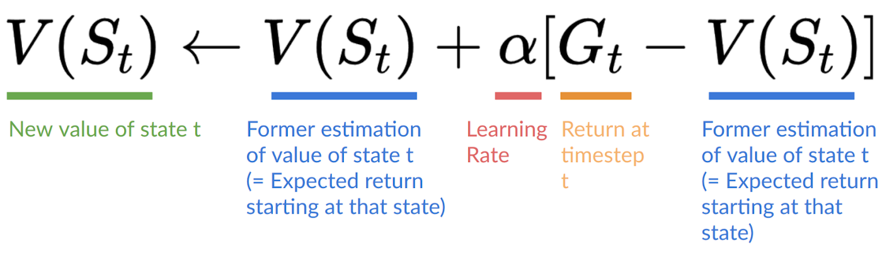

Part B: Monte Carlo Update (First-Visit)
At the end of the episode, compute the return
For each state visited first time in the episode:
$$G_{t}=R_{t+1}​+R_{t+2}​​+. .R_{T}$$

Slide 4
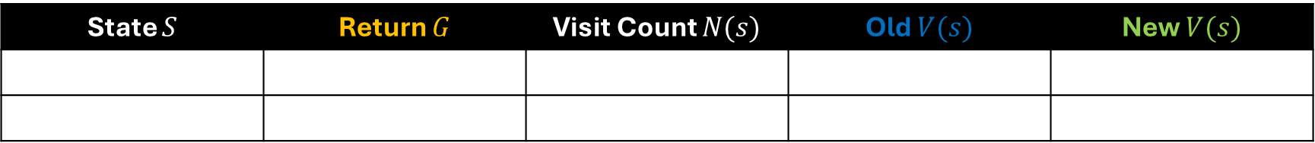

Part B: Monte Carlo Update (First-Visit)
Record the sequence of states, actions, and rewards.
Use $α = \frac{1}{n}$ for manual calculations.
State $S$ | Return $G$ | Visit Count $N(s)$ | Old $V(s)$ | New $V(s)$

Slide 5
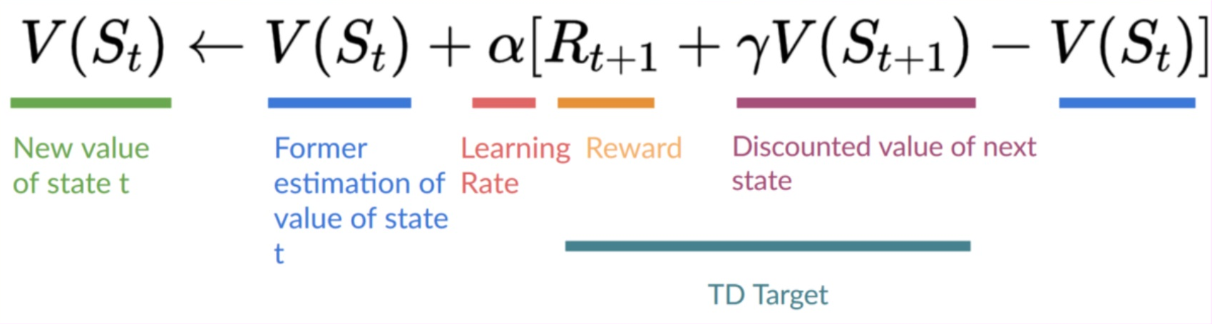

Part C: TD(0) update
Update during the episode for each transition:
Take $γ = 1.0$, choose $α = 0.5$ for manual calculations.

Slide 6
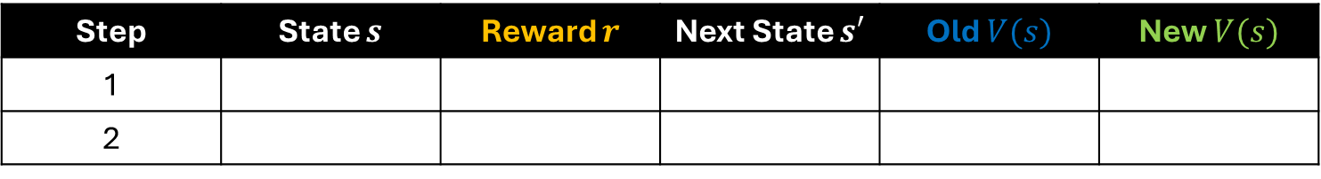
Part C: TD(0) update
Step | State $s$ | Reward $r$ | Next State $s′$ | Old $V(s)$ | New $V(s)$
1
2

