Slide 1
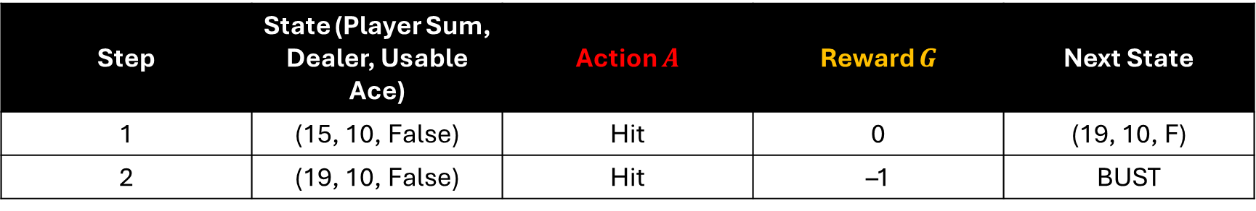
Example Episode: Player Loses
Step | State (Player Sum, Dealer, Usable Ace) | Action $A$ | Reward $G$ | Next State
1 | (15, 10, False) | Hit | 0 | (19, 10, F)
2 | (19, 10, False) | Hit | –1 | BUST

Slide 2
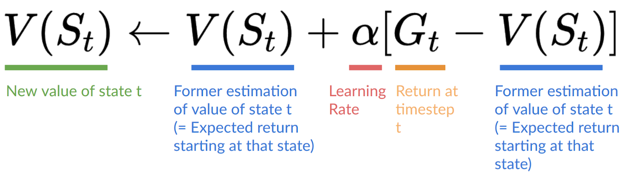
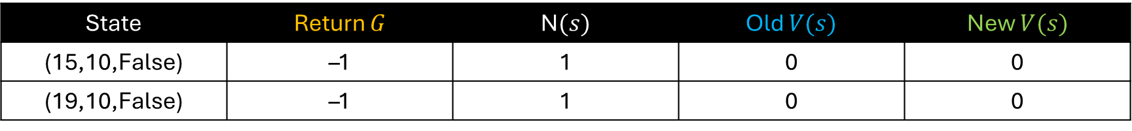
Sample Monte Carlo (First-Visit) Update
State | Return $G$ | N$(s)$ | Old $V(s)$ | New $V(s)$
(15,10,False) | –1 | 1 | 0 | 0
(19,10,False) | –1 | 1 | 0 | 0

Slide 3
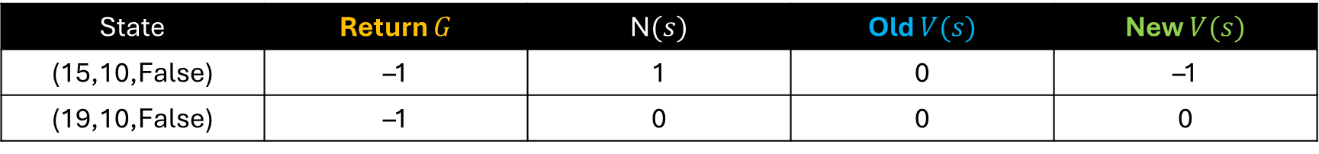

Sample Monte Carlo (First-Visit) Update
Step 1
State =(15,10,F)
Number of Visits: $N\left(\text{15,10,}\text{False}\right)=0$
V(15,10,False) = 0
Increment visit count: $N\left(\text{15,10,}\text{False}\right)=1$
Update value function$: V\left(\text{15,10,}\text{False}\right)=0+\frac{1}{1}(−1−0)=−1$
State | Return $G$ | N$(s)$ | Old $V(s)$ | New $V(s)$
(15,10,False) | –1 | 1 | 0 | –1
(19,10,False) | –1 | 0 | 0 | 0

Slide 4


Sample Monte Carlo (First-Visit) Update
Step 1
State =(19,10,F)
Number of Visits: $N\left(\text{1}\text{9}\text{,10,}\text{False}\right)=0$
V(19,10,False) = 0
Increment visit count: $N\left(\text{1}\text{9}\text{,10,}\text{False}\right)=1$
Update value function$: V\left(\text{1}\text{9}\text{,10,}\text{False}\right)=0+\frac{1}{1}(−1−0)=−1$
State | Return $G$ | N$(s)$ | Old $V(s)$ | New $V(s)$
(15,10,False) | –1 | 1 | 0 | –1
(19,10,False) | –1 | 1 | 0 | –1

Slide 5
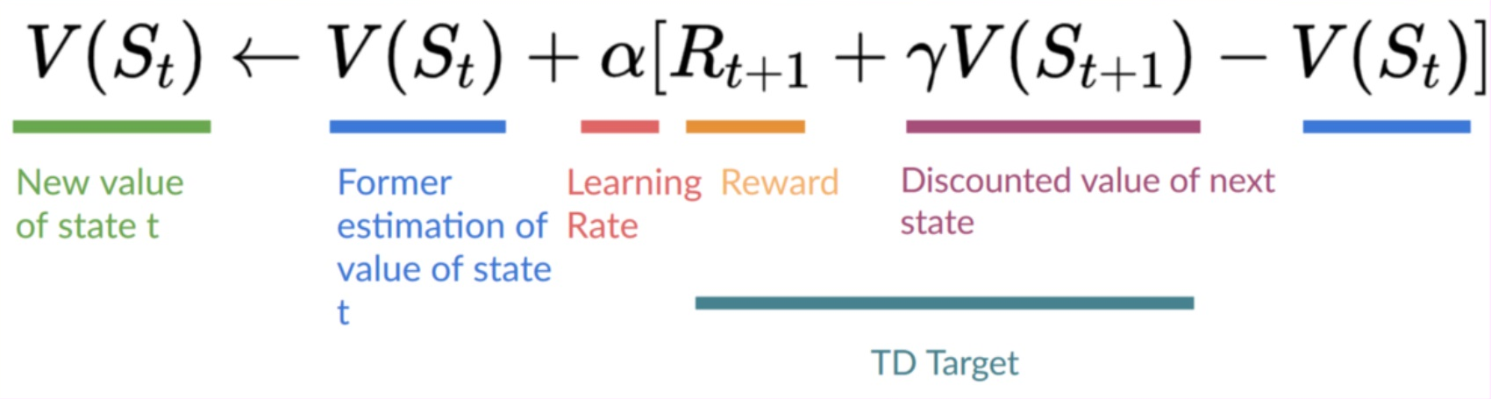
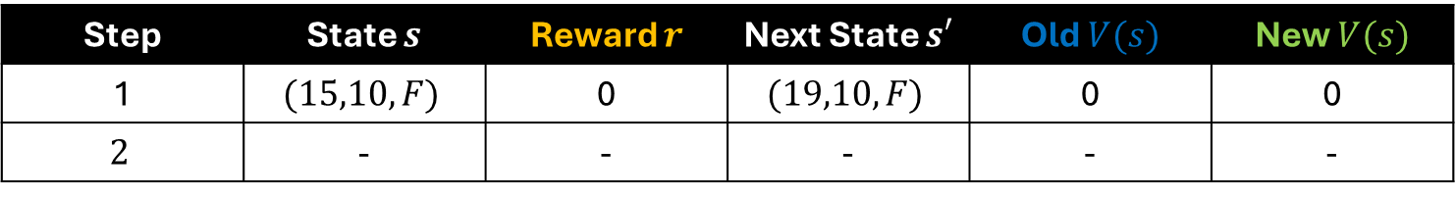

Sample Temporal Difference(0) Update
Step 1
Start with $V(s)=0$.
Update each step immediately using
State = (15,10,F)
Reward r = 0,
Next state = (19,10,F)
Update: $V\left(15,10,F\right)=0+0.5(0+V(19,10,F)−0)=0$
Step | State $s$ | Reward $r$ | Next State $s′$ | Old $V(s)$ | New $V(s)$
1 | $$(15,10,F)$$ | 0 | $$(19,10,F)$$ | 0 | 0
$$2$$ | - | - | - | - | -

Slide 6
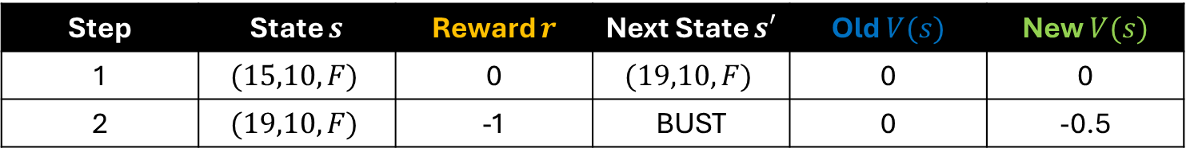

Sample Temporal Difference(0) Update
Step 2
Update each step immediately using
State = $(19,10,F)$
Reward r = $−1$,
Next state = BUST
Update value function: $V\left(15,10,F\right)=0+0.5(−1+0−0)=0$
Step | State $s$ | Reward $r$ | Next State $s′$ | Old $V(s)$ | New $V(s)$
1 | $$(15,10,F)$$ | 0 | $$(19,10,F)$$ | 0 | 0
2 | $$(19,10,F)$$ | -1 | BUST | 0 | -0.5

Slide 7
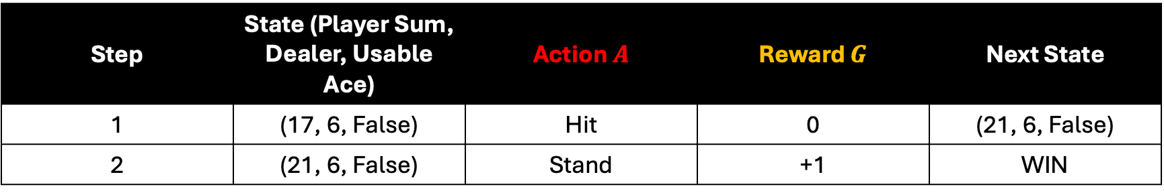
Example Episode: Player Wins
Step | State (Player Sum, Dealer, Usable Ace) | Action $A$ | Reward $G$ | Next State
1 | (17, 6, False) | Hit | 0 | (21, 6, False)
2 | (21, 6, False) | Stand | +1 | WIN

Slide 8
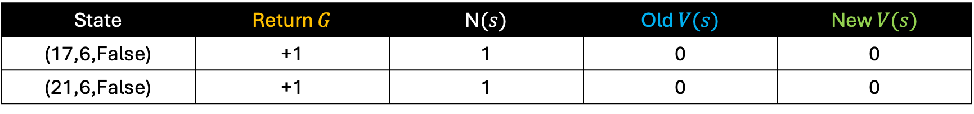
Sample Monte Carlo (First-Visit) Update
State | Return $G$ | N$(s)$ | Old $V(s)$ | New $V(s)$
(17,6,False) | +1 | 1 | 0 | 0
(21,6,False) | +1 | 1 | 0 | 0

Slide 9
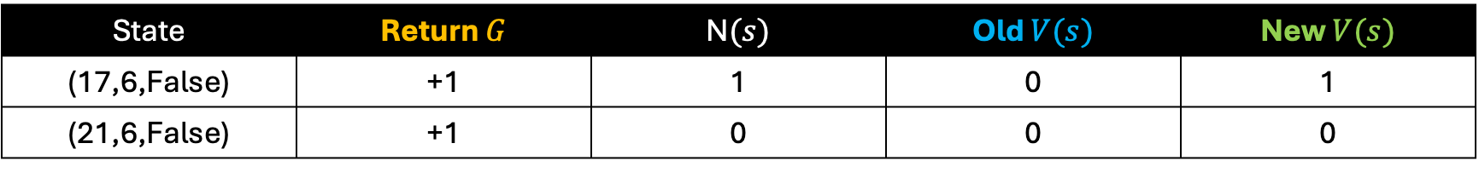

Sample Monte Carlo (First-Visit) Update
Step 1
State =(17,6,False)
Number of Visits: $N\left(\text{1}\text{7}\text{,}\text{6}\text{,}\text{False}\right)=0$
V(17,6,False) = 0
Increment visit count: $N\left(\text{1}\text{7}\text{,}\text{6}\text{,}\text{False}\right)=1$
Update value function$: V\left(\text{1}\text{7}\text{,}\text{6}\text{,}\text{False}\right)=0+\frac{1}{1}(1−0)=1$
State | Return $G$ | N$(s)$ | Old $V(s)$ | New $V(s)$
(17,6,False) | +1 | 1 | 0 | 1
(21,6,False) | +1 | 0 | 0 | 0

Slide 10


Sample Monte Carlo (First-Visit) Update
Step 2
State =(21,6,False)
Number of Visits: $N\left(\text{21}\text{,}\text{6}\text{,}\text{False}\right)=0$
V(21,6,False) = 0
Increment visit count: $N\left(\text{21}\text{,}\text{6}\text{,}\text{False}\right)=1$
Update value function$: V\left(\text{21}\text{,}\text{6}\text{,}\text{False}\right)=0+\frac{1}{1}(1−0)=1$
State | Return $G$ | N$(s)$ | Old $V(s)$ | New $V(s)$
(17,6,False) | +1 | 1 | 0 | 1
(21,6,False) | +1 | 1 | 0 | 1

Slide 11
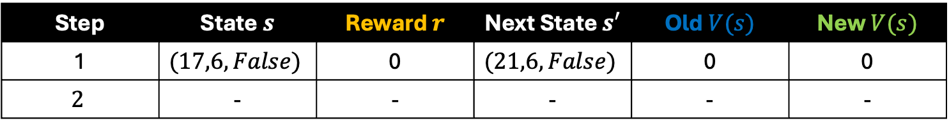

Sample Temporal Difference(0) Update
Step 1
Start with $V(s)=0$.
Update each step immediately using
State = (17,6,False)
Reward r = 0,
Next state = (21,6,False)
Update: $V\left(17,6,False\right)=0+0.5(0+V(21,6,False)−0)=0$
Step | State $s$ | Reward $r$ | Next State $s′$ | Old $V(s)$ | New $V(s)$
1 | $$(17,6,False)$$ | 0 | $$(21,6,False)$$ | 0 | 0
$$2$$ | - | - | - | - | -

Slide 12
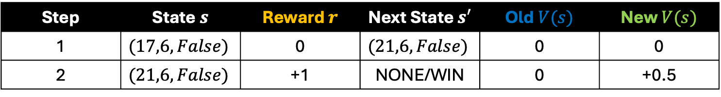

Sample Temporal Difference(0) Update
Step 2
Update next state immediately using
State = $(21,6,False)$
Reward r = $+1$,
Next state = NONE/WIN
Update value function: $V\left(21,6,F\right)=0+0.5(1+0−0)=0$
Step | State $s$ | Reward $r$ | Next State $s′$ | Old $V(s)$ | New $V(s)$
1 | $$(17,6,False)$$ | 0 | $$(21,6,False)$$ | 0 | 0
2 | $$(21,6,False)$$ | +1 | NONE/WIN | 0 | +0.5

Slide 13

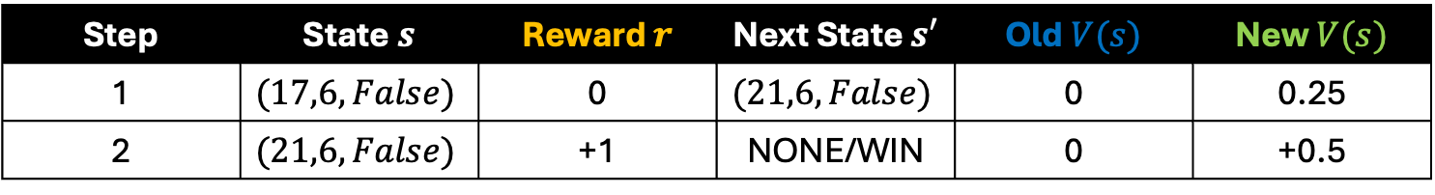
Sample Temporal Difference(0) Update
Step 3
Update all previously visited states
using
State = $(17,6,False)$
Reward r = $+1$,
Next state = $(21,6,False)$
Update value function: $V\left(17,6,F\right)=0+0.5(1+0.5−0)=0.25$
Step | State $s$ | Reward $r$ | Next State $s′$ | Old $V(s)$ | New $V(s)$
1 | $$(17,6,False)$$ | 0 | $$(21,6,False)$$ | 0 | 0.25
2 | $$(21,6,False)$$ | +1 | NONE/WIN | 0 | +0.5

