Slide 1
Exercise 5
Instructions
Play Blackjack in small groups. One student acts as the dealer, the others are players.
Use a fixed policy:
Hit if your total < 20, otherwise Stand.
For each episode (a full hand until win/loss/draw):
Record the sequence of states, actions, and rewards.
Compute MC updates (after the episode).
Compute TD(0) updates (during the episode).
Compare how the two methods update the value table.

Slide 2
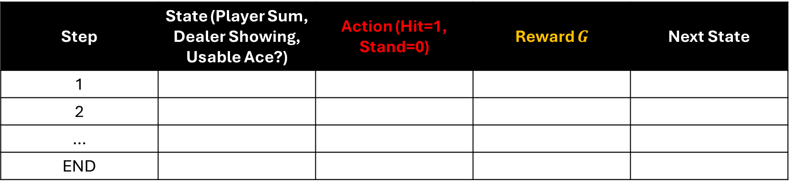
Part A: Record an Episode
Step | State (Player Sum, Dealer Showing, Usable Ace?) | Action (Hit=1, Stand=0) | Reward $G$ | Next State
1
2
…
END

Slide 3
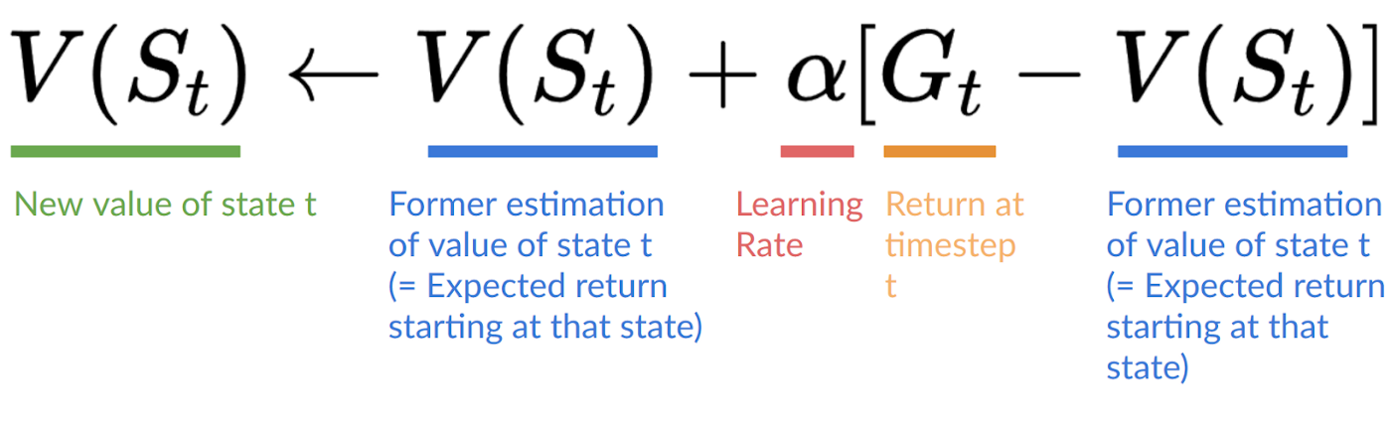

Part B: Monte Carlo Update (First-Visit)
At the end of the episode, compute the return
For each state visited first time in the episode:
$$G_{t}=R_{t+1}​+R_{t+2}​​+. .R_{T}$$

Slide 4
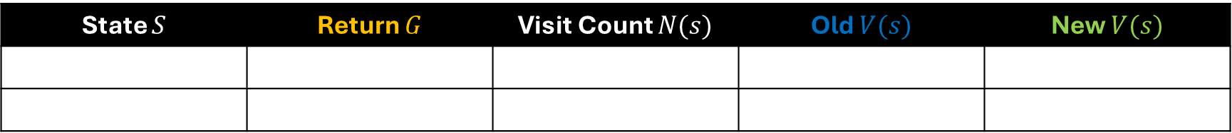

Part B: Monte Carlo Update (First-Visit)
Record the sequence of states, actions, and rewards.
Use $α = \frac{1}{n}$ for manual calculations.
State $S$ | Return $G$ | Visit Count $N(s)$ | Old $V(s)$ | New $V(s)$

Slide 5
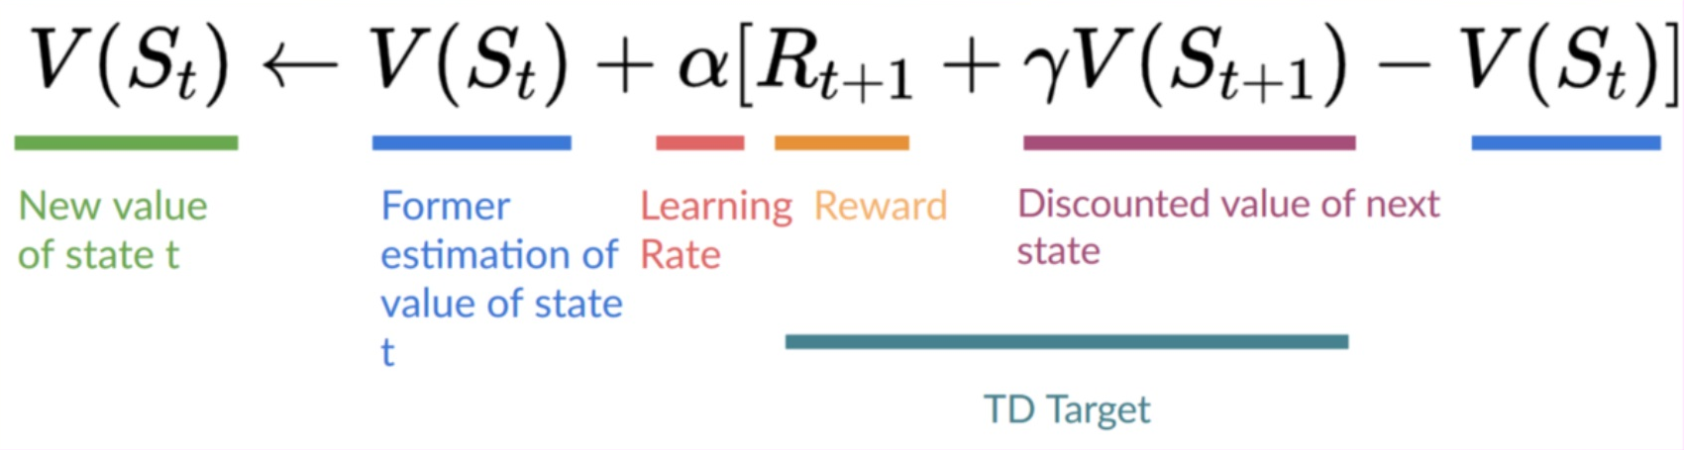

Part C: TD(0) update
Update during the episode for each transition:
Take $γ = 1.0$, choose $α = 0.5$ for manual calculations.

Slide 6
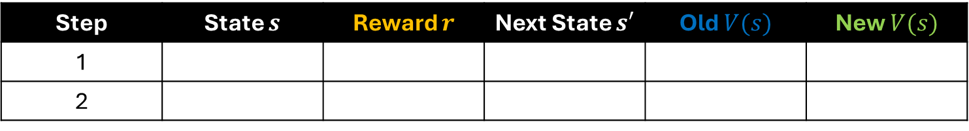
Part C: TD(0) update
Step | State $s$ | Reward $r$ | Next State $s′$ | Old $V(s)$ | New $V(s)$
1
2

Slide 7
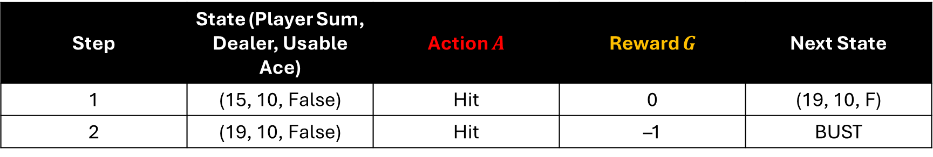
Example Episode: Player Loses
Step | State (Player Sum, Dealer, Usable Ace) | Action $A$ | Reward $G$ | Next State
1 | (15, 10, False) | Hit | 0 | (19, 10, F)
2 | (19, 10, False) | Hit | –1 | BUST

Slide 8
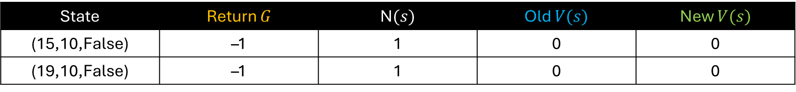
Sample Monte Carlo (First-Visit) Update
State | Return $G$ | N$(s)$ | Old $V(s)$ | New $V(s)$
(15,10,False) | –1 | 1 | 0 | 0
(19,10,False) | –1 | 1 | 0 | 0

Slide 9
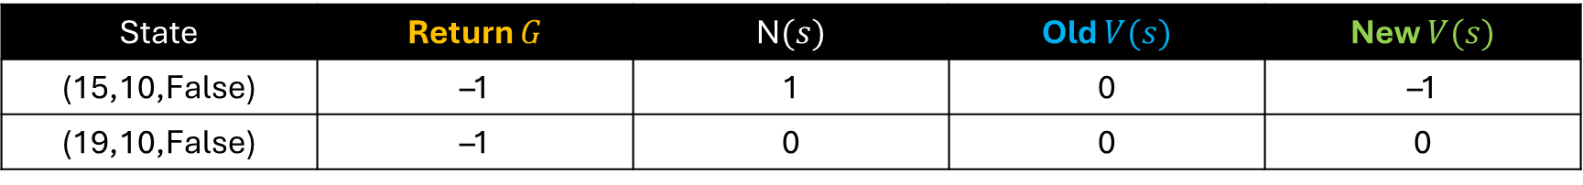

Sample Monte Carlo (First-Visit) Update
Step 1
State =(15,10,F)
Number of Visits: $N\left(\text{15,10,}\text{False}\right)=0$
V(15,10,False) = 0
Increment visit count: $N\left(\text{15,10,}\text{False}\right)=1$
Update value function$: V\left(\text{15,10,}\text{False}\right)=0+\frac{1}{1}(−1−0)=−1$
State | Return $G$ | N$(s)$ | Old $V(s)$ | New $V(s)$
(15,10,False) | –1 | 1 | 0 | –1
(19,10,False) | –1 | 0 | 0 | 0

Slide 10


Sample Monte Carlo (First-Visit) Update
Step 1
State =(19,10,F)
Number of Visits: $N\left(\text{1}\text{9}\text{,10,}\text{False}\right)=0$
V(19,10,False) = 0
Increment visit count: $N\left(\text{1}\text{9}\text{,10,}\text{False}\right)=1$
Update value function$: V\left(\text{1}\text{9}\text{,10,}\text{False}\right)=0+\frac{1}{1}(−1−0)=−1$
State | Return $G$ | N$(s)$ | Old $V(s)$ | New $V(s)$
(15,10,False) | –1 | 1 | 0 | –1
(19,10,False) | –1 | 1 | 0 | –1

Slide 11
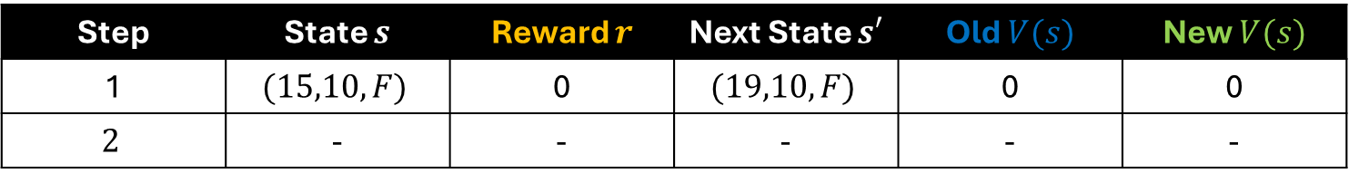

Sample Temporal Difference(0) Update
Step 1
Start with $V(s)=0$.
Update each step immediately using
State = (15,10,F)
Reward r = 0,
Next state = (19,10,F)
Update: $V\left(15,10,F\right)=0+0.5(0+V(19,10,F)−0)=0$
Step | State $s$ | Reward $r$ | Next State $s′$ | Old $V(s)$ | New $V(s)$
1 | $$(15,10,F)$$ | 0 | $$(19,10,F)$$ | 0 | 0
$$2$$ | - | - | - | - | -

Slide 12
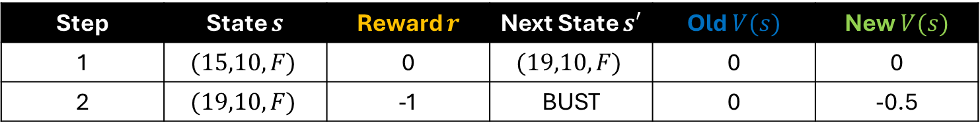

Sample Temporal Difference(0) Update
Step 2
Update each step immediately using
State = $(19,10,F)$
Reward r = $−1$,
Next state = BUST
Update value function: $V\left(15,10,F\right)=0+0.5(−1+0−0)=0$
Step | State $s$ | Reward $r$ | Next State $s′$ | Old $V(s)$ | New $V(s)$
1 | $$(15,10,F)$$ | 0 | $$(19,10,F)$$ | 0 | 0
2 | $$(19,10,F)$$ | -1 | BUST | 0 | -0.5

Slide 13
Example Episode: Player Wins
Step | State (Player Sum, Dealer, Usable Ace) | Action $A$ | Reward $G$ | Next State
1 | (15, 10, False) | Hit | 0 | (19, 10, F)
2 | (19, 10, False) | Hit | –1 | BUST

