Slide 1
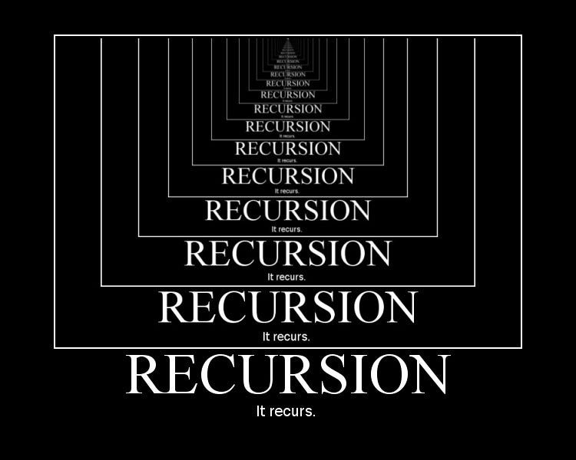
Recursion
Recursion is a programming technique where a function calls itself to solve a problem

Slide 2
Recursion
Output:
You took a step
You took a step
You took a step
You took a step
You took a step
You took a step
You took a step
You took a step
You took a step
You took a step
You took a step
You took a step
…
void walk(int steps)
{
for (int i = 0; i < steps; ++i)
{
cout << "You took a step" << endl;
}
}

Slide 3
Recursion
int main()
{
walk_iterative(100);
return 0;
}
Output:
You took a step
You took a step
You took a step
You took a step
You took a step
You took a step
You took a step
You took a step
You took a step
You took a step
You took a step
You took a step
…
void walk_iterative(int steps)
{
for (int i = 0; i < steps; i++)
{
cout << "You took a step" << endl;
}
}
This can be done by using an iterative approach

Slide 4
Recursion
Output:
You took a step
You took a step
You took a step
You took a step
You took a step
You took a step
You took a step
You took a step
You took a step
You took a step
You took a step
You took a step
…
void walk_recursive(int steps)
{
if (steps > 0)
{
cout << "You took a step" << endl;
walk_recursive(steps - 1);
}
}
We could do the same task with recursion

Slide 5
Recursion
int main()
{
walk_recursive(100);
return 0;
}
Output:
You took a step
You took a step
You took a step
You took a step
You took a step
You took a step
You took a step
You took a step
You took a step
You took a step
You took a step
You took a step
…
void walk_recursive(int steps)
{
if (steps > 0)
{
cout << "You took a step" << endl;
walk_recursive(steps - 1);
}
}
We could do the same task with recursion

Slide 6
Base Case and Recursive Case
void walk_recursive(int steps)
{
if (steps > 0)
{
cout << "You took a step" << endl;
walk_recursive(steps - 1);
}
}
Base Case
Recursive Case
A recursive function must have, a base case and a recursive case

Slide 7
Base Case and Recursive Case
void walk_recursive(int steps)
{
if (steps > 0)
{
cout << "You took a step" << endl;
walk_recursive(steps - 1);
}
}
Base Case
The base case is where we stop the recursion to prevent it from calling itself forever (Stack Overflow)

Slide 8
Base Case and Recursive Case
void walk_recursive(int steps)
{
if (steps > 0)
{
cout << "You took a step" << endl;
walk_recursive(steps - 1);
}
}
Base Case
Recursive Case
The recursive case is where we call the function.

Slide 9
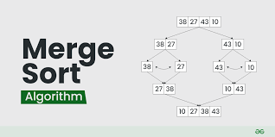
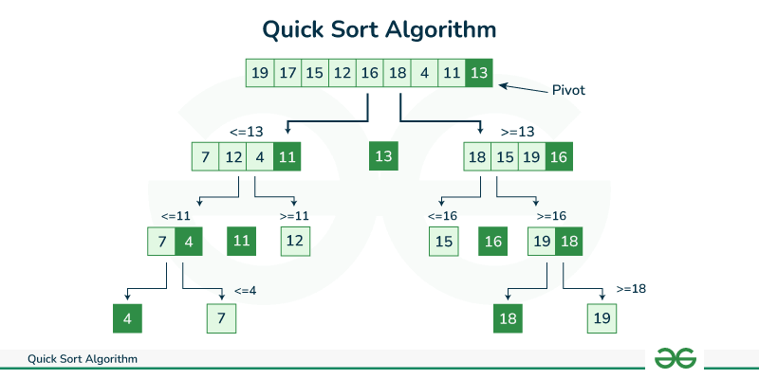
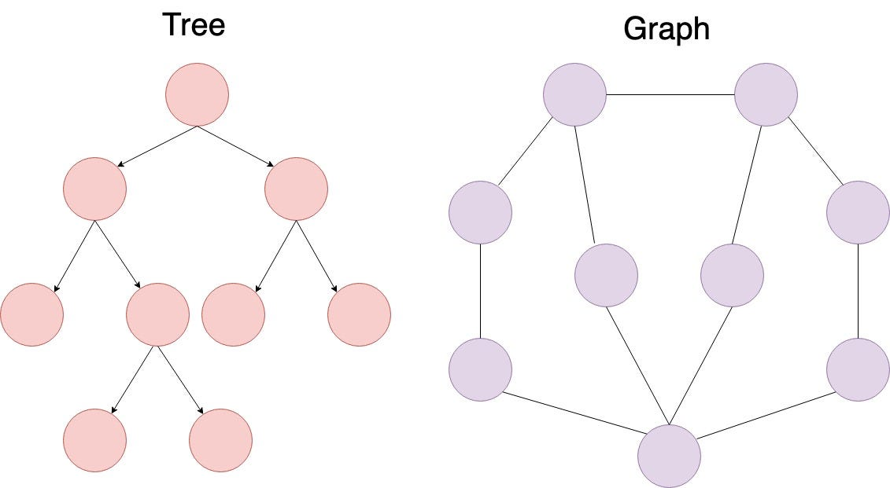
Why use Recursion?
Recursion is useful when a problem has a self-similar structure, meaning the solution can be defined in terms of smaller instances of itself.

Slide 10





Recursion Example: Factorial
$$1!=1$$
$$2!=2×1$$
$$3!=3×2×1$$
$$4!=4×3×2×1$$
$$5!=5 ×4×3×2×1$$

Slide 11
Recursion Example: Factorial
int main()
{
// Iterative approach
factorial_iterative(5)
return 0;
}
Output:
120
int factorial_iterative(int num)
{
int result = 1;
for (int i = 1; i <= num; I++)
{
result = result * i;
}
return result;
}

Slide 12
Recursion Example: Factorial
int main()
{
// Iterative approach
factorial_iterative(5)
return 0;
}
Output:
120
int factorial_recursive(int num)
{
if (num > 1)
{
return num * factorial_recursive(num - 1);
}
}

Slide 13










Recursion Example: Factorial
$$factorial_recursive(5)$$
$$5 ∗24=120$$
$$5!=5 ∗factorial_recursive(4)$$
$$4∗6=24$$
$$4!=4∗factorial_recursive(3)$$
$$3∗2=6$$
$$3!=3 ∗factorial_recursive(2)$$
$$2∗1=2$$
$$2!=2∗factorial_recursive(1)$$

