Slide 1
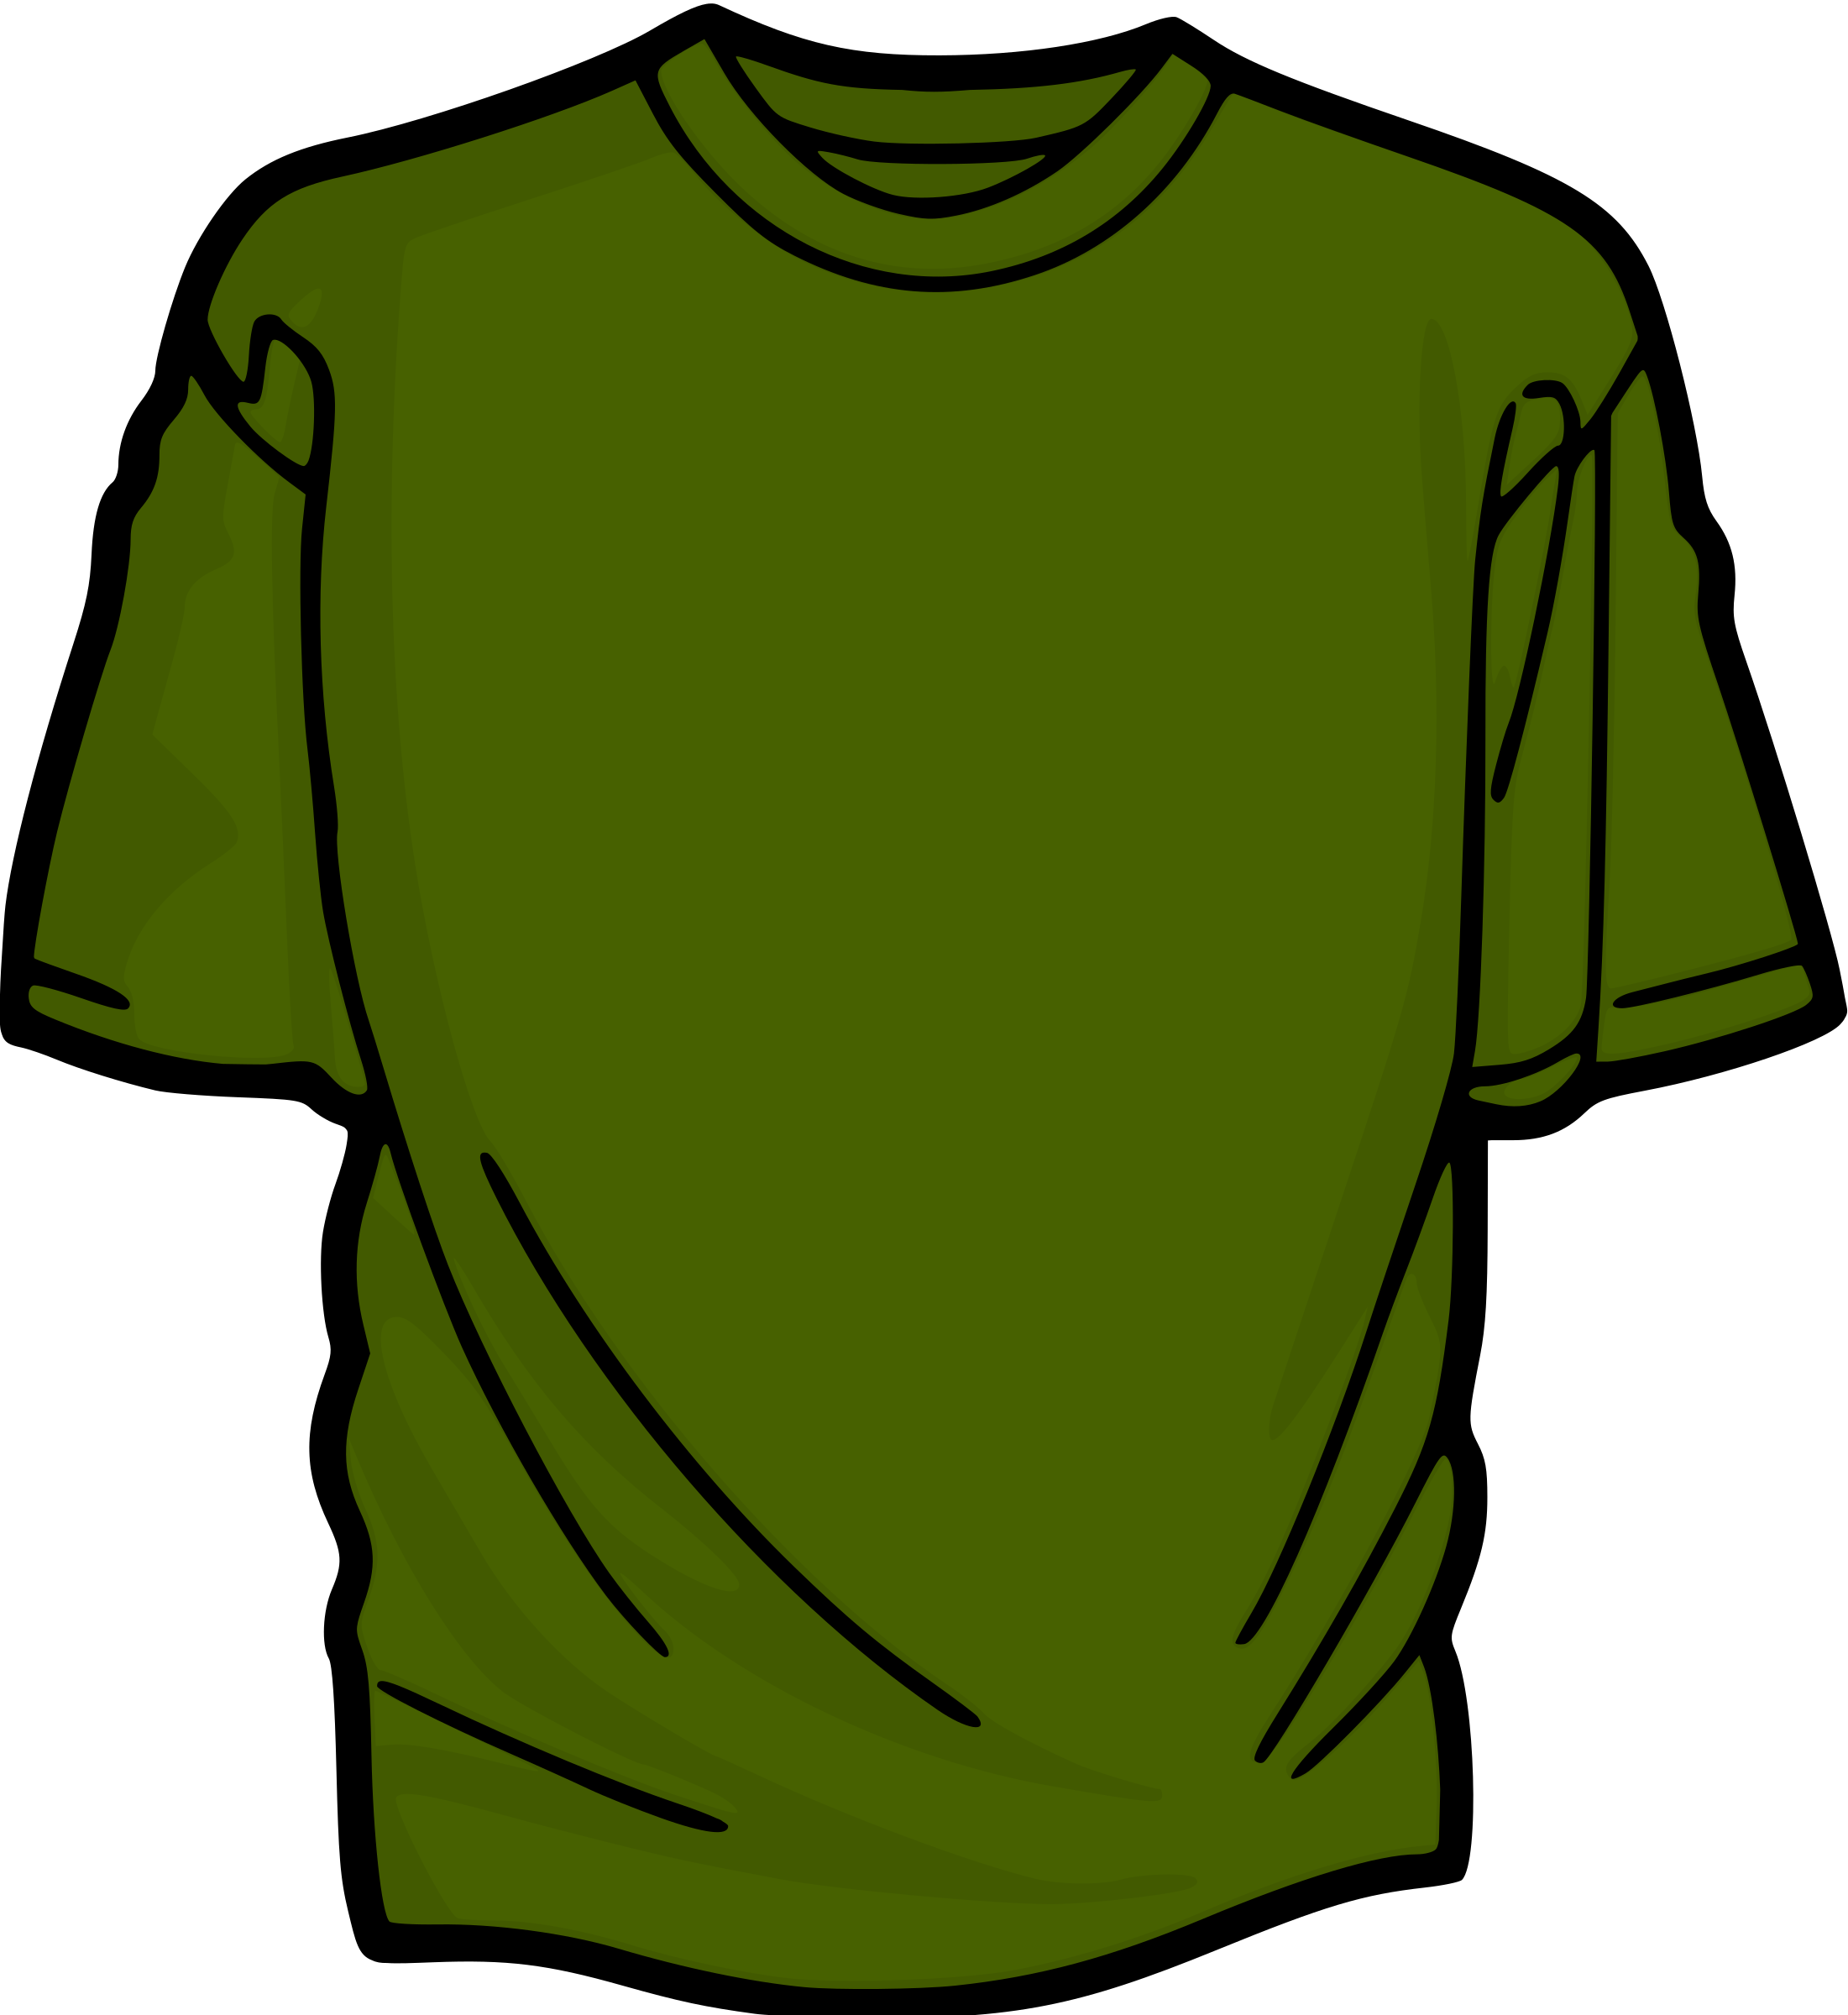
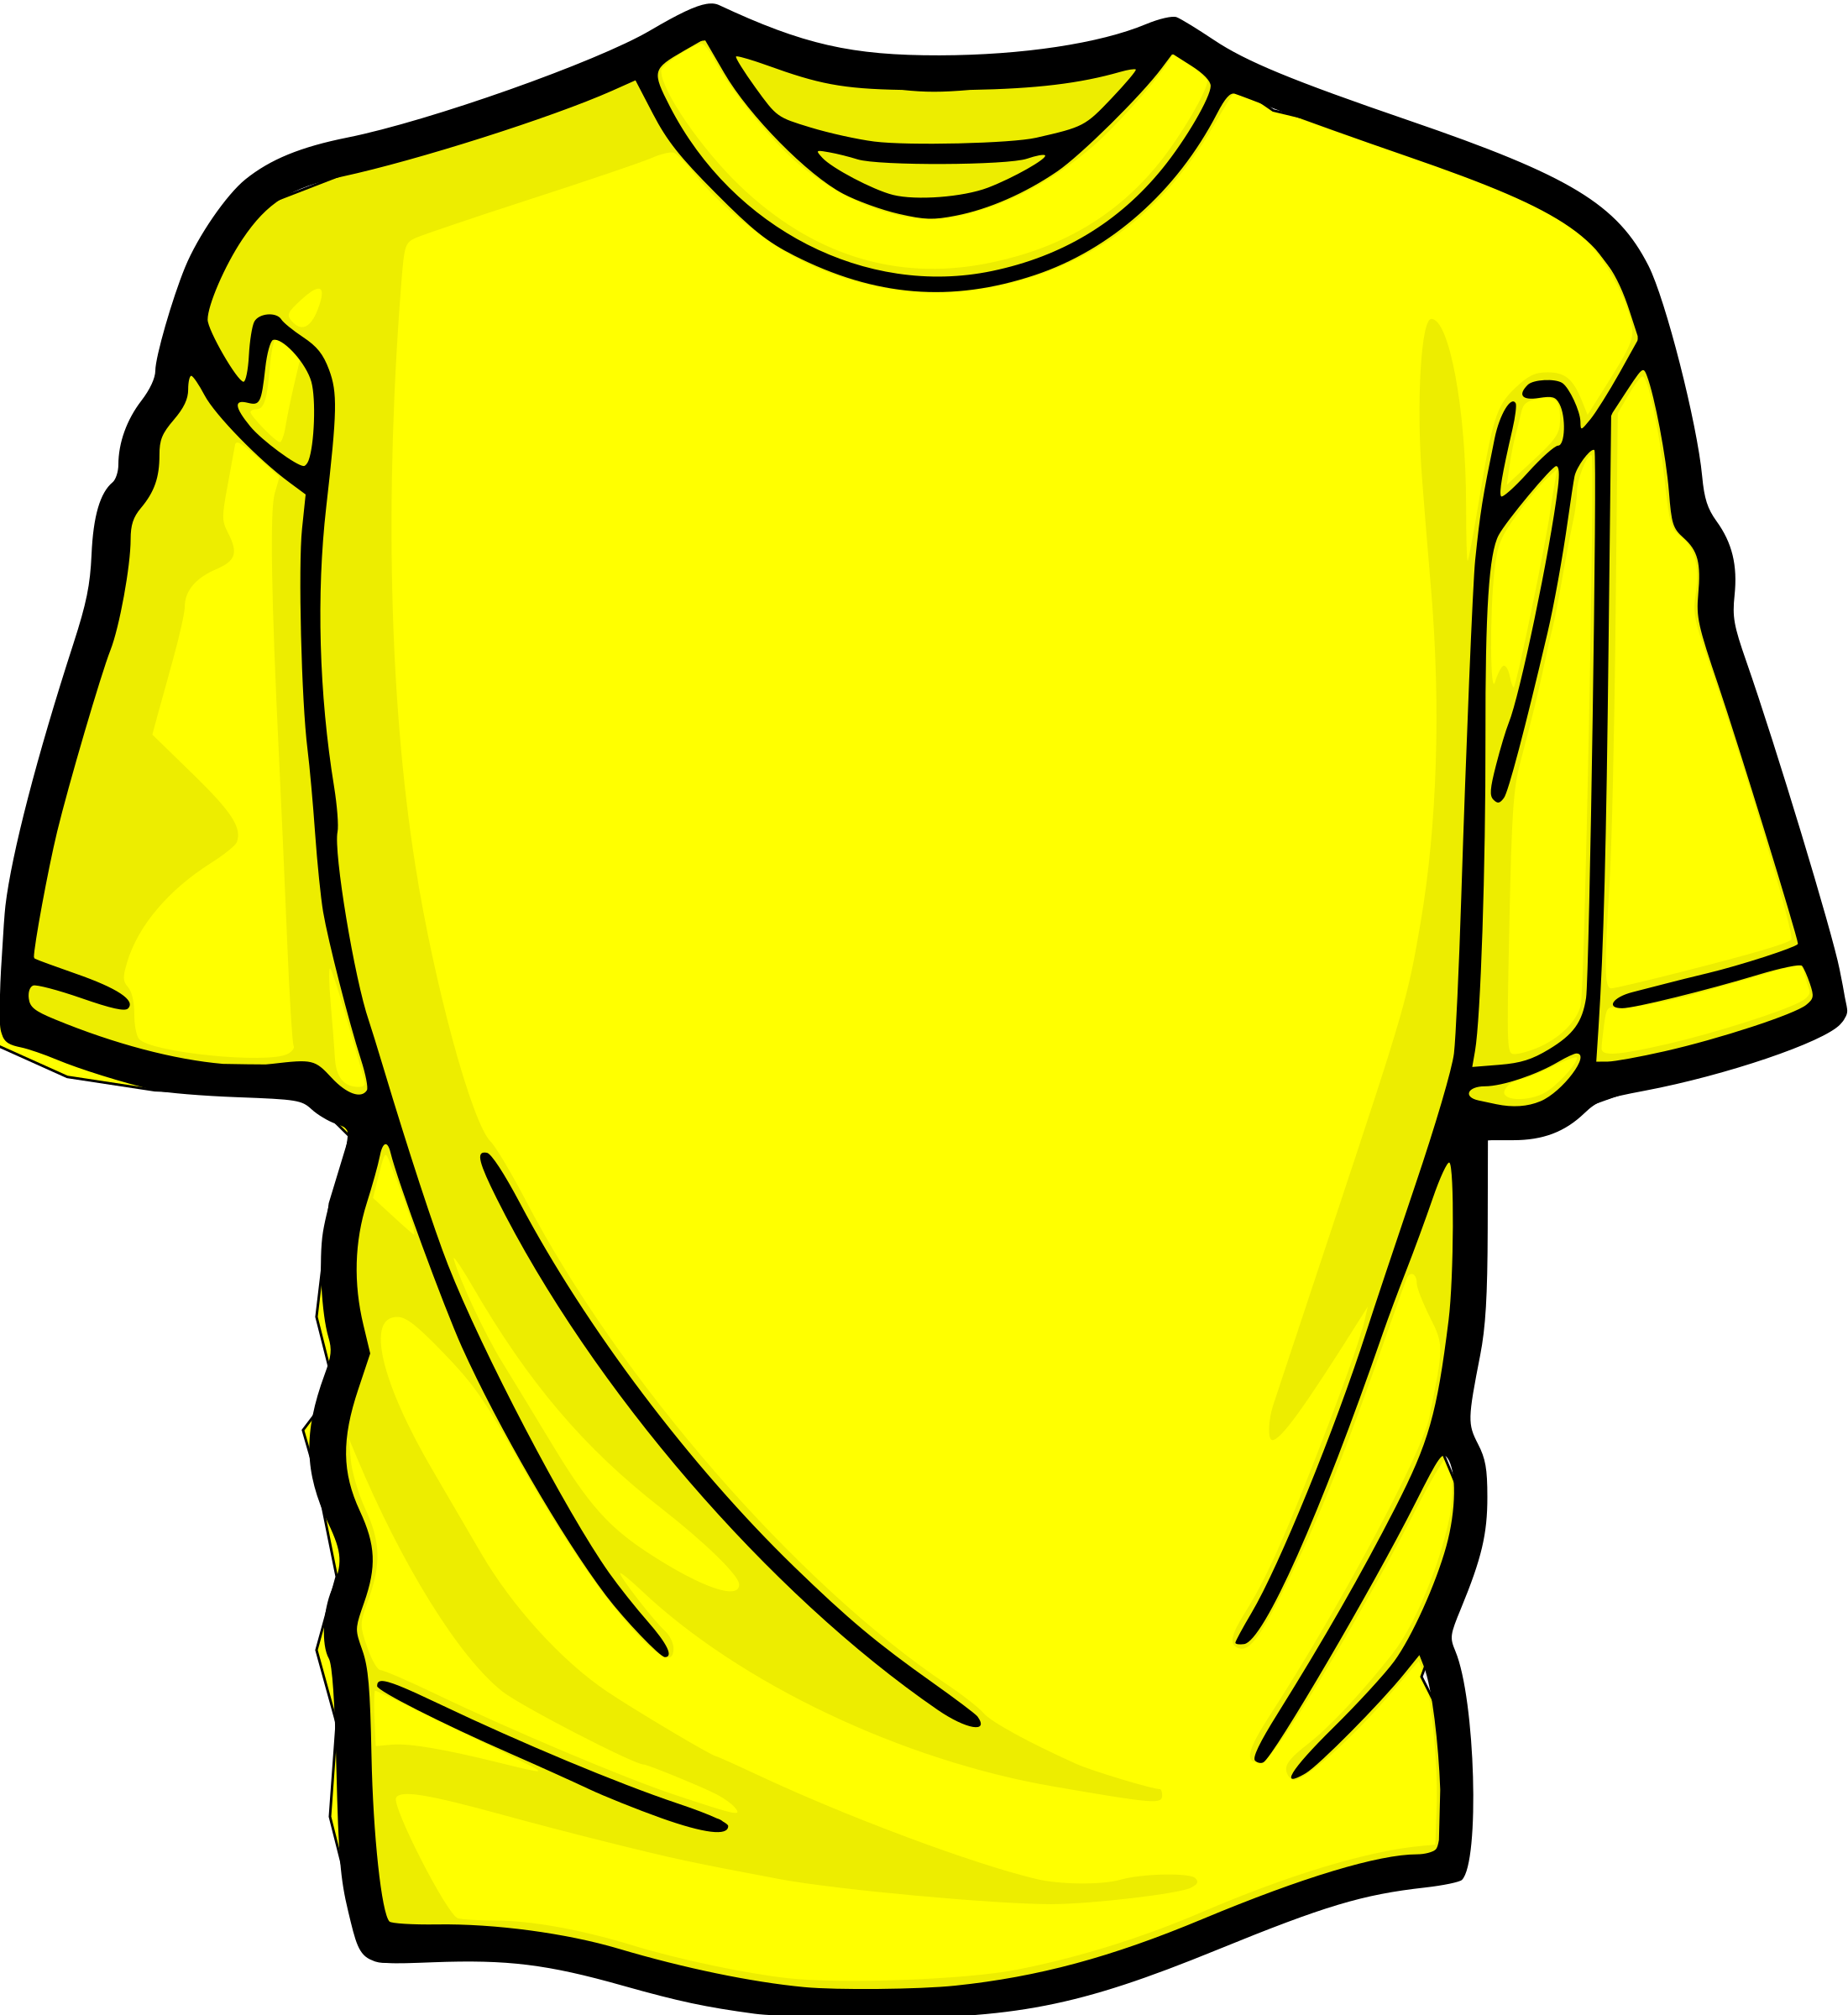
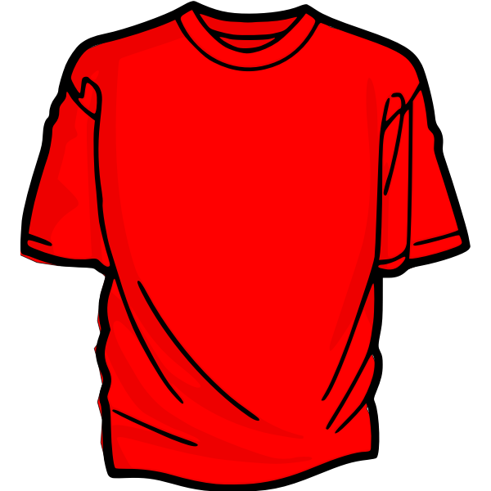
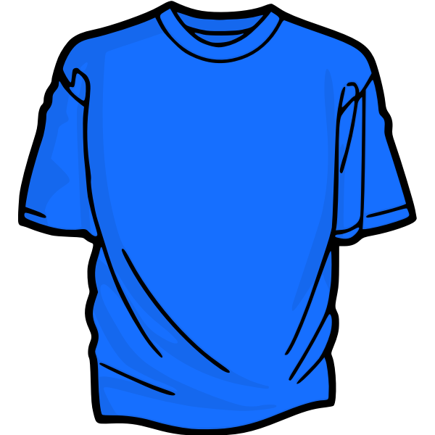
Stack
Top →
Green Shirt
Yellow Shirt
Red Shirt
Blue Shirt
A stack is a linear data structure that follows the principle of Last In First Out (LIFO).
Notes:
Have you asked yourself the question, why do people organize?
Lets go to the psychology of organizing
This predictability applies within the context of our homes, manifesting through the concept of organization

Slide 2
Push operation
Top →
Green Shirt
Top →
Yellow Shirt
Top →
Red Shirt
Top →
Blue Shirt
Last In First Out (LIFO). The last element that is inserted (push) will be the first element that will be removed (pop)
Notes:
Have you asked yourself the question, why do people organize?
Lets go to the psychology of organizing
This predictability applies within the context of our homes, manifesting through the concept of organization

Slide 3
Pop operation
Top →
Green Shirt
Top →
Yellow Shirt
Top →
Red Shirt
Top →
Blue Shirt
Last In First Out (LIFO). The last element that is inserted (push) will be the first element that will be removed (pop)
Notes:
Have you asked yourself the question, why do people organize?
Lets go to the psychology of organizing
This predictability applies within the context of our homes, manifesting through the concept of organization

Slide 4
Types of Stack
Static Stack
Blue Shirt | Red Shirt | Yellow Shirt | Green Shirt
0 | 1 | 2 | 3 (TOP)
Green Shirt
Yellow Shirt
Red Shirt
Blue Shirt
Dynamic Stack
Top (Head)
Notes:
Have you asked yourself the question, why do people organize?
Lets go to the psychology of organizing
This predictability applies within the context of our homes, manifesting through the concept of organization

Slide 5
Types of Stack
Static Stack
Blue Shirt | Red Shirt | Yellow Shirt | Green Shirt
0 | 1 | 2 | 3 (TOP)
A static stack is fixed in size and can be implemented using an array
Notes:
Have you asked yourself the question, why do people organize?
Lets go to the psychology of organizing
This predictability applies within the context of our homes, manifesting through the concept of organization

Slide 6
Types of Stack
Blue Shirt | Red Shirt | Yellow Shirt | Green Shirt
0 | 1 | 2 | 3 (TOP)
Static Stack
Blue Shirt | Red Shirt | Yellow Shirt | Green Shirt | White Shirt
0 | 1 | 2 | 3 | 4 (TOP)
Because static stacks are fixed, we need to create another stack if we want to increase the number of items/elements
Notes:
Have you asked yourself the question, why do people organize?
Lets go to the psychology of organizing
This predictability applies within the context of our homes, manifesting through the concept of organization

Slide 7
Types of Stack
Dynamic Stack
Green Shirt
Yellow Shirt
Red Shirt
Blue Shirt
Top (Head)
In contrast, a dynamic stack can grow in size and can be implemented using a linked list
Notes:
Have you asked yourself the question, why do people organize?
Lets go to the psychology of organizing
This predictability applies within the context of our homes, manifesting through the concept of organization

Slide 8
Types of Stack
White Shirt
Green Shirt
Yellow Shirt
Red Shirt
Blue Shirt
Top (Head)
Being dynamic means that we can reuse the same stack if we need to add more items
Notes:
Have you asked yourself the question, why do people organize?
Lets go to the psychology of organizing
This predictability applies within the context of our homes, manifesting through the concept of organization

Slide 9
Stack implementation using Arrays
Blue Shirt | Red Shirt | Yellow Shirt | Green Shirt
0 | 1 | 2 | 3 (TOP)
Green Shirt
Yellow Shirt
Red Shirt
Blue Shirt
Push Sequence:
Push (Blue Shirt)
Push (Red Shirt)
Push (Yellow Shirt)
Push (Green Shirt)
Notes:
Have you asked yourself the question, why do people organize?
Lets go to the psychology of organizing
This predictability applies within the context of our homes, manifesting through the concept of organization

Slide 10
Push operation
0 | 1 | 2 | 3
Blue Shirt
Red Shirt
Yellow Shirt
Green Shirt
(TOP)
Push Sequence:
Green Shirt
stack.push(“Blue Shirt”)
Yellow Shirt
stack.push(“Red Shirt”)
stack.push(“Yellow Shirt”)
Red Shirt
stack.push(“Green Shirt”)
Blue Shirt
Notes:
Have you asked yourself the question, why do people organize?
Lets go to the psychology of organizing
This predictability applies within the context of our homes, manifesting through the concept of organization

Slide 11
Pop operation
0 | 1 | 2 | 3
Blue Shirt
Red Shirt
Yellow Shirt
Green Shirt
Pop Sequence:
Green Shirt
Stack.pop()
Yellow Shirt
Stack.pop()
Stack.pop()
Red Shirt
Stack.pop()
Blue Shirt
Notes:
Have you asked yourself the question, why do people organize?
Lets go to the psychology of organizing
This predictability applies within the context of our homes, manifesting through the concept of organization

Slide 12
Stack Implementation using Linked Lists
Green Shirt
Yellow Shirt
Red Shirt
Blue Shirt
Top (Head)
Green Shirt
Yellow Shirt
Red Shirt
Blue Shirt
Push Sequence:
stack.push(“Blue Shirt”)
stack.push(“Red Shirt”)
stack.push(“Yellow Shirt”)
stack.push(“Green Shirt”)
Notes:
Have you asked yourself the question, why do people organize?
Lets go to the psychology of organizing
This predictability applies within the context of our homes, manifesting through the concept of organization

Slide 13
Push operation
Green Shirt
Yellow Shirt
Red Shirt
Blue Shirt
Head (Top)
Push Sequence:
Green Shirt
stack.push(“Blue Shirt”)
Yellow Shirt
stack.push(“Red Shirt”)
stack.push(“Yellow Shirt”)
Red Shirt
stack.push(“Green Shirt”)
Blue Shirt
Notes:
Have you asked yourself the question, why do people organize?
Lets go to the psychology of organizing
This predictability applies within the context of our homes, manifesting through the concept of organization

Slide 14
Pop operation
Green Shirt
Yellow Shirt
Red Shirt
Blue Shirt
Pop Sequence:
Green Shirt
stack.pop()
Yellow Shirt
stack.pop()
stack.pop()
Red Shirt
stack.pop()
Blue Shirt
Notes:
Have you asked yourself the question, why do people organize?
Lets go to the psychology of organizing
This predictability applies within the context of our homes, manifesting through the concept of organization

