Slide 1




Queue
0 | 1 | 2 | 3
A queue is a linear data structure that follows the principle of
First In First Out (FIFO).

Slide 2
Queue
0 | 1 | 2 | 3
This means the first element inserted in the queue is removed first.

Slide 3
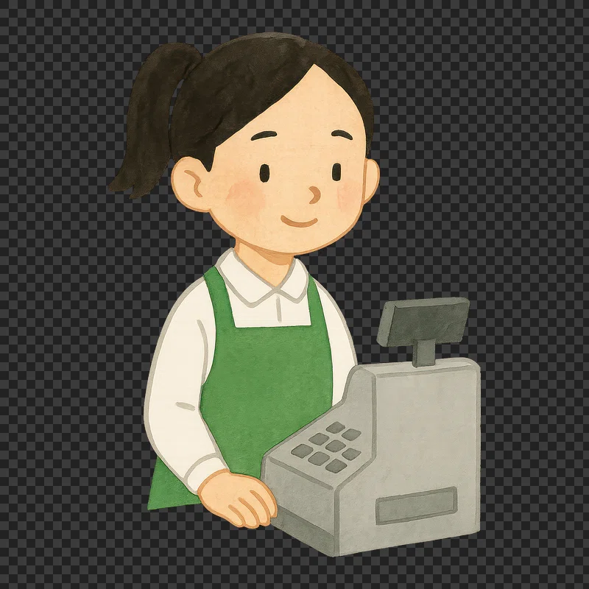
Queue
0 | 1 | 2 | 3
This means the first element inserted in the queue is removed first.

Slide 4
Queue
0 | 1 | 2 | 3
This means the first element inserted in the queue is removed first.

Slide 5
Queue
0 | 1 | 2 | 3
This means the first element inserted in the queue is removed first.

Slide 6
Queue
0 | 1 | 2 | 3
This means the first element inserted in the queue is removed first.

Slide 7
Queue
0 | 1 | 2 | 3
This means the first element inserted in the queue is removed first.

Slide 8
Queue
0 | 1 | 2 | 3
This means the first element inserted in the queue is removed first.

Slide 9
Queue
0 | 1 | 2 | 3
This means the first element inserted in the queue is removed first.

Slide 10
Queue
0 | 1 | 2 | 3
This means the first element inserted in the queue is removed first.

Slide 11
Queue
0 | 1 | 2 | 3
This means the first element inserted in the queue is removed first.

Slide 12
Queue
Front
Rear
0 | 1 | 2 | 3
In a queue, we need to keep track what element is at the front and at the rear

Slide 13
Queue Operations
0 | 1 | 2 | 3
There are two operations in a queue, enqueue and dequeue

Slide 14
Queue Operations
Front
Rear
0 | 1 | 2 | 3
To enqueue is to insert an element at the rear of the queue

Slide 15
Queue Operations
Front
Rear
0 | 1 | 2 | 3
The first element inserted in the queue will be both the front and rear element

Slide 16
Queue Operations
Front
Rear
0 | 1 | 2 | 3
To enqueue is to insert an element at the rear of the queue

Slide 17
Queue Operations
Front
Rear
0 | 1 | 2 | 3
To enqueue is to insert an element at the rear of the queue

Slide 18
Queue Operations
Front
Rear
0 | 1 | 2 | 3
To enqueue is to insert an element at the rear of the queue

Slide 19
Queue Operations
Front
Rear
0 | 1 | 2 | 3
To dequeue is to remove an element at the front of the queue

Slide 20
Queue Operations
Front
Rear
0 | 1 | 2 | 3
To dequeue is to remove an element at the front of the queue

Slide 21
Queue Operations
Front
Rear
0 | 1 | 2 | 3
To dequeue is to remove an element at the front of the queue

Slide 22
Queue Operations
Front
Rear
0 | 1 | 2 | 3
To dequeue is to remove an element at the front of the queue

Slide 23
Queue Operations
0 | 1 | 2 | 3
To dequeue is to remove an element at the front of the queue

Slide 24
Implementing a Queue
Front
Rear
0 | 1 | 2 | 3
Static Queue
Front
Rear
Dynamic Queue

Slide 25
Static Queue
Front
Rear
0 | 1 | 2 | 3
Static Queue
A static queue is implemented using arrays. This will only allow our queue to have a fixed number of elements.
Front
Rear
Dynamic Queue

Slide 26
Dynamic Queue
Front
Rear
0 | 1 | 2 | 3
Static Queue
Front
Rear
Dynamic Queue
A dynamic queue is implemented using linked lists. This will allow our queue to have as many elements as we want to.

Slide 27
Static Queue
class IntQueue{
private:
int* queueArray;
int queueSize;
int front;
int rear;
int numItems;
public:
IntQueue(int size);
~IntQueue();
void enqueue(int num);
void dequeue(int &num);
bool isFull();
bool isEmpty();
void clear();
};
0 | 1 | 2 | 3
Array
Queue

Slide 28
Static Queue
0 | 1 | 2 | 3
IntQueue::IntQueue(int s)
{
queueArray = new int[s];
queueSize = s;
front = -1;
rear = -1;
numItems = 0;
}
Array
IntQueue::~IntQueue()
{
delete[] queueArray;
}
Queue

Slide 29
Static Queue
bool IntQueue::isFull()
{
bool status;
if (numItems < queueSize)
{
status = false;
}
else
{
status = false;
}
return status;
}
0 | 1 | 2 | 3
Array
Queue

Slide 30
Static Queue
0 | 1 | 2 | 3
bool IntQueue::isEmpty()
{
bool status;
if (numItems) {
status = false;
}
else
{
status = true;
}
return status;
}
Array
Queue

Slide 31
Static Queue
0 | 1 | 2 | 3
void IntQueue::clear()
{
front = queueSize -1;
rear = queueSize -1;
numItems = 0;
}
Array
Queue

Slide 32
void IntQueue::enqueue(int num)
{
if (isFull())
{
cout << "Queue is full. Cannot enqueue " << num << "." << endl;
}
rear = (rear + 1) % queueSize;
queueArray[rear] = num;
numItems++;
}
0 | 1 | 2 | 3
Array
Queue

Slide 33
void IntQueue::dequeue(int &num)
{
if (isEmpty())
{
cout << "Queue is empty. Cannot dequeue." << endl;
}
front = (front + 1) % queueSize;
num = queueArray[front];
numItems--;
}
0 | 1 | 2 | 3
Array
Queue

Slide 34
void IntQueue::dequeue(int &num)
{
if (isEmpty())
{
cout << "Queue is empty. Cannot dequeue." << endl;
}
front = (front + 1) % queueSize;
num = queueArray[front];
numItems--;
}
0 | 1 | 2 | 3
Array
Queue

Slide 35
int main()
{
IntQueue myQueue(5);
cout << "Enqueueing 5 items..." << endl;
// Enqueue 5 items
for (int x = 0; x < 5; x++)
{
myQueue.enqueue(x);
}
// Attempt to enqueue a 6th item
cout << "Attempting to enqueue a 6th item..." << endl;
myQueue.enqueue(5);
//Dequeue and retrieve all items in the queue
cout << "The values in the queue are: " << endl;
while (!myQueue.isEmpty())
{
int value;
myQueue.dequeue(value);
cout << value << " ";
}
}
0 | 1 | 2 | 3 | 4
Array
0
1
2
3
4
Queue

Slide 36
Front
Rear
int main()
{
IntQueue myQueue(5);
cout << "Enqueueing 5 items..." << endl;
// Enqueue 5 items
for (int x = 0; x < 5; x++)
{
myQueue.enqueue(x);
}
// Attempt to enqueue a 6th item
cout << "Attempting to enqueue a 6th item..." << endl;
myQueue.enqueue(5);
//Dequeue and retrieve all items in the queue
cout << "The values in the queue are: " << endl;
while (!myQueue.isEmpty())
{
int value;
myQueue.dequeue(value);
cout << value << " ";
}
}
0
0 | 1 | 2 | 3 | 4
Array
Front
Rear
0
1
2
3
4
Queue

Slide 37
Front
Rear
int main()
{
IntQueue myQueue(5);
cout << "Enqueueing 5 items..." << endl;
// Enqueue 5 items
for (int x = 0; x < 5; x++)
{
myQueue.enqueue(x);
}
// Attempt to enqueue a 6th item
cout << "Attempting to enqueue a 6th item..." << endl;
myQueue.enqueue(5);
//Dequeue and retrieve all items in the queue
cout << "The values in the queue are: " << endl;
while (!myQueue.isEmpty())
{
int value;
myQueue.dequeue(value);
cout << value << " ";
}
}
0 | 1
0 | 1 | 2 | 3 | 4
Array
Front
Rear
0
1
2
3
4
Queue

Slide 38
Front
Rear
int main()
{
IntQueue myQueue(5);
cout << "Enqueueing 5 items..." << endl;
// Enqueue 5 items
for (int x = 0; x < 5; x++)
{
myQueue.enqueue(x);
}
// Attempt to enqueue a 6th item
cout << "Attempting to enqueue a 6th item..." << endl;
myQueue.enqueue(5);
//Dequeue and retrieve all items in the queue
cout << "The values in the queue are: " << endl;
while (!myQueue.isEmpty())
{
int value;
myQueue.dequeue(value);
cout << value << " ";
}
}
0 | 1 | 2
0 | 1 | 2 | 3 | 4
Array
Front
Rear
0
1
2
3
4
Queue

Slide 39
Front
Rear
int main()
{
IntQueue myQueue(5);
cout << "Enqueueing 5 items..." << endl;
// Enqueue 5 items
for (int x = 0; x < 5; x++)
{
myQueue.enqueue(x);
}
// Attempt to enqueue a 6th item
cout << "Attempting to enqueue a 6th item..." << endl;
myQueue.enqueue(5);
//Dequeue and retrieve all items in the queue
cout << "The values in the queue are: " << endl;
while (!myQueue.isEmpty())
{
int value;
myQueue.dequeue(value);
cout << value << " ";
}
}
0 | 1 | 2 | 3
0 | 1 | 2 | 3 | 4
Array
Front
Rear
0
1
2
3
4
Queue

Slide 40
Front
Rear
int main()
{
IntQueue myQueue(5);
cout << "Enqueueing 5 items..." << endl;
// Enqueue 5 items
for (int x = 0; x < 5; x++)
{
myQueue.enqueue(x);
}
// Attempt to enqueue a 6th item
cout << "Attempting to enqueue a 6th item..." << endl;
myQueue.enqueue(5);
//Dequeue and retrieve all items in the queue
cout << "The values in the queue are: " << endl;
while (!myQueue.isEmpty())
{
int value;
myQueue.dequeue(value);
cout << value << " ";
}
}
0 | 1 | 2 | 3 | 4
0 | 1 | 2 | 3 | 4
Array
Front
Rear
0
1
2
3
4
Queue

Slide 41
Front
Rear
int main()
{
IntQueue myQueue(5);
cout << "Enqueueing 5 items..." << endl;
// Enqueue 5 items
for (int x = 0; x < 5; x++)
{
myQueue.enqueue(x);
}
// Attempt to enqueue a 6th item
cout << "Attempting to enqueue a 6th item..." << endl;
myQueue.enqueue(5);
//Dequeue and retrieve all items in the queue
cout << "The values in the queue are: " << endl;
while (!myQueue.isEmpty())
{
int value;
myQueue.dequeue(value);
cout << value << " ";
}
}
0 | 1 | 2 | 3 | 4
0 | 1 | 2 | 3 | 4
Array
Front
Rear
0
1
2
3
4
Queue

Slide 42
Front
Rear
int main()
{
IntQueue myQueue(5);
cout << "Enqueueing 5 items..." << endl;
// Enqueue 5 items
for (int x = 0; x < 5; x++)
{
myQueue.enqueue(x);
}
// Attempt to enqueue a 6th item
cout << "Attempting to enqueue a 6th item..." << endl;
myQueue.enqueue(5);
//Dequeue and retrieve all items in the queue
cout << "The values in the queue are: " << endl;
while (!myQueue.isEmpty())
{
int value;
myQueue.dequeue(value);
cout << value << " ";
}
}
0 | 1 | 2 | 3 | 4
0 | 1 | 2 | 3 | 4
Array
Front
Rear
0
1
2
3
4
Queue

Slide 43
Front
Rear
int main()
{
IntQueue myQueue(5);
cout << "Enqueueing 5 items..." << endl;
// Enqueue 5 items
for (int x = 0; x < 5; x++)
{
myQueue.enqueue(x);
}
// Attempt to enqueue a 6th item
cout << "Attempting to enqueue a 6th item..." << endl;
myQueue.enqueue(5);
//Dequeue and retrieve all items in the queue
cout << "The values in the queue are: " << endl;
while (!myQueue.isEmpty())
{
int value;
myQueue.dequeue(value);
cout << value << " ";
}
}
0 | 1 | 2 | 3 | 4
0 | 1 | 2 | 3 | 4
Array
Front
Rear
0
1
2
3
4
Queue

Slide 44
Front
Rear
int main()
{
IntQueue myQueue(5);
cout << "Enqueueing 5 items..." << endl;
// Enqueue 5 items
for (int x = 0; x < 5; x++)
{
myQueue.enqueue(x);
}
// Attempt to enqueue a 6th item
cout << "Attempting to enqueue a 6th item..." << endl;
myQueue.enqueue(5);
//Dequeue and retrieve all items in the queue
cout << "The values in the queue are: " << endl;
while (!myQueue.isEmpty())
{
int value;
myQueue.dequeue(value);
cout << value << " ";
}
}
0 | 1 | 2 | 3 | 4
0 | 1 | 2 | 3 | 4
Array
Front
Rear
0
1
2
3
4
Queue

Slide 45
Front
Rear
int main()
{
IntQueue myQueue(5);
cout << "Enqueueing 5 items..." << endl;
// Enqueue 5 items
for (int x = 0; x < 5; x++)
{
myQueue.enqueue(x);
}
// Attempt to enqueue a 6th item
cout << "Attempting to enqueue a 6th item..." << endl;
myQueue.enqueue(5);
//Dequeue and retrieve all items in the queue
cout << "The values in the queue are: " << endl;
while (!myQueue.isEmpty())
{
int value;
myQueue.dequeue(value);
cout << value << " ";
}
}
0 | 1 | 2 | 3 | 4
0 | 1 | 2 | 3 | 4
Array
Front
Rear
0
1
2
3
4
Queue

Slide 46
Front
Rear
int main()
{
IntQueue myQueue(5);
cout << "Enqueueing 5 items..." << endl;
// Enqueue 5 items
for (int x = 0; x < 5; x++)
{
myQueue.enqueue(x);
}
// Attempt to enqueue a 6th item
cout << "Attempting to enqueue a 6th item..." << endl;
myQueue.enqueue(5);
//Dequeue and retrieve all items in the queue
cout << "The values in the queue are: " << endl;
while (!myQueue.isEmpty())
{
int value;
myQueue.dequeue(value);
cout << value << " ";
}
}
0 | 1 | 2 | 3 | 4
0 | 1 | 2 | 3 | 4
Array
Front
Rear
0
1
2
3
4
Queue

Slide 47
Front
Rear
int main()
{
IntQueue myQueue(5);
cout << "Enqueueing 5 items..." << endl;
// Enqueue 5 items
for (int x = 0; x < 5; x++)
{
myQueue.enqueue(x);
}
// Attempt to enqueue a 6th item
cout << "Attempting to enqueue a 6th item..." << endl;
myQueue.enqueue(5);
//Dequeue and retrieve all items in the queue
cout << "The values in the queue are: " << endl;
while (!myQueue.isEmpty())
{
int value;
myQueue.dequeue(value);
cout << value << " ";
}
}
0 | 1 | 2 | 3 | 4
0 | 1 | 2 | 3 | 4
Array
Front
Rear
0
1
2
3
4
Queue

