Slide 1

BIOS
Presented By:
Elizer Ponio Jr.

Slide 2

Turning on a computer
When a computer is turned on, the microprocessor has no idea what to do next as there is nothing at all in the memory to execute, it tries to execute its first instruction and it has to get the instruction from somewhere.

Slide 3
Turning on a computer
BIOS provides those instructions and it is stored in a BIOS ROM.
This process is known as booting, or booting up, which is short for bootstrapping.
The whole process is hidden because the only thing displayed by the monitor is the logo of the machine manufacturer or the logo of the bios company.

Slide 4
Turning on a computer
BIOS comes included with computers, as firmware on a chip on the motherboard
When BIOS boots up a computer, it first determines whether all of the necessary attachments are in place and operational.

Slide 5
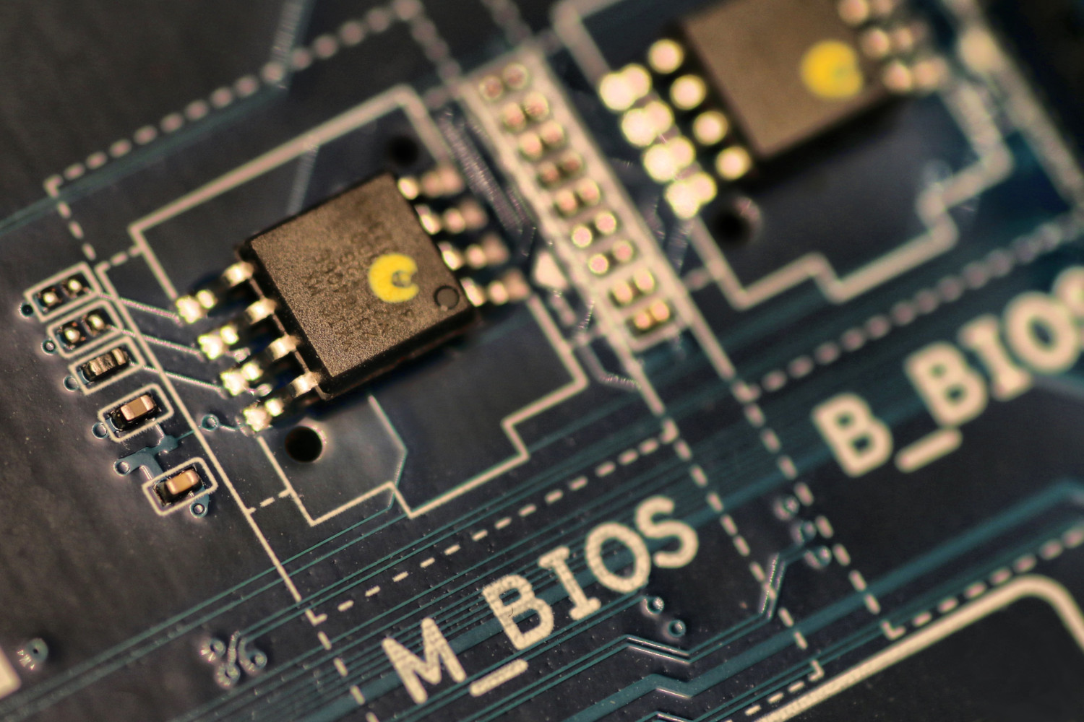
What is BIOS?
Short for Basic Input/Output System, the BIOS (pronounced bye-oss) is a ROM chip found on motherboards that lets you access and set up your computer system at the most basic level.

Slide 6
Four Main Functions
Power-on Self test (POST). Test the computer hardware and make sure no errors exist before loading the operating system. Additional information on the POST is available on our POST and beep codes page.
Bootstrap Loader. Locate the operating system. If a capable operating system is located, the BIOS will pass control to it.
BIOS drivers. Locates drivers that give the computer basic operational control over your computer's hardware.
BIOS setup or CMOS setup. Configuration program that lets you configure hardware settings, including system settings, such as date, time, and computer passwords.

Slide 7
The BIOS Setup Utility
It is configuration program that allows you to configure hardware settings including system settings such as:
Change the Boot sequence or boot device
Passwords
System and Date
Memory settings (frequency, voltage)
Computer fan speed
CPU Voltage

Slide 8
How to access the BIOS Setup Utility?
Turn on or restart the computer.
When the computer turns back on, look for a message that says "entering setup" or something similar.
Accompanying that message will be a key that the user should press to enter system configuration. Depending on the BIOS, some keys often used as prompts are DELETE, TAB, Esc or any of the function keys F1-F12).
Upon seeing the prompt, press the key specified.

Slide 9
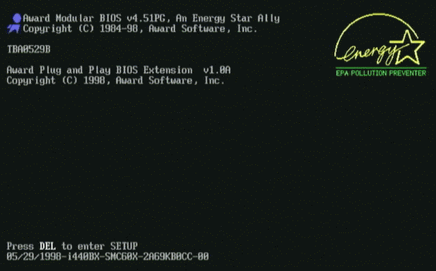
How to access the BIOS Setup Utility?
Press this key to enter the BIOS Setup

Slide 10
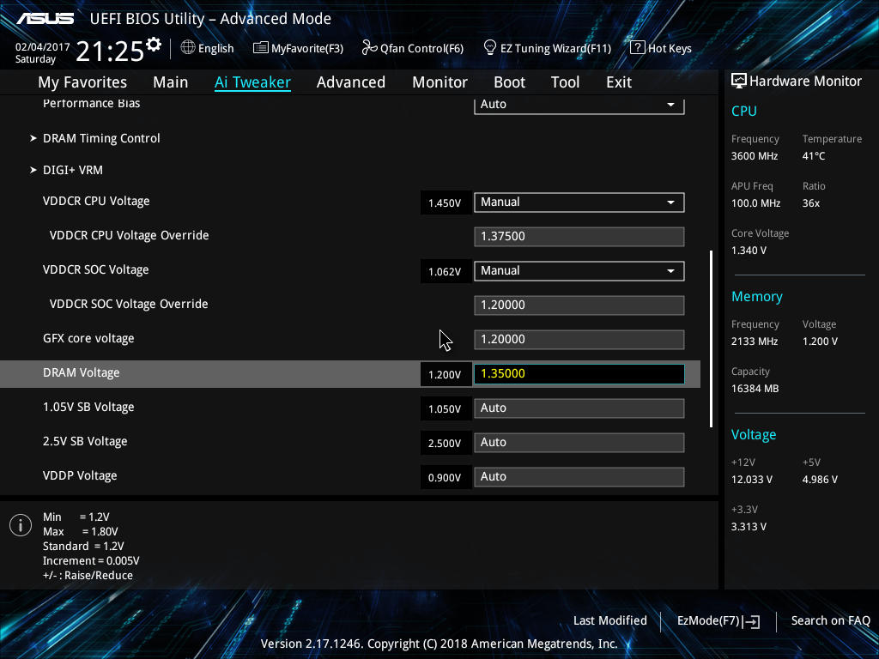
How to access the BIOS Setup Utility?

Slide 11
How to access the BIOS Setup Utility?
Turn on or restart the computer.
When the computer turns back on, look for a message that says "entering setup" or something similar.
Accompanying that message will be a key that the user should press to enter system configuration. Depending on the BIOS, some keys often used as prompts are DELETE, TAB, Esc or any of the function keys F1-F12).
Upon seeing the prompt, press the key specified.

Slide 12
Updating the BIOS
Unlike updating Windows or GPU drivers, a BIOS update isn’t routine.
It’s recommended only when your motherboard manufacturer advises it, or when you’ve diagnosed a problem that a BIOS update is known to fix.
Installing (or "flashing") a new BIOS is more dangerous than updating a simple Windows program, and if something goes wrong during the process, you could end up bricking your computer.

Slide 13
Only update the BIOS if..
Compatibility. An update expands compatibility and allows you to use new hardware like recently-released memory, storage drives, or CPUs.
Stability. An update improves stability. This is appropriate if you’re experiencing system crashes that you’ve traced back to your motherboard.
Optional features. An update enables optional functions of new hardware, such as Resizable BAR on graphics cards.
Security. An update addresses newly-discovered security flaws.

Slide 14
Steps
The procedure for updating the BIOS varies, check the exact procedure first.
Identify the make and model of your motherboard
Download the latest BIOS or UEFI from the manufacturer’s website
Store the downloaded BIOS on a USB flash drive
Restart the computer and enter the BIOS
Navigate the menus to find the update screen
Click an ‘Update’ button and select the file on your USB drive
Wait until the update process has completed, then restart the computer

