Slide 1

"Wave Linguistics"
The one true grammar is the grammar which cannot be known

Slide 2
Overview:
The problem
Movie metaphor
Subjective truth - an explanation for the elusiveness of grammar
Examples

Slide 3
Everyone who has worked for a time in NLP knows eventually you can't add new rules without breaking old rules
This is a problem for statistical as well as symbolic models (statistical = overtraining)
Why have we not been able to find an exhaustive grammar for Natural Language?...

Slide 4

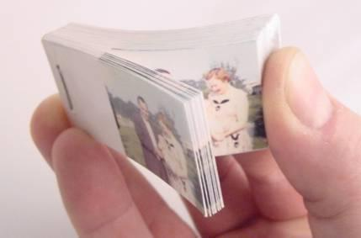
Paradigm Change

Slide 5
What is the problem with CL?
Suggestion: A Paradigm Change
Forms Basic -> Collections of Examples Basic
(The structure you see is not the real structure.)

Slide 6
For instance the collection of examples
ADJ (foreign) N (exchange)
foreign exchange
... ...
... ...
foreign bonds
... ...
stock exchange
foreign currency
... ...
... ...
currency exchange
... ...
securities exchange
foreign bond
... ...
... ...
regional exchanges
regional exchange
... ...
Could be summarized as the rule:
NP <- ADJ + N

Slide 7
But isn't that like building a puppet to mimic a flip-book?
How much more powerful is the flip-book.

Slide 8
In practice - do grammar by meshing vectors of examples rather than restricting yourself to the regularities expressed in traditional classes (N, V, PREP, NP etc.)
The basic process of language is not the expression of rules but the search for regularities.
Classes -> Vectors
Vectors - the power of many dimensions (of rules), extent, waves.

Slide 9
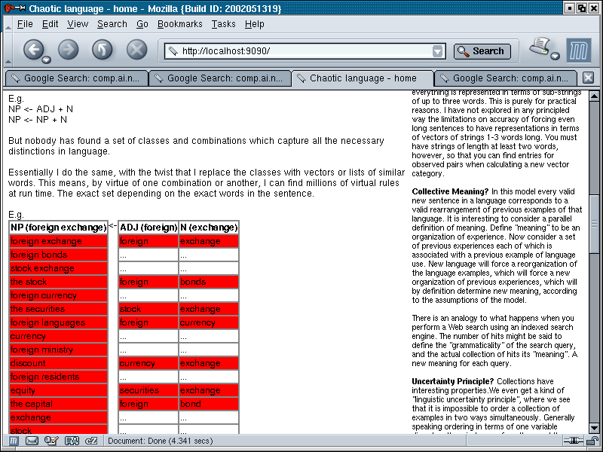

Slide 10
The extent to which the vectors mesh (the amount of red)
...the number of examples which fit the pattern if you like
...gives you a measure for the grammaticality of the combination.

Slide 11
Example of Power:
Important property of systems based on collections of examples
Subjective Truth
Because grammar is based on collections of examples they can be collected together in different ways.

Slide 12
Property of regularities over collections of elements: subjective truth - things that can't be true at the same time:
Letter sorted: AAAAA FFFFF
Colour sorted: AAAFF AAFFF
Example can be sorted according to colour or letter, but not both at the same time.

Slide 13
In this view the pattern (grammar) is rather like one or other perspective of an Escher drawing...

Slide 14
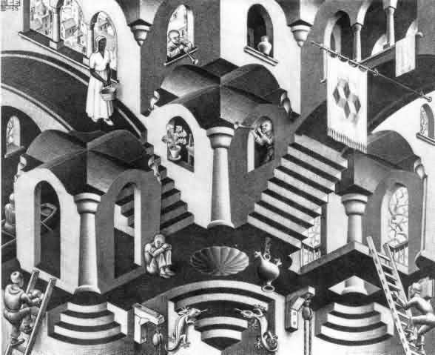

Slide 15
The picture can be seen as either convex or concave, but not both at the same time.

Slide 16
You get the same kind of thing happening with waves. They have a tension between wavelength and position.
You can collect waves according to wavelength or position, but not both at the same time. Not beyond a certain constant.

Slide 17
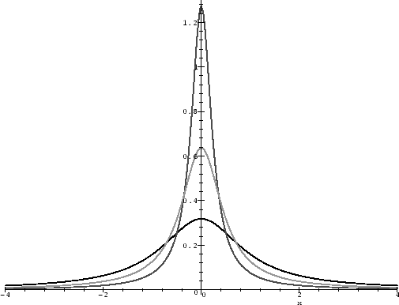
Waves collected w.r.t position = completely undefined w.r.t. wavelength

Slide 18
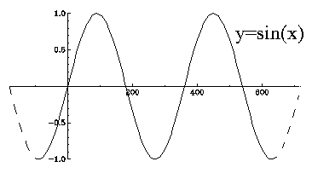
Waves selected w.r.t. wavelength = completely undefined w.r.t position

Slide 19
This is the basis of the famous uncertainty principle of Quantum or Wave Mechanics in Physics - It is impossible to simultaneously know the momentum and position of a particle.
Hence my whimsical characterization of this approach as "wave linguistics"
(The parallel is not coincidental - they both result from degrees of freedom in ways of organizing collections.)

Slide 20

There is a long observed parallel between this "unknowability" of modern Physics and Daoist philosophy - "The one true Dao is the Dao which cannot be known". The same tension between two aspects of reality.
Could we now be seeing the same parallel between Daoist philosophy and our processes of thought expressed as language.
Collections of examples predict language will behave in this way.

Slide 21
Example of subjective truth in grammatical categories:
Sentences where no one grammatical analysis seems obvious:
"He came only yesterday"
(pron + (v +(only yesterday)))
or
(pron + ((came only) + adv))
(c.f. "kino kita bakari"
"he only came yesterday"
"he came yesterday only")
You can make rules for both possibilities. But you can't capture the tension between possibilities. Except with collections of examples.

Slide 22
Example of subjective truth in grammatical categories:
A collocation is a rule reflecting a very specific sub-categorization of a word
But we can have a tension between different collocations.
E.g. "tea merchants" and "green tea"
"Tea merchants" is a term, and "green tea" is a term, but they can't both be terms in:
"The green tea merchants"
Rules don't handle this well. Collections of examples can be rearranged to sub-categorize smoothly and incompatibly in this way.

Slide 23
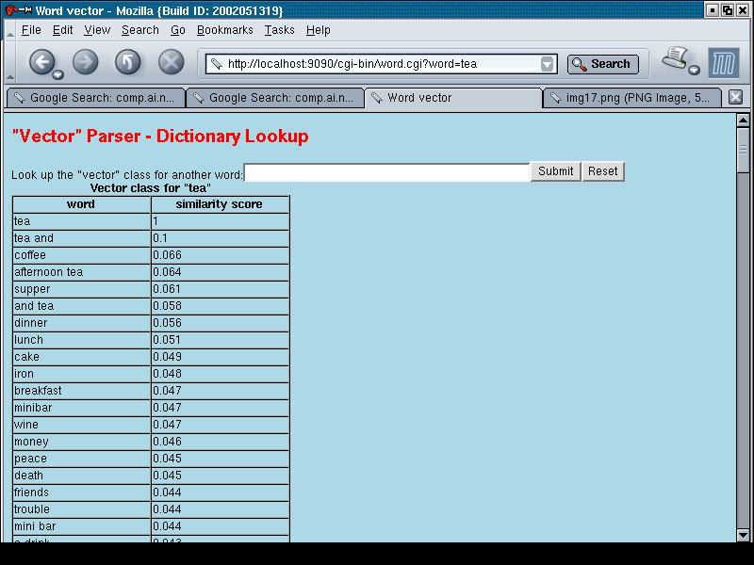

Slide 24
Collection of examples defining global category for tea:
coffee
afternoon tea
supper
dinner
lunch
cake
iron
breakfast
minibar
wine
money
...
a drink
...

Slide 25
c.f. The grammar of a word expressed as its position in a word association space (Hinrich Schuetze):

Slide 26
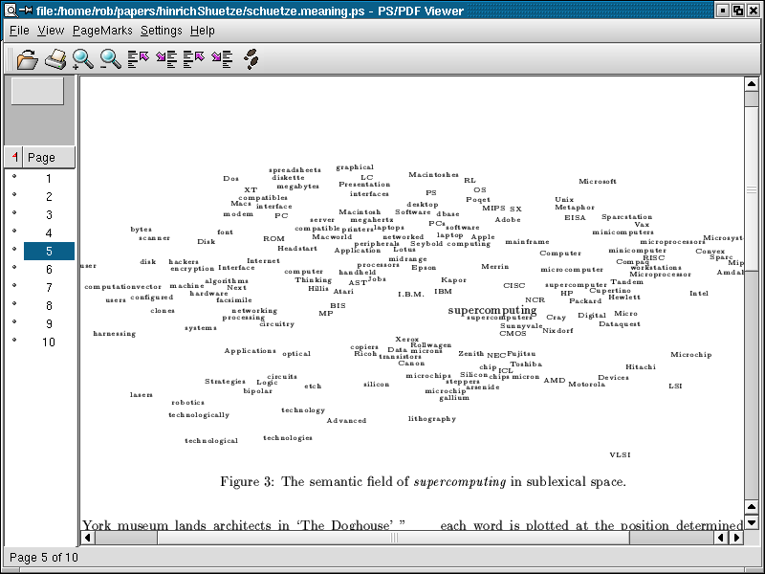

Slide 27
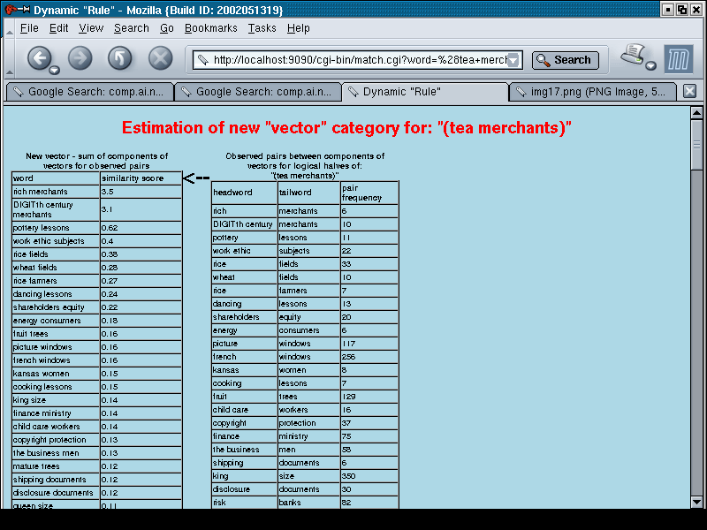
Associates of tea as modifier:
rich
century
pottery
work ethic
rice
wheat
dancing
share holders
energy
picture
french
kansas
cooking
fruit

Slide 28
Collection of examples defining category of tea as modifier:
(The combination of "vector" categories filter each other)
rich (merchants)
pottery (lessons)
work ethic (subjects)
rice (fields)
wheat (fields)
dancing (lessons)
share holders (equity)
energy (...)
picture
french
kansas
cooking
fruit
...
Note how the countable concrete object quality of "merchants" picks out adjectival aspects of "tea": "rich", "french"... Qualities ("work ethic", "energy") or actions ("cooking", "dancing"), not objects.

Slide 29
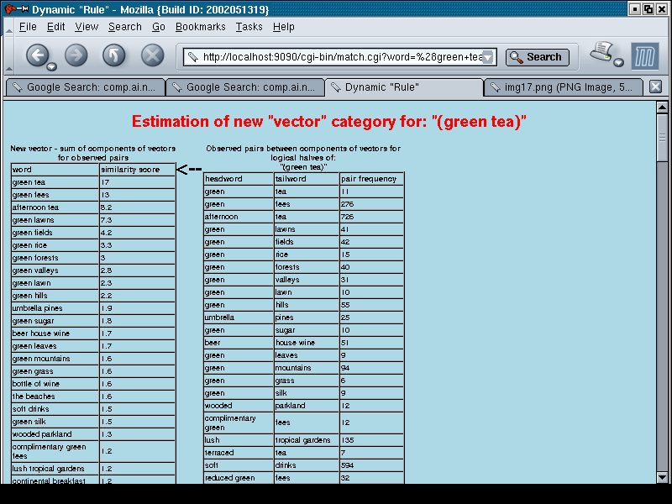

Slide 30
Collection of examples defining category of tea as modified:
(green) fees
(green) lawns
(green) fields
(green) rice
(green) forests
(green) valleys
(green) lawn
(green) hills
(umbrella) pines
(...) sugar
leaves
mountains
grass
silk
...
Note how the modifier "green" has picked out mostly plurals, which characterize "categorical" nouns in English. Substantive, objects (a bit like "zi/jai" in Chinese c.f. "a chair", "the chair", "chairs")

Slide 31
A modifier picks out the substantive aspects "tea". A role as modifier picks out its qualitative aspects.
Both sub-categorizations of "tea" are possible, but not both at the same time.
In each case a sub-category is being crystallized from a broader of list of words in the general category of "tea" (which is in itself a rearrangement of examples characterizing the language.)

Slide 32
You can list rules and sub-categorizations for these two possibilities.
But in the limit you will need to list them for every such collocation and habitual usage.
In this sense a "knowable" grammar for a NL would be an exhaustive list of every possible production in the language!

Slide 33
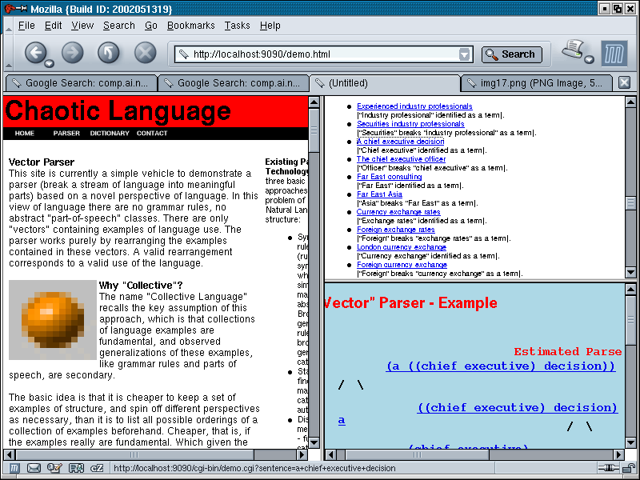
Further examples of subjective grammatical categories:

Slide 34
Note: you do not get this indeterminate and combinatorially idiosyncratic (infinitely sub-categorizable) quality in a system based on rules (e.g. a computer language)
There it is always possible to find a finite and unambiguous set of rules and classes which completely describe all the productions.
But only because all productions are exactly produced by those rules!
It will ALWAYS happen in a system based on examples. You will always have these combinatorial possibilities

Slide 35
The essential point is there is no single label which can summarize the several potentialities (collocational sub-categorizations) of the collection of examples defining "tea" or any other word.
This is an example of the fundamental incompatibility between arrangements of examples mentioned before:
i.e.
Letter sorted: AAAAA FFFFF
Colour sorted: AAAFF AAFFF
In the same way you can't find a single labelling over these two sets which reflects these two patterns, so no absolute labelling over language is possible which captures grammar perfectly.
We NEED to base language on collections of examples - the movie metaphor - to get this behaviour.

Slide 36
Appendix I
Allusions to unknowability in existing work

Slide 37
Hopper - Emergent Grammar:
http://eserver.org/home/hopper/emergence.html
"The notion of emergence is a pregnant one. It ... takes the adjective emergent seriously as a continual movement towards structure, a postponement or 'deferral' of structure, a view of structure as always provisional, always negotiable, and in fact as epiphenomenal, that is at least as much an effect as a cause."

Slide 38
"Structure, then, in this view is not an overarching set of abstract principles, but more a question of a spreading of systematicity from individual words, phrases, and small sets."

Slide 39
"Because grammar is always emergent but never present, it could be said that it never exists as such, but is always coming into being. There is, in other words, no 'grammar' but only 'grammaticization'"

Slide 40
Kenneth Pike ('50s Structuralist):
The structure of language is like that of a population of people...

Slide 41
Appendix II
Existing vector models of grammaticality
c.f. The grammar of a word expressed as its position in a word association space (Hinrich Schuetze):

Slide 43
Similarity modelling - Dagan, Marcus, Markovitch '93:
Estimates probabilities from ad-hoc collections of examples
"While traditional approaches, especially for semantic classification, have the view that information should be captured by the maximal possible generalizations, our method assumes that generalizations should be minimized. Information is thus kept at a maximal level of detail, and missing information is deduced by the most specific analogies, which are carried out whenever needed."

Slide 44
Appendix III
Other examples of "unknowability"
1) Sub-atomic Physics...
You can collect waves according to wavelength or position, but not both at the same time. Not beyond a certain constant.

Slide 45
Waves collected w.r.t position = completely undefined w.r.t. wavelength

Slide 46
Waves selected w.r.t. wavelength = completely undefined w.r.t position

Slide 47
This is the basis of the famous uncertainty principle of Quantum or Wave Mechanics in Physics - It is impossible to simultaneously know the momentum and position of a particle.
Hence my whimsical characterization of this approach as "wave linguistics"
(The parallel is not coincidental - they both result from degrees of freedom in ways of organizing collections.)

Slide 48
Other examples of "unknowability"
2) Eastern Philosophy
Emphasis of practice over principle
"The one true Dao is the Dao which cannot be known"

Slide 49
There is a long observed parallel between this "unknowability" of modern Physics and Daoist philosophy. The same tension between two aspects of reality.
Could we now be seeing the same parallel between Daoist philosophy and our processes of thought expressed as language.
Collections of examples predict language will behave in this way.

Slide 50
"Because grammar is always emergent but never present, it could be said that it never exists as such, but is always coming into being. There is, in other words, no 'grammar' but only 'grammaticization'"

