Slide 1
Coherent Probabilistic Forecasting for Temporal Hierarchies
Presenter: Syama Rangapuram
Discussant: Bahman Rostami-Tabar,
Associate Professor of Data-Driven Decision Science, Cardiff Business School, Cardiff University, Wales, UK.

Slide 2
Introduction
Temporal hierarchies concerns one single time series
There are many applications where data is collected in the finest temporal granularity such as arrival time of patients in hospitals, point-of-sales in retail, smart sensors, etc.
Implementing temporal hierarchies in practice is generally more straightforward compared to cross-sectional or cross-temporal approaches.
Data is available in a single temporal granularity and forecast might be required at the same level, higher or lower granularities
Forecasting approaches:
Using data at a single level of granularity
Using data at multiple levels of granularities created using non-overlapping temporal aggregation
Most research in this space concerns point forecast

Slide 3
Summary and contributions
Contributions:
Proposes an end-to-end framework that takes as input a univariate time series at the given frequency, learns joint embeddings, and generates coherent, probabilistic forecasts for any required aggregation frequency.
Presents empirical evidence that forecasts for time series, including the noisy one at the bottom level, can be enhanced by simultaneously generating coherent forecasts for aggregated time series.
Guarantees that the forecasts are non-negative, a critical consideration when forecasting with daily and sub-daily time series.
Five distinct datasets are used in the empirical evaluation, spanning temporal granularities from 1 minute to 1 day.
Appropriate benchmarks are included
The evaluation of forecasts using Scaled CRPS shows that the proposed approach outperforms benchmarks at all levels for every temporal frequency, except for the daily frequency.
Model variance is also reduced using the proposed framework.

Slide 4
Clarifications/questions
Would you be able to provide further detail on the attributes of time series data? Additionally, could you explain how you quantify the level of noise in a series?
It seems that the study primarily focusses on high-frequency data. Could you please clarify how you define 'high frequency'? Additionally, the results show that there is no improvement in accuracy for daily data. Could you offer an explanation for this finding?
Is the framework applicable to all frequencies? If so, how does it handle fractional data transitioning from weekly to monthly, considering that some weeks may overlap with multiple months?
Is it possible to extend the methodology to incorporate count and intermittent time series data?
Could you provide clarification on the evaluation process for forecasting each time series? Specifically, do you use forecasting with rolling origins?
Have you explored the possibility of presenting forecast accuracy for individual series using a box-plot or a density plot rather than using averages and standard deviations? Alternatively, considering MCB Nemenyi test might be beneficial.
What is the reasoning behind choosing aggregation levels of 15 minutes, 1 hour, and 30 minutes?

Slide 5
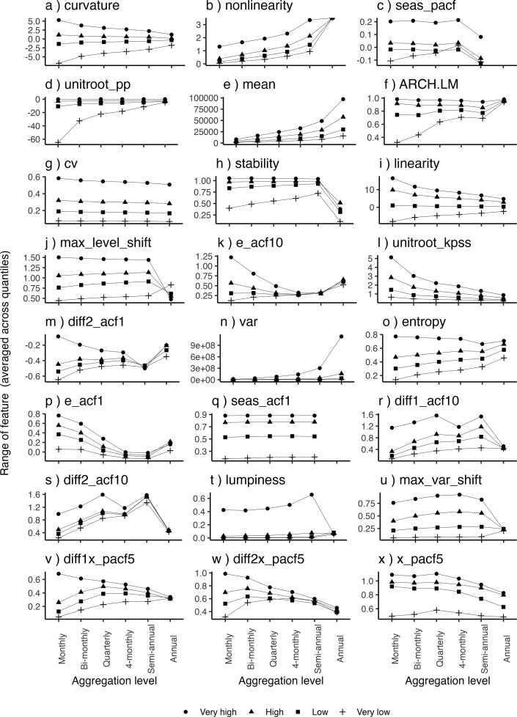
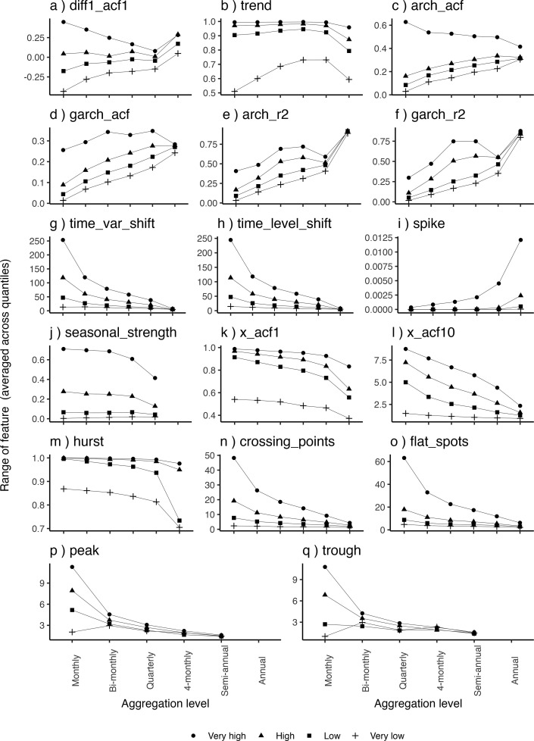
Thoughts – incorporating time series features
In what ways can temporal hierarchies efficiently use the features of time series data at different temporal granularities?
Rostami-Tabar, Bahman, and Mircetic Dejan. "Exploring the association between time series features and forecasting by temporal aggregation using machine learning." Neurocomputing (2023): 126376.

Slide 6
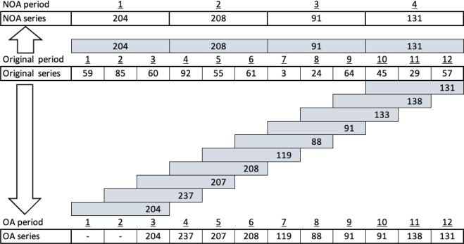
Thoughts – using overlapping temporal aggregation
How might we integrate the overlapping temporal aggregation into the temporal hierarchy framework?
Rostami-Tabar, Bahman, Thanos E. Goltsos, and Shixuan Wang. "Forecasting for lead-time period by temporal aggregation: Whether to combine and how." Computers in Industry 145 (2023): 103803.

Slide 7
Thoughts – implications and organisational challenges
Also valid for cross-sectional & cross-temporal
Temporal hierarchies underlines two primary advantages
Generate coherent forecasts
Improve forecast accuracy
How can we demonstrate the influence of these two accomplishments on decision-making processes?
Is it feasible to assess how coherent forecasts might improve coordination? What approach could we take to address this?
What are the implications of using forecasts generated by temporal hierarchies for utilities like service level, response time, cost, and robust planning, among other measures?
Considering that generating reconciled forecasts might be less accurate at certain time granularities compared to the base forecast , how do we address the organizational implementation of such a framework?
Is coherency always a desirable requirement from the decision-making point of view?

Slide 8
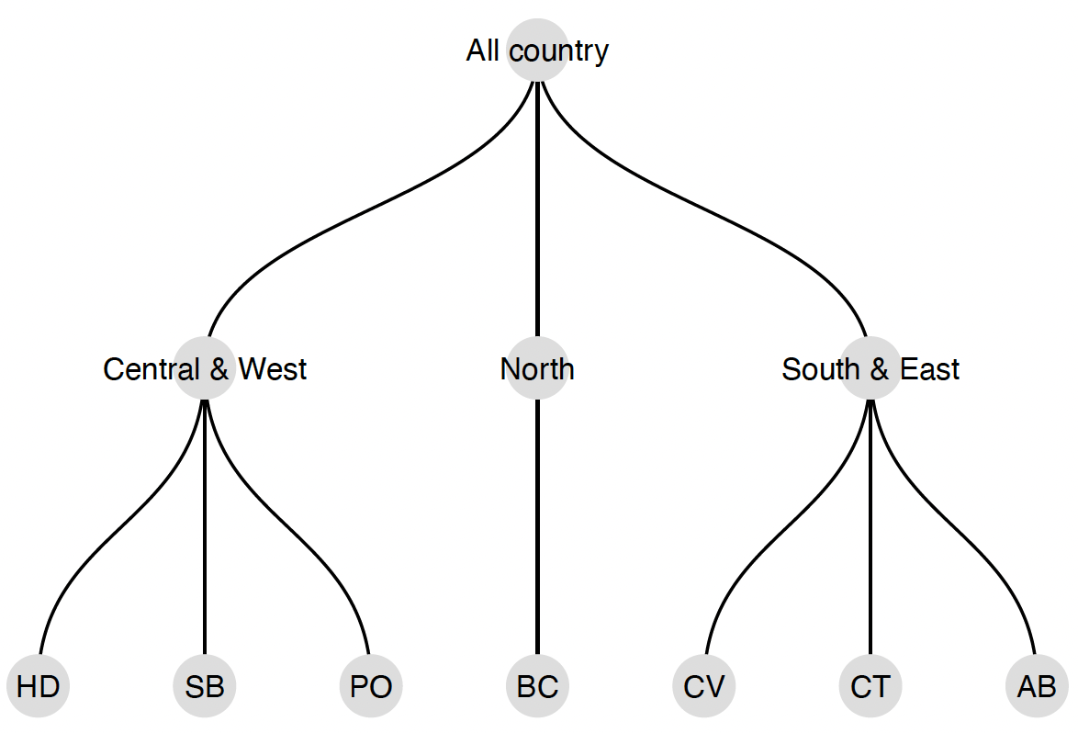
Every temporal hierarchy is linked to a cross-sectional hierarchy. Also, temporal hierarchies are much easier to implement.
With the recent development of cross-temporal approaches, when do temporal hierarchies prove independently valuable, and when are cross-temporal hierarchies more advantageous?
Hourly
Daily
Monthly
Rostami-Tabar Bahman, Hyndman Rob, Hierarchical Time Series Forecasting in Emergency Medical Services, Journal of Service Research (under review)
Girolimetto, Daniele, et al. "Cross-temporal Probabilistic Forecast Reconciliation." arXiv preprint arXiv:2303.17277 (2023).

