Slide 1


Forecasting hierarchies with coherency-learning
Julien Leprince, Jan Kloppenborg Møller, Waqas Khan, Henrik Madsen, Wim Zeiler
Sep 7th 2023
Building Services

Slide 2

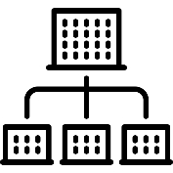

Building to grid energy flexibility
Energy balancing
Energy flexibility identification
Need for information coherency between aggregation layers
Credit: https://siemens.com/
Context | Method | Results | 1 | 2 | Conclusion

Slide 3

Forecasting building loads
Situation
Multiple disconnected system scales Buildings – Districts – Energy grid
Can coherency requirements of hierarchical forecast support improved predictions?
Problem
Incoherent forecasts due to independent data and predictions
Idea
Exploit methods from hierarchical forecasting to improve prediction performances
Context | Method | Results | 1 | 2 | Conclusion

Slide 4
Approach
Context | Method | Results | 1 | 2 | Conclusion
Notes:
Nomenclature to introduce

Slide 5
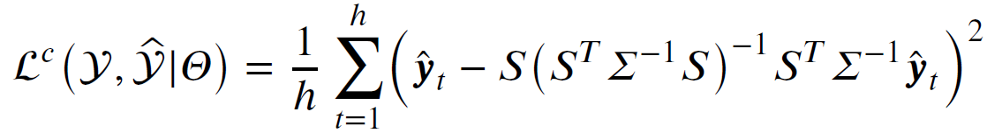
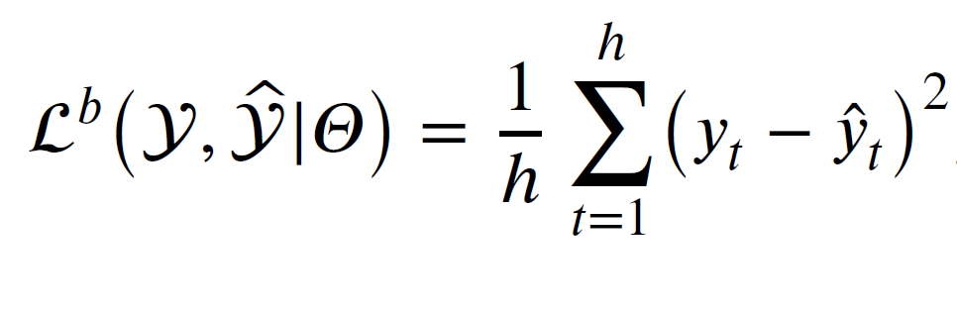
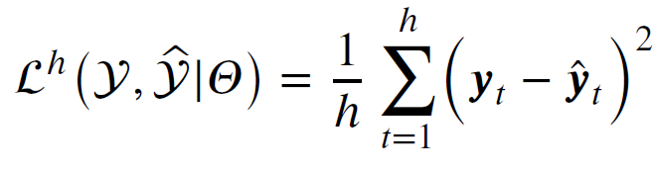
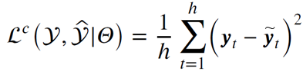

Towards hierarchical learning
Context | Method | Results | 1 | 2 | Conclusion

Slide 6
Covariance matrices
Σ
Context | Method | Results | 1 | 2 | Conclusion

Slide 7
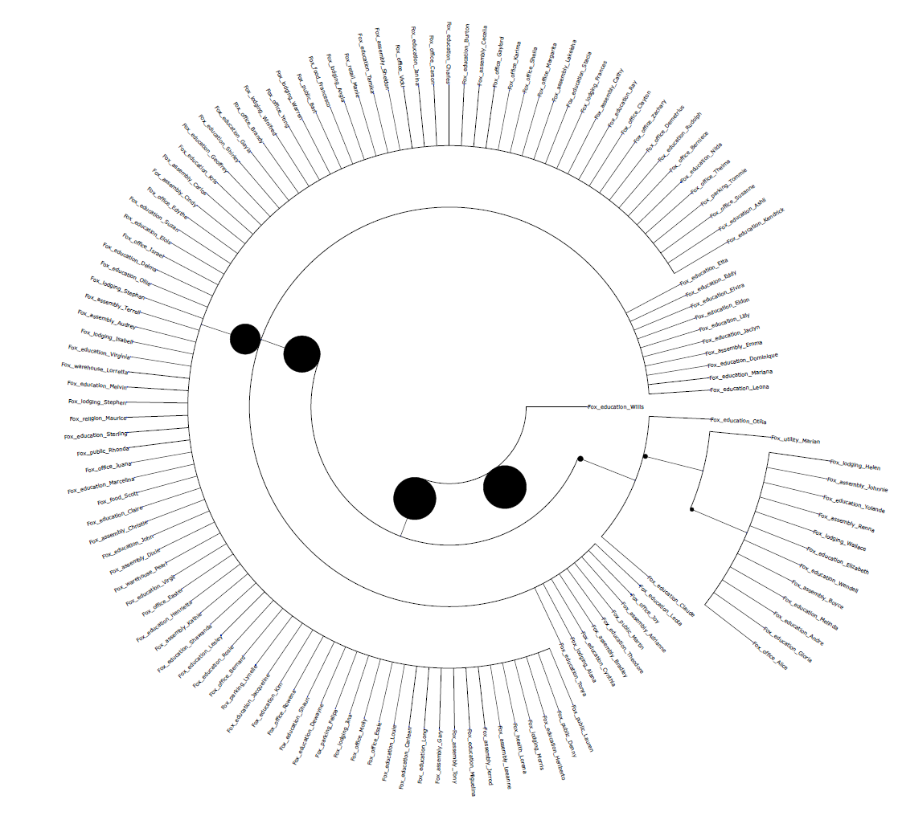



Case studies
41 residential households
The Netherlands
Horizon: 3 years, 2019-2022
133 electric-meter measurements United States of America
Horizon: 2 full years, 2016-2017
Credit: https://freepik.com/
Context | Method | Results | 1 | 2 | Conclusion

Slide 8
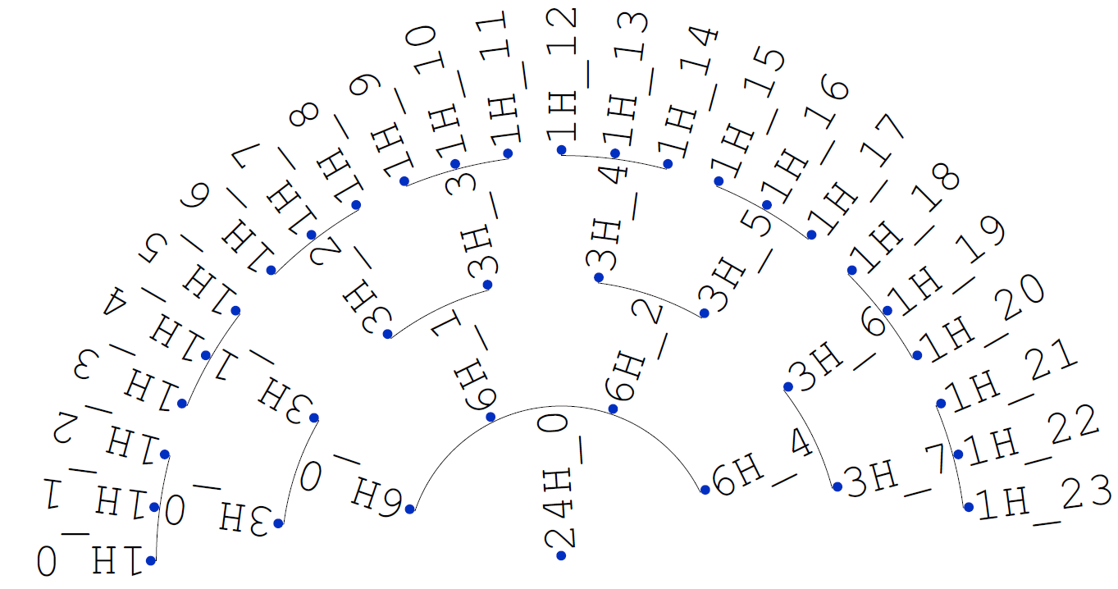
Case studies
41 residential households
The Netherlands
Horizon: 3 years, 2019-2022
133 electric-meter measurements United States of America
Horizon: 2 full years, 2016-2017
Credit: https://freepik.com/
Context | Method | Results | 1 | 2 | Conclusion

Slide 9
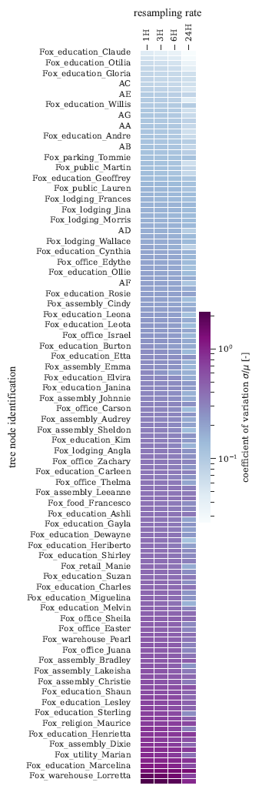
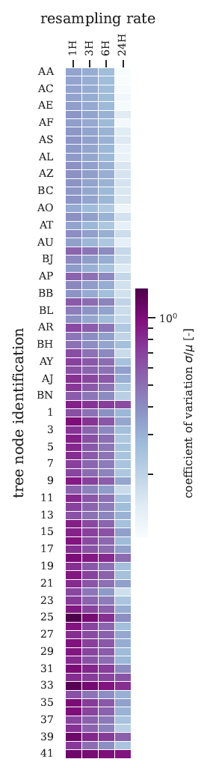
Case studies
41 residential households
The Netherlands
Horizon: 3 years, 2019-2022
133 electric-meter measurements United States of America
Horizon: 2 full years, 2016-2017
Time series variability
Credit: https://freepik.com/
Context | Method | Results | 1 | 2 | Conclusion

Slide 10
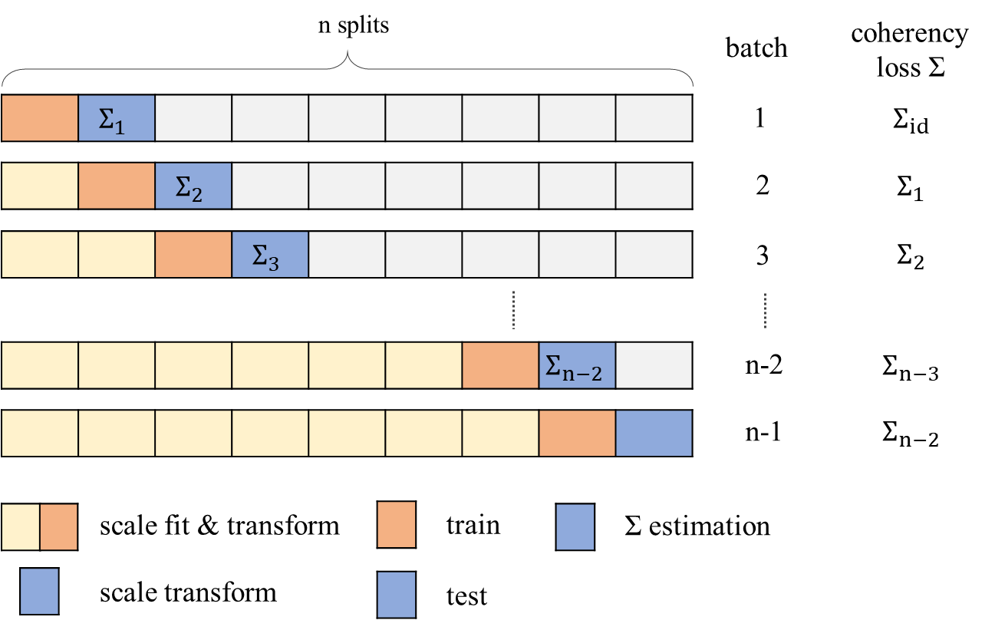
Training setup
Data partitioning & transformation
Designing hierarchical regressors
Activation function sigmoid
Dropout ratio 0.2
Context | Method | Results | 1 | 2 | Conclusion
Notes:
Scaling: Avoid data leakage

Slide 11
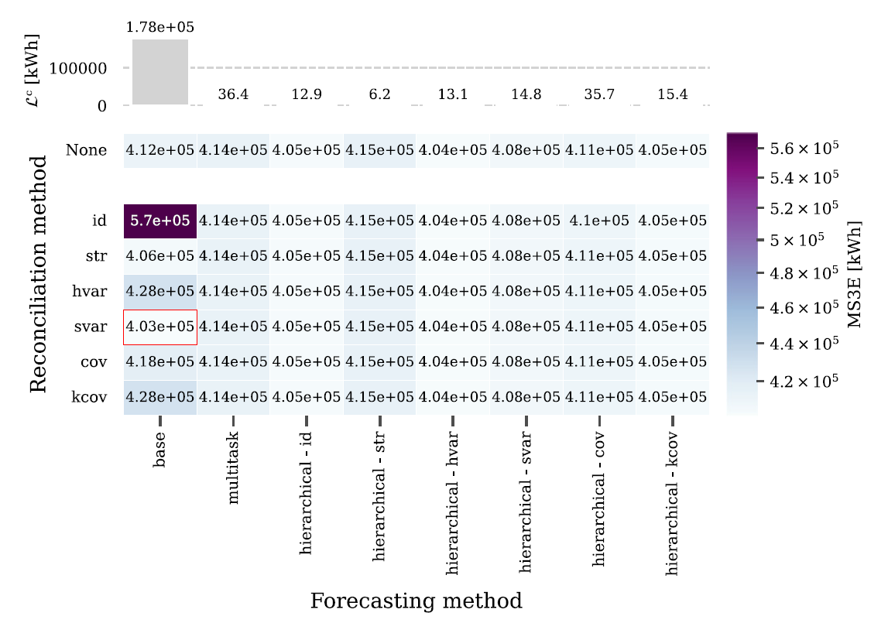
Results
Eneco dataset 41 residential households
Spatial hierarchy
Hour-ahead forecast
Context | Method | Results | 1 | 2 | Conclusion

Slide 12
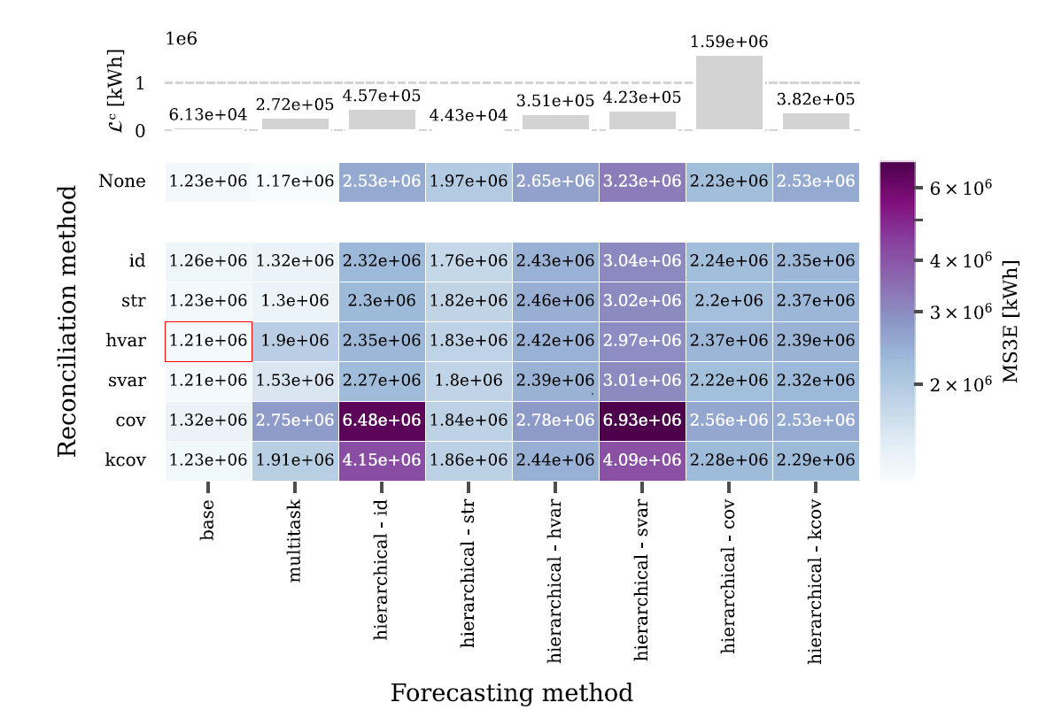
Results
Eneco dataset 41 residential households
Temporal hierarchy
Day-ahead forecast
Context | Method | Results | 1 | 2 | Conclusion

Slide 13
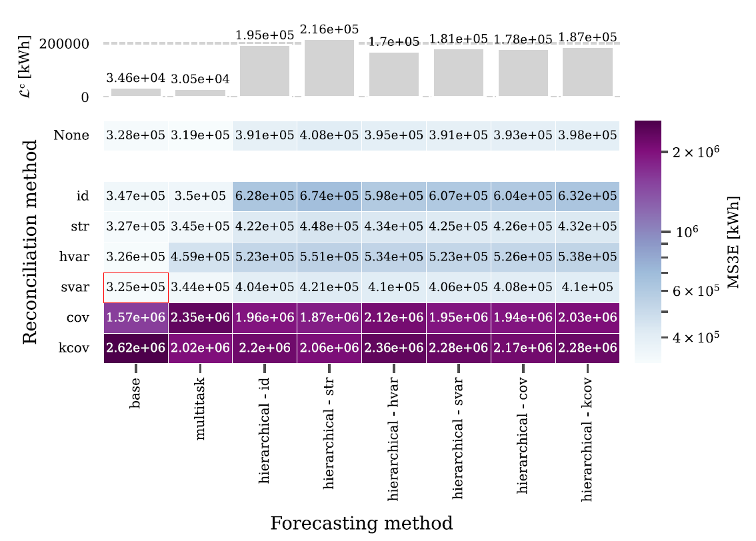
Results
Eneco dataset 41 residential households
Spatiotemporal hierarchy
Day-ahead forecast
Context | Method | Results | 1 | 2 | Conclusion

Slide 14
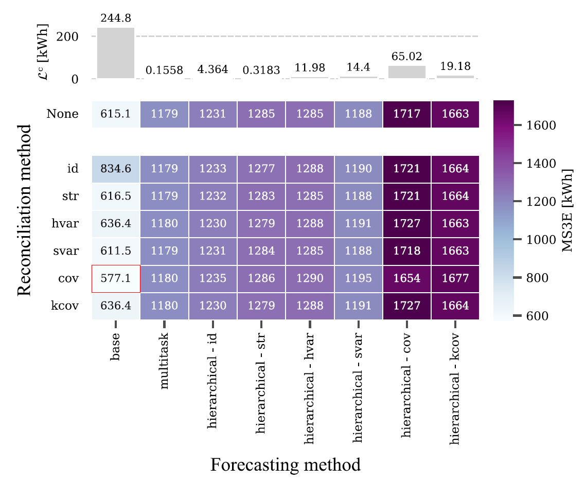
Results
BDG2 dataset 133 electric-meters
Spatial hierarchy
Hour-ahead forecast
Context | Method | Results | 1 | 2 | Conclusion

Slide 15
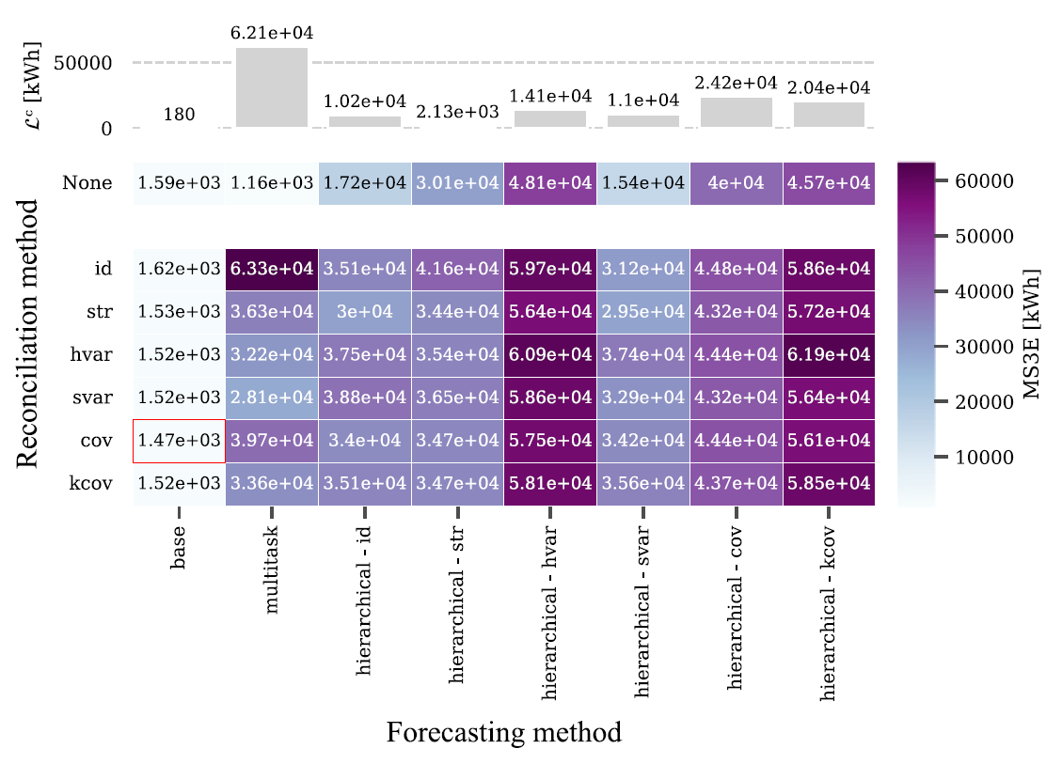
Results
BDG2 dataset 133 electric-meters
Temporal hierarchy
Day-ahead forecast
Context | Method | Results | 1 | 2 | Conclusion

Slide 16
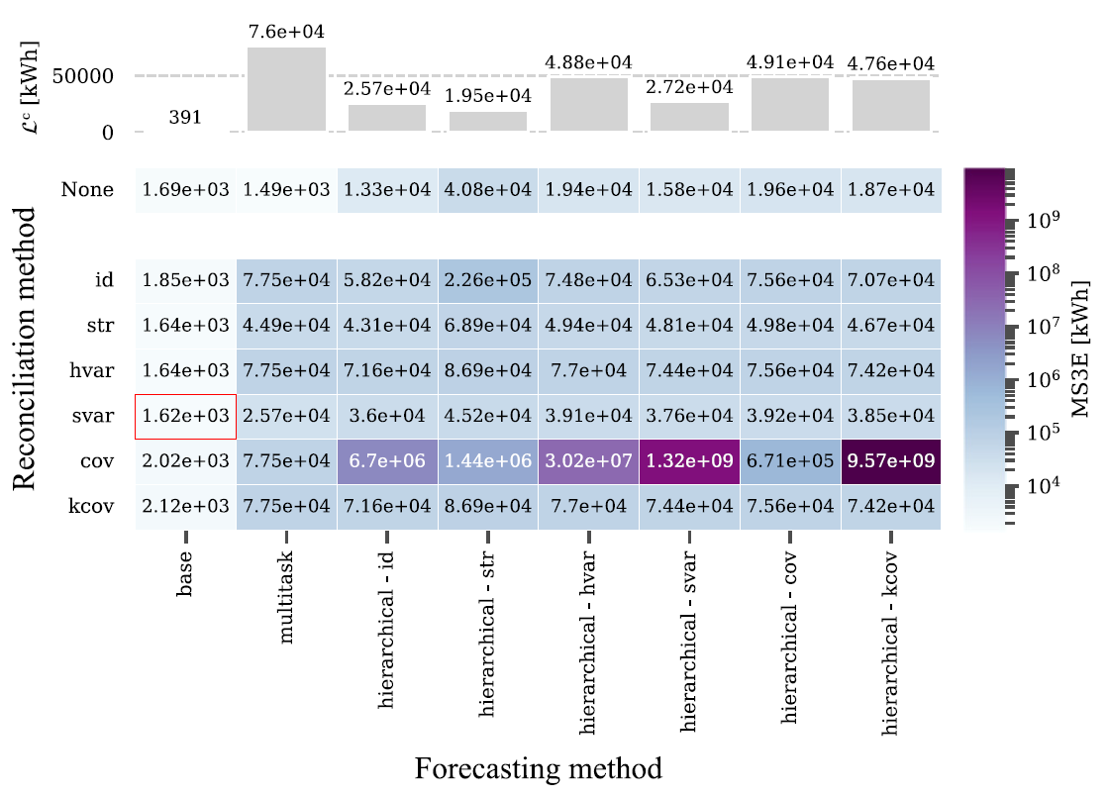
Results
BDG2 dataset 133 electric-meters
Spatiotemporal hierarchy
Day-ahead forecast
Context | Method | Results | 1 | 2 | Conclusion

Slide 17
Findings & method adjustments
Arduous learning
Faulty coherency learning
Many weights to update with little data
Normalization tempers the coherency learning
Explore architectures with fewer weights
Explore methods robust to varying ranges of target values
Induced coherency over accuracy
Batch normalization
Temporal hierarchy - periodicity falling on prediction horizon & fewer data points
Context | Method | Results | 1 | 2 | Conclusion

Slide 18
Method extension
Tailored designs of neural networks for efficient learning
Context | Method | Results | 1 | 2 | Conclusion

Slide 19
Method extension
Tailored designs of neural networks for efficient learning
Context | Method | Results | 1 | 2 | Conclusion

Slide 20
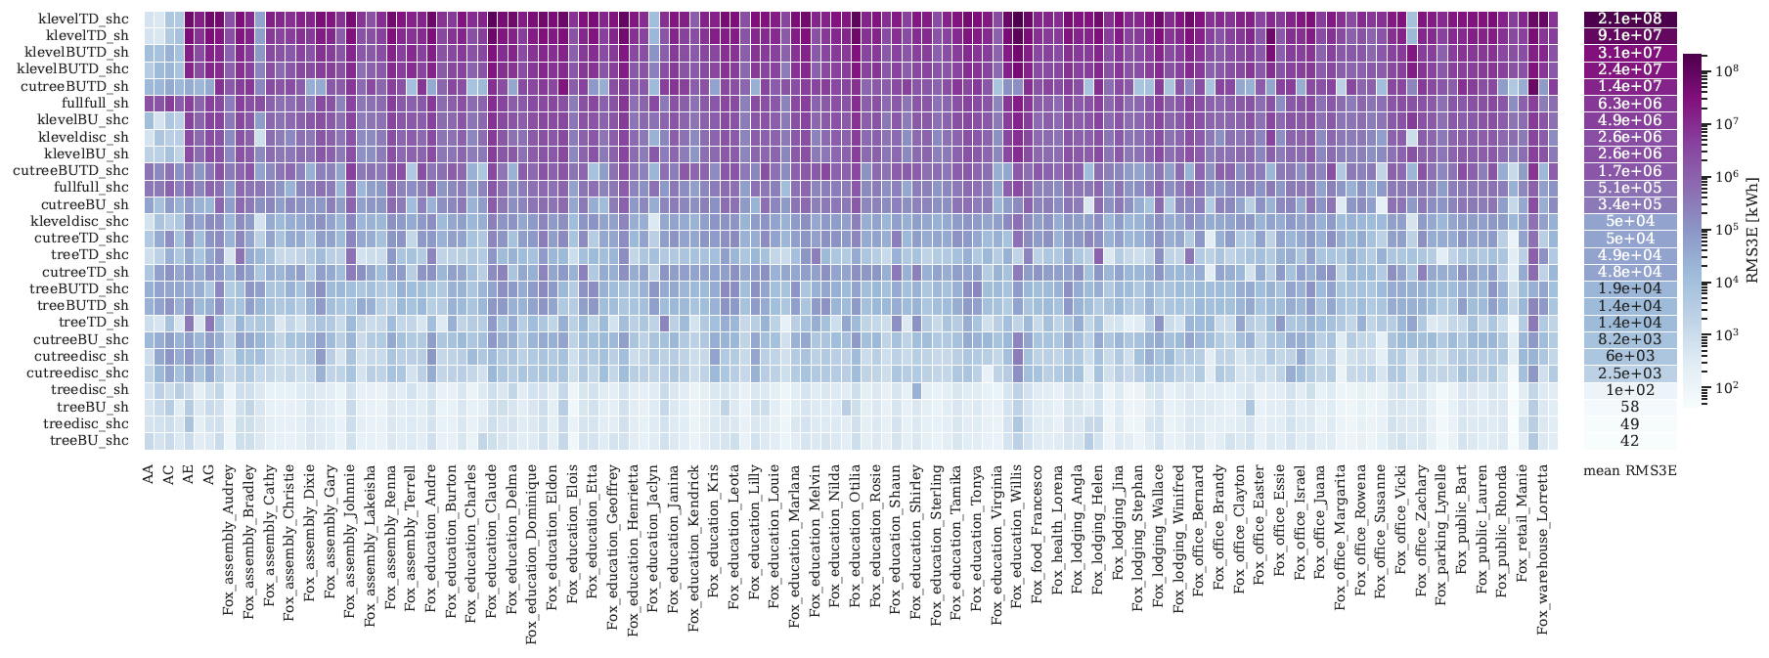
Results
BDG2 dataset Spatial tree – hour ahead
Context | Method | Results | 1 | 2 | Conclusion
Notes:
Shc – structural hierarchical coherency loss
Sh - structural hierarchical loss

Slide 21

Is coherency learning worth it?
Value from connecting scales?
Future work
Improved forecast performances with simpler models
Other machine learning methods
Varying hierarchical structures
Cluster homogeneity
Tree depth, width etc.
Requires centralized data
Complexity/value trade-off still too little
Linking prediction performances to hierarchical time-series characteristics
Scalability
Distributed approaches?
Piecewise reconciliation
Open-source research
https://github.com/JulienLeprince
Credit: https://freepik.com/
Context | Method | Results | 1 | 2 | Conclusion

Slide 22
Forecasting hierarchies with coherency-learning
Thank you
Julien Leprince | Sep 7th 2023
Building Services

Slide 23
Extra slides

Slide 24
Extra slides

Slide 25
Extra slides

Slide 26
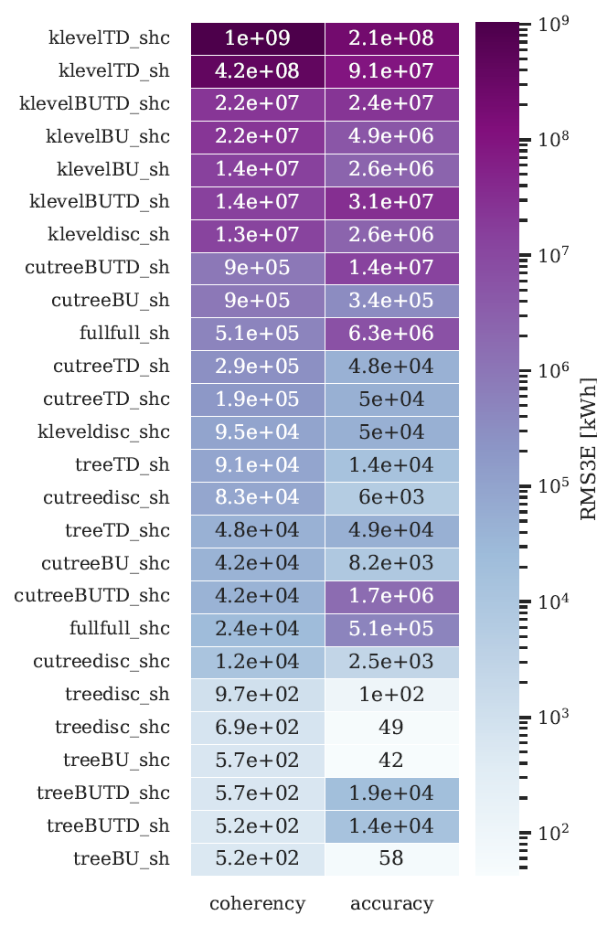
Extra slides Results

Slide 27
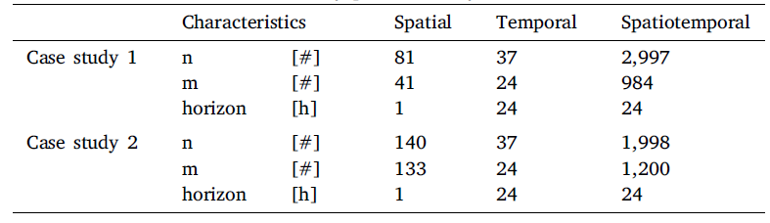
Extra slides
Case studies
Credit: https://freepik.com/

