Slide 1
Adding, Subtracting, and Multiplying Polynomials
I CAN…
add, subtract, and multiply polynomials.
Notes:
k

Slide 2
EXPLORE & REASON
Let S be the set of expressions that can be written as ax + b where a and b are
real numbers.
​Describe the Associative Property, Commutative Property, and the Distributive Property. Then, explain the role of each in simplifying the sum (3x + 2) + (7x − 4). Identify the leading coefficient and the constant term in the result.
​Is the sum you found in part A a member of S? Explain.
Construct Arguments Is the product of two expressions in S also a member of S? Explain why or produce a counterexample.

Slide 3

Essential Question
How do you add, subtract, and multiply polynomials?
Add and Subtract Polynomials
How do you add or subtract the polynomials?
To add and subtract polynomials, use the Commutative and Associative Properties to group like terms. Then combine like terms.
​
Example 1
(6x³ + 4x + x² − 7) + (2x³ – 8x² + 3)
= (6x³ + 2x³) + 4x + (x² − 8x²) + (−7 + 3)
= 8x³ + 4x − 7x² − 4
= 8x³ − 7x² + 4x − 4

Slide 4
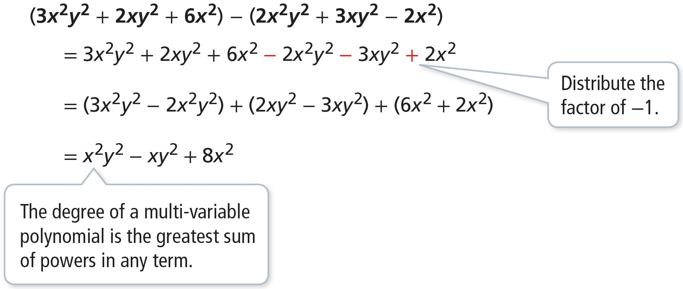
Add and Subtract Polynomials
How do you add or subtract the polynomials?
​
Example 1
USE STRUCTURE
In order for terms to be like terms, the variables and their corresponding exponents must be identical.

Slide 5
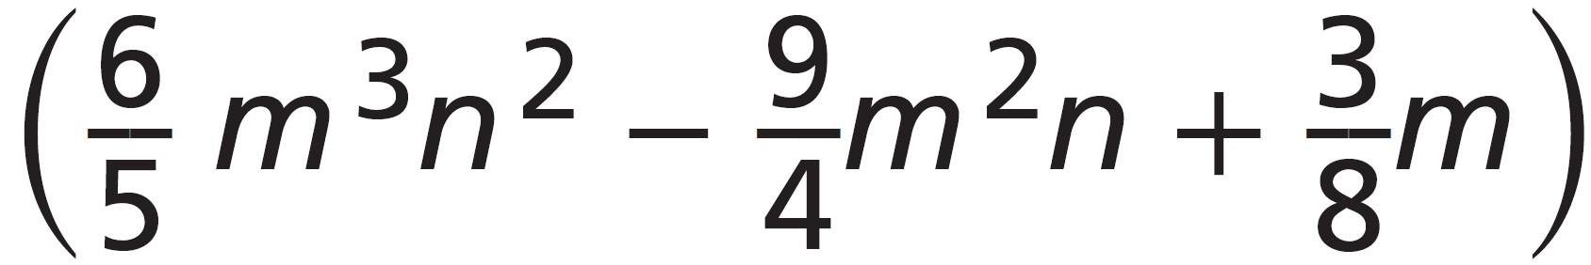
Add and Subtract Polynomials
Try It!
​ Add or subtract the polynomials.
​​(4a⁴ − 6a³ − 3a² + a + 1) + (5a³ + 7a² + 2a − 2)
​(2a²b² +3ab² − 5a²b) − (3a²b² − 9a²b + 7ab²)
​(3.4m³n² + 5.6m²n) − (0.7m³n² − 4.1m²n − n) +
Example 1

Slide 6

Multiply Polynomials
How do you multiply the polynomials?
To multiply polynomials, use the Distributive Property, then group like terms and combine.
​ (2m + 5) (3m² − 4m + 2)
= 2m(3m² − 4m + 2) + 5(3m² − 4m + 2)
= 6m³ − 8m² + 4m + 15m² − 20m + 10
= 6m³ + (−8m² + 15m²) + (4m − 20m) + 10
= 6m³ + 7m² − 16m + 10
Example 2

Slide 7

Multiply Polynomials
How do you multiply the polynomials?
(mn + 1)(mn − 2)(mn + 4)
= [(mn + 1)(mn − 2)](mn + 4)
= (m²n² − 2mn + mn − 2)(mn + 4)
= (m²n² − mn − 2)(mn + 4)
= m²n² (mn + 4) + (−mn)(mn + 4) + (−2)(mn + 4)
= m³n³ + 4m²n² − m²n² − 4mn − 2mn − 8
= m³n³ + (4m²n² − m²n²) + (−4mn − 2mn) − 8
= m³n³ + 3m²n² − 6mn − 8.
Example 2
LEARN TOGETHER
How do you value other perspectives and points of view respectfully?

Slide 8
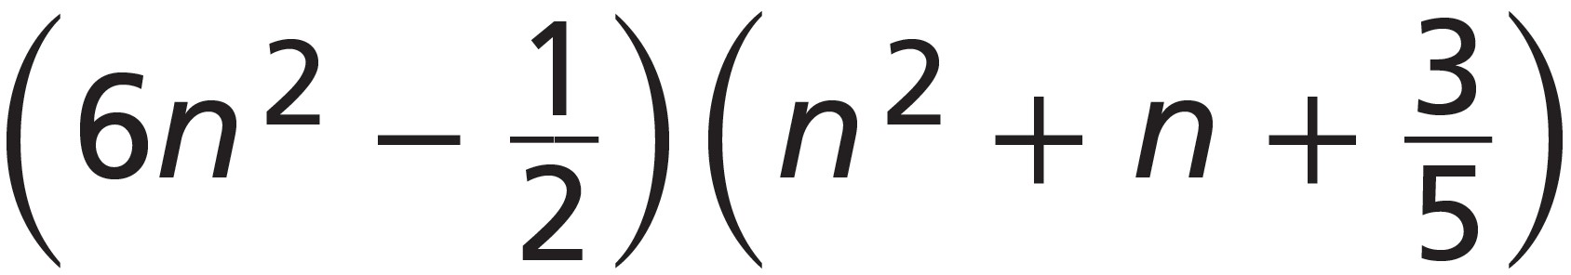
Multiply Polynomials
Try It!
​​Multiply the polynomials.
​ ​
​(mn + 1)(m²n − 1)(mn² + 2)
Example 2

Slide 9
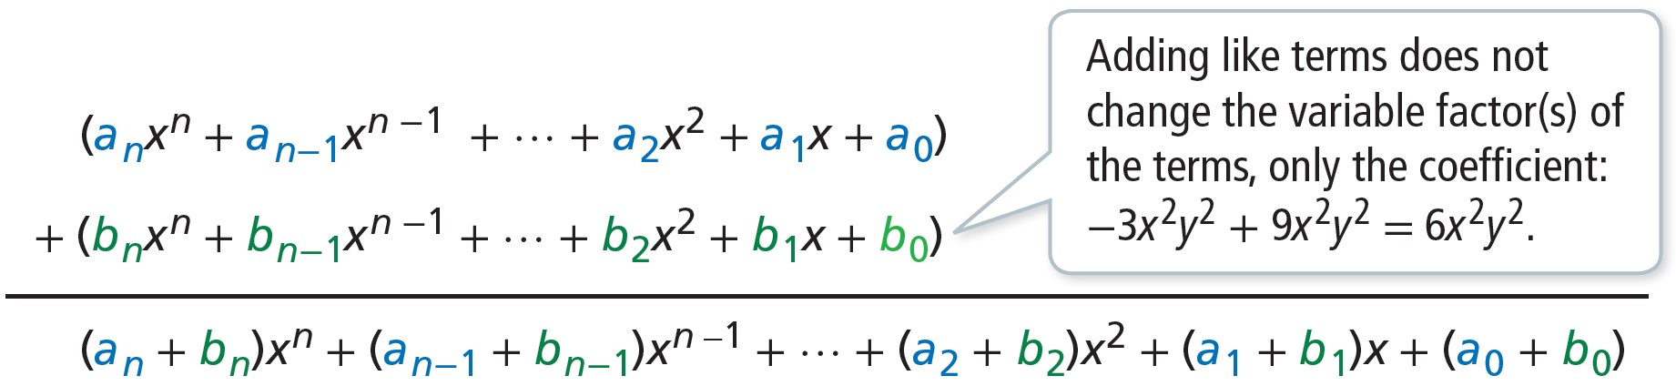
CONCEPTUAL UNDERSTANDING
Understand Closure
Is the set of polynomials closed under addition and subtraction? Explain.
Add two polynomials:
Example 3
Since the coefficients are real and the exponents are unchanged, the sum is still a polynomial.
So the set of polynomials is closed under addition.
Likewise for subtraction, each coefficient is in the form a_{i}− b_{i} and the exponents are unchanged,
so the set of polynomials is closed under subtraction.
COMMUNICATE PRECISELY
The set of real numbers is closed under addition: if a and b are real and a + b = c, then c is also real.

Slide 10
Understand Closure
Try It!
​Show that the set of monomials is closed under multiplication.
Example 3

Slide 11
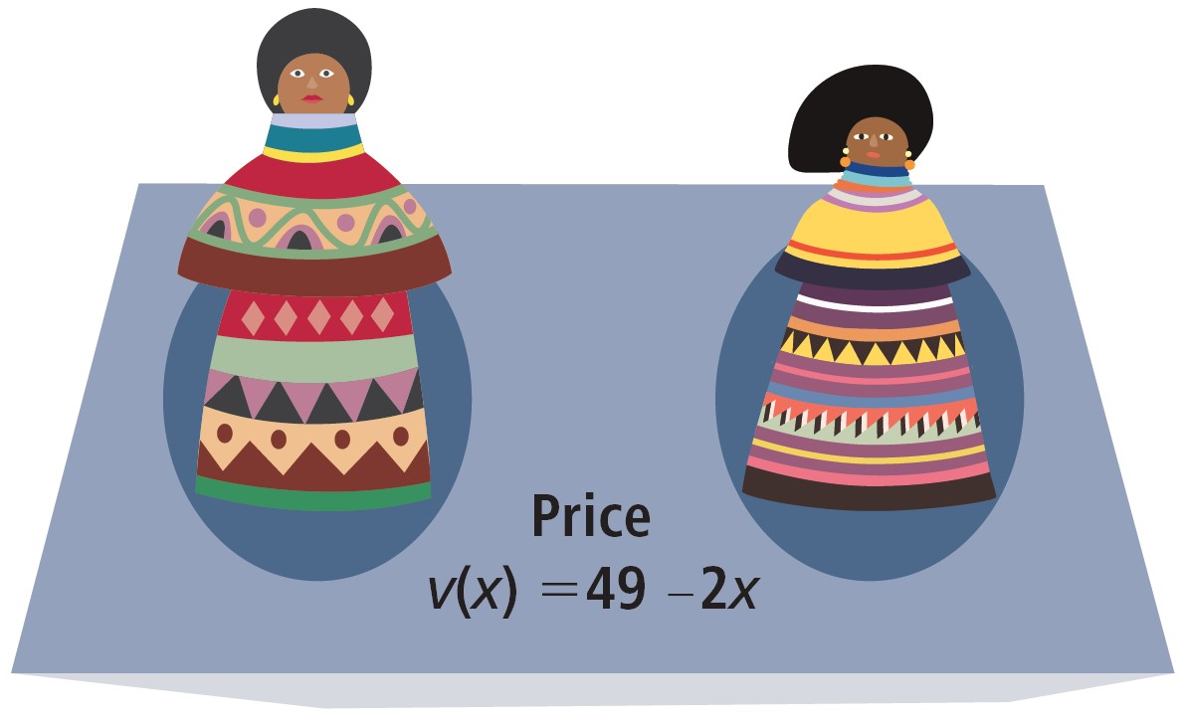
APPLICATION
Write a Polynomial Function
Hachi makes Seminole Indian dolls to sell at the local
street market.
As Hachi produces a greater number of dolls, she
can lower the cost per unit. The cost c of making
x dolls can be represented with the function
c(x) = 12x + 64 . The function v(x) relates the
price v to the number of dolls produced, x.
How many Seminole Indian dolls should Hachi sell each week to maximize her
profit P? Recall that profit equals revenue minus cost.
Formulate
Write a function for revenue R by multiplying the price v(x) = 49 − 2x of each item by the number sold x.
R(x) = (49 − 2x)x
Then write the function for profit P.
P(x) = R(x) − c(x)
= (49 − 2x)x − (12x + 64)
Example 4

Slide 12
APPLICATION
Write a Polynomial Function
Hachi makes Seminole Indian dolls to sell at the local
street market.
As Hachi produces a greater number of dolls, she
can lower the cost per unit. The cost c of making
x dolls can be represented with the function
c(x) = 12x + 64 . The function v(x) relates the
price v to the number of dolls produced, x.
How many Seminole Indian dolls should Hachi sell each week to maximize her
profit P? Recall that profit equals revenue minus cost.
Compute
Simplify the function.
P(x) = (49 − 2x)x − (12x + 64)
  = (49x − 2x²) − (12x + 64)
= 49x − 2x² − 12x − 64
= −2x² + 37x − 64
Hachi's profit function is P(x) = −2x² + 37x − 64.
Example 4

Slide 13
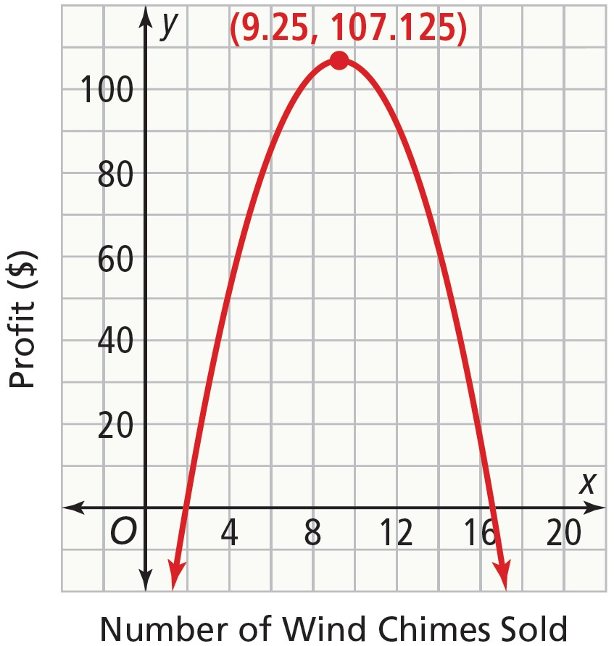
APPLICATION
Write a Polynomial Function
Hachi makes Seminole Indian dolls to sell at the local
street market.
As Hachi produces a greater number of dolls, she
can lower the cost per unit. The cost c of making
x dolls can be represented with the function
c(x) = 12x + 64 . The function v(x) relates the
price v to the number of dolls produced, x.
How many Seminole Indian dolls should Hachi sell each week to maximize her
profit P? Recall that profit equals revenue minus cost.
Interpret
Hachi’s profit is modeled by a quadratic function. The domain of the
function is the set of whole numbers. Her maximum profit cannot
correspond to the vertex of the graph because she cannot sell a part
of a doll. Consider P(9) =107 and P(10) =106 and choose the maximum
profit of the two.
Hachi’s best business plan is to produce and sell 9 Seminole Indian dolls
per week, for a weekly profit of $107.
Example 4

Slide 14
Write a Polynomial Function
Try It!
​The cost of Hachi's materials changes so that her new cost function is c(x) = 4x + 42.
Find the new profit function. Then find the quantity that maximizes profit and
calculate the profit.
Example 4

Slide 15
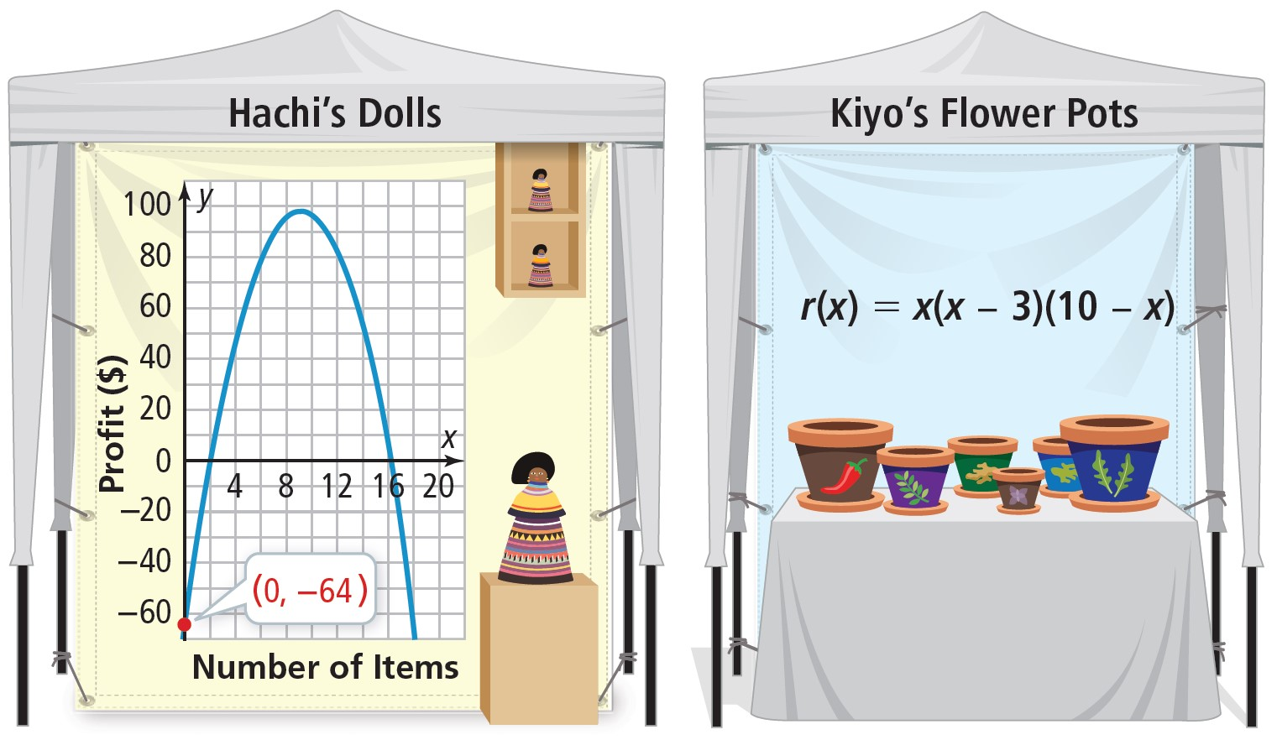
APPLICATION
Compare Two Polynomial Functions
Hachi's profit function, y = P(x), is represented by the graph. Kiyo’s profit from selling x flowerpots can be modeled by the function shown.
Example 5

Slide 16
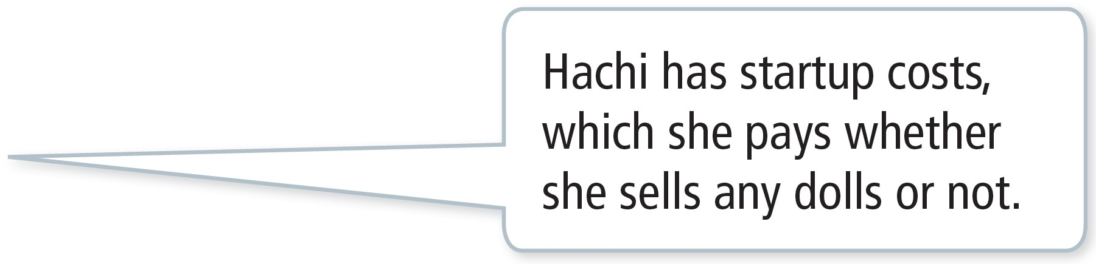

APPLICATION
Compare Two Polynomial Functions
Hachi's profit function, y = P(x), is represented by the graph. Kiyo’s profit from selling x flowerpots can be modeled by the function shown.
Find the y-intercept of each function. Who would lose more money if neither person sold any items?
The y-intercept of P(x) is −64.
If Hachi does not sell any dolls this
week, she will lose $64.
Substitute 0 for x in r to find the y -intercept.
r(0) = 0(0 − 3)(10 − 0)
      = 0
Example 5
The y-intercept of r is 0. If Kiyo does not sell any flowerpots, he will not lose any money.
So, Hachi loses more money by not making any sales.

Slide 17
APPLICATION
Compare Two Polynomial Functions
Hachi's profit function, y = P(x), is represented by the graph. Kiyo’s profit from selling x flowerpots can be modeled by the function shown.
Interpret the end behavior of the functions.
The domain of each function includes only non-negative values.
The graph of P(x) shows that the end behavior, as x → ∞, is y → −∞.
Rewrite the function r in standard form to identify end behavior.
r(x) = x(x − 3)(10 − x)
    = (x² − 3x)(10 − x)
= −x³ + 13x² − 30x
Because the leading coefficient is negative, we know that as x → ∞, y → −∞.
Kiyo and Hachi each have a finite number of items they should sell to maximize profits.
They will both lose money if they sell too many items.
Example 5
USE STRUCTURE
As x approaches positive infinity or negative infinity, the leading term of the polynomial determines the end behavior of the graph of the function.

Slide 18
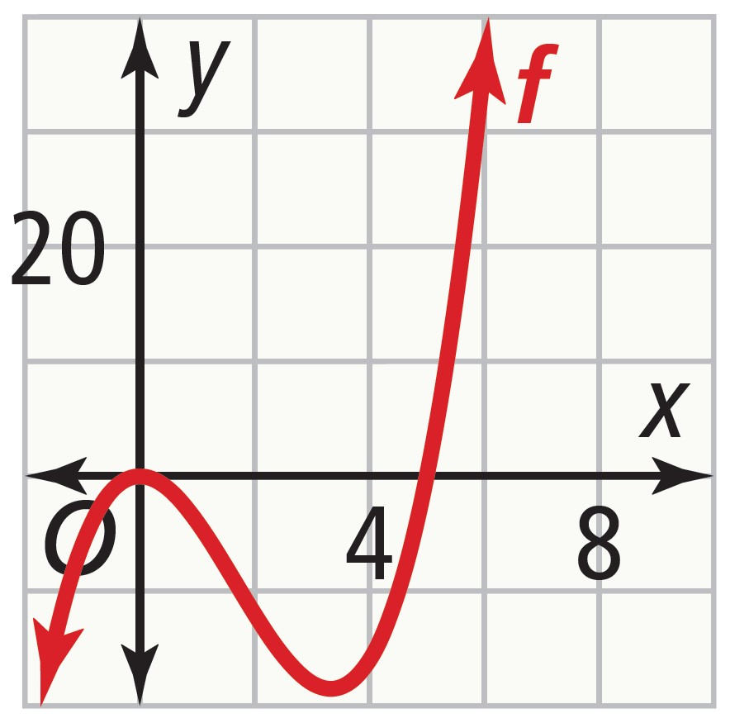
Compare Two Polynomial Functions
Try It!
​​Compare the profit functions of two additional market sellers modeled by the graph of
f and the equation g(x) = (x + 1)(5 – x). Compare and interpret the y-intercepts of these functions and their end behavior.
Example 5

Slide 19
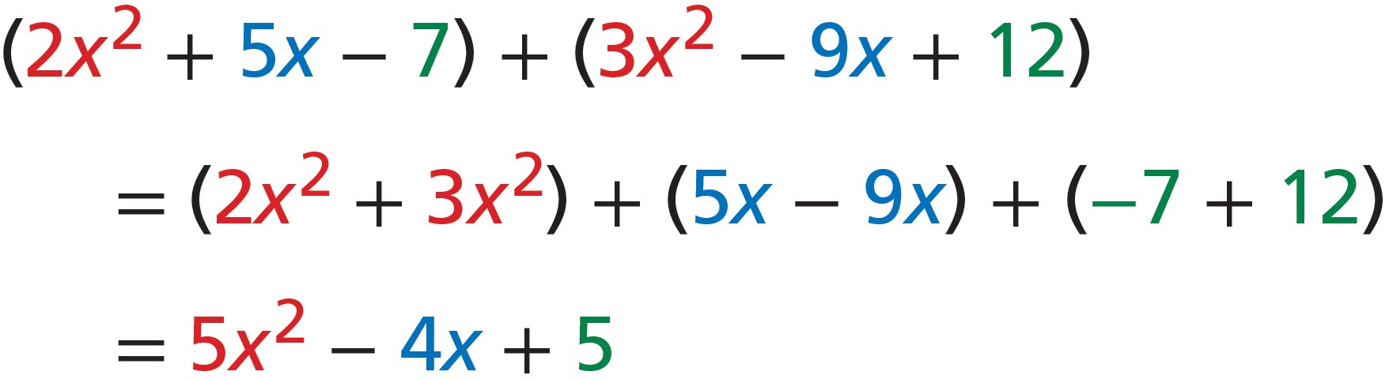
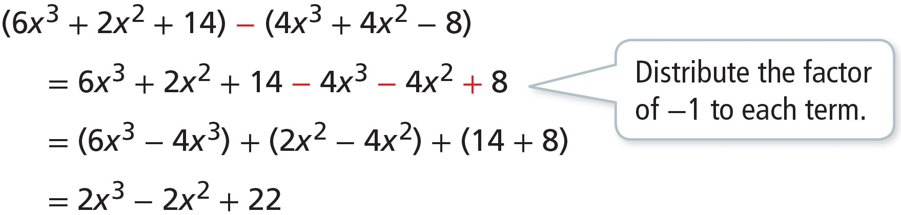
CONCEPT SUMMARY
Adding, Subtracting, and Multiplying Polynomials
ADD To add polynomials, use the Associative and Commutative Properties to group like terms. Then combine like terms.
SUBTRACT To subtract polynomials, group and combine like terms.

Slide 20
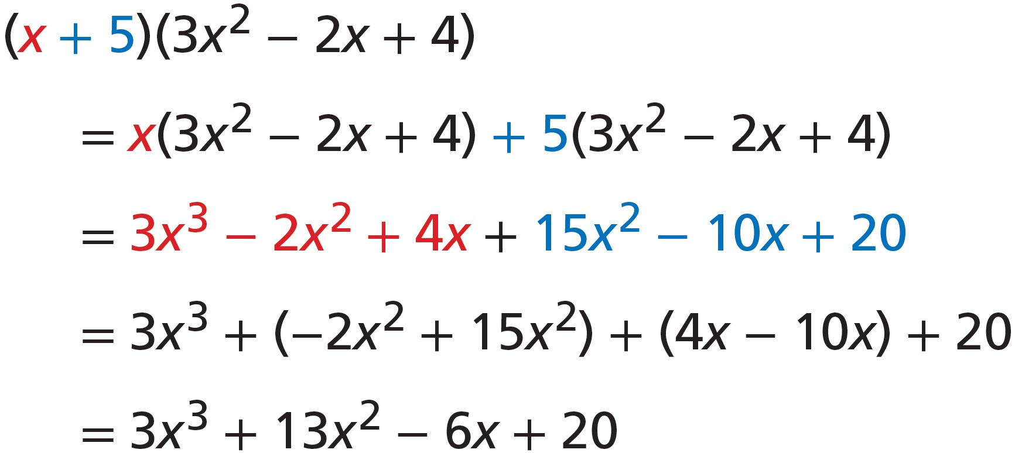
CONCEPT SUMMARY
Adding, Subtracting, and Multiplying Polynomials
MULTIPLY To multiply polynomials, use the Distributive Property. Then, group and combine like terms.

Slide 21
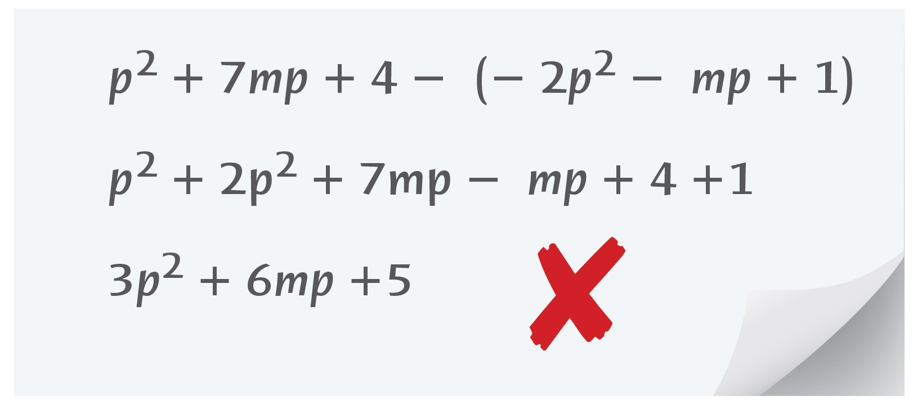
Do You Understand?
Essential Question How do you add, subtract, and multiply polynomials?
Error Analysis Chen subtracted two polynomials as shown. Explain Chen’s error.
Communicate Precisely Why do we often write the results of polynomial calculations in standard form?
Construct Arguments Is the set of whole numbers closed under subtraction?
Explain why you think so, or provide a counterexample.

Slide 22

Do You Know How?
Add or subtract the polynomials.​
​(−3a³ + 2a² − 4) + (a³ − 3a² − 5a + 7)​
​(7x²y² − 6x³ + xy) − ( 5x²y² − x³ + xy + x)
Multiply the polynomials.
​(7a + 2)(2a² − 5a + 3)
​(xy − 1)(xy + 6)(xy − 8)
​The length of a rectangular speaker is three times its width, and the height is four more than the width. Write an expression for the volume V of the rectangular prism in terms of its width w.

