Slide 1
Inverse Variation and the Reciprocal Function
I CAN…
use inverse variation and graph translations of the reciprocal function.
VOCABULARY
asymptote
constant of variation
inverse variation
reciprocal function
Notes:
k

Slide 2
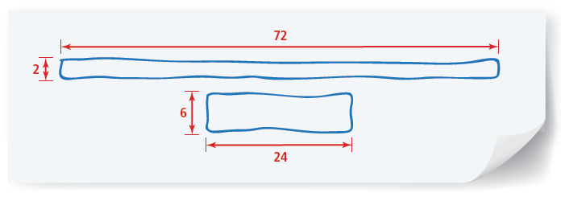
MODEL & DISCUSS
The two rectangles shown both have an area of 144 square units.
​Sketch as many other rectangles as you can that have the same area. Organize and record your data for the lengths and widths of the rectangles.
Use Structure Considering rectangles with an area of 144 square units, what happens to the width of the rectangle as the length increases?
​Examine at least five other pairs of rectangles, each pair sharing the same area. How would you describe the relationship between the lengths and widths?

Slide 3

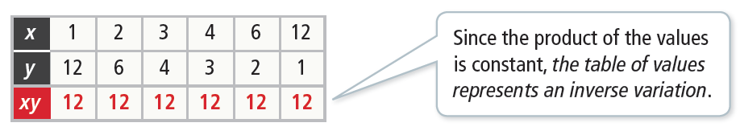
Essential Question
How are inverse variations related to the reciprocal function?
Identify Inverse Variation
How do you determine if a relationship represents an inverse variation?
​Does the table of values represent an inverse variation?
An inverse variation is a relation between two variables such that as one variable increases, the other decreases proportionally. For the table to represent an inverse variation, the product of x and y must be constant. Find the product, xy, for each column in the table.
Example 1
STUDY TIP
Be sure to check the products for every pair of values before drawing a conclusion.

Slide 4

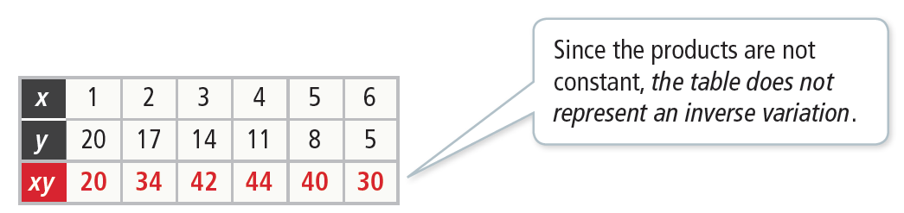
Identify Inverse Variation
How do you determine if a relationship represents an inverse variation?
​Does the table of values represent an inverse variation?
Find the products.
Example 1

Slide 5


Identify Inverse Variation
Try It!
​​Determine if each table of values represents an inverse variation.
​
​
Example 1

Slide 6

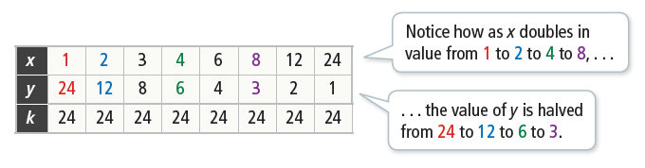
CONCEPT Inverse Variation
When a relation between x and y is an inverse variation, we say that x varies inversely as y. Inverse
variation is modeled by the equation where k ≠ 0. The variable k represents the constant of variation, the number that relates the two variables in an inverse variation.

Slide 7
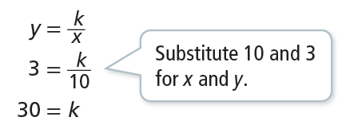
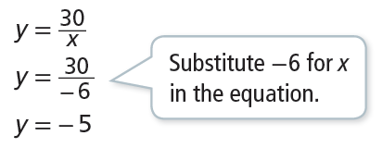

Use Inverse Variation
In an inverse variation, x = 10 when y = 3. Write an equation to represent
the inverse variation. Then find the value of y when x = − 6.
Step 1 Write the equation for an inverse variation and solve for k.
Step 2 Substitute k = 30 in the inverse variation equation and then find y.
The equation that represents the inverse relation is When x = −6, y = −5.
Example 2
COMMON ERROR
Remember in direct variation, y = kx, that x and y increase or decrease at the same time. In inverse variation xy = k, as one variable increases the other decreases.

Slide 8

Use Inverse Variation
Try It!
​In an inverse variation, x = 6 and
​What is the equation that represents the inverse variation?
​What is the value of y when x = 15?
Example 2

Slide 9
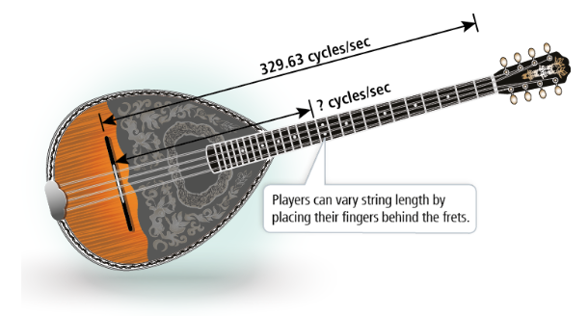
APPLICATION
Use an Inverse Variation Model
On a Greek bouzouki, the string length s varies inversely with the frequency f of its vibrations.
Example 3
LEARN TOGETHER
How can you share your ideas and communicate your thinking with others?
Photo credit: Vectorshape/Shutterstock

Slide 10
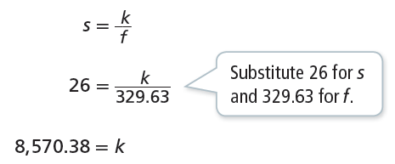
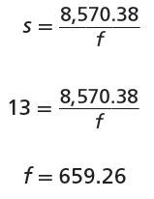
APPLICATION
Use an Inverse Variation Model
Step 1 Write the equation for an inverse variation and solve for k.
Step 2 Substitute k = 8,570.38 in the inverse variation equation and then find f.
So the frequency of the 13-inch string is 659.26 cycles per second.
Example 3
The frequency of a 26-inch E-string is 329.63 cycles per second. What is the frequency when the string length is 13 inches?
MAKE SENSE AND PERSEVERE
In stringed instruments, higher frequencies result in higher pitched sounds. How does varying string length affect pitch?

Slide 11
Use an Inverse Variation Model
Try It!
​The amount of time it takes for an ice cube to melt varies inversely to the air temperature, in degrees. At 20° Celsius, the ice will melt in 20 minutes. How long will it take the ice to melt if the temperature is 30° Celsius?
Example 3

Slide 12


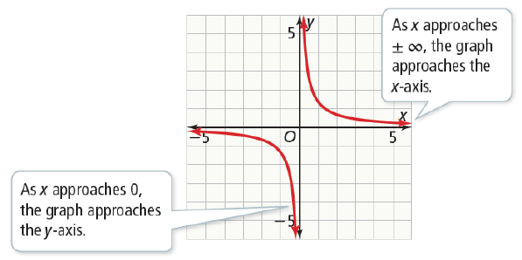


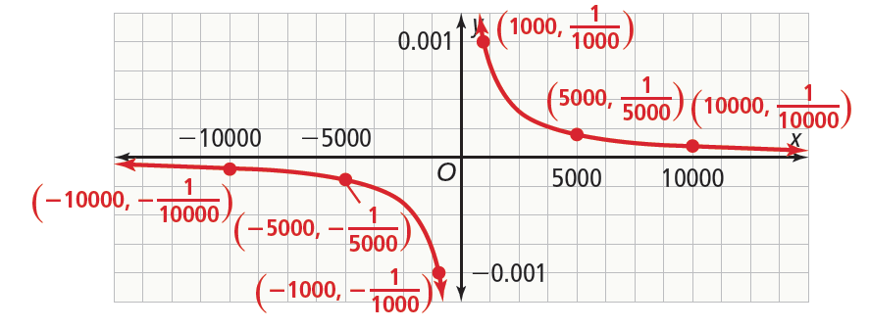
CONCEPTUAL UNDERSTANDING
Understand the Graph of the Reciprocal Function
​What are the key features of the reciprocal function
The reciprocal function maps
every non-zero real number to its reciprocal. Use technology to graph the function.
You can use the TRACE feature to understand the end behavior. Notice that the values of f(x) get closer and closer to 0 as x goes to or , but never equal 0.
Example 4

Slide 13
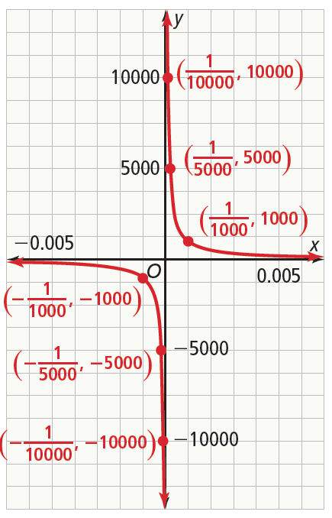

CONCEPTUAL UNDERSTANDING
Understand the Graph of the Reciprocal Function
​What are the key features of the reciprocal function
The graph of f has a horizontal asymptote y = 0. An asymptote is a line that a graph approaches.
Recall that a fraction with a denominator of 0 is undefined. Use the TRACE feature again with x-values close to 0. For positive x-values, as x approaches 0, f(x) goes to . For negative x-values, as x approaches 0, f(x) goes to .
The graph of f has a vertical asymptote x = 0.
The domain of . The range
is {y | y ≠ 0}.
The end behavior is f(x) → 0 as x → ± .
Example 4

Slide 14

Understand the Graph of the Reciprocal Function
Try It!
​Graph the function . What are the domain, range, and asymptotes of the function?
Example 4

Slide 15


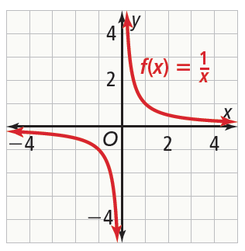
Graph Translations of the Reciprocal Function
​Graph What are the equations of the asymptotes?
What are the domain and range?
Use technology to graph the parent function,
Example 5

Slide 16

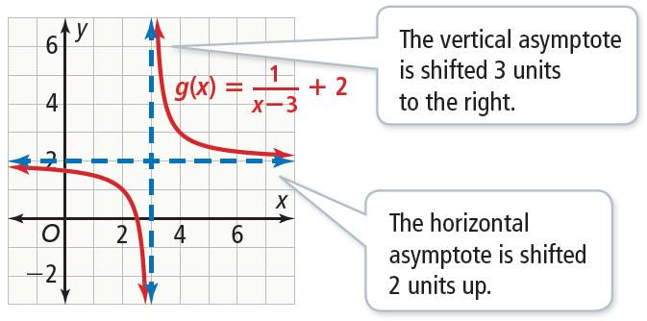


Graph Translations of the Reciprocal Function
​Graph What are the equations of the asymptotes?
What are the domain and range?
In terms of f(x), you can write g(x) as
Therefore, the graph of g is the graph of f translated 3 units right and 2 units up.
The line x = 3 is a vertical asymptote. The line y = 2 is a horizontal asymptote.
The domain is {x | x ≠ 3}.
The range is {y | y ≠ 2}.
Example 5
GENERALIZE
Recall that subtracting h from x ranslates the graph of f horizontally. Adding k to f(x) translates the graph of f vertically.
So the graph of is the
graph of translated h units
horizontally and k units vertically.

Slide 17

Graph Translations of the Reciprocal Function
Try It!
​​Graph What are the equations of the asymptotes?
What are the domain and range?
Example 5

Slide 18



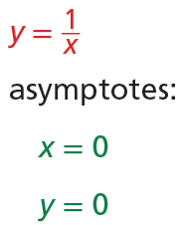
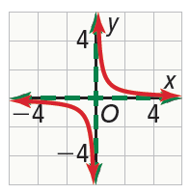
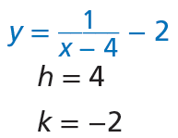
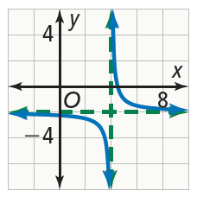





CONCEPT SUMMARY
Inverse Variation and the Reciprocal Function
 | Inverse Variation | Transformations of the Reciprocal Function
WORDS | An inverse variation is a relation between two variables such that as one variable increases, the other decreases proportionally. | The reciprocal function models the inverse variation, Like other functions, it can be transformed.
ALGEBRA | ,
EXAMPLES

Slide 19
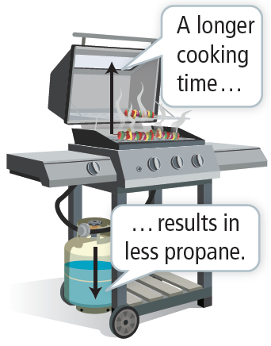
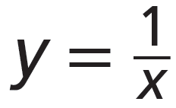

Do You Understand?
Essential Question How are inverse variations related to the reciprocal function?
Construct Arguments Explain why the amount of propane in a grill’s tank and the time spent grilling could represent an inverse variation.
Vocabulary Why is it impossible for the graph of the function to intersect the horizontal asymptote at the x-axis?
Error Analysis Carmen said the table of values shown represents an inverse variation. Explain why Carmen is mistaken.

Slide 20

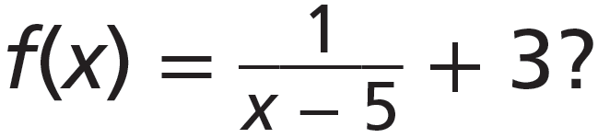
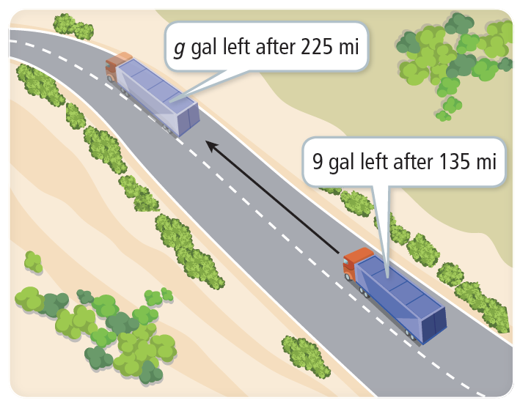
Do You Know How?
​In an inverse variation, x = −8 when What is the value of y when x = 4?
​What are the equations of the asymptotes of the function What are the domain and range?
​Until the truck runs out of gas, the amount of gas in its fuel tank varies inversely with the number of miles traveled. Model a relationship between the amount of gas in a fuel tank of a truck and the number of miles traveled by the truck as an inverse variation.

