Slide 1
Transformations of Functions
I CAN…
apply transformations to graph functions and write equations.
VOCABULARY
compression
reflection
stretch
transformation
translation

Slide 2
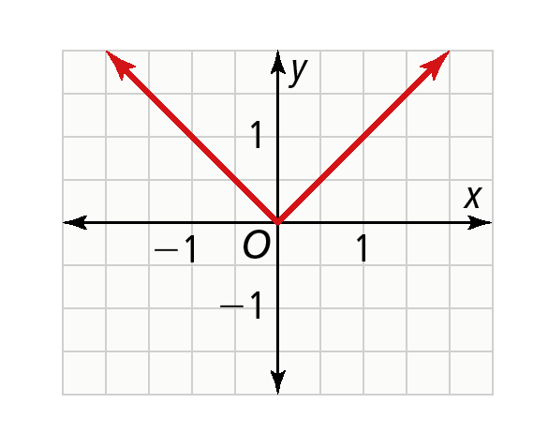

EXPLORE & REASON
The graph of the function f(x) = ∣x∣ is shown.
​Graph the function g(x) = ∣x + c∣ several times with different values for c (any value from −5 to 5).
​Look for Relationships Predict what will happen to the graph if c is a number
greater than 100. What if c is a number between 0 and

Slide 3
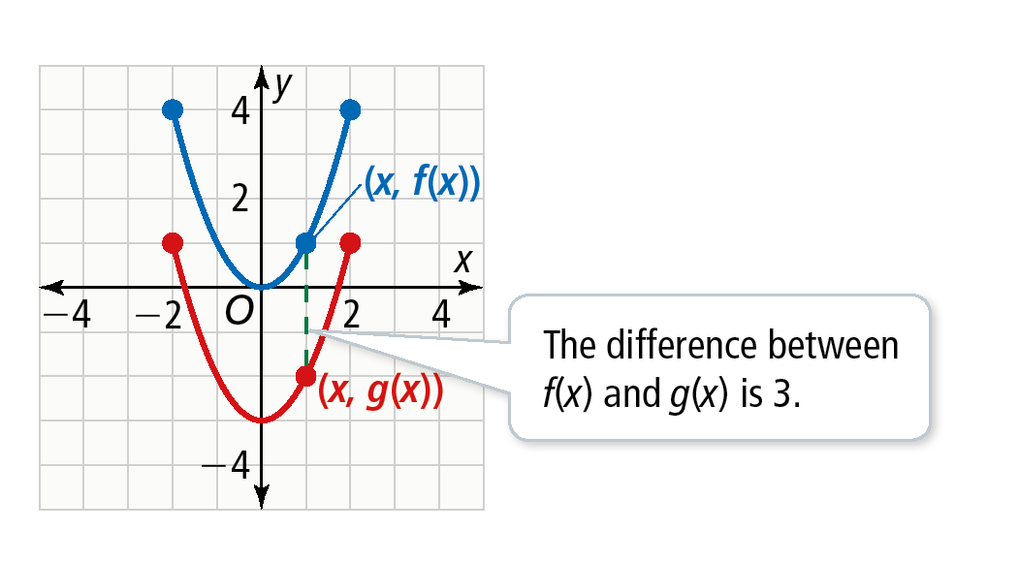
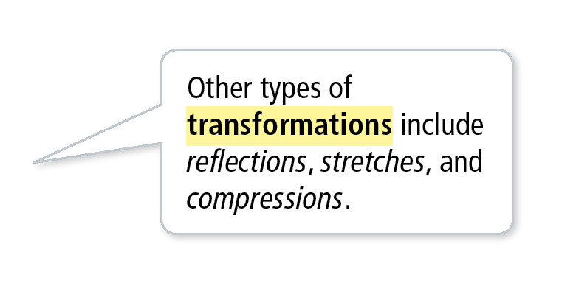
Essential Question
How do the values a, b, h, and k in a • f [b(x − h)] + k transform the graph of a parent function, f(x)?
CONCEPTUAL UNDERSTANDING
Translate a Function
​Graph the function f(x) = x² for the domain [−2, 2]. The graph of g is the graph of f after a translation of 3 units down. How are the functions, domains, and ranges of f and g related?
Every point on the graph of g is 3 units below a corresponding
point on the graph of f.
g(x) = f(x) − 3
g(x) = x² − 3
The domains of f and g are the same: [−2, 2]. The range values of g are 3 units less than the range values of f. The range of f is [0, 4] and the range of g is [−3, 1].
A translation is a type of transformation
of a function, one that shifts each point
on a graph the same distance and
direction.
In general, if g(x) = f(x) + k, then the
graph of g is a vertical translation of the graph of f by k units.
Example 1
LOOK FOR RELATIONSHIPS
This type of transformation slides the graph up or down. You could perform a transformation like this to a non-vertical line and produce a parallel line.

Slide 4
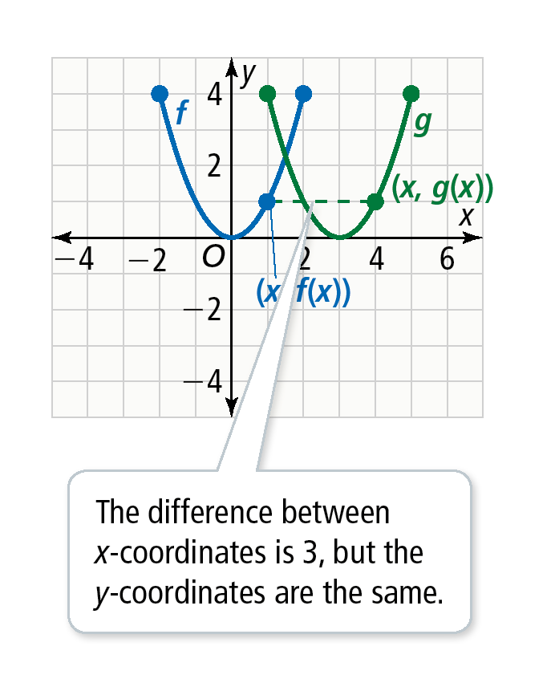
CONCEPTUAL UNDERSTANDING
Translate a Function
​Graph the function f(x) = x² for the domain [−2, 2]. The graph of the function
g is the graph of f after a translation 3 units to the right. How are the functions, domains, and ranges of f and g related?
Every point on the graph of g is 3 units to the right of the corresponding
point on the graph of f. Express g(x) in terms of f(x).
g(x) = f(x − 3)
g(x) = (x − 3)²
The range values of f and g are the same: [0, 4]. The domain values
of g are 3 units more than the domain values of f. The domain of
f is [−2, 2] and the domain of g is [1, 5].
In general, if g(x) = f(x − h), then the graph of g is a horizontal
translation of the graph of f by h units.
Example 1

Slide 5
Translate a Function
Try It!
1. a. Compare the intercepts of f to the intercepts of g in part (a).
b. Compare the intercepts of f to the intercepts of g in part (b).
Example 1

Slide 6
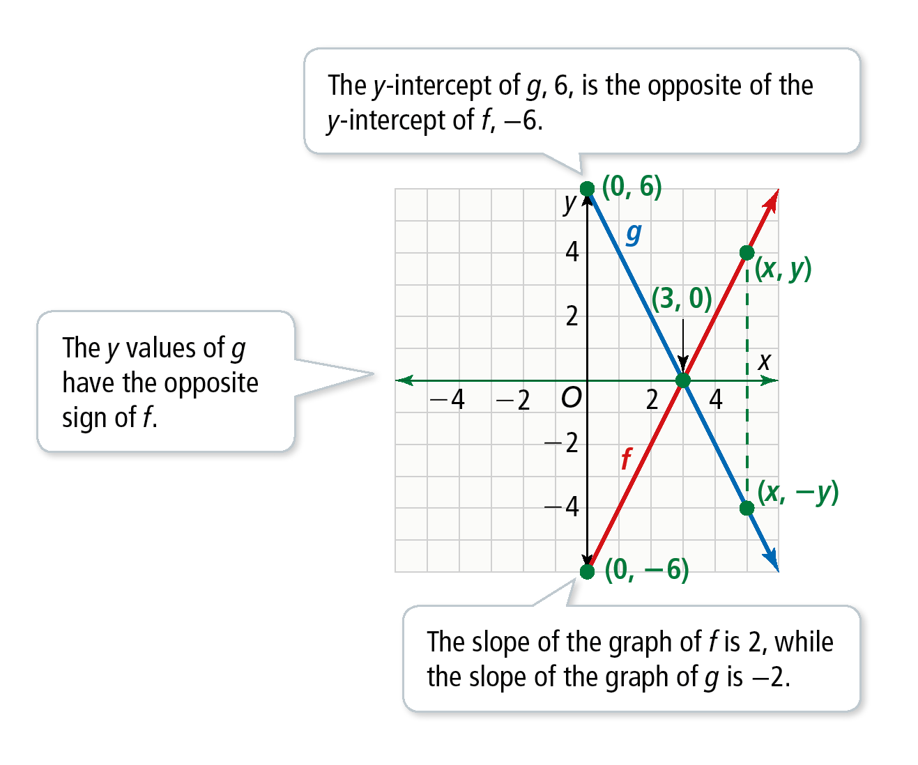
Reflect a Function Across the x- or y-Axis
Graph f(x) = 2x − 6 for the domain (0, ∞) and the function g, whose graph is the reflection of the graph of f across the x-axis. How are their functions related?
Graph f. Then graph g by reflecting each point of the
graph of f across the x-axis. For each point (x, y) on the
graph of f, plot the point (x, −y) to get the graph of g.
g(x) = −f(x)
= −(2x − 6)
g(x) = −2x + 6
The expression that defines g is the opposite of the
expression that defines f. The domain of g is the same as f.
The range of f is [−6, ∞) and the range of g is (−∞, 6].
Example 2
VOCABULARY
Recall that a reflection is a transformation that maps each point to a new point across a given line, called the line of reflection.

Slide 7
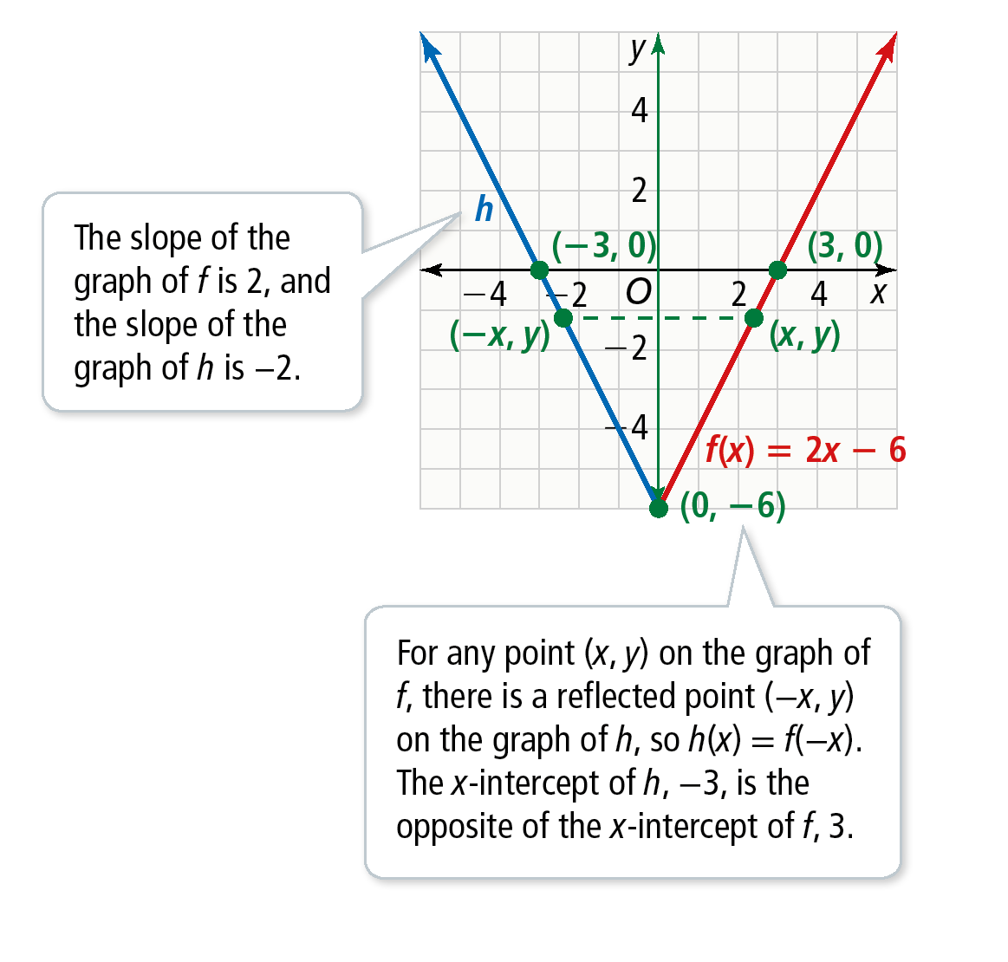
Reflect a Function Across the x- or y-Axis
Graph f(x) = 2x − 6 for the domain [0, ∞) and the function h, whose graph is the reflection of the graph of f across the y-axis. How are their functions related?
Graph f. Then reflect every point on the graph
of f over the y-axis to produce the graph of h.
h(x) = f(−x)
= 2(−x) − 6
h(x) = −2x − 6
The function h has a slope that is the opposite
of the slope of f but with the same y-intercept.
The domain of h is (−∞, 0]. The range for f and h
are the same, [−6, ∞).
Example 2
USE STRUCTURE
Why does g(x) = −f(x) affect the y-coordinate of each point and g(x) = f(−x) affect the x-coordinate of each point?

Slide 8
Reflect a Function Across the x- or y-Axis
Try It!
​What is the function for the reflected graph? Check by graphing.
​the graph of f(x) = x² − 2 reflected across the x-axis
​the graph of f(x) = x² − 2 reflected across the y-axis
Example 2

Slide 9

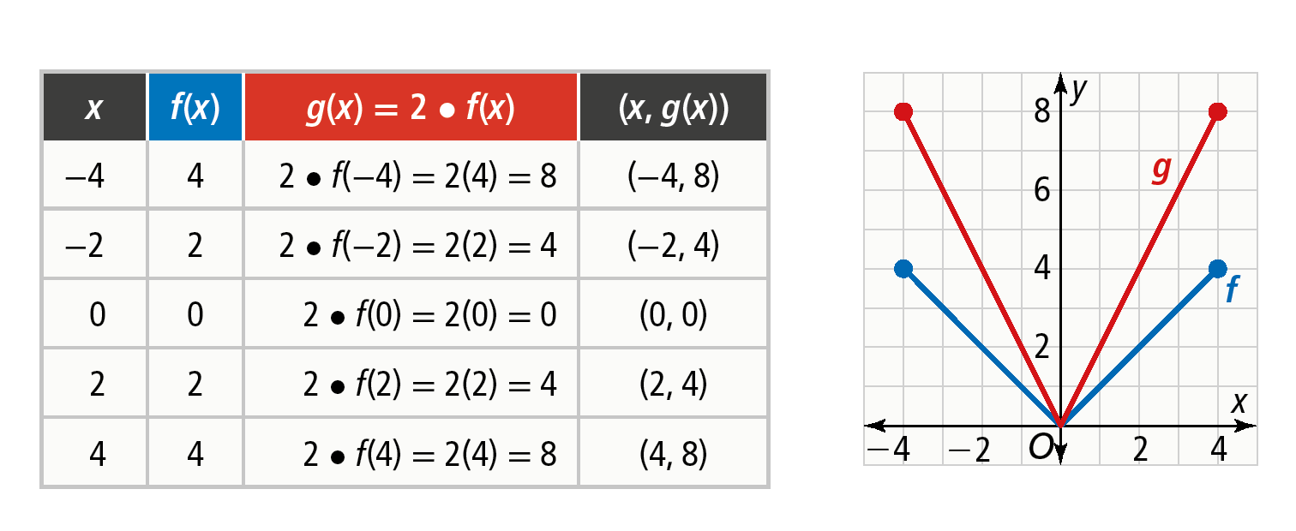
Understand Stretches and Compressions
​Graph f(x) = ∣x∣ with domain [−4, 4] and g(x) = 2 f(x). How are the graphs, domains, and ranges related?
Use a table to find points on the graph of g.
A transformation that increases the distance between the points of a graph and a given line, usually the x-axis, by the same factor is called a stretch. The graph of g is a vertical stretch of the graph of f by a factor of 2.
The domains of f and g are the same. The range of f, [0, 4], is doubled for g to [0, 8].
Example 3
Example

Slide 10
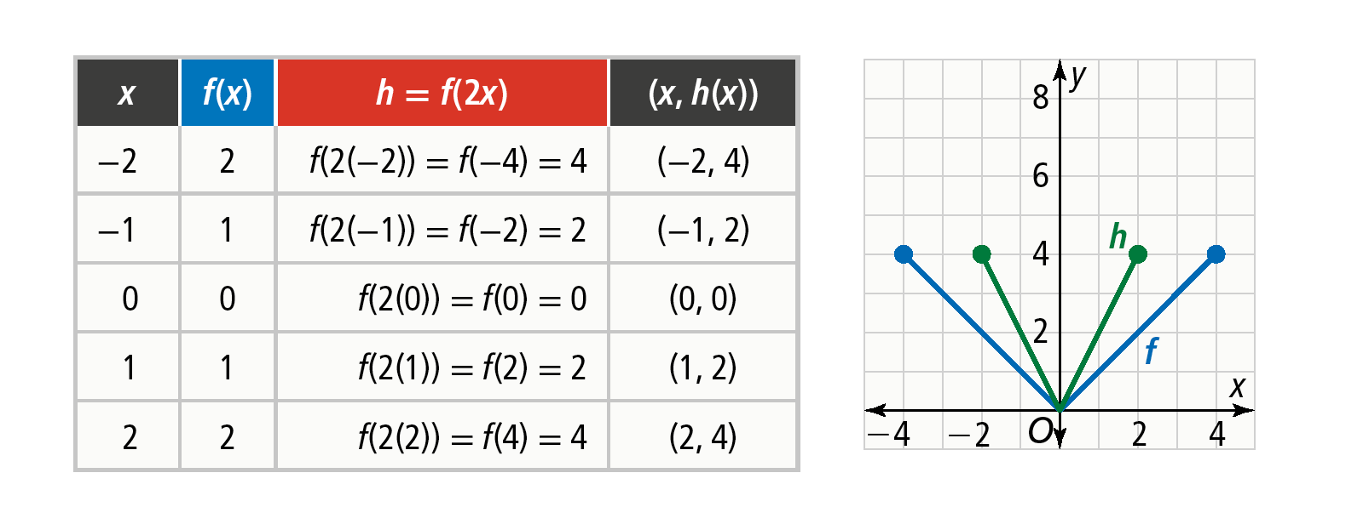
Understand Stretches and Compressions
​Graph f(x) = ∣x∣ with domain [−4, 4] and h(x) = f(2x). How are the graphs, domains, and ranges related?
Use a table to find points on the graph of h.
A transformation that decreases the distance between the
points of a graph and a given line, usually the y-axis, by the
same factor is called a compression. The graph of h is a
horizontal compression of the graph of f by a factor of 2.
For each corresponding output, the value of the input for h
is half the value of the input for f. The two functions have the
same range. The values in the domain of h, [–2, 2], are half
as large as the values in the domain of f, [–4, 4].
Example 3
Example
COMMON ERROR
Be careful not to assume that the domain of a transformed function is the same as the domain of the original function. Notice that h(−4) would equal f(−8), which is outside the domain of f, [−4, 4].

Slide 11

Understand Stretches and Compressions
Try It!
​The domain of j(x) is [a, b]. Show that is a horizontal stretch of the graph of f. What is the domain of f?
Example 3

Slide 12
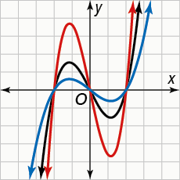
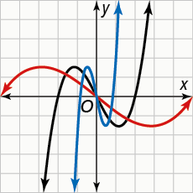
CONCEPT Stretches and Compressions
Vertical
g(x) = k • f(x)
Horizontal
h(x) = f(kx)
stretch when k > 1
compression when 0 < k < 1
stretch when 0 < k < 1
compression when k > 1

Slide 13
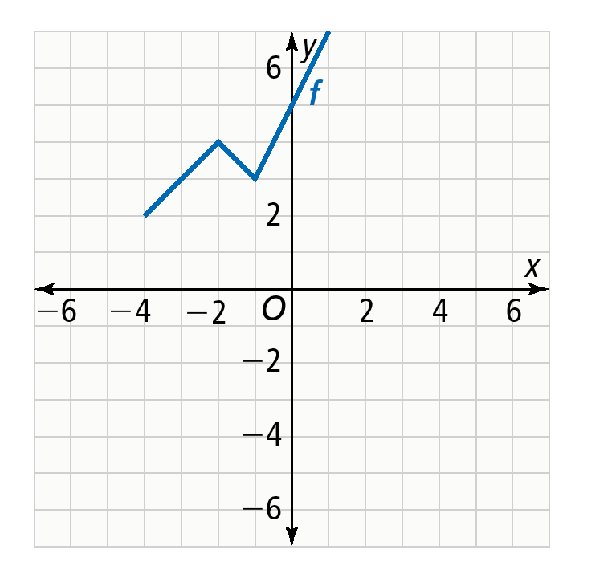
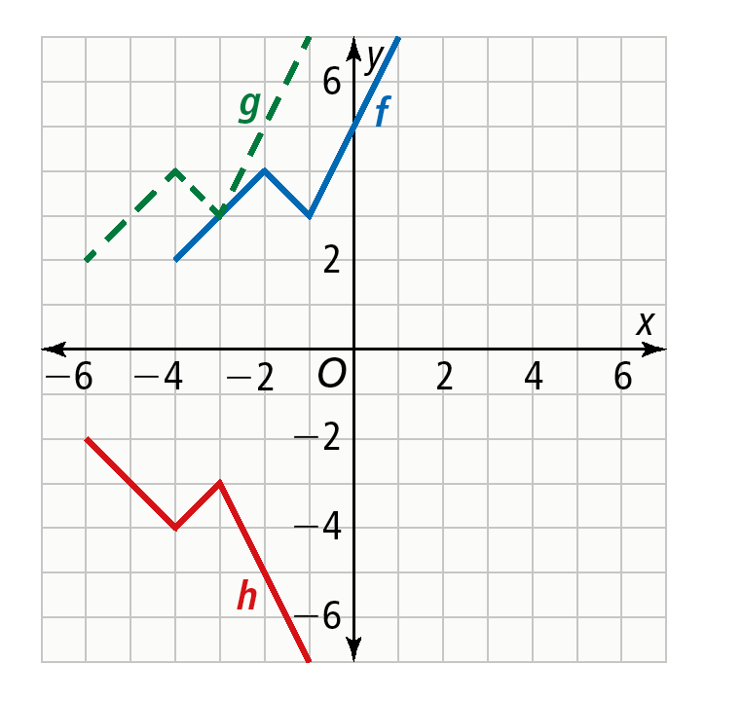
Graph a Combination of Transformations
Using the graph y = f(x), how can you graph a combination
of transformations?
​Graph y = −f(x + 2).
Graph g(x) = f(x + 2), which is a translation of f left 2 units.
Graph h(x) = −f(x + 2), which is a reflection of g across the x-axis.
The graph of h is a translation of f left 2 units followed by a reflection
across the x-axis.
Example 4
STUDY TIP
To graph transformations with multiple steps, graph the intermediate graphs following equation order of operations. Parenthesis first, then exponents, multiplication and division from left to right, and finally addition and subtraction from left to right.

Slide 14
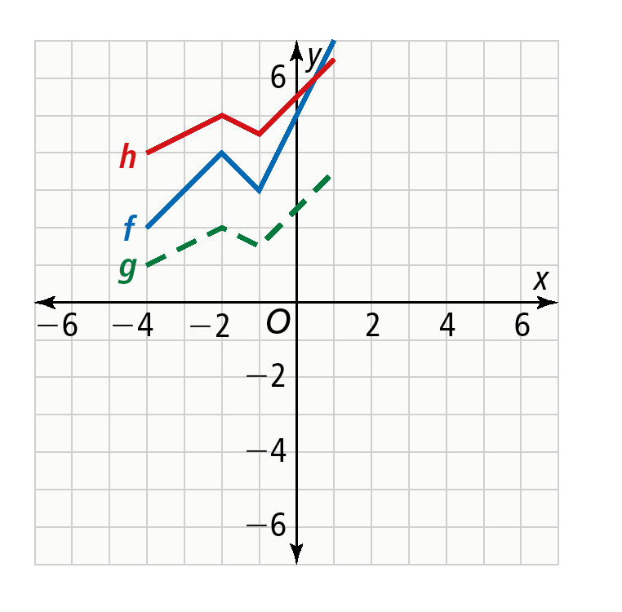
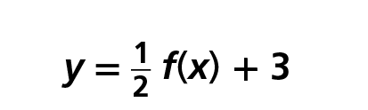
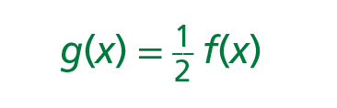

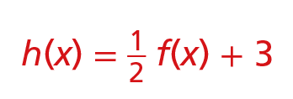

Graph a Combination of Transformations
Using the graph y = f(x), how can you graph a combination
of transformations? ​
B. ​Graph .
Graph , which is a vertical compression of f by the
factor
Graph , which is a translation of g up 3 units.
The graph of h is a vertical compression of f by the factor
followed by a translation 3 units up.
​
Example 4

Slide 15
Graph a Combination of Transformations
Try It!
​Using the graph of f above, graph each equation.
a. ​ y = f(2x) − 4
b. y = f(2x − 3) − 2
Example 4

Slide 16
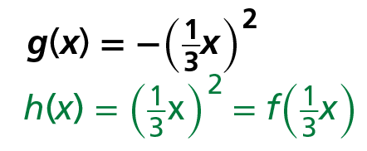
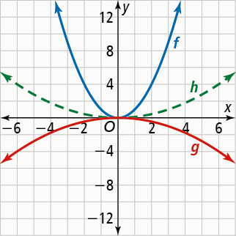
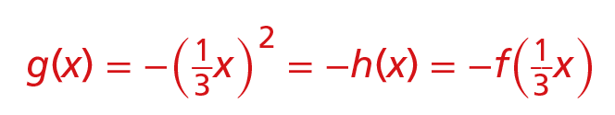

Identify Transformations From an Equation
What transformations of f(x) = x² result in the graph of the function g?
represents a horizontal stretch of the
graph of f by the factor .
represents a reflection
across the x-axis of .
The graph of g is a horizontal stretch by the factor and a reflection across the
x-axis of the graph of f.
Example 5
USE APPROPRIATE TOOLS
You can use graphing technology to graph the original and transformed equations to check that the transformations you have identified are correct.

Slide 17
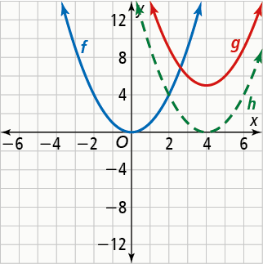
Identify Transformations From an Equation
What transformations of f(x) = x² result in the graph of the function g?
g(x) = (x − 4)² + 5
h(x) = (x − 4)² = f(x − 4) represents a translation 4 units
to the right of the graph of f.
g(x) = (x − 4)² + 5 = h(x) + 5 = f(x − 4) + 5 represents
a translation 5 units up of the graph of f(x − 4).
The graph of g is a translation 4 units right and 5 units up
of the graph of f.
Example 5

Slide 18
Identify Transformations From an Equation
Try It!
​What transformations of the graph of f(x) = ∣x∣ are applied to graph the function g?
a. ​ g(x) = ∣x + 3∣
b. g(x) = −∣x∣ + 2
Example 5

Slide 19
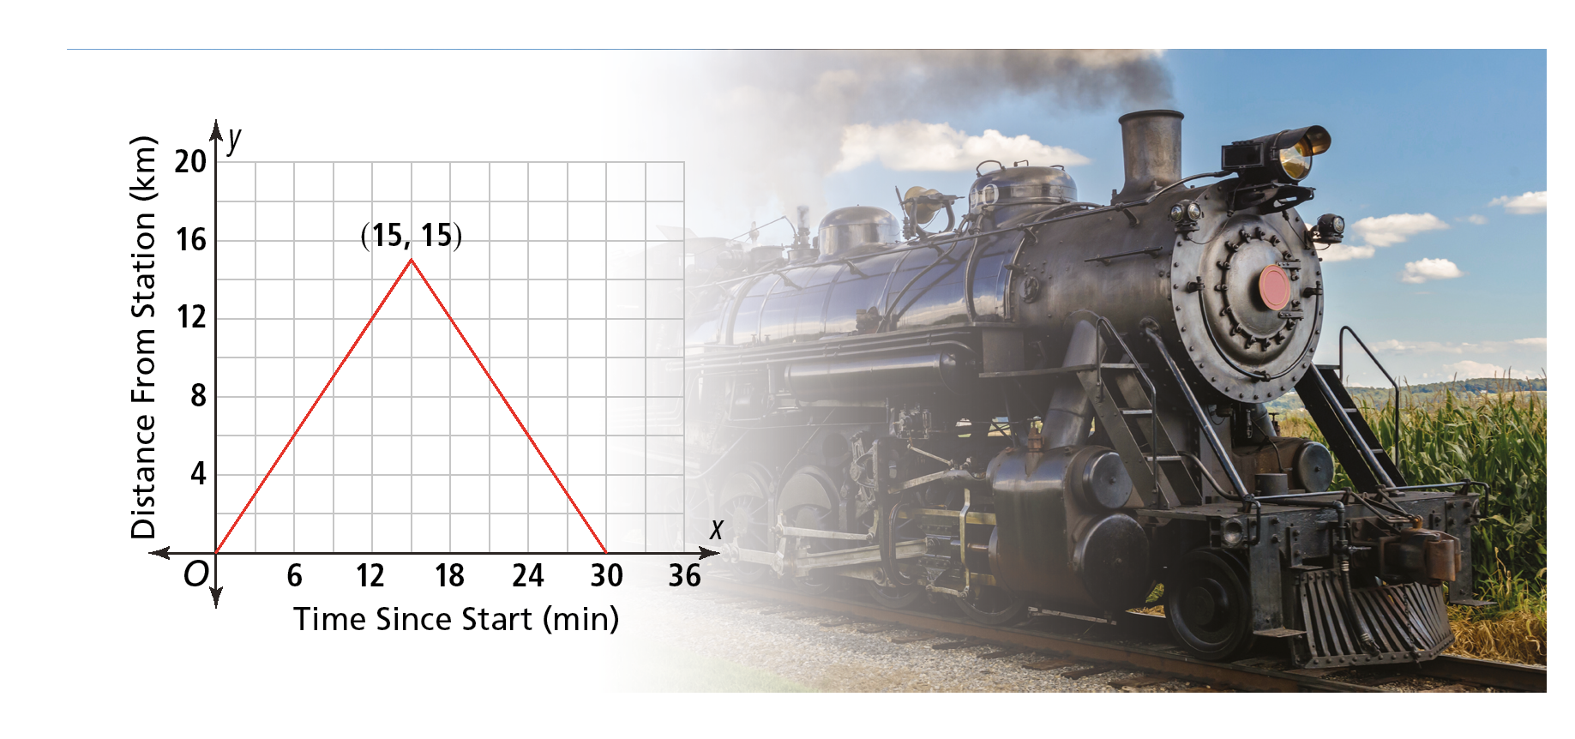
APPLICATION
Write an Equation From a Graph
A scenic train ride makes trips on an old mining line. The graph shows the distance
y in kilometers of the train from the station x minutes after the ride begins. What equation represents the distance from the station as a function of time? What is
its domain?
Example 6
Photo credit: Jan Gorzynik/123RF

Slide 20
APPLICATION
Write an Equation From a Graph
A scenic train ride makes trips on an old mining line. The graph shows the distance
y in kilometers of the train from the station x minutes after the ride begins. What equation represents the distance from the station as a function of time? What is
its domain?
The graph shows a reflection of an absolute value graph across the x-axis and a translation upward and to the right. The general form of this absolute value function is y = −a∣x − h∣ + k, where the point (h, k) represents the vertex and −a indicates that the graph opens downward.
Substituting the point of the vertex (15, 15) for (h, k) gives the equation y = −a∣x − 15∣ + 15.
To solve for a, you can use any point on the graph. Using the point (0, 0) to substitute for (x, y) in the equation simplifies the computation:
y = −a∣x − 15∣ + 15
0 = −a∣0 − 15∣ + 15
0 = −15a + 15
−15 = −15a
a = 1
Now you can write the equation for distance as a function of time:
y = −∣x − 15∣ + 15.
According to the graph, the train returns to its station after 30 minutes, so the function’s domain is [0, 30].
Example 6
STUDY TIP
Solving algebraically is only one method for determining a stretch or compression factor.

Slide 21
Write an Equation From a Graph
Try It!
​How would the graph and equation be affected if the train traveled twice as far in the same amount of time?
Example 6

Slide 22
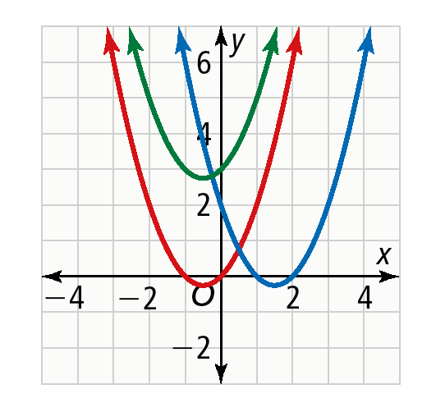
CONCEPT SUMMARY
Transformations of Functions
For a function f(x), the graph of f(x) = a • f [b(x − h)] + k represents a transformation of the graph of that function by translation, reflection, or stretching.
WORDS | EQUATIONS | GRAPHS
Horizontal translation of f right 2 units (altering h) | g(x) = f(x − 2) f(x) = x² + x g(x) = (x − 2)² + (x − 2) = x² − 3x + 2
Vertical translation of f up 3 units (altering k) | h(x) = f(x) + 3 f(x) = x² + x h(x) = x² + x + 3

Slide 23
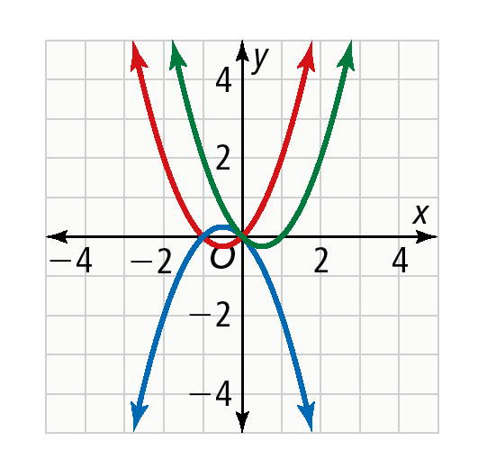
CONCEPT SUMMARY
Transformations of Functions
For a function f(x), the graph of f(x) = a • f [b(x − h)] + k represents a transformation of the graph of that function by translation, reflection, or stretching.
WORDS | EQUATIONS | GRAPHS
Reflection of f across the x-axis (altering a) | g(x) = −f(x) f(x) = x² + x −f(x) = −(x² + x) = −x² − x
Reflection of f across the y-axis (altering b) | h(x) = f(−x) f(x) = x² + x f(−x) = (−x)² + (−x) = x² − x

Slide 24
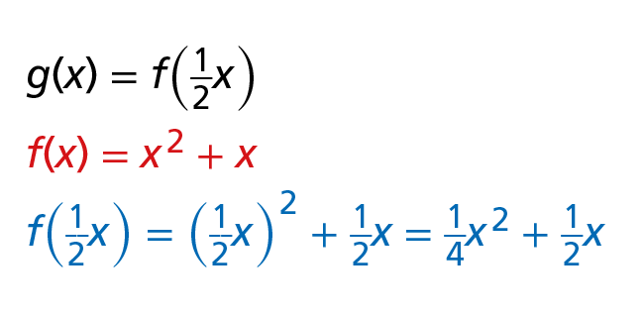
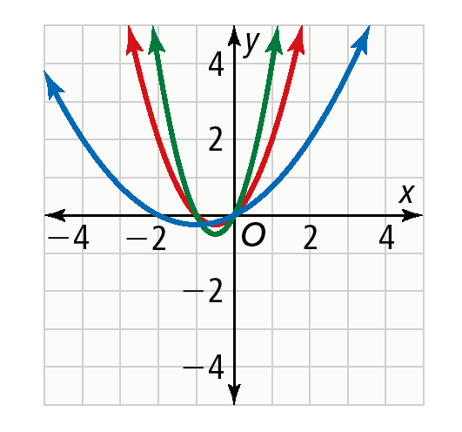
CONCEPT SUMMARY
Transformations of Functions
For a function f(x), the graph of f(x) = a • f [b(x − h)] + k represents a transformation of the graph of that function by translation, reflection, or stretching.
WORDS | EQUATIONS | GRAPHS
Horizontal stretch of f by the factor (altering b)
Vertical stretch of f by the factor 2 (altering a) | h(x) = 2f(x) f(x) = x² + x 2f(x) = 2(x² + x) = 2x² + 2x

Slide 25
Do You Understand?
Essential Question How do the values a, b, h, and k in a • f[b(x − h)] + k transform the graph of a parent function, f(x)?
Reason Do k and h affect the input or output for g(x) = f(x) + k and g(x) = f(x − h)? Explain.
Error Analysis Margo is comparing the functions f(x) = ∣x∣ and g(x) = ∣x + 1∣ − 5. She said the graph of g is a vertical translation of the graph of f 5 units down and a horizontal translation of the graph of f 1 unit right. What is Margo’s error?

Slide 26
Do You Know How?
Graph each function and its parent function.
4. g(x) = ∣x∣ − 1
​​ 5. g(x) = (x − 3)²
​​ 6. g(x) = −∣x∣
​​ 7. g(x) = −x
8​. g(x) = x² − 2
9​. g(x) = ∣x∣
10. ​ ​ g(x) = 4x
11. ​ g(x) = ∣5x∣
12. ​ Which types of transformations in Exercises 4–11 do not change the shape of a
graph? Which types of transformations change the shape of a graph? Explain.

