Slide 1
- **Asymptote**: A line that a graph approaches but never touches as it extends toward infinity
- **Constant of variation**: A fixed number that relates two variables in a direct or inverse variation equation
- **Inverse variation**: A relationship where one variable increases as the other decreases, typically expressed as y = k/x, where k is a constant.
- **Reciprocal function**: A function of the form f(x) = 1/x, where the output is the reciprocal of the input.

Slide 2
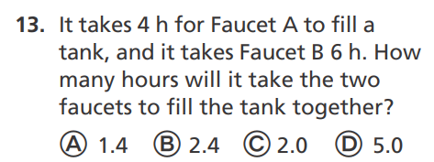

Slide 3

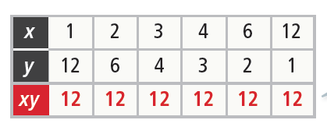
Essential Question
How are inverse variations related to the reciprocal function?
Identify Inverse Variation
How do you determine if a relationship represents an inverse variation?
​Does the table of values represent an inverse variation?
An inverse variation is a relation between two variables such that as one variable increases, the other decreases proportionally. For the table to represent an inverse variation, the product of x and y must be constant. Find the product, xy, for each column in the table.
Example 1

Slide 4

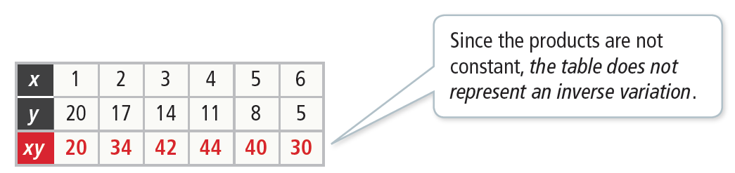
Identify Inverse Variation
How do you determine if a relationship represents an inverse variation?
​Does the table of values represent an inverse variation?
Find the products.
Example 1

Slide 5

Identify Inverse Variation
Try It!
​​Determine if each table of values represents an inverse variation.
​
Example 1

Slide 6

Identify Inverse Variation
Try It!
​​Determine if each table of values represents an inverse variation
B.
Example 1

Slide 7
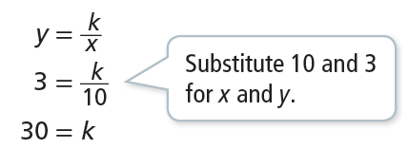
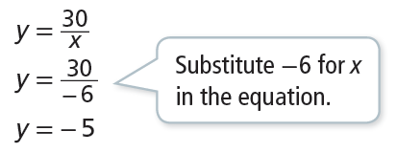

Use Inverse Variation
In an inverse variation, x = 10 when y = 3. Write an equation to represent
the inverse variation. Then find the value of y when x = − 6.
Step 1 Write the equation for an inverse variation and solve for k.
Step 2 Substitute k = 30 in the inverse variation equation and then find y.
The equation that represents the inverse relation is When x = −6, y = −5.
Example 2
COMMON ERROR
Remember in direct variation, y = kx, that x and y increase or decrease at the same time. In inverse variation xy = k, as one variable increases the other decreases.

Slide 8

Use Inverse Variation
Try It!
​In an inverse variation, x = 6 and
​What is the equation that represents the inverse variation?
Example 2

Slide 9
Use Inverse Variation
Try It!
​In an inverse variation, x = 6 and
b. ​What is the value of y when x = 15?
Example 2

Slide 10
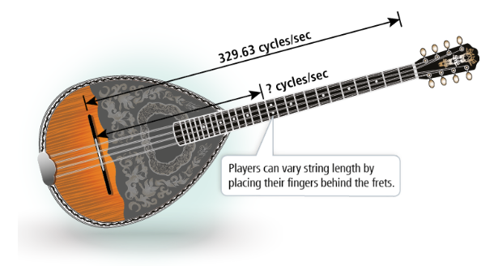
APPLICATION
Use an Inverse Variation Model
On a Greek bouzouki, the string length s varies inversely with the frequency f of its vibrations.
Example 3
Photo credit: Vectorshape/Shutterstock

Slide 11
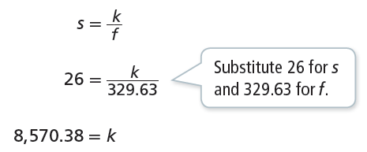
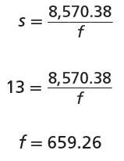
APPLICATION
Use an Inverse Variation Model
Step 1 Write the equation for an inverse variation and solve for k.
Step 2 Substitute k = 8,570.38 in the inverse variation equation and then find f.
So the frequency of the 13-inch string is 659.26 cycles per second.
Example 3
The frequency of a 26-inch E-string is 329.63 cycles per second. What is the frequency when the string length is 13 inches?

Slide 12
Use an Inverse Variation Model
Try It!
​The amount of time it takes for an ice cube to melt varies inversely to the air temperature, in degrees. At 20° Celsius, the ice will melt in 20 minutes. How long will it take the ice to melt if the temperature is 30° Celsius?
Example 3

Slide 13


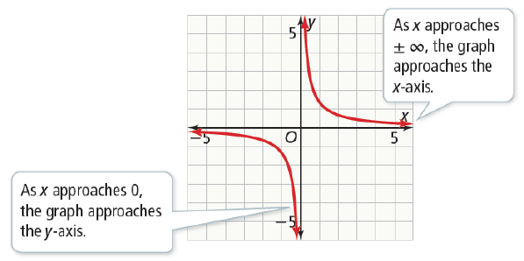


CONCEPTUAL UNDERSTANDING
Understand the Graph of the Reciprocal Function
​What are the key features of the reciprocal function
The reciprocal function maps
every non-zero real number to its reciprocal. Use technology to graph the function.
Example 4

Slide 14
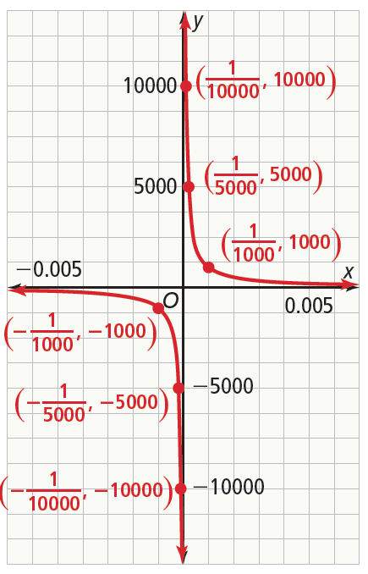

CONCEPTUAL UNDERSTANDING
Understand the Graph of the Reciprocal Function
​What are the key features of the reciprocal function
The graph of f has a horizontal asymptote y = 0. An asymptote is a line that a graph approaches.
Recall that a fraction with a denominator of 0 is undefined. Use the TRACE feature again with x-values close to 0. For positive x-values, as x approaches 0, f(x) goes to . For negative x-values, as x approaches 0, f(x) goes to .
The graph of f has a vertical asymptote x = 0.
The domain of . The range
is {y | y ≠ 0}.
The end behavior is f(x) → 0 as x → ± .
Example 4

Slide 15

Understand the Graph of the Reciprocal Function
Try It!
​Graph the function . What are the domain, range, and asymptotes of the function?
Example 4

Slide 16


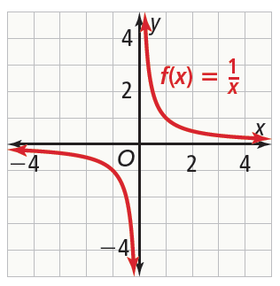
Graph Translations of the Reciprocal Function
​Graph What are the equations of the asymptotes?
What are the domain and range?
Use technology to graph the parent function,
Example 5

Slide 17

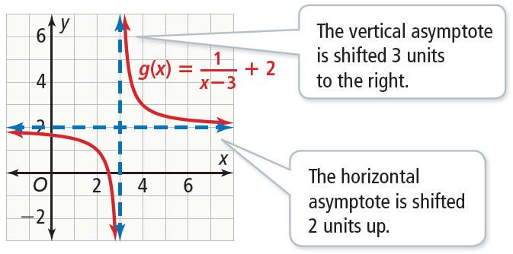
Graph Translations of the Reciprocal Function
​Graph What are the equations of the asymptotes?
What are the domain and range?
In terms of f(x), you can write g(x) as
Therefore, the graph of g is the graph of f translated 3 units right and 2 units up.
The line x = 3 is a vertical asymptote. The line y = 2 is a horizontal asymptote.
The domain is {x | x ≠ 3}.
The range is {y | y ≠ 2}.
Example 5

Slide 18

Graph Translations of the Reciprocal Function
Try It!
​​Graph What are the equations of the asymptotes?
What are the domain and range?
Example 5

Slide 19



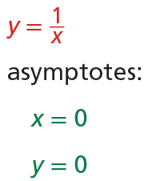
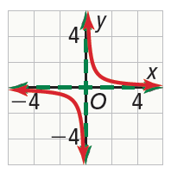
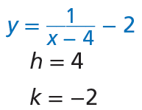
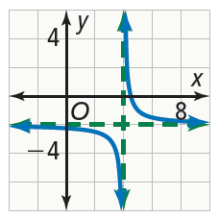





CONCEPT SUMMARY
Inverse Variation and the Reciprocal Function
 | Inverse Variation | Transformations of the Reciprocal Function
WORDS | An inverse variation is a relation between two variables such that as one variable increases, the other decreases proportionally. | The reciprocal function models the inverse variation, Like other functions, it can be transformed.
ALGEBRA | ,
EXAMPLES

