Slide 1



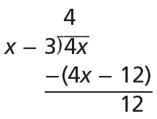
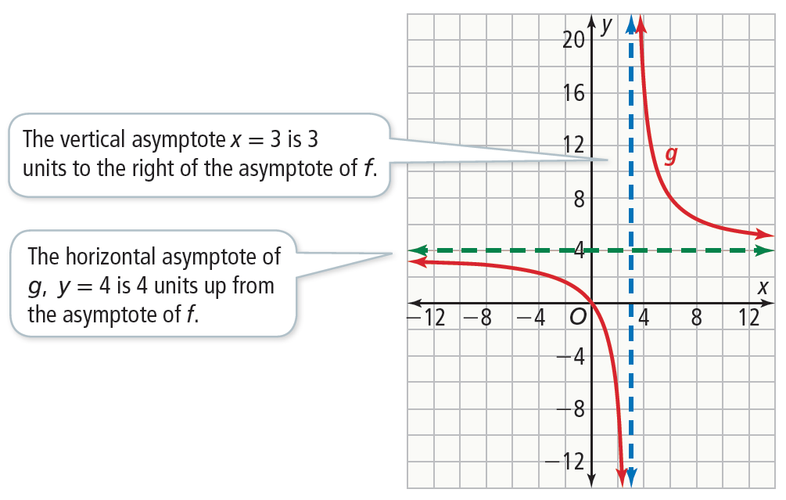


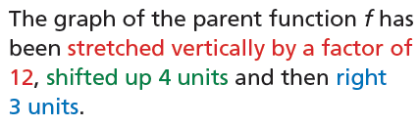
Essential Question
How can you graph a rational function?
Rewrite a Rational Function to Identify Asymptotes
How is the quotient related to the reciprocal function, Sketch the graph.
Use long division to write the rational expression in the form
Therefore,
In terms of
So, the graph of g will be the graph of
f translated and stretched vertically.
Example 1
USE STRUCTURE
Rewriting g in this way is similar to rewriting an improper fraction as a mixed number.

Slide 2


Rewrite a Rational Function to Identify Asymptotes
Try It!
​​Use long division to rewrite each rational function. Find the asymptotes of f and sketch the graph.
​
​
Example 1

Slide 3



CONCEPT Rational Functions
Just as a rational number is a number that can be expressed as the ratio of two integers, a rational
expression is an expression that can be expressed as the ratio of two polynomials, such as
A rational function is any function defined by a rational expression, such as . The domain
of R(x) is all values of x for which Q(x) ≠ 0.
The function is a rational function.

Slide 4

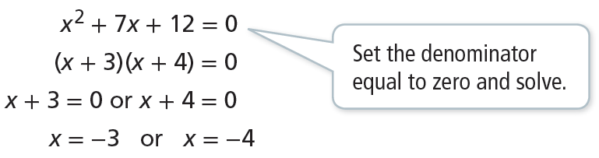
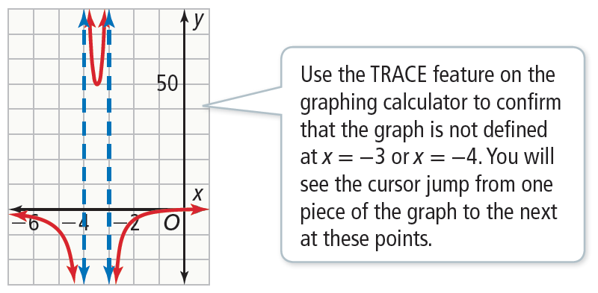
CONCEPTUAL UNDERSTANDING
Find Multiple Vertical Asymptotes of a Rational Function
What are the vertical asymptotes for the graph of
Vertical asymptotes can occur at the x-values where the function is undefined. Determine where the denominator of the rational function is equal to 0.
The possible vertical asymptotes are x = −3 and x = −4.
Graph the function to determine if there are asymptotes at x = − 3 or x = − 4.
The graph is not defined at x = −3 or x = −4. These lines are vertical asymptotes.
Example 2
COMMUNICATE PRECISELY
When creating a graph with asymptotes, it is important to clarify if the lines indicated are vertical or horizontal asymptotes.

Slide 5


Find Multiple Vertical Asymptotes of a Rational Function
Try It!
​Find the vertical asymptotes for each function. Graph the function to check your work.
​
​
Example 2

Slide 6

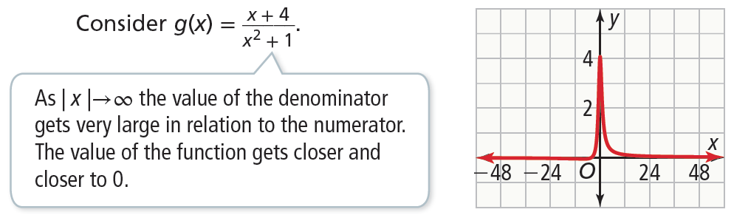
CONCEPTUAL UNDERSTANDING
Find Types of Horizontal Asymptotes
​What are the horizontal asymptotes for the graph
Horizontal asymptotes describe end behavior. To identify horizontal asymptotes, we have to consider three cases.
Case 1: When the degree of the numerator is less than the degree of the denominator, there exists a horizontal asymptote at y = 0.
Example 3
STUDY TIP
The vertical asymptote(s) are found by setting the denominator of the function equal to zero.
The horizontal asymptote(s) are found using the relationship between the degree of the numerator and the degree of the denominator.

Slide 7
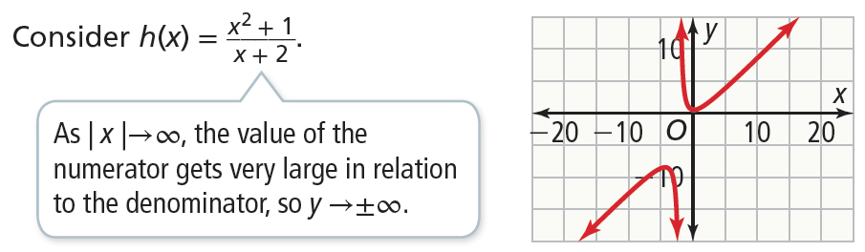
CONCEPTUAL UNDERSTANDING
Find Types of Horizontal Asymptotes
​What are the horizontal asymptotes for the graph
Case 2: When the degree of the numerator is greater than the degree of the denominator, there is no horizontal asymptote.
Example 3

Slide 8

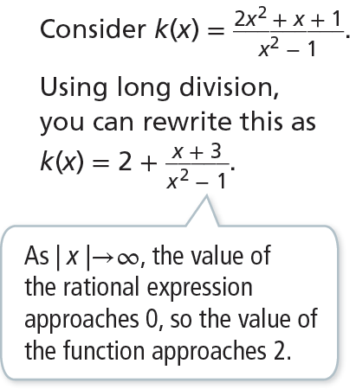
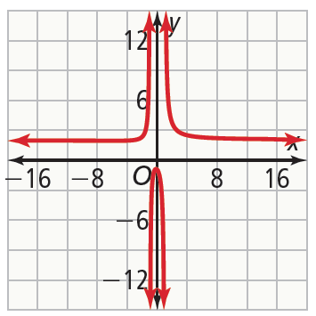

CONCEPTUAL UNDERSTANDING
Find Types of Horizontal Asymptotes
​What are the horizontal asymptotes for the graph
Case 3: When the degree of the numerator is equal to the degree of the denominator, the horizontal asymptote is at where is the ratio of the leading coefficients.
Example 3
MAKE SENSE AND PRESERVE
To show that the horizontal asymptote is accurate, try substituting different values for x and see if the values for y approach the asymptote(s).

Slide 9
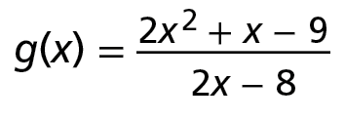
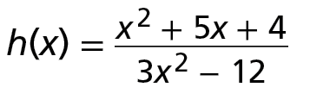
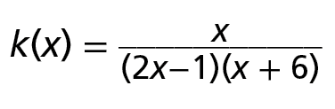
Find Types of Horizontal Asymptotes
Try It!
​What are the horizontal asymptotes of the graph of each function?
​
​
​
Example 3

Slide 10


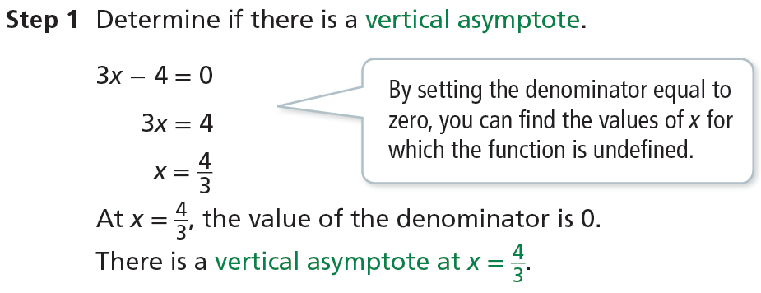

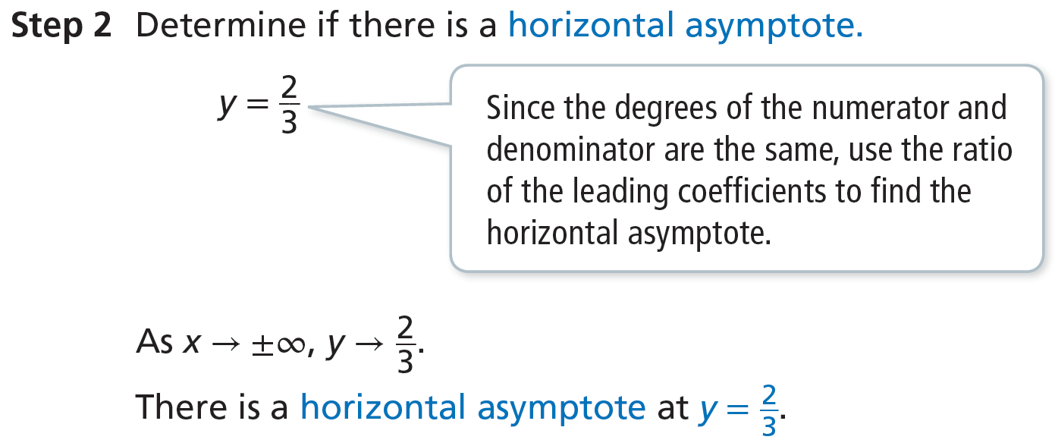
Graph a Function of the Form
​What is the graph of the function
Example 4
REASON
Consider time = . Fix a
distance and let the rate vary. This represents a reciprocal function. As you travel faster and faster, it takes less time to reach the set distance. But because you have a fixed distance to travel, it will always take some small amount of time to travel it. This represents the horizontal asymptote. Now consider going slower and slower. What does this represent?

Slide 11

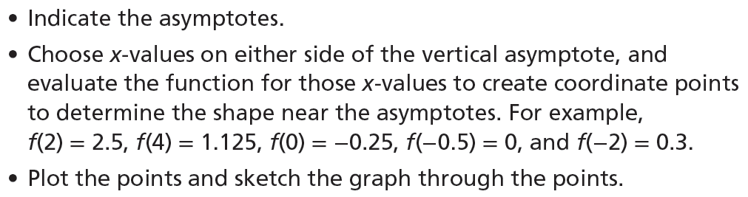
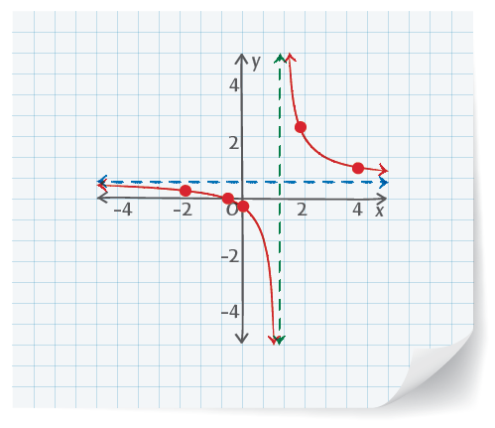
Graph a Function of the Form
​What is the graph of the function
Example 4

Slide 12
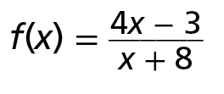
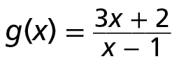
Graph a Function of the Form
Try It!
​Graph each function.
​
​
Example 4

Slide 13

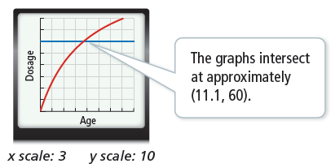
APPLICATION
Use a Rational Function Model
​Formulate
The adult dosage is 125 mcg, so the dosage for a child a years old is A child can receive the medication if D(a) ≥ 60.
Compute
Graph the function using technology. Then graph the line y = 60. You can solve the inequality D(a) ≥ 60 by finding the intersection point of the two graphs.
The solution to the inequality D(a) ≥ 60 is approximately a ≥ 11.1.
Interpret
A child 11.1 years old or older will be able to receive the medication.
Example 5

Slide 14

APPLICATION
Use a Rational Function Model
​A pediatric doctor may need to administer medication without knowing a child’s weight. Young’s Rule can be used to calculate a child’s dosage D(a) given their age a and the adult dosage.
A doctor has 60 mcg of a medication. What is the youngest a child can be to receive this dose of medication if the adult dosage is 125 mcg?
Example 5
Photo credit: Yurakrasil/Shutterstock; Mega Pixel/Shutterstock

Slide 15
Use a Rational Function Model
Try It!
5. Use Young’s Rule to calculate the minimum age a child can be if a doctor has 85 mcg of a medication, and the adult dosage is 200 mcg.
Example 5

Slide 16

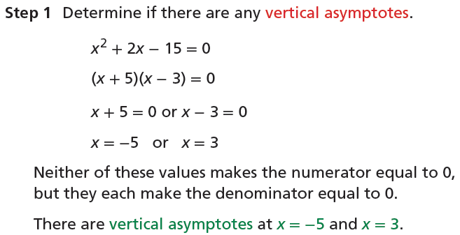
Graph a Rational Function that Crosses a Horizontal Asymptote
​What is the graph of
Example 6

Slide 17
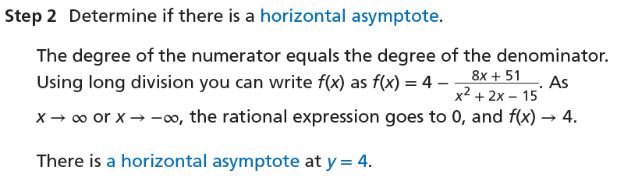
Graph a Rational Function that Crosses a Horizontal Asymptote
Example 6
COMMUNICATE PRECISELY
When graphing, it is important to include both horizontal and vertical asymptotes to clearly identify the graph’s behavior near them.

Slide 18
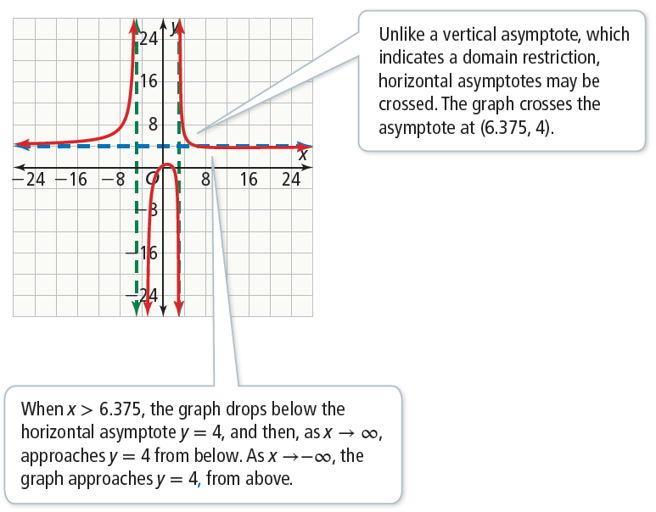
Graph a Rational Function that Crosses a Horizontal Asymptote
Example 6

Slide 19
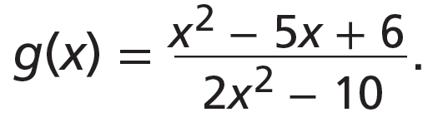
Graph a Rational Function that Crosses a Horizontal Asymptote
Try It!
6. Identify the asymptotes and sketch the graph of
Example 6

Slide 20

CONCEPT SUMMARY
Graphing Rational Functions
RATIONAL FUNCTION | A function that is expressible as a fraction with polynomials in the numerator and the denominator
ASYMPTOTES | Vertical Vertical asymptotes are guides for the behavior of a graph as it approaches a vertical line. The line x = a is a vertical asymptote of , if Q(a) = 0 and P(a) ≠ 0. The up or down behavior of the function as it approaches the asymptote can be determined by substituting values close to a on either side of the asymptote. | Horizontal Horizontal asymptotes are guides for the end behavior of a graph as it approaches a horizontal line. If the degree of the numerator is less than the degree of the denominator, the horizontal asymptote is at y = 0. greater than the denominator, there is no horizontal asymptote. equal to the degree of the denominator, set y equal to the ratio of the leading coefficients. The graph of this line is the horizontal asymptote.

Slide 21

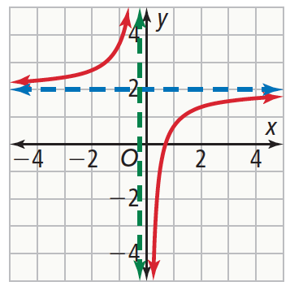

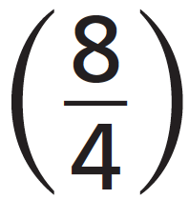

CONCEPT SUMMARY
Graphing Rational Functions
ALGEBRA | Vertical Asymptote: Let 4x + 1 = 0 and solve. Horizontal Asymptote: Find the ratio of the leading coefficients . | GRAPH

