Slide 1
Adding and Subtracting Rational Expressions
I CAN…
find the sum or difference of rational expressions.
VOCABULARY
compound fraction
Notes:
k

Slide 2
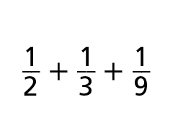
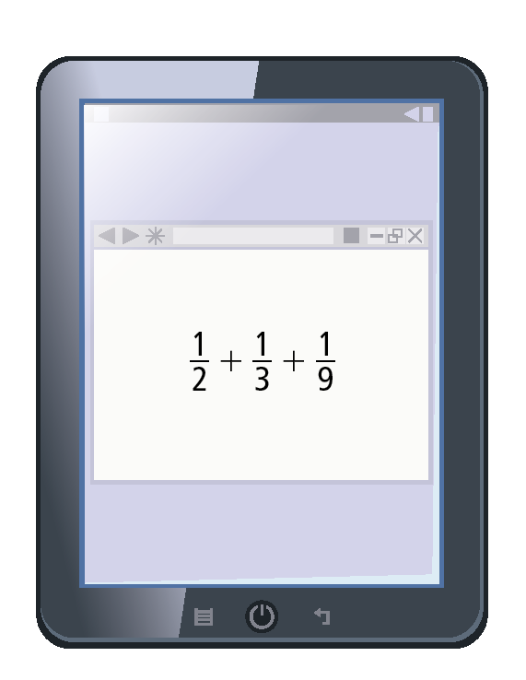

CRITIQUE & EXPLAIN
Teo and Evander find the following exercise in their homework:
​Teo claims that a common denominator of the sum is 2 + 3 + 9 = 14. Evander claims that it is Is either student correct? Explain why or why not.
​Find the sum, explaining the method you use.
​Construct Arguments Timothy states that the quickest way to find the sum of any two fractions with unlike denominators is to multiply their denominators to find a common denominator, and then rewrite each fraction with that denominator. Do you agree?

Slide 3
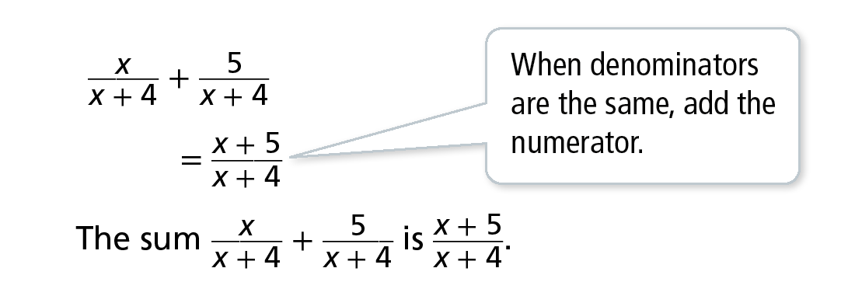
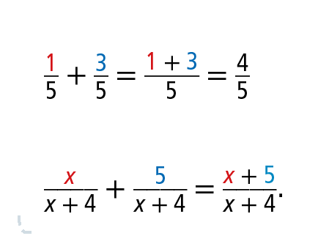
Essential Question
How do you rewrite rational expressions to find sums and differences?
Add Rational Expressions With Like Denominators
What is the sum?
Example 1
USE STRUCTURE
Compare addition of numerical and algebraic fractions:
In the same way,

Slide 4
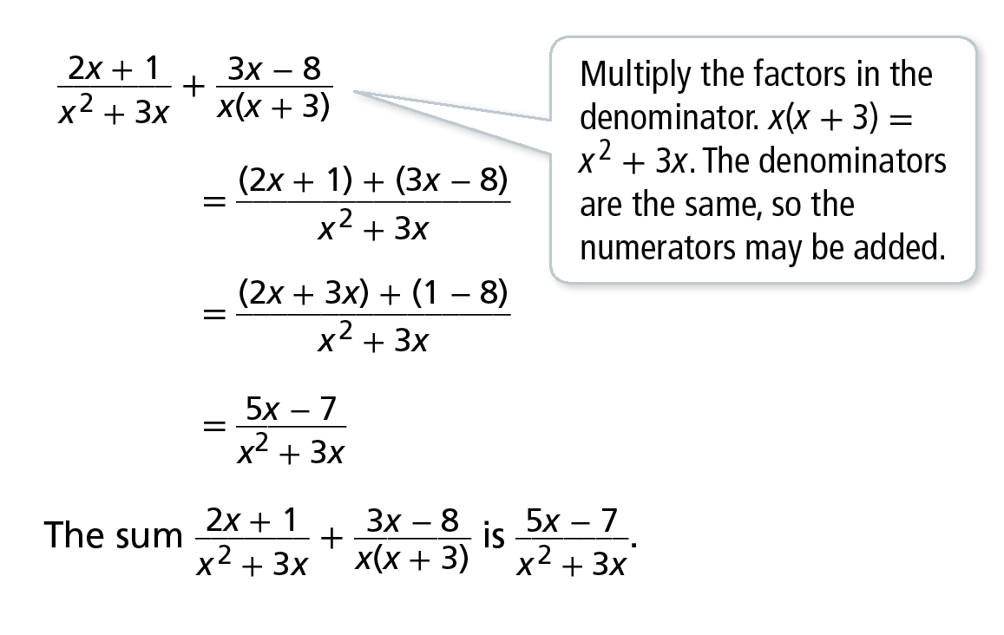
Add Rational Expressions With Like Denominators
What is the sum?
B.
Example 1

Slide 5
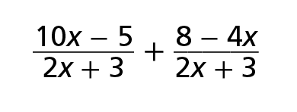
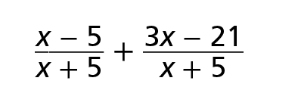
Add Rational Expressions With Like Denominators
Try It!
​Find the sum.
​
​
Example 1

Slide 6


CONCEPTUAL UNDERSTANDING
Identify the Least Common Multiple of Polynomials
How can you find the least common multiple (LCM) of polynomials?
A. (x + 2)², x² + 5x + 6
Factor each polynomial.
(x + 2)² = (x + 2)(x + 2)
x² + 5x + 6 = (x + 2)(x + 3)
The LCM is the product of the factors. Include the greatest number of any one factor in each polynomial.
LCM: (x + 2)(x + 2)(x + 3) or (x + 2)²(x + 3)
Example 2
USE STRUCTURE
The LCM of 6 and 15 is 30, not 90.
The LCM does not contain the common factor 3 twice. Similarly, in Example 2B, the common factors (x + 3) and (x − 5) are not used twice.

Slide 7
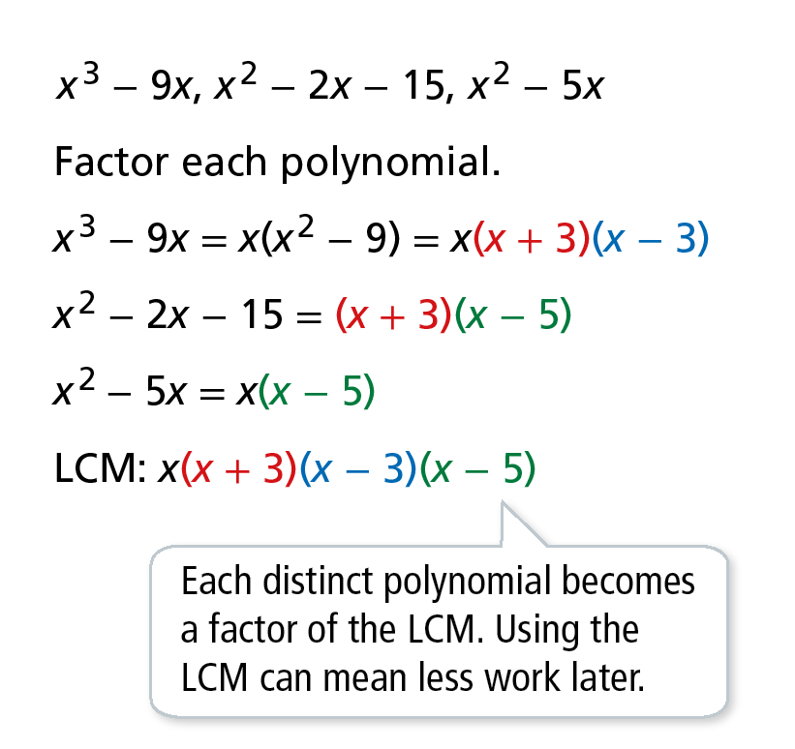
CONCEPTUAL UNDERSTANDING
Identify the Least Common Multiple of Polynomials
How can you find the least common multiple (LCM) of polynomials?
B.
Example 2

Slide 8
Identify the Least Common Multiple of Polynomials
Try It!
​Find the LCM for each set of expressions.
​ x³ + 9x² + 27x + 27, x² − 4x − 21
​ 10x² − 10y², 15x² − 30xy + 15y², x² + 3xy + 2y²
Example 2

Slide 9
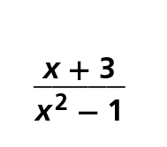
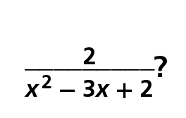
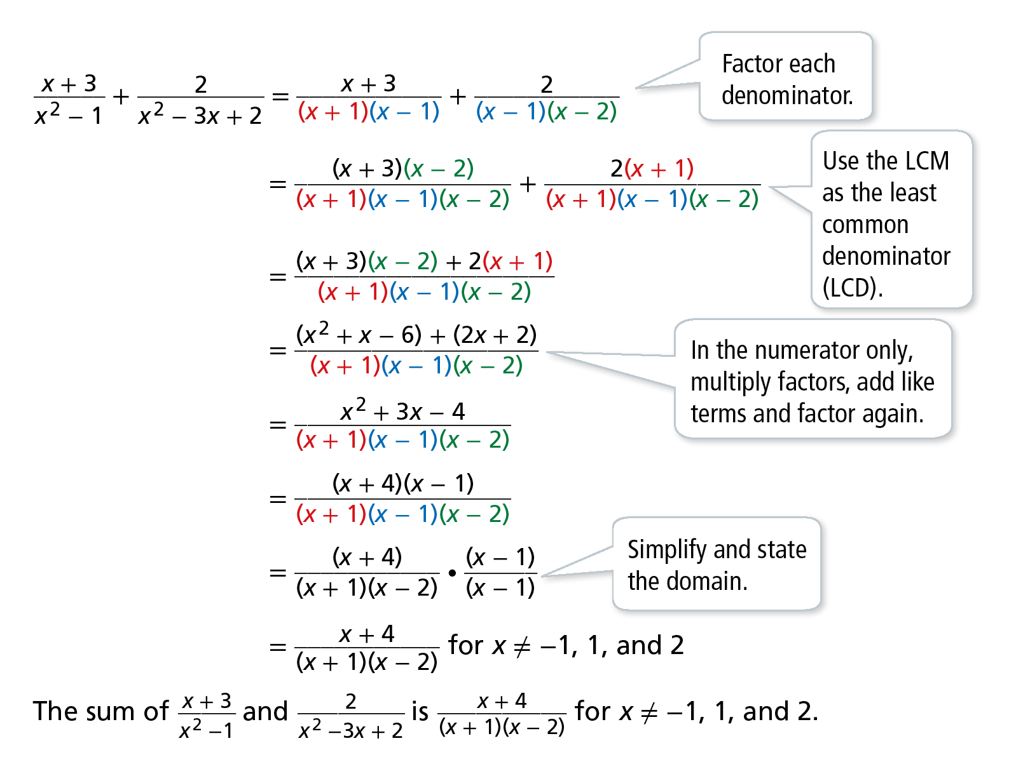
Add Rational Expressions With Unlike Denominators
What is the sum of and
Follow a similar procedure to the one you use to add numerical fractions with unlike denominators.
Example 3
MAKE SENSE AND PERSEVERE
We must keep equivalent addends. So multiply each addend by a form of one. Choose the missing factors of the LCD.

Slide 10
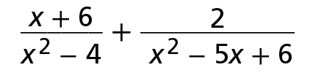
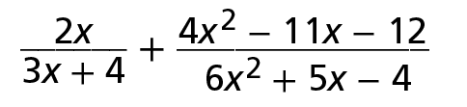
Add Rational Expressions With Unlike Denominators
Try It!
​Find the sum.
​
​
Example 3

Slide 11
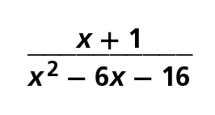
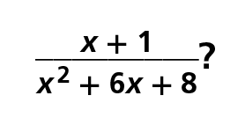
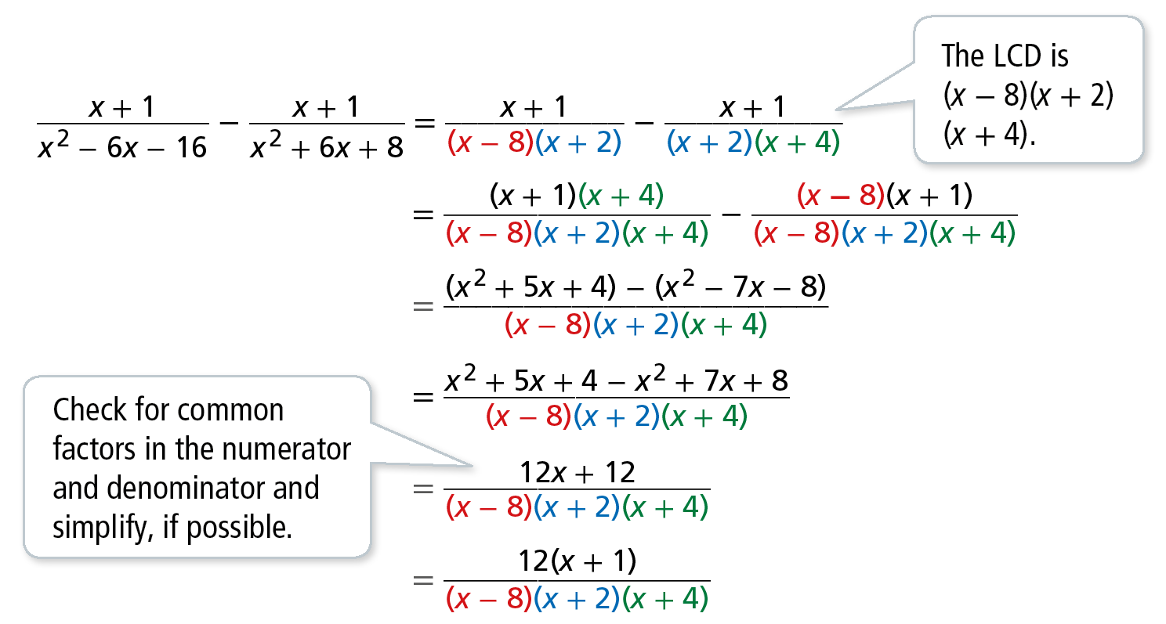
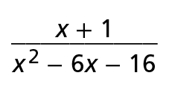
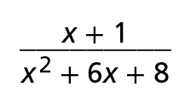
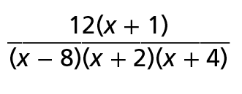
Subtract Rational Expressions
What is the difference between and
The difference between and is for x ≠ −4, −2, and 8.
Example 4
COMMON ERROR
When subtracting polynomials, remember to distribute −1 when removing the parentheses.

Slide 12
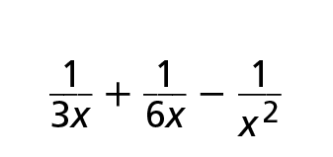
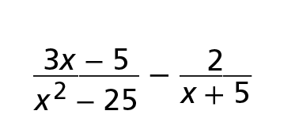
Subtract Rational Expressions
Try It!
​​Simplify.
​
​
Example 4

Slide 13
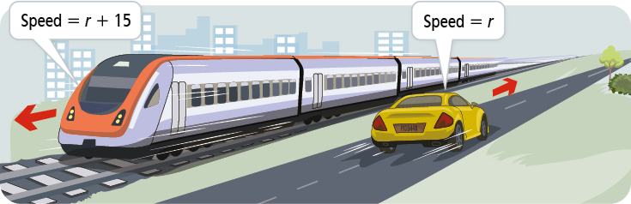
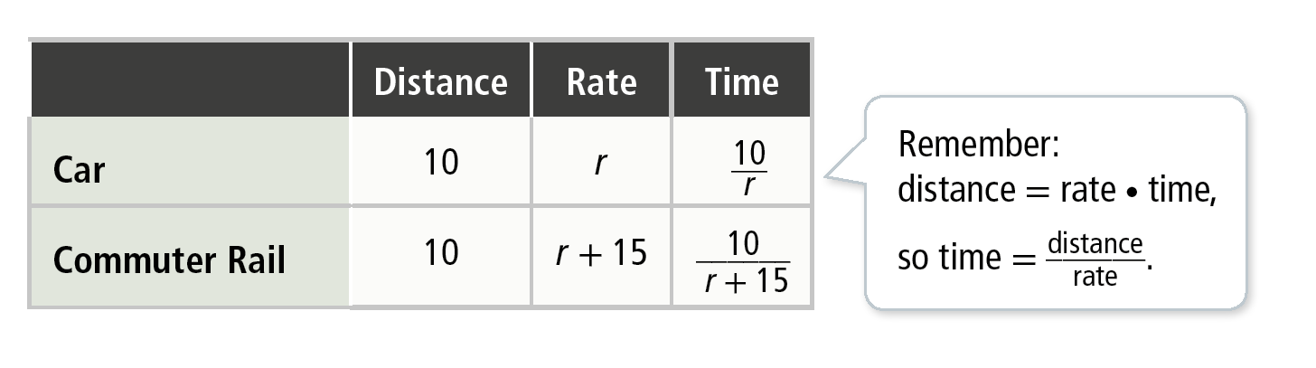
APPLICATION
Use Rational Expressions to Solve Problems
​Jorge drives his car to the mechanic, then he takes the commuter rail train back to his neighborhood. The average speed for the 10-mile trip is 15 miles per hour faster on the train. Find an expression for Jorge’s total travel time. If he drove 30 mph, how long did this take?
Example 5
USE APPROPRIATE TOOLS
Use a table to organize information and help create an accurate model of the situation.

Slide 14
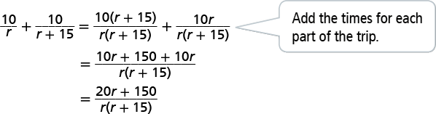
APPLICATION
Use Rational Expressions to Solve Problems
​Jorge drives his car to the mechanic, then he takes the commuter rail train back to his neighborhood. The average speed for the 10-mile trip is 15 miles per hour faster on the train. Find an expression for Jorge’s total travel time. If he drove 30 mph, how long did this take?
Total time for the trip:
Example 5

Slide 15
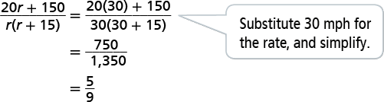
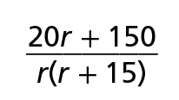

APPLICATION
Use Rational Expressions to Solve Problems
Jorge drives his car to the mechanic, then he takes the commuter rail train back to his neighborhood. The average speed for the 10-mile trip is 15 miles per hour faster on the train. Find an expression for Jorge’s total travel time. If he drove 30 mph, how long did this take?
At a driving rate of 30 mph, you can find the total time.
The expression for Jorge’s total travel time is . The total time is h, or about 33 min.
Example 5

Slide 16
Use Rational Expressions to Solve Problems
Try It!
​Jorge drives to visit his friends. His 20 mile trip to their house is congested with traffic, but it has cleared by the time he travels home. He can travel 5 miles per hour faster. Write an expression that represents Jorge’s total travel time.
Example 5

Slide 17
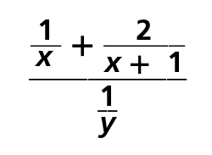
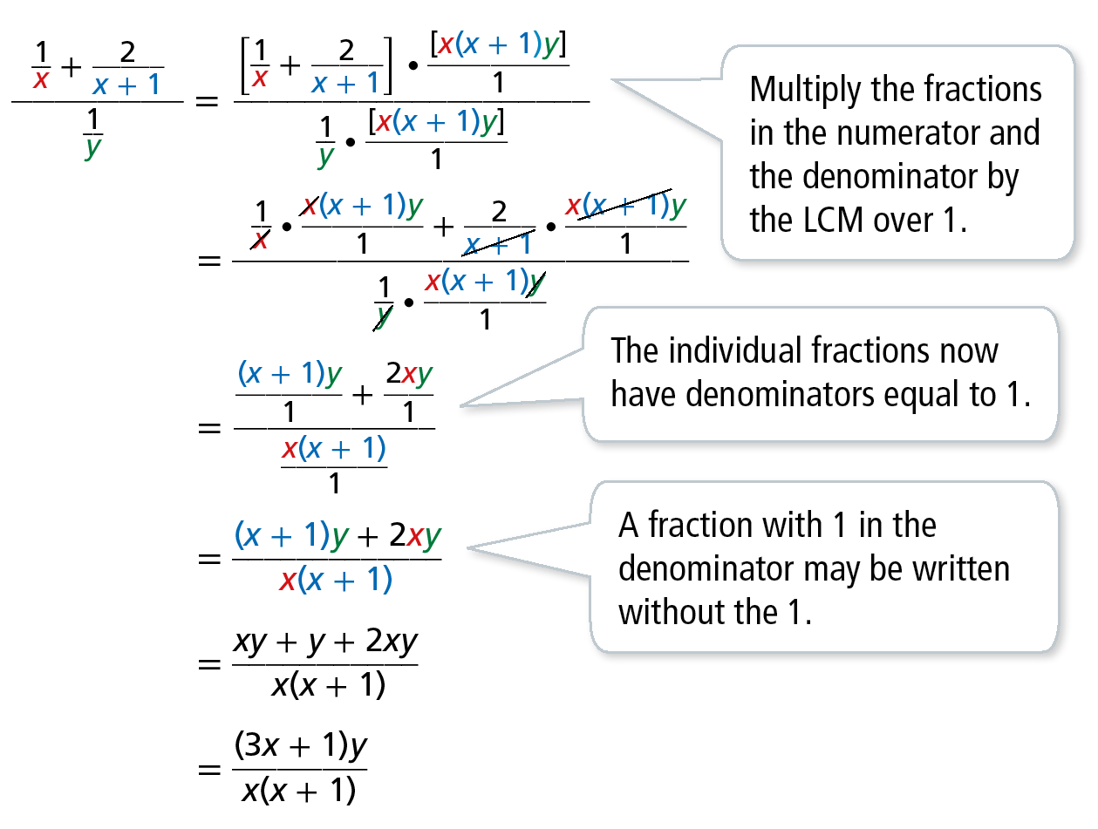
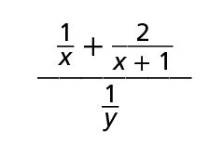
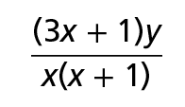
Simplify a Compound Fraction
Write a simpler form of the compound fraction .
Find the Least Common Multiple (LCM) of all the denominators.
Example 6
VOCABULARY
A compound fraction contains a rational expression in its numerator, denominator, or both.
So, is equivalent to when x ≠ −1, 0 and y ≠ 0.

Slide 18
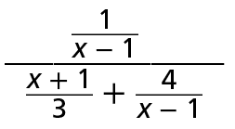
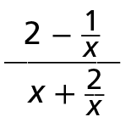
Simplify a Compound Fraction
Try It!
​Simplify each compound fraction.
​
​
Example 6

Slide 19
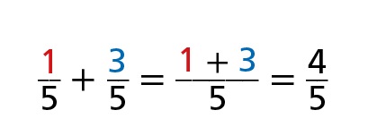
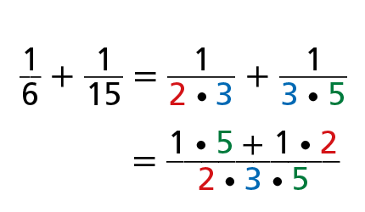
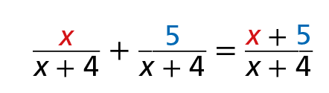
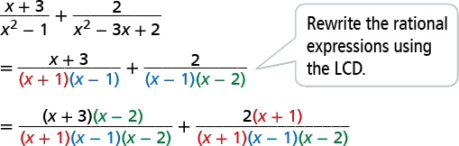
CONCEPT SUMMARY
Find Sums and Differences of Rational Expressions
WORDS | To add or subtract rational expressions with common denominators, add the numerators and keep the denominator the same. | To add or subtract rational expressions with different denominators, rewrite each expression so that its denominator is the LCD, then add or subtract the numerators.
NUMBERS
ALGEBRA

Slide 20
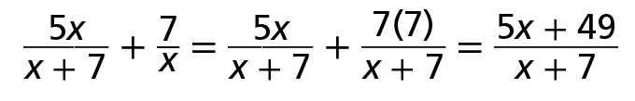
Do You Understand?
Essential Question How do you rewrite rational expressions to find sums and differences?
Vocabulary In your own words, define compound fraction and provide an example of one.
Error Analysis A student added the rational expressions as follows:
Describe and correct the error the student made.
Construct Arguments Explain why, when stating the domain of a sum or difference of rational expressions, not only should the simplified sum or difference be considered but the original expression should also be considered.
Make Sense and Persevere In adding or subtracting rational expressions, why is the L in LCD significant?

Slide 21
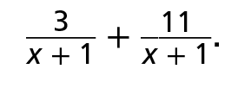
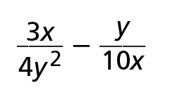
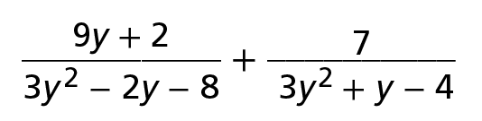
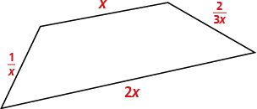
Do You Know How?
​​Find the sum of
Find the simplified form of each product, and state the domain.
​x² − y² and x² − 2xy + y²
​5x³y and 15x²y²​
Find the simplified form of each quotient, and state the domain.
​
​
​ ​Find the perimeter of the quadrilateral in simplest form.

