Slide 1



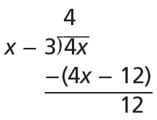
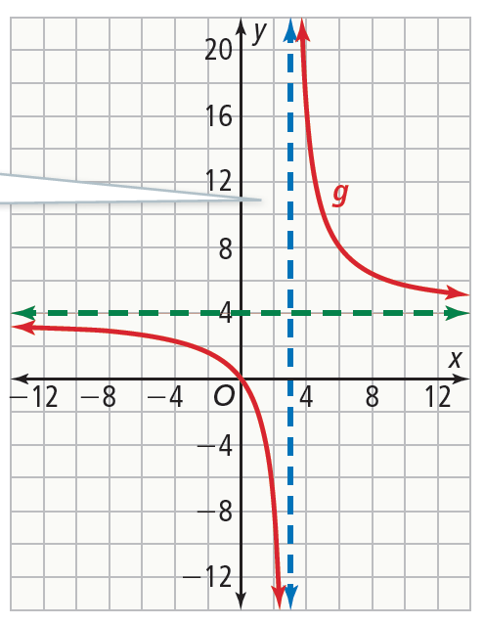


Essential Question
How can you graph a rational function?
Rewrite a Rational Function to Identify Asymptotes
How is the quotient related to the reciprocal function, Sketch the graph.
Use long division to write the rational expression in the form
Therefore,
In terms of
So, the graph of g will be the graph of
f translated and stretched vertically.
Example 1

Slide 2

Rewrite a Rational Function to Identify Asymptotes
Try It!
​​Use long division to rewrite each rational function. Find the asymptotes of f and sketch the graph.
​
Example 1

Slide 3

Rewrite a Rational Function to Identify Asymptotes
Try It!
​​Use long division to rewrite each rational function. Find the asymptotes of f and sketch the graph.
b. ​
Example 1

Slide 4
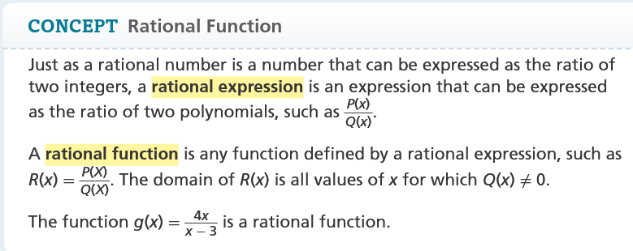

Slide 5

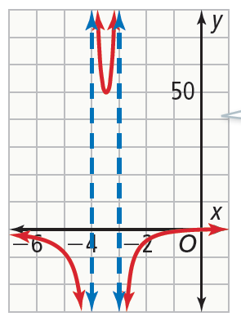
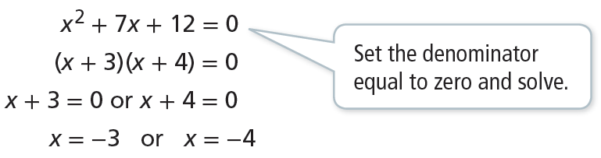
CONCEPTUAL UNDERSTANDING
Find Multiple Vertical Asymptotes of a Rational Function
What are the vertical asymptotes for the graph of
Vertical asymptotes can occur at the x-values where the function is undefined. Determine where the denominator of the rational function is equal to 0.
Example 2

Slide 6

Find Multiple Vertical Asymptotes of a Rational Function
Try It!
​Find the vertical asymptotes for each function. Graph the function to check your work.
​
Example 2

Slide 7

Find Multiple Vertical Asymptotes of a Rational Function
Try It!
​Find the vertical asymptotes for each function. Graph the function to check your work.
b.
Example 2

Slide 8
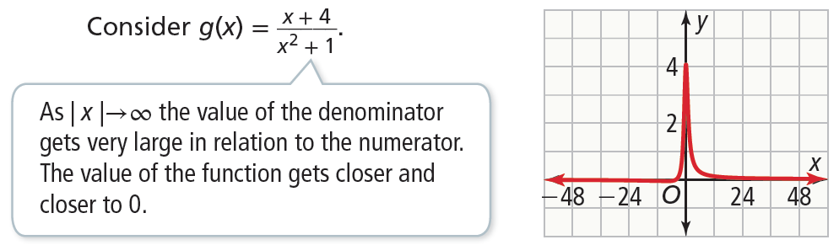
CONCEPTUAL UNDERSTANDING
Find Types of Horizontal Asymptotes
There are 3 cases to consider, below is case #1
Example 3
Degree of numerator < degree of denominator, Asymptote at y=0

Slide 9
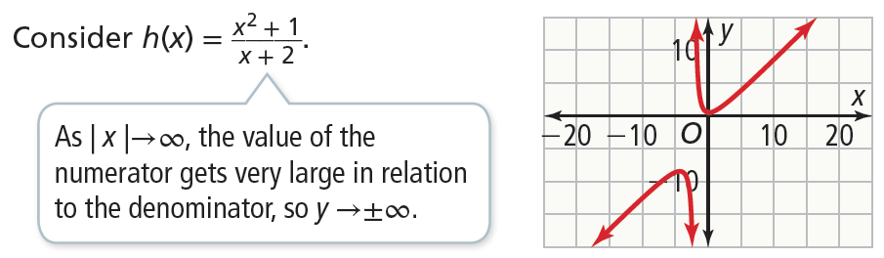
CONCEPTUAL UNDERSTANDING
Find Types of Horizontal Asymptotes
​What are the horizontal asymptotes for the graph
Case 2: When the degree of the numerator is greater than the degree of the denominator,there is no horizontal asymptote.
Example 3

Slide 10

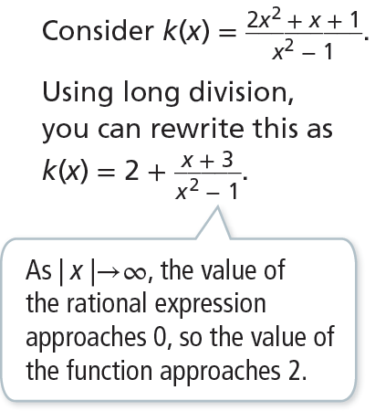
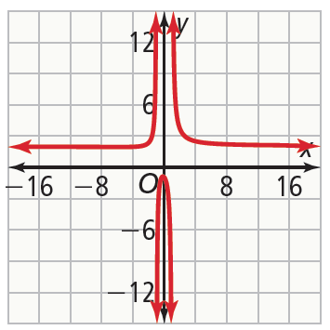
CONCEPTUAL UNDERSTANDING
Find Types of Horizontal Asymptotes
Case 3; When the degree of the numerator is equal to the degree of the denominator, the horizontal asymptote is at where is the ratio of the leading coefficients.
Example 3

Slide 11


CONCEPTUAL UNDERSTANDING
Find Types of Horizontal Asymptotes
​What are the horizontal asymptotes for the graph
Example 3

Slide 12
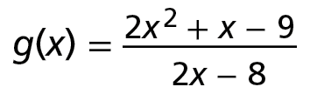
Find Types of Horizontal Asymptotes
Try It!
​What are the horizontal asymptotes of the graph of each function?
​
Example 3

Slide 13
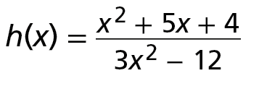
Find Types of Horizontal Asymptotes
Try It!
​What are the horizontal asymptotes of the graph of each function?
b.​
Example 3

Slide 14
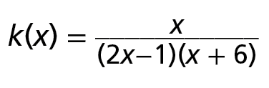
Find Types of Horizontal Asymptotes
Try It!
​What are the horizontal asymptotes of the graph of each function?
c.​
Example 3

Slide 15

CONCEPT SUMMARY
Graphing Rational Functions
RATIONAL FUNCTION | A function that is expressible as a fraction with polynomials in the numerator and the denominator
ASYMPTOTES | Vertical Vertical asymptotes are guides for the behavior of a graph as it approaches a vertical line. The line x = a is a vertical asymptote of , if Q(a) = 0 and P(a) ≠ 0. The up or down behavior of the function as it approaches the asymptote can be determined by substituting values close to a on either side of the asymptote. | Horizontal Horizontal asymptotes are guides for the end behavior of a graph as it approaches a horizontal line. If the degree of the numerator is less than the degree of the denominator, the horizontal asymptote is at y = 0. greater than the denominator, there is no horizontal asymptote. equal to the degree of the denominator, set y equal to the ratio of the leading coefficients. The graph of this line is the horizontal asymptote.

Slide 16

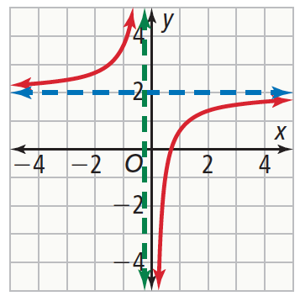



CONCEPT SUMMARY
Graphing Rational Functions
ALGEBRA | Vertical Asymptote: Let 4x + 1 = 0 and solve. Horizontal Asymptote: Find the ratio of the leading coefficients . | GRAPH

