Slide 1
Multiplying and Dividing Rational Expressions
I CAN…
find the product and the quotient of rational expressions.
VOCABULARY
simplified form of a rational expression

Slide 2
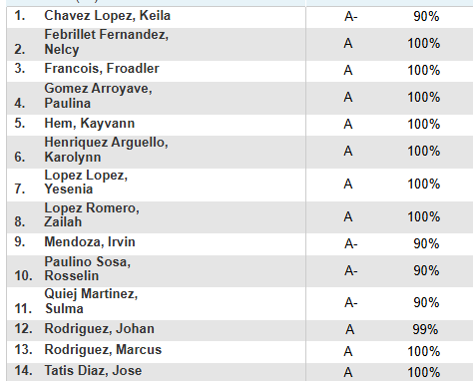

Slide 3
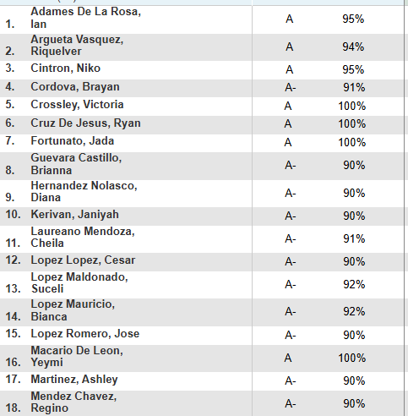
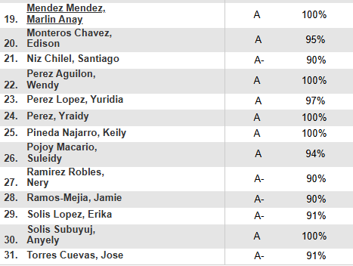

Slide 4
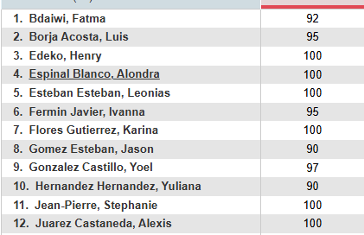
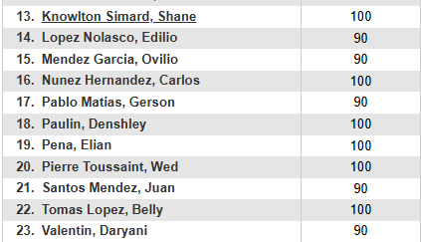

Slide 5
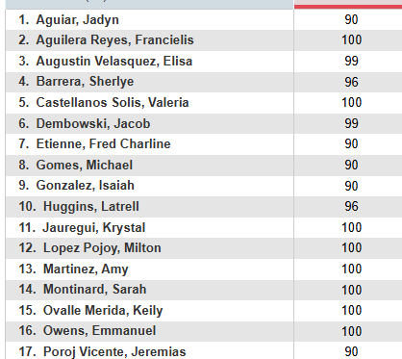
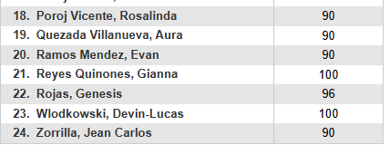

Slide 6
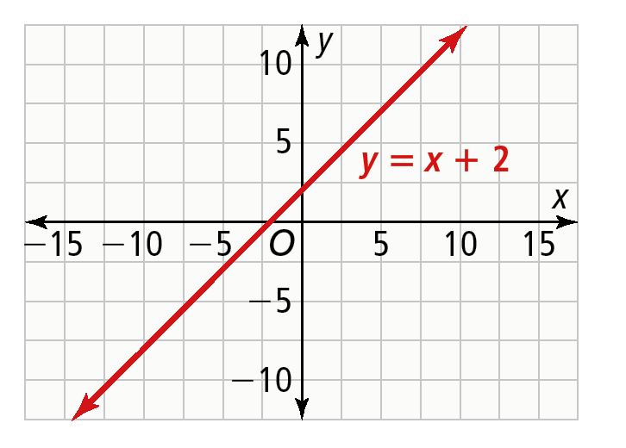
EXPLORE & REASON
Consider the following graph of the function y = x + 2.
​What is the domain of this function?
​Sketch a function that resembles the graph, but restrict its domain to exclude 2.
​Use Structure Consider the function you have sketched.
What kind of function might have a graph like this? Explain.

Slide 7
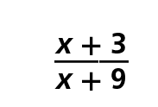
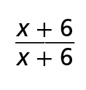

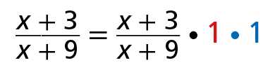

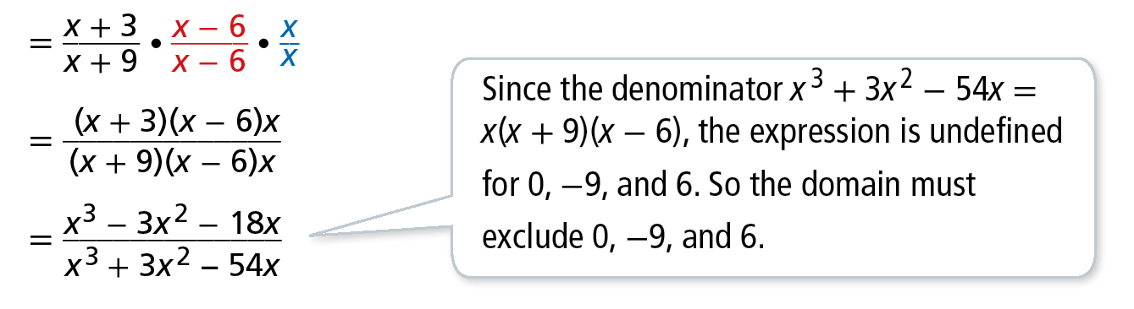
Essential Question
How does multiplying and dividing fractions help you multiply and divide rational expressions?
CONCEPTUAL UNDERSTANDING
Write Equivalent Rational Expressions
Write an expression that is equivalent to . For what domain are the expressions equivalent?
You can multiply by factors of 1 in any form 1 to write equivalent rational expressions. In this Example, multiply by and .
Example 1

Slide 8

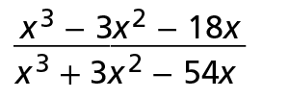
CONCEPTUAL UNDERSTANDING
Write Equivalent Rational Expressions
Expressions are equivalent for all values of x that are in both domains.
Therefore, is equivalent to over the domain {x | all real numbers where x ≠ 0, 6 or −9}.
Example 1
COMMUNICATE PRECISELY
A statement of equivalence between two expressions is an identity. The identity is only valid where both expressions are defined.

Slide 9

Write Equivalent Rational Expressions
Try It!
1. Write an expression equivalent to over the domain {x | x ≠ 0 or −2}.
Example 1

Slide 11
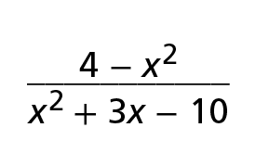
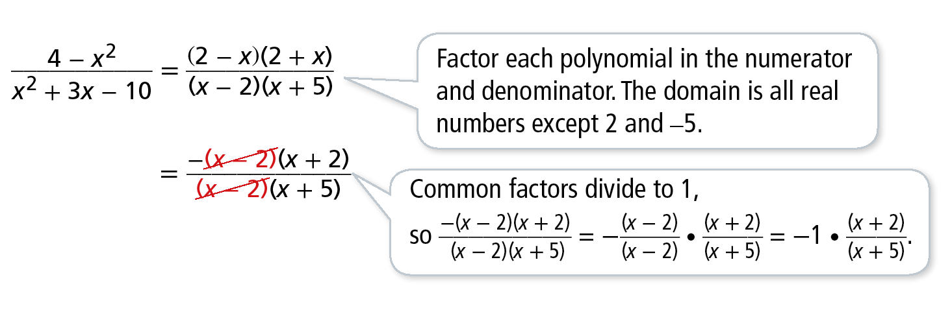
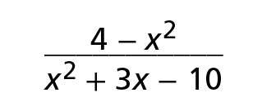
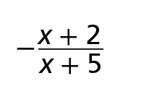
Simplify a Rational Expression
What is the simplified form of the rational expression? What is the domain for which the identity between the two expressions is valid?
The simplified form of a rational expression has no common factors, other than 1, in the numerator and the denominator.
The simplified form of is for x ≠ 2 or –5.
Example 2
COMMON ERROR
You may not recognize a common factor. Notice that 2 − x = −1 (−2 + x) = −1(x − 2).

Slide 12
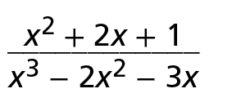
Simplify a Rational Expression
Try It!
​Simplify each expression and state the domain.
​
Example 2

Slide 13
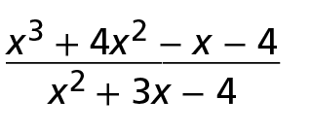
Simplify a Rational Expression
Try It!
​Simplify each expression and state the domain.
b.​
Example 2

Slide 14

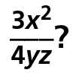
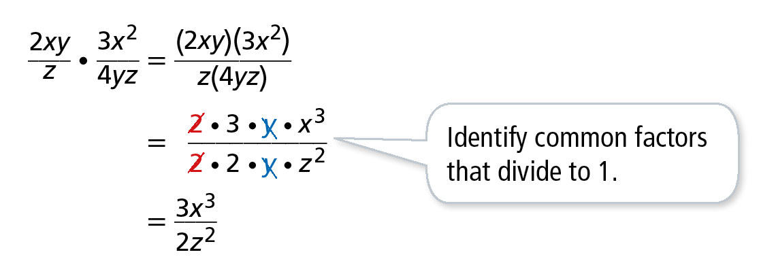



Multiply Rational Expressions
What is the product of and
To multiply rational expressions, follow a similar method to that for multiplying two numerical fractions.
The product of and is for y ≠ 0 and z ≠ 0.
Example 3

Slide 15
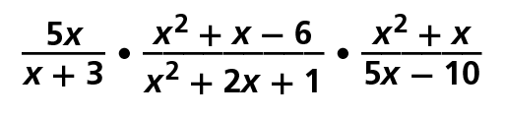
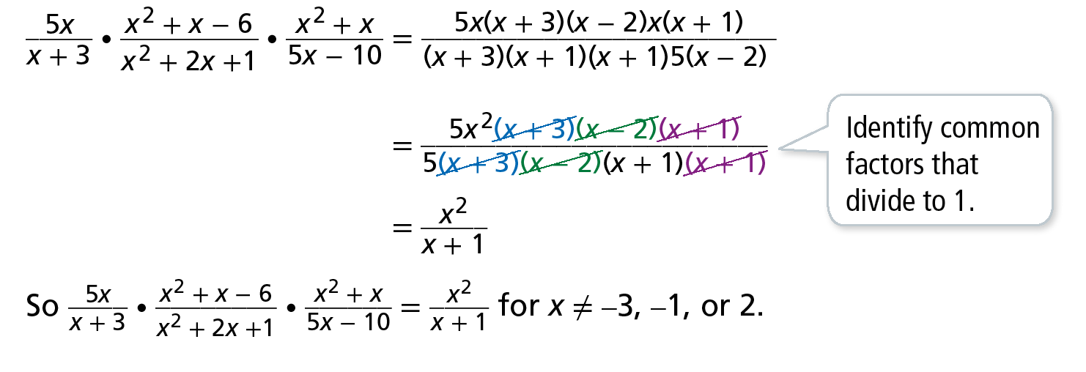
Multiply Rational Expressions
What is the product of in simplified form?
Example 3
USE STRUCTURE
Notice that the product of rational expressions is a rational expression. How can you use the definition of rational expressions to show that rational expressions are closed under multiplication?

Slide 16
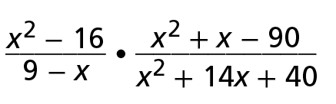
Multiply Rational Expressions
Try It!
​Find the simplified form of each product, and state the domain.
​
Example 3

Slide 17
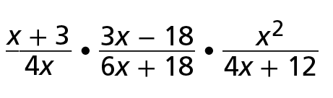
Multiply Rational Expressions
Try It!
​Find the simplified form of each product, and state the domain.
b​
Example 3

Slide 18
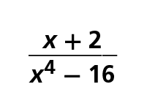
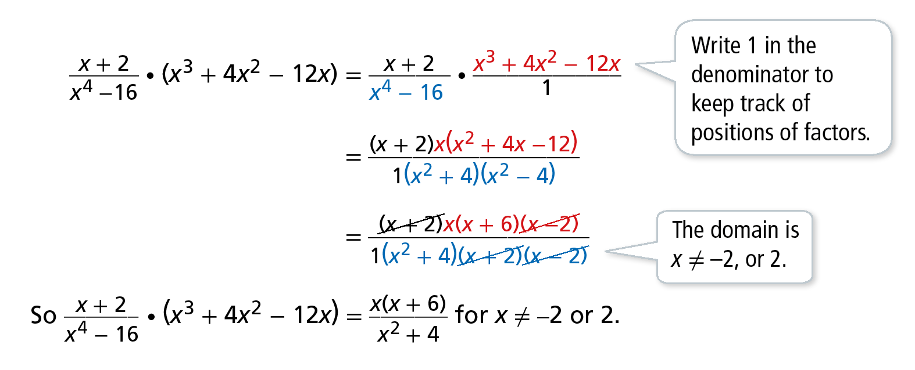

Multiply a Rational Expression by a Polynomial
What is the product of and x³ + 4x² − 12x?
Example 4
COMMON ERROR
Only common factors, not terms, reduce to one. You cannot factor an x out of .

Slide 19
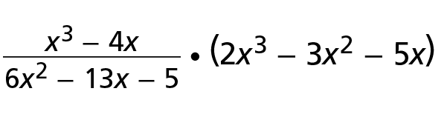
Multiply a Rational Expression by a Polynomial
Try It!
​Find the simplified form of each product and the domain.
​
Example 4

Slide 20
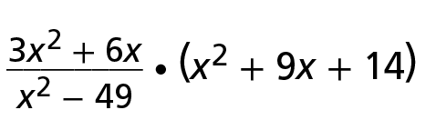
Multiply a Rational Expression by a Polynomial
Try It!
​Find the simplified form of each product and the domain.
b​
Example 4

Slide 21
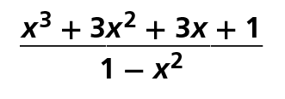
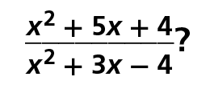
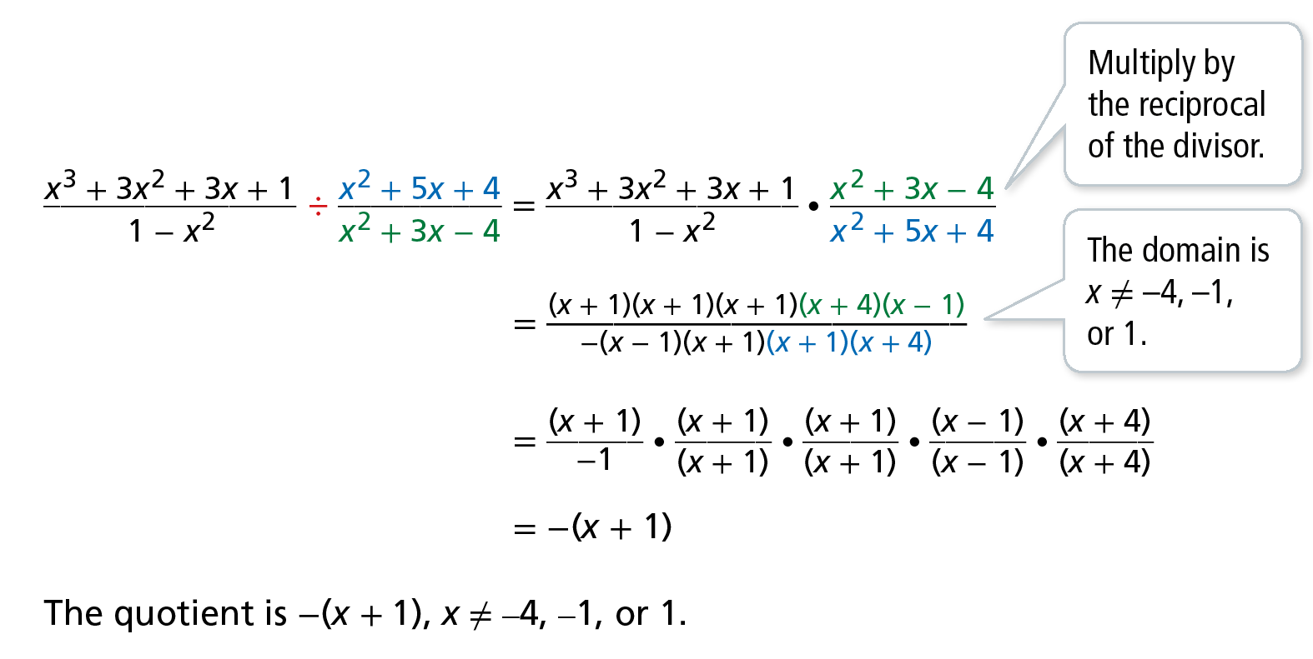
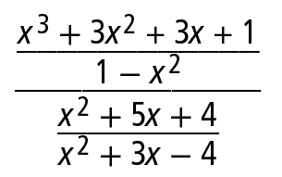
Divide Rational Expressions
​What is the quotient of and
Example 5
USE STRUCTURE
This division problem could be written as a complex fraction.
You can rewrite any complex fraction as a division statement.

Slide 22
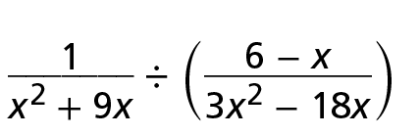
Divide Rational Expressions
Try It!
​Find the simplified quotient and the domain of each expression.
​
Example 5

Slide 23
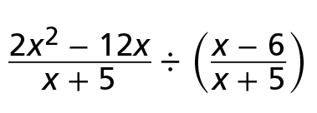
Divide Rational Expressions
Try It!
​Find the simplified quotient and the domain of each expression.
b.​
Example 5

Slide 24


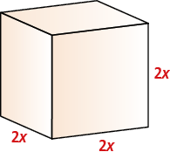
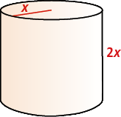
APPLICATION
Use Division of Rational Expressions
A company is evaluating two packaging options for its product line. The
more efficient design will have the lesser ratio of surface area to volume.
Should the company use packages that are cylinders or rectangular prisms?
Example 6
Option 1: A rectangular prism
with a square base
Option 2: A cylinder with the same height as the prism, and diameter equal to the side length of the prism’s base
STUDY TIP
Recall that surface area tells how much packaging material is needed and volume tells how much product the package can hold.
Surface Area: 2(2x)² + 4(2x)²
Volume: (2x)³
Surface Area: 2πx² + 2πx(2x)
Volume: πx²(2x)

Slide 25

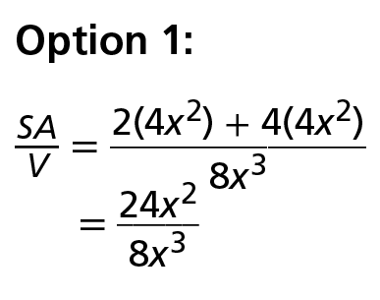
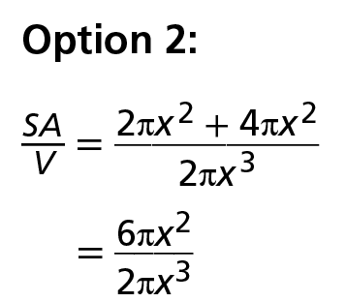
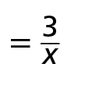

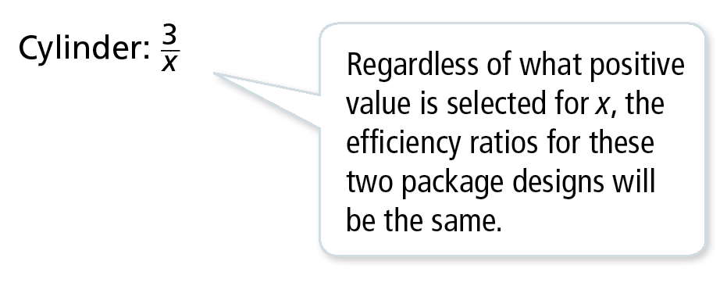
APPLICATION
Use Division of Rational Expressions
A company is evaluating two packaging options for its product line. The more efficient design will have the lesser ratio of surface area to volume.
Should the company use packages that are cylinders or rectangular prisms?
The efficiency ratio is , where SA represents surface area and V represents volume.
The company can now compare the efficiency ratio of the package designs.
Example 6
In this example, the efficiency ratio of the
cylinder is equal to that of the prism. So
the company should choose their package
design based on other criteria.

Slide 26
Use Division of Rational Expressions
Try It!
​The company compares the ratios of surface area to volume for two more containers. One is a rectangular prism with a square base. The other is a rectangular prism with a rectangular base. One side of the base is equal to the side length of the first container, and the other side is twice as long. The surface area of this second container is 4x² + 6xh. The heights of the two containers are equal. Which has the smaller surface area-to-volume ratio?
Example 6

Slide 27
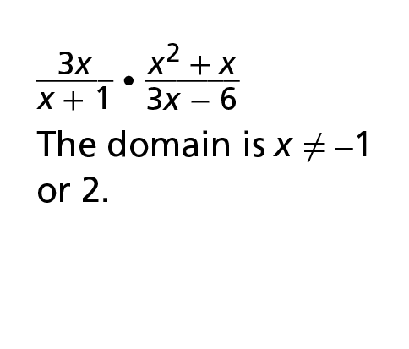
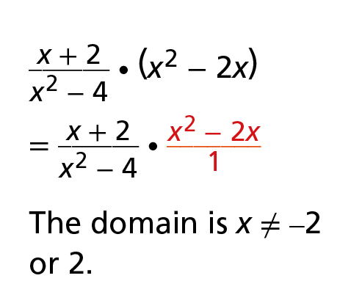
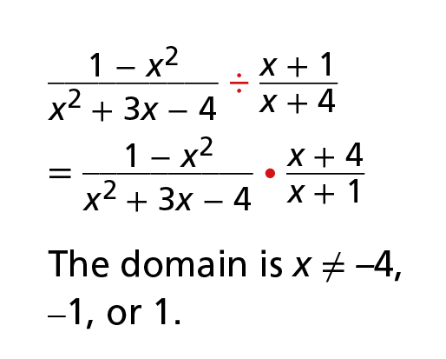
CONCEPT SUMMARY
Products and Quotients of Rational Expressions
 | Multiply | Multiply an Integer or a Polynomial | Divide
RATIONAL EXPRESSIONS
WORDS | Identify common factors and simplify. | Write the polynomial as a rational expression with 1 in the denominator. Then multiply. | Multiply by the reciprocal of the divisor.

