Slide 1
Auto Loss Complaint Predictor
Rob wentworth – GoForCode Developer

Slide 2
Business Use Case
Data set included Auto Loss information at a Customer level
Question Statement: Can customer and loss information predict the probability that a customer will have an open complaint?
Examined the question on the following criteria:
Gender
Income
Months since last Claim
Monthly Premium
Generalized Location
Vehicle Size

Slide 3
Business Value
Question appears simple but can have implications on:
Rate
Retention
Customer Satisfaction

Slide 4
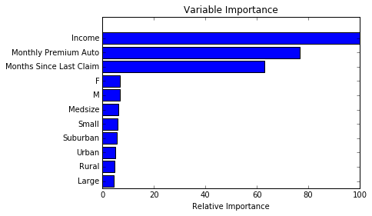
Data Science
The Model
Gradient Boosting Classifier
Number of Estimators = 500
Max Depth = 10
Learning Rate = 0.01
Model score of 80.08

Slide 5
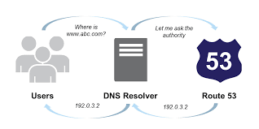

Demo
Application is hosted an Amazon EC2 Instance
Utilizing Amazon Route 53 Service to point to my registered domain
http://www.robjwentworth.com

