Slide 1
Auto Loss Complaint Predictor
Rob wentworth – GoForCode Developer

Slide 2
Business Use Case
Data set included Auto Loss information at a Customer level
Question Statement: Can customer and loss information predict the probability that a customer will have an open complaint?
Examined the question on the following criteria:
Gender
Income
Months since last Claim
Monthly Premium
Generalized Location
Vehicle Size

Slide 3
Data Science
The Model
Gradient Boosting Classifier
Number of Estimators = 500
Max Depth = 10
Learning Rate = 0.01
Accuracy score of 80.08%

Slide 4
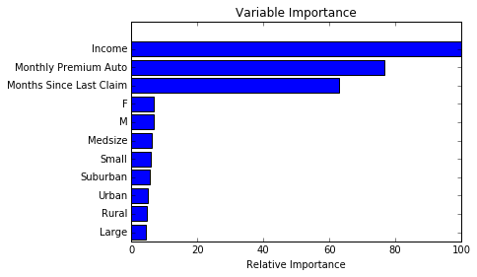
Feature Importance

Slide 5
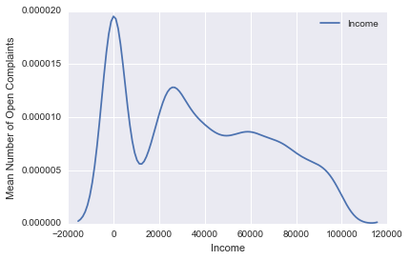
Income Graph

Slide 6

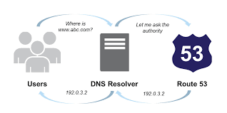
Web Application
Application is hosted an Amazon EC2 Instance
Utilizing Amazon Route 53 Service to point to my registered domain
http://www.robjwentworth.com

Slide 7
