Slide 1

Standard Error Estimation for Clustered Data
Andrew Amore & Rob Kravec

Slide 2
Introduction and motivation
What is Clustered Data
Applications to Causal Inference
SUTVA
Biased Standard Error Estimation
Neglected Cluster Correlation(s)
Simulations
Explore Existing Methods
New Bootstrap Procedure
Cluster randomization (e.g., villages, schools, hospitals)
Individual randomization
Simple RCT
Cluster
RCT
Treatment
Control
Treatment
Control
Image inspriation: https://mpog.org/wp-content/uploads/2019/10/10.Spence.pdf

Slide 3

Review of existing methods
Closed Form Methods
OLS-SE
Huber-White Robust SE Estimation (Sandwich)
Bootstrap Based Methods
Regular
Cluster
Double

Slide 4
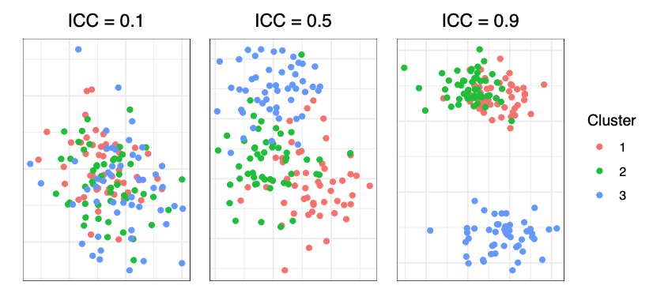

Simulation procedure
Data generated based on random intercept model with no predictors:
$y_{ij}=μ+ α_{j}+ε_{ij}$ for all observations i in cluster j where $ε_{ij}{}_{\sim }^{iid}{N(0, σ^{2})}$ and $α_{j}{}_{\sim }^{iid}{N(0, τ^{2})}$
Intracluster correlation (ICC) = $\frac{τ^{2}}{τ^{2}+σ^{2}}$
Vary number of clusters, observations per cluster, ICC
3 bootstrap-based standard error estimation techniques: standard, cluster, double
Check coverage and 95% confidence interval width

Slide 5
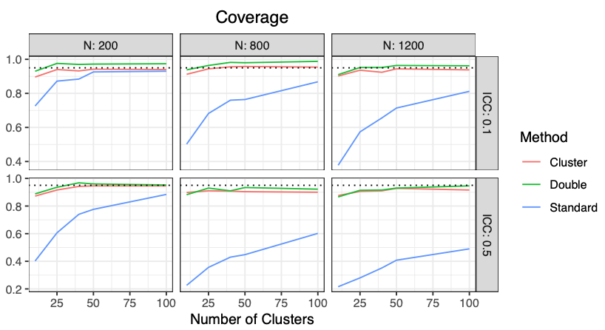
Simulation results
Severe downward bias for standard bootstrap (worsened at high ICC)
Slight downward bias for cluster-robust techniques with small number of clusters
Cluster-robust techniques are overly conservative when ICC = 0

Slide 6
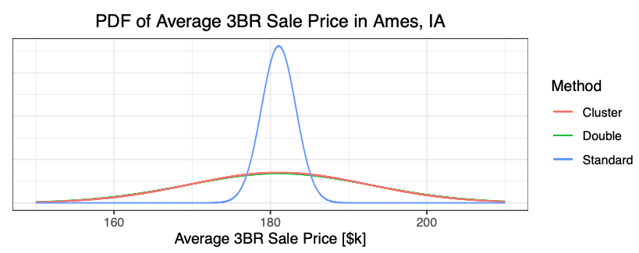
Case study: Home sales in Iowa
Goal: Estimate average value of 3-bedroom homes in Ames, IA from 2006-2010 given data on home sales
“Neighborhood” provides highly influential clustering variable, yielding ICC of 0.6
While true population parameter is unknown, standard bootstrap produces pdf that is likely too narrow

Slide 7
Future work
Possible extensions include:
Considering more complex data generation mechanisms (e.g., with predictors) and population parameters (e.g., causal estimands)
Exploring multi-level clustering (e.g., students in schools in districts in states)

Slide 8
Acknowledgements + References
We would like to thank Dr. Fan Li for inspiring us to pursue this topic and Rihui Ou / Yunran Chen for excellent guidance while learning causal inference
References
Jo B, Asparouhov T, Muthén BO. Intention-to-treat analysis in cluster randomized trials with noncom- pliance. Stat Med. 2008;27(27):5565-5577. doi:10.1002/sim.3370
Arceneaux, Kevin, and David W. Nickerson. 2009. “Modeling Certainty with Clustered A Comparison of Methods.” Political Analysis 1
Harden, Jeffrey J. “A Bootstrap Method for Conducting Statistical Inference with Clustered Data.” State Politics & Policy Quarterly, vol. 11, no. 2, 2011, pp. 223–46, http://www.jstor.org/stable/41575822. Accessed 18 Apr. 2022.
Matthew D. Webb, 2014. “Reworking Wild Bootstrap Based Inference For Clustered Errors,” Working Paper 1315, Economics Department, Queen’s University.
https://www.kaggle.com/competitions/house-prices-advanced-regression-techniques/overview

