Slide 1
HTTP Proxies
Rob Lapp

Slide 2

Goals
Understand proxies and what it really means to proxy requests
Learn about request timeouts and cancellations
What is meant by streaming and how proxies can impact it

Slide 3

Environment Setup
docker proxy
(host)
5010
HTTP client
http://localhost:5010/api/v1/test/sql-query
172.19.0.1
Bridge Gateway
toplevelproxy
apigateway
webapi
upstream_webapi
sqlserver
172.19.0.6
172.19.0.3
172.19.0.5
172.19.0.2
172.19.0.4
5010
5011
5012
5013
5050
Docker Bridge Network
Docker Desktop for Windows

Slide 4

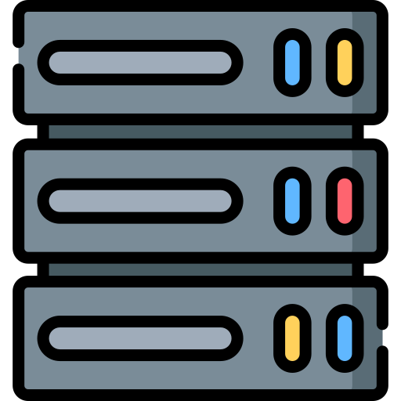
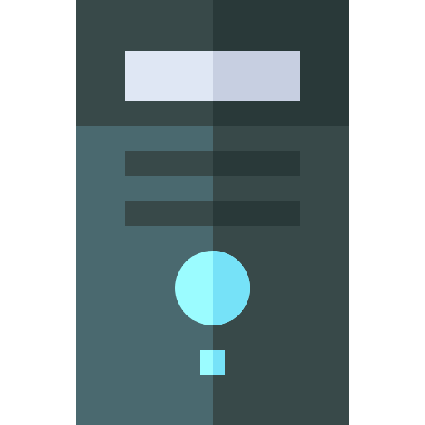

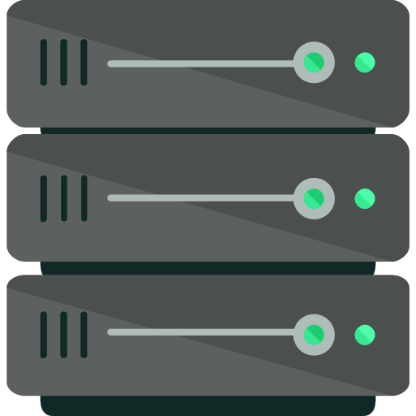
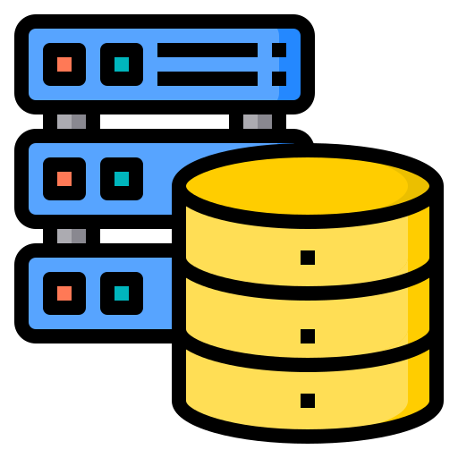
Forward Proxy vs. Reverse Proxy
LAN
LAN
Forward Proxy
Reverse Proxy

Slide 5

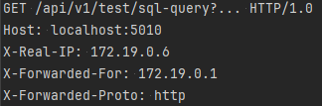
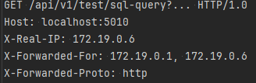
Proxying Requests
HTTP client
http://localhost:5010/api/v1/test/sql-query
Target server
toplevelproxy
apigateway
webapi
172.19.0.6
172.19.0.3
172.19.0.5
http
http
5010
5011
5012
TCP socket(s)
172.19.0.1
GET /api/v1/test/sql-query
Host: localhost:5010
172.19.0.6
172.19.0.6
GET /api/v1/test/sql-query
Host: localhost:5010
172.19.0.3
172.19.0.3
GET /api/v1/test/sql-query
Host: localhost:5010
172.19.0.5

Slide 6


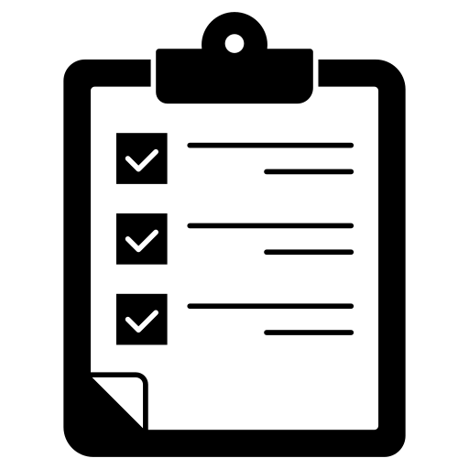

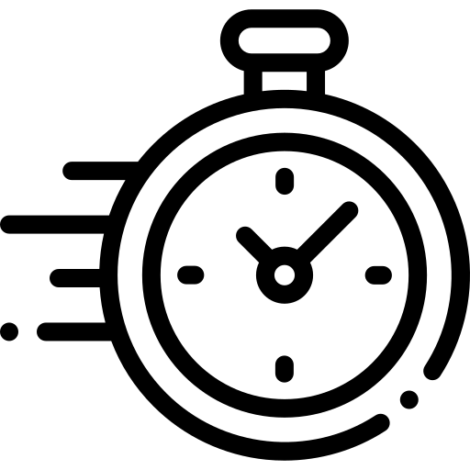

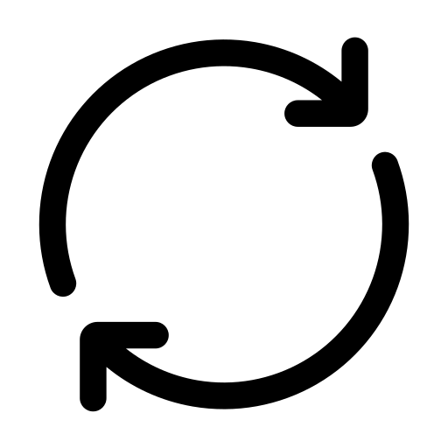

Request/Response Streaming
The continuous transmission of data between a client and server
Data is sent in smaller chunks instead of all at once
Streaming is a design concept, not a specific protocol
Types of streaming:
Writing an HTTP response incrementally
Server sent events
Long polling
Web sockets

Slide 7
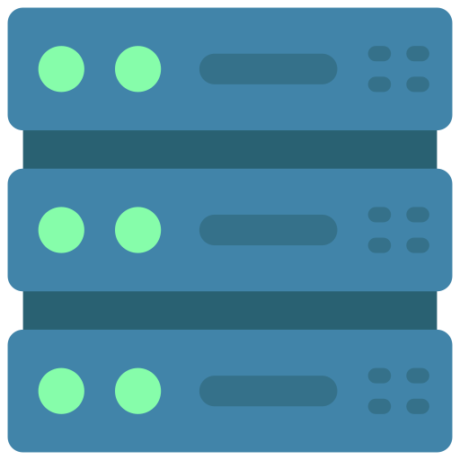
Long Polling
HTTP client
Connect
Server
Single HTTP connection
Close connection
Connect
Single HTTP connection
Data
Connect
Single HTTP connection
Data
Connect
Single HTTP connection
Close connection

Slide 8
Server Sent Events
Connect
Data
Data
Single HTTP connection
Data
Close connection
Connect
HTTP client
Server
Data
Data
Single HTTP connection
Close connection
Connect
Single HTTP connection

Slide 9

What Happens When a Timeout Occurs?
HTTP client
curl http://localhost:5010/api/v1/test/sql-query
toplevelproxy
apigateway
webapi
172.19.0.6
http
172.19.0.3
http
172.19.0.5
172.19.0.4
5010
5011
5012
5050

Slide 10

Summary
What exactly does it mean to "proxy" a request?
It means to route a request through an intermediary server instead of sending it to a destination server directly
A proxy server can modify the incoming request before it is sent to the destination server
Data travels between servers over HTTP and HTTPS

Slide 11
Summary
What does it mean to “cancel” a request?
Cancelling a request means the client (or a proxy in the call chain) has prematurely closed the connection
The following actions are all forms of cancellation
Forcibly closing the client
The client times out
A proxy server times out
If you don’t opt-in to cancellation via CancellationTokens, your server endpoint will continue to run code even after the client has disconnected

Slide 12
Summary
Streaming
Streaming is the continuous transmission of data
Buffering is when data is pre-loaded in a temporary storage location (disk, cache, memory)
Buffering can kill performance especially if it’s being done in an HTTP call chain that invokes a streaming-based endpoint

