Slide 1
Introduction to Scalable vector Graphics (SVG)

Slide 2

Rob Larsen
Rob is an experienced front-end engineer, author and open-source contributor.
Rob is co-author of Professional jQuery, the author of Beginning HTML and CSS, the author of The Uncertain Web, from O’Reilly, the author of Mastering SVG and co-author of The HTML and CSS Workshop.
A long-time open-source contributor, Rob currently maintains HTML5-Boilerplate and administers the H5BP organization on GitHub.

Slide 3
What we’ll cover
What is SVG?
Your First SVG Image
Adding an SVG File to an HTML Document
Drawing with Code
Embedding an SVG Element in an HTML Document

Slide 4
What is SVG?

Slide 5

Scalable vector Graphics (SVG)
SVG is an XML-based markup language used to define images.
Defined in 1999, SVG took a long time to gain traction as browser support was limited until the 2010s.
These days it’s widely supported.
Since it’s a markup language, if you know HTML, you can jump right in with SVG using familiar concepts and structures.

Slide 6
Your first SVG IMAGE

Slide 7
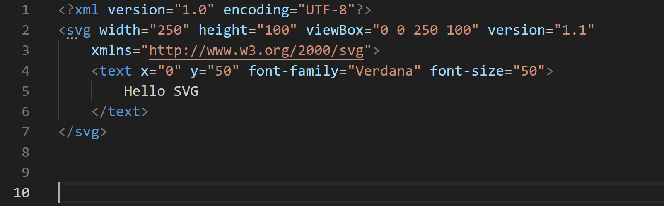
Example.svg
Notes:
The following code sample shows the basic structure of an SVG image. Let’s walk through it.
Again, if you’re familiar with HTML, this should be pretty familiar to you- you are just using a new set of ements and attributes.
The first element is the standard xml declaration indicating that document should be parsed as XML.
Next up is the root SVG element, this is the root element of an SVG document- equivalent to the root <HTML> element in an HTML document
There are many possible attributes for the SVG element. Here we are using four
height and width define the intrinsic dimensions of the document.
The xmlns (XML Name Space) is a reference to schema that defines this XML element.
The viewBox will be covered in depth in a later video in this series. Briefly it defines the coordinate plane of the SVG document. The top left coordinate is 0,0 and the bottom-right coordinate is 250,100, which maps to the height and width of the image. Other things can be done with the viewBox- It’s very powerful There will be a whole video on the viewBox in the future.
The single child of the SVG element is a text element. The text element also has many possible attributes. We’ll eventually cover the most common use cases for all attributes of all the common SVG elements.
In this case there are four attributes related to the display of the element.
The x and y attributes represent the position of the top left corner of the text element as points on
the coordinate plane.
font-family maps to the familiar CSS property of the same name- it defines the typeface that should be used for the text
font-size also maps to the common CSS property and defines the size of the front

Slide 8
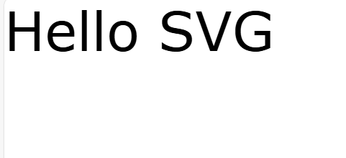
Example.svg
This is the example.svg rendered in a web browser.

Slide 9
Embedding an SVG image in an HTML Document

Slide 10
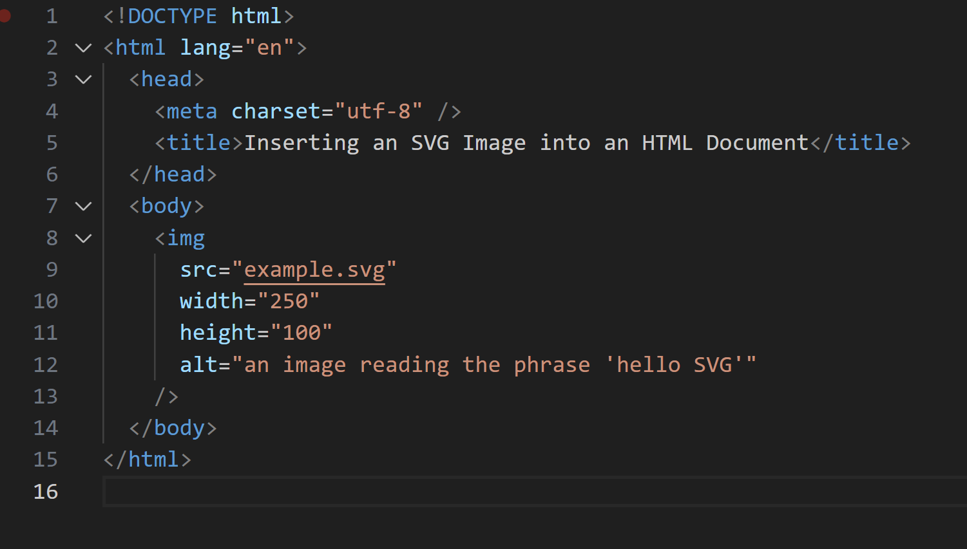
example.html
Notes:
All you need to do to embed an SVG image is to set it as the source of a familiar image element. It’s that simple. This is a trend with SVG. So much of it is familiar.

Slide 11
Drawing with code

Slide 12
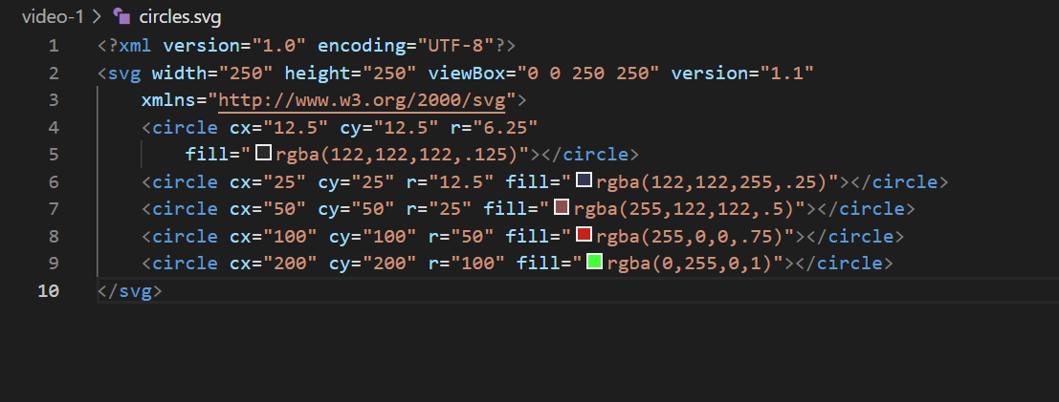
Circles.svg
Notes:
While the text element is useful, SVG is exciting because it allows you to draw with code. Let’s look at a simple example that illustrates the basics.
In this SVG image there are four circle elements. Each has four attributes
cx Center X is the x coordinate of the center of the circle.
cy Center Y is the y coordinate of the center of the circle.
r is the radius of the circle
fill is the fill color of the circle, in this case defined using the RGBA notation (red blue green alpha)

Slide 13
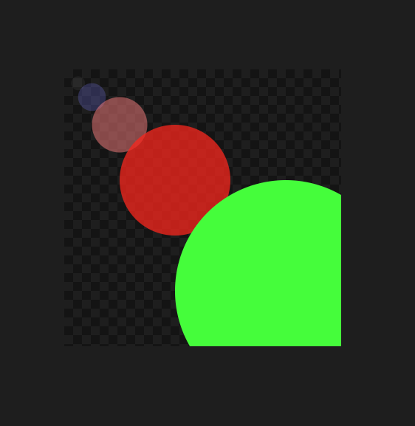
circles.svg
This is the circles.svg rendered in a web browser.

Slide 14
Adding an SVG element directly into an HTML Document

Slide 15
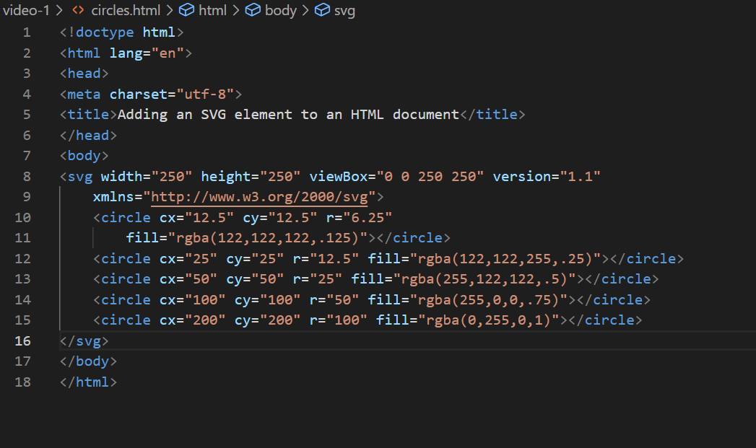
circles.html
Notes:
As you can see, instead of including it as the src of an image element, you can embed an SVG element directly into an HTML document. The SVG element is then part of the DOM and can be manipulated alongside other elements on the page. This is a VERY powerful aspect of SVG and we will go into depth on this powerful feature in a later video in the series.

Slide 16
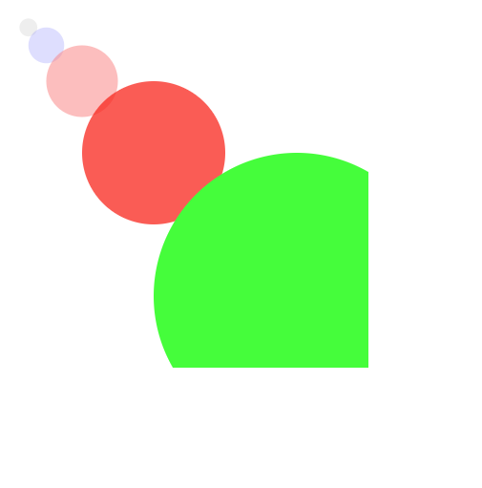
circles.html
This is the circles.html rendered in a web browser.

Slide 17
What we’ve learned
Key takeaways
SVG is an XML-based markup language defined to create images
SVG is defined using the familiar pattern of attributes and elements
Embedding SVG in a page an be done one of two ways
As the src of an img element
Directly in the HTML code

Slide 18
THANK YOU
Rob Larsen
https://htmlcssjavascript.com
https://github.com/roblarsen
https://www.linkedin.com/in/robreact/
Code and slides:
https://github.com/roblarsen/introduction-to-svg

