Slide 1
Wild World Web
Web Development in a World of Ever-Changing Browsers, Platforms & Compatibilities

Slide 2

The Web a Dozen Years Ago

Slide 3
Just Click the Big Blue E
At the height of their dominance, Windows XP + Internet Explorer (5,5.5 and 6) was 95% of the web
Just 2 screen resolutions mattered

Slide 4
Things Were Pretty Stale
We had rules iand browser specific fixes
Think: 960 pixel grids, the Netscape Navigator resize fix and conditional comments all over the place
We had a calcified specification & browser landscape
Between December 1997: HTML4.0 specification
Early 1998: XML 1.0 Standard
May 1998: CSS level 2 specification
December 1999: ECMASCript version 3.0
January 2000: XHTML 1.0
Internet Explorer 6 was released August 27, 2001
September 2001: SVG 1.0 W3C Recommendation

Slide 5
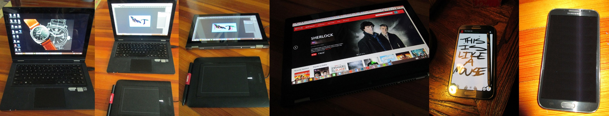
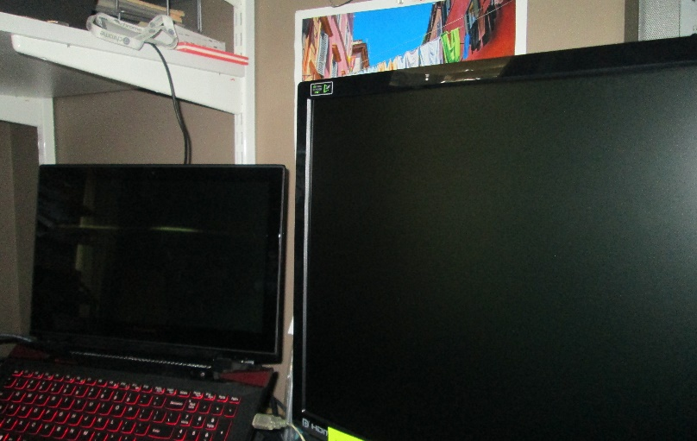
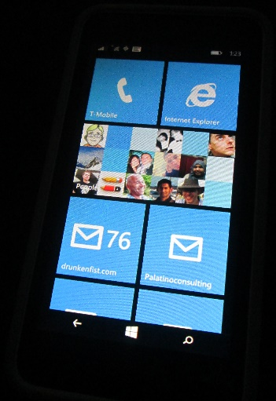
The Web is Facing An Explosion of Devices and Browsers
I’d list out all the different modes I might use in a day but it might take a while.

Slide 6
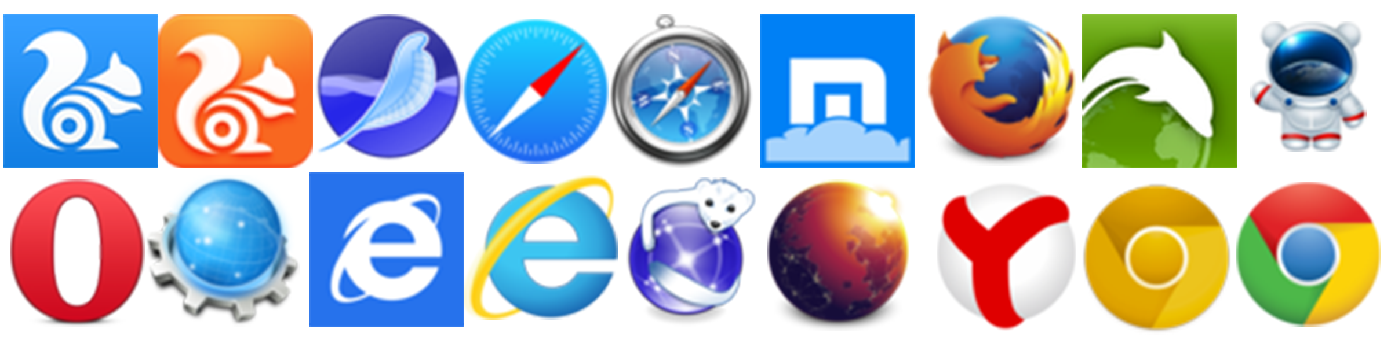
Lots of Browsers:

Slide 7
The Web is No Longer Just the Big Blue E
Resolutions from 240 x 320 to 3840 x 1080 (or more)
Pixel densities from 72ppi up past 300ppi
A broad range of input options (keyboard, stylus, gesture, touch, mouse)
A dozen (or more) major and hundreds of minor browser versions in the wild
A rapidly changing open web platform landscape

Slide 8
So… Let’s Make More Rules?
Initially, developers and designers tried to navigate this new complicated reality by creating new rules.

Slide 9
New Rules? Not so Great.
As soon as a new rule was created, it would start to fall apart. People built “iPhone” sites because the iPhone was the only mobile device worth targeting. People tested for touch capabilities and assumed that those users would never have a mouse.

Slide 10
New Rules? Not so Great.
As Android’s huge growth over the past few years, and the presence of Chromebooks and Windows 8 laptops with both mouse and touch capabilities have proved, those new rules have a short shelf life.

Slide 11

Notes:
Nothing could ever challenge the iPhone, right?

Slide 12
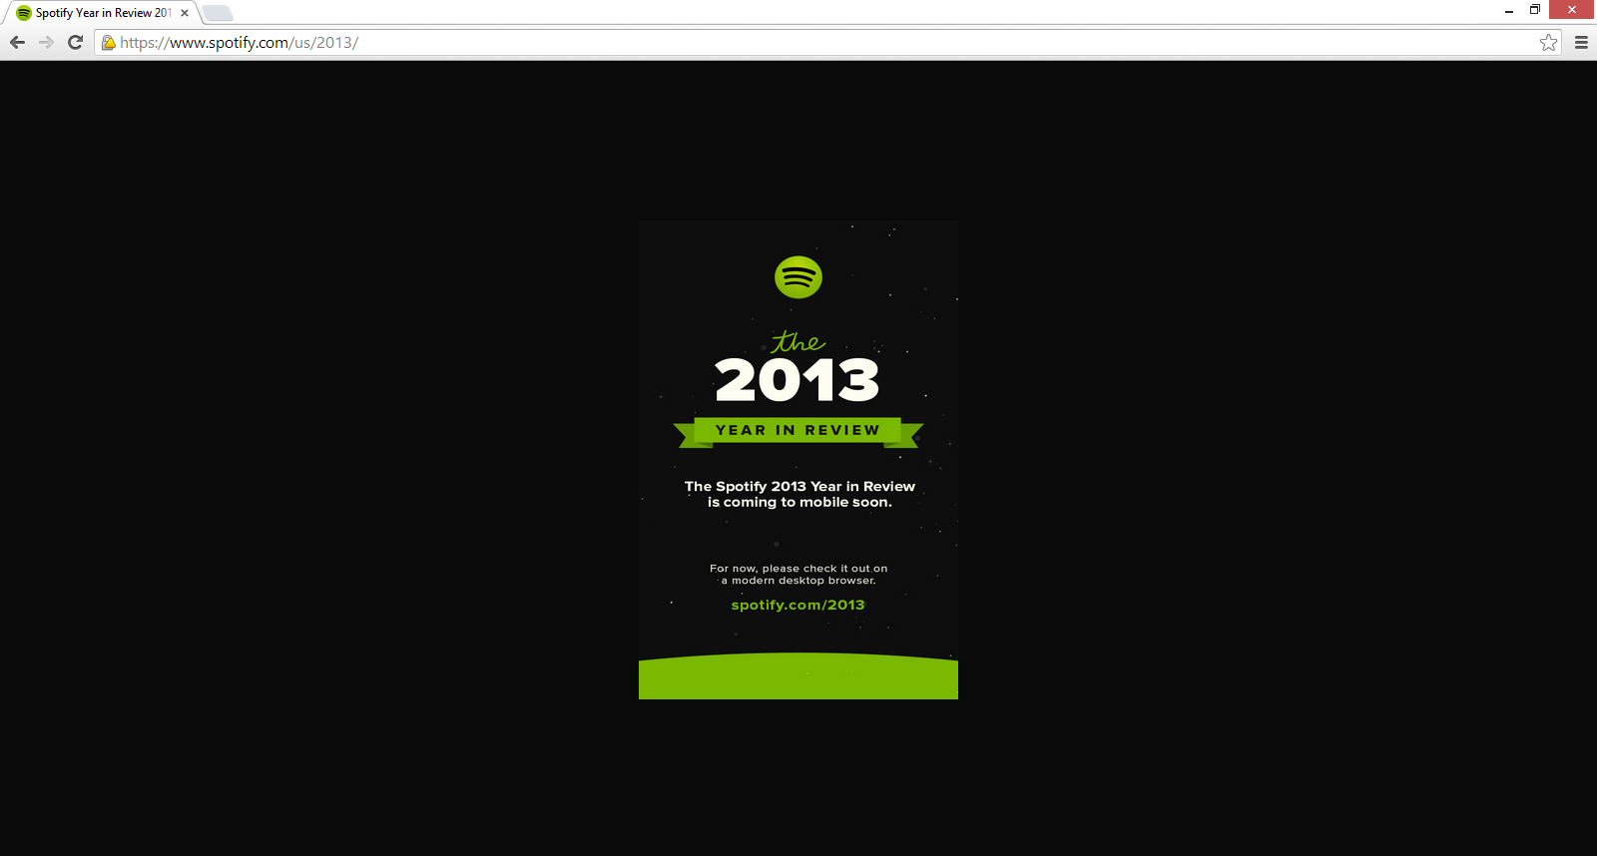
Simple Rules Definitely Don’t Work

Slide 13
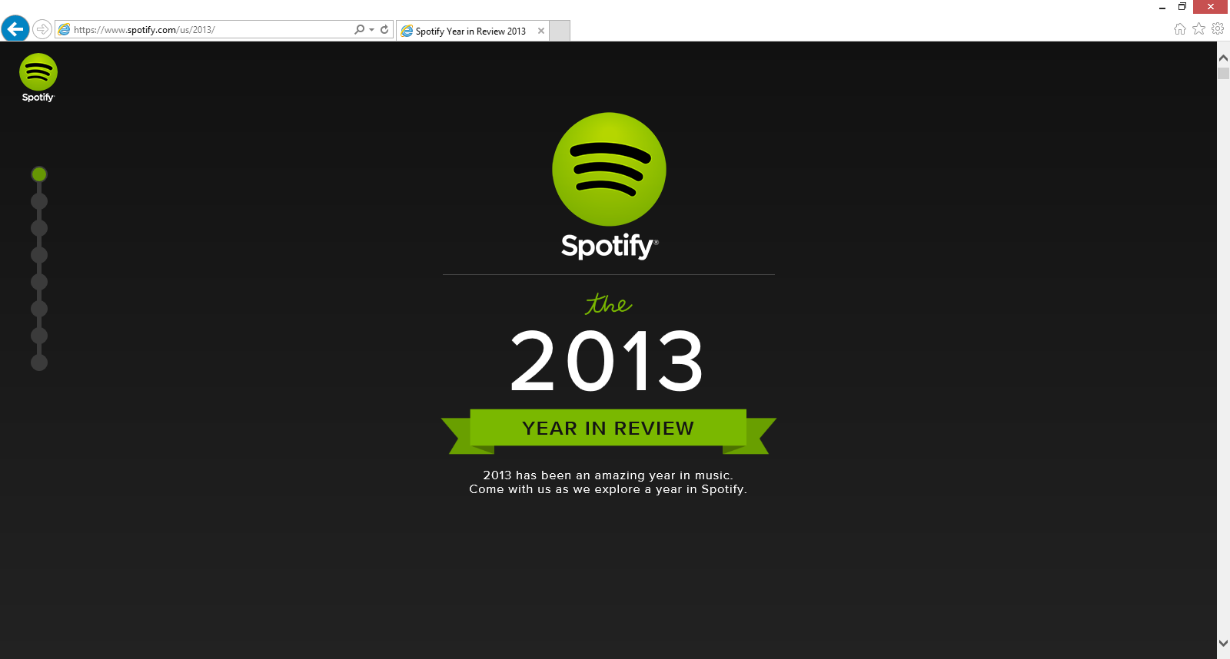

Slide 14
One Size Fits All?
Even patterns like Responsive Web Design (RWD), which some people see as the solution for everything, can get hectic when applied against complicated application patterns and the questions of bandwidth and the challenge of mobile performance.

Slide 15
So What Are We Supposed to Do?
The best way to approach the web today is to forgo hard and fast rules and design for uncertainty.
This is the best bet for creating future proof web solutions.

Slide 16
Embracing Uncertainty
What follows are a series of high level ideas that will allow you approach compatibility in a nimble way and will help you when you're faced with the web's uncertainty.

Slide 17
Embracing Uncertainty

Slide 18
Don't Blame the Web for being the Web
The web is a diverse place that's getting more diverse every single day.
If you accept the web's diversity (and maybe even celebrate it) and you're getting angry about one thing (maybe Internet Explorer 8) or another (the stock Android Browser) just take a minute to remind yourself that this is just the way the web is.
This is just the way the web is.

Slide 19
Identify and embrace your audience
While you can look at web-scale statistics for browser and operating system market share to get some idea of where things, the only metrics that truly matter are those for your audience.

Slide 20
Identify and embrace your audience
Who are they? What do they use? Where do they live?
Knowing this information makes your life significantly easier.

Slide 21
Identify and embrace your audience
If, for example, you're planning on leveraging SVG for data visualizations, and you still have big legacy IE audience you would want to look at Raphaël, which has built-in support for legacy IE rather than Snap.svg, the successor which solely leverages modern browser features.

Slide 22
Test and pray for the best
Once you've identified your audience, where they are and what they're using it's time to define the technical demographics you're going to target.

Slide 23
Testing Could Look Like This:
Samsung Galaxy S3
Samsung Galaxy S4
Samsung Galaxy S5
Samsung Galaxy Note III
Samsung Galaxy Note 4
Nexus 5
Kindle Fire
Motorola Droid X (Android 2.3)
Google Nexus 7
Nokia Lumia 920
iPhone 4S
iPad 2G
iPhone 5s
iPhone 6
Chrome (latest) Mac, PC and a Chromebook
Firefox (latest) Mac and PC.
Opera (latest) Mac and PC
IE 8.0 on Windows XP
IE 9.0 on Windows 7
IE 10.0 Windows 7/8 - including a touch screen laptop
IE 11.0 Windows 7/8/8.1 - including a touch screen laptop
Safari 6.0

Slide 24
Or Scaled Down to This
Samsung Galaxy S4
iPhone 6
iPad 2G
Motorola Droid X
Chrome (latest) Mac and PC
Firefox (latest) Mac and PC.
Opera (latest) Mac and PC
IE 8.0 on Windows XP
IE 9.0 on Windows 7
IE 10.0 Windows 7
IE 11.0 Windows 8
Safari 6.0

Slide 25
Whatever it is…
Test on as many real devices as early and as often as you can. You will be surprised.

Slide 26
Focus on optimal, not absolute solutions
Your site is not an absolute thing. The best possible site you can have will be the best possible site for everyone that visits it. If that means it's a high DPI, 25MB monstrosity for a guy on a Macbook air in a coffee shop in Palo Alto or just a logo and an unordered list for someone on a-rented-by-the-minute feature phone in Lagos, then that's the way it is.

Slide 27
Embrace Accessibility
Simply put, if your site is accessible you're guaranteeing that you'll be able to reach the largest possible audience. You're also doing the right thing.

Slide 28
If Doing the Right Thing Isn’t Enough…
Based on the 2010 US census, 56 million Americans were classified as having a disability. That's 18.7% of the population.
Notes:
With the understanding that individuals might have one or more class of disability, and that not all disabilities would hinder the ability of a user to access the web the following table shows the number of Americans with disabilities that might interfere with their use of the web.

Slide 29
…Tens of Millions of People Are Directly Affected
Numbers for this are hard to come by, but even using these numbers as a rough guide you can estimate that there are millions of Americans that rely on the accessibility of sites to use the web. Getting numbers outside of the US is even more difficult, but the rest if the world is a lot bigger than the US, so millions in the US means many more millions in the rest of the world.

Slide 30
Class of Disability | % of Americans | Total # of Americans | Note
Visual | 3.3 | 8,077,000
Hearing | 3.1 | 7,572,000
Motor | 2.8 | 6,700,000 | Based on the number Americans with "difficulty grasping objects like a glass or pencil" as a rough analog for mouse use
Cognitive | 6.3 | 15,155,000 | Covers all mental disabilities

Slide 31
Every User is Indirectly Affected
The following slides list some of the ways that accessibility techniques can help all users.
Notes:
Video transcripts and other access

Slide 32
Accessibility Guidelines that Especially Aid the Multi-device Landscape
Provide text alternatives for all non-text content
Ensure that information and structure can be separated from presentation
Content can be paused by the user
Make all functionality operable via a keyboard interface
Provide mechanisms to help users find content
Notes:
If images fail to load or are loading slowly alternative text can provide crucial context to users.
Good structure for your code makes it much easier to translate into different formats for devices with different capabilities and needs. This used to be a much bigger issue when people commonly used tables for layout, but it's still important now.
The intent of this guideline is to ensure that visually impaired or cognitively-disabled users have time to digest your content.
Ensure that video, audio and time-based visualizations can be controlled by the user
Avoid automatically refreshing content after a set period of time or to allow that functionality to be turned off.
Don't force updates down your user's throat. In addition to the accessibility concerns, all users can benefit from avoiding this practice. On mobile, for example, this rule is important for all users because battery life, bandwidth and processor time are all important factors in the overall mobile experience. You don't want to download unnecessarily updates, wasting kilobytes of data and battery life.
This is just good sense, of course, but is especially true when dealing with smaller screens. Make links make sense, give a good sense of where users are within your site or application and give them multiple ways to reach content. The less you ask a mobile user to do to get to their important content, the better.
Having a clearly labeled "contact us" link with a big fat button that takes them to a simple list which includes your telephone number is worth more for the customer's experience than pretty much anything else you can do on the web. You might have the most beautiful site in the world, but if your customer can't find your phone number you might as well have made your site out of sticks and glue. It's useless.

Slide 33
More Accessibility Guidelines that Help Everyone in the Multi-Device Landscape
Help users avoid mistakes & make it easy to correct mistakes that do occur
Support compatibility with current and future user agents
Notes:
It's hard to fill out forms on the web. The more help you can give users, the better. This is true for all users.
The more time and care you spend on your forms, the better off you'll be. Making it difficult for people to make errors, offering meaningful error messages and designing forms to lessen the user's cognitive load are going to directly affect your bottom line.
For example, offering inline validation (checking the form data for validity as they enter it) and providing help text in context can help users more confidently enter the correct information in form fields.
Support compatibility with current and future user agents (including assistive technologies)
The fact that the first website ever made still works is a guiding principle here. Don't back yourself into a corner and you'll be sitting pretty in 2025.
I will say that getting a basic understanding of how assistive technologies work and how they may work in the future is a good idea to add onto the understanding of the browser and device market.

Slide 34
Don't Stop There
In addition to being a vital link for disabled users, all the WCAG guidelines are going to make your site more robust for all users.

Slide 35
Don't Stop There
It's important to assess the compatibility and accessibility impact of new technologies and technology patterns. Issues like the 300ms delay for tap/click on touch devices and the use of icon fonts are multi-faceted problems.

Slide 36
Lose your technology biases
Tech folks generally have great hardware and new, high powered smart phones and tablets. Most other people in the world don't. Tech folks tend to forget that.

Slide 37
The iPhone isn’t the only mobile experience
At the height of the iPhone's dominance as a mobile platform, it was typical to base mobile web designs on the interface and interaction model of the iPhone.
And then came Android.

Slide 38
Where Do We Put the Back Button?
If your vision of the web is iPhone-centric, inserting a back button into your web UI seems like a good idea. The thing is, every Android device has a back button built in, either as a dedicated software button on screen or as a physical button on the device.
Notes:
There's only the one button on the iPhone so you need a software back button. If your vision of the web is iPhone-centric, inserting a back button into your web UI seems like a good idea. The thing is, every Android device has a back button built in, either as a dedicated software button on screen or as a physical button on the device. All of them. It's required and it also gets used all the time so a back button in the UI of a web app, for an Android user, is a foreign experience. You're just wasting precious pixels. But yet, people do it because the iOS experience is all they know.

Slide 39
Closed. Won't fix. Can't Reproduce.
"That animation is super fast on my machine.“
Another painful example of the trap tech folks fall into is with JavaScript performance.
Most people don't look critically at their application performance in enough devices to truly test performance.
Notes:
"That animation is super fast on my machine.“
Another painful example of the trap tech folks fall into is with JavaScript performance.
While there's a lot of talk about being jank free and the web performance community has grown to be a real force in the industry; the plain fact is most people don't look critically at their application performance in enough devices to truly test performance. There are underpowered mobile devices, old desktops and old browsers aplenty out there waiting to expose problems with your site. You can easily trip long running script errors, freeze the screen and even crash the browser if you're not careful. If you think you're getting a second look from a user whose browser you just crashed, you've got another thing coming.
It's said so often that it's a cliché, but the reality is it can "work on my machine" only to fail on some other hardware/browser combination.

Slide 40
Contrary to Popular Opinion Internet Explorer Does Exist
People don't test enough in Internet Explorer.
Whether it's Windows-based developers working all day in Firefox or Chrome or developers on a Mac not wanting to fire up Parallels, people don't test in IE early or often enough.
Notes:
People don't test enough in Internet Explorer.
Whether it's Windows-based developers working all day in Firefox or Chrome or developers on a Mac not wanting to fire up Parallels, people don't test in IE early or often enough.
That's crazy.
I know it's the bogeyman, but it remains a huge portion of the browser market. Depending on where you look for your stats, it's got a larger market share than Firefox and Safari combined. Yet, people treat it like an afterthought. This is less of a problem than it was six or seven years ago as IE's market share has halved, but it's still a major issue when you're ignoring hundreds of millions of potential customers.
I've managed a lot of developers and projects over the years and I've had specific feedback on this issue about folks that worked for me on several different occasions. This is especially problematic as I've done a lot of consulting and agency work for health-care companies, financial services firms and law firms. There's a *lot* of Internet Explorer in those industries. As I mentioned previously, it's often the *only* browser allowed on internal networks.
Some people would blame IE for my crummy night, *because it's the bogeyman*. Two things about that thought. First, IE can't win. They lose when they don't follow the specification and they lose when they do. It's true. The ES3 specification didn't allow trailing commas in Object literals. Crazy that the IE implementation could be *to the specification.* Secondly, the developer is to blame because... he didn't test his code and checked it in. Blaming IE for that is like blaming the rain for getting you wet if you walk outside without an umbrella.
I think this behavior is at least part of the reason why people have such a visceral dislike of IE- including later versions which are actually quite easy work with. Since so many people save IE for later on in the development process, or downright ignore it, their only experience with the browser is one of shock and betrayal.
If IE was constantly sneaking up on me and punching me in the face because I wasn't paying attention, I'd be mad at it too.

Slide 41
Contrary to Popular Opinion Internet Explorer Does Exist
I know it's the bogeyman, but it remains a huge portion of the browser market with hundreds of millions of users
Yet, people treat it like an afterthought.
Notes:
People don't test enough in Internet Explorer.
Whether it's Windows-based developers working all day in Firefox or Chrome or developers on a Mac not wanting to fire up Parallels, people don't test in IE early or often enough.
That's crazy.
I know it's the bogeyman, but it remains a huge portion of the browser market. Depending on where you look for your stats, it's got a larger market share than Firefox and Safari combined. Yet, people treat it like an afterthought. This is less of a problem than it was six or seven years ago as IE's market share has halved, but it's still a major issue when you're ignoring hundreds of millions of potential customers.
I've managed a lot of developers and projects over the years and I've had specific feedback on this issue about folks that worked for me on several different occasions. This is especially problematic as I've done a lot of consulting and agency work for health-care companies, financial services firms and law firms. There's a *lot* of Internet Explorer in those industries. As I mentioned previously, it's often the *only* browser allowed on internal networks.
Some people would blame IE for my crummy night, *because it's the bogeyman*. Two things about that thought. First, IE can't win. They lose when they don't follow the specification and they lose when they do. It's true. The ES3 specification didn't allow trailing commas in Object literals. Crazy that the IE implementation could be *to the specification.* Secondly, the developer is to blame because... he didn't test his code and checked it in. Blaming IE for that is like blaming the rain for getting you wet if you walk outside without an umbrella.
I think this behavior is at least part of the reason why people have such a visceral dislike of IE- including later versions which are actually quite easy work with. Since so many people save IE for later on in the development process, or downright ignore it, their only experience with the browser is one of shock and betrayal.
If IE was constantly sneaking up on me and punching me in the face because I wasn't paying attention, I'd be mad at it too.

Slide 42
Contrary to Popular Opinion Internet Explorer Does Exist
I think this behavior is at least part of the reason why people have such a visceral dislike of IE- including later versions which are actually quite easy work with. Since so many people save IE for later on in the development process, or downright ignore it, their only experience with the browser is one of shock and betrayal.
If IE was constantly sneaking up on me and punching me in the face because I wasn't paying attention, I'd be mad at it too.
Notes:
People don't test enough in Internet Explorer.
Whether it's Windows-based developers working all day in Firefox or Chrome or developers on a Mac not wanting to fire up Parallels, people don't test in IE early or often enough.
That's crazy.
I know it's the bogeyman, but it remains a huge portion of the browser market. Depending on where you look for your stats, it's got a larger market share than Firefox and Safari combined. Yet, people treat it like an afterthought. This is less of a problem than it was six or seven years ago as IE's market share has halved, but it's still a major issue when you're ignoring hundreds of millions of potential customers.
I've managed a lot of developers and projects over the years and I've had specific feedback on this issue about folks that worked for me on several different occasions. This is especially problematic as I've done a lot of consulting and agency work for health-care companies, financial services firms and law firms. There's a *lot* of Internet Explorer in those industries. As I mentioned previously, it's often the *only* browser allowed on internal networks.
Some people would blame IE for my crummy night, *because it's the bogeyman*. Two things about that thought. First, IE can't win. They lose when they don't follow the specification and they lose when they do. It's true. The ES3 specification didn't allow trailing commas in Object literals. Crazy that the IE implementation could be *to the specification.* Secondly, the developer is to blame because... he didn't test his code and checked it in. Blaming IE for that is like blaming the rain for getting you wet if you walk outside without an umbrella.
I think this behavior is at least part of the reason why people have such a visceral dislike of IE- including later versions which are actually quite easy work with. Since so many people save IE for later on in the development process, or downright ignore it, their only experience with the browser is one of shock and betrayal.
If IE was constantly sneaking up on me and punching me in the face because I wasn't paying attention, I'd be mad at it too.

Slide 43
Embrace Empathy
Don't blind yourself to what your audience actually is by assuming that they are just like you.
Try to get in their shoes instead of assuming everyone else is in yours.
Notes:
They're not. Your average experience at work, at home or on your phone is almost certainly an optimal view of your site. Make sure you look at it, really look at it, in every scenario you can muster. Sure, we're all guilty of demoing code under the best possible circumstances. That's natural. The thing is, that demo is the ideal vision of your site. The thing you're actually building, the down and dirty version, is for people with a completely different relationship with technology than yours.

Slide 44
Lose your stack biases
Your users don't care if your stack is clever. What they care about is the speed, usability, look and feel, interactivity and features. If your stack isn't adding to one of those then you might be going down the road to stack obsession.
At the end of the day developer comfort isn't the most important part of this equation. The experience of the users of your site trumps everything else. Or at least it should. To that end, doing things like pushing 1Mb of fancy framework JavaScript down the pipe on a site that's meant to be consumed on a mobile device over a potentially dicey connection is simply a terrible idea.

Slide 45
There was a time…
…when front end development heroes made things and showed you how to make things. Now, they make things to help you make things and talk about plumbing.

Slide 46
E.g., Don’t Turn HTML back in XHTML
While Front-end Model View Controller (MVC) style libraries and frameworks are great, these libraries and frameworks are really designed for application development- they shouldn't be used for every circumstance.
Notes:
Why, when the goal is to simplify and lighten the payload in the front end are we willingly passing a task that was solved 15 years ago on the server to the browser? Having to download a framework as well as any other dependencies is going to slow your site down. Downloading Ajax requests with the content data, parsing it and inserting it into the DOM is also a performance penalty. We've learned to minimize the number of DOM traversals and manipulations. Why add more when the server can send a rendered page on the back of one HTTP request? It doesn't make sense.

Slide 47
E.g., Don’t Turn HTML back in XHTML
For example, don’t use one of these libraries in place of server side templates for a content site. One of the first lessons of web performance was that most of the performance hit on the page happened in the browser, not on the server. Templates on the server aren't a performance problem. Why, then, are we rushing headlong to push functionality that was handled perfectly well by the server down to the front end?
Notes:
Why, when the goal is to simplify and lighten the payload in the front end are we willingly passing a task that was solved 15 years ago on the server to the browser? Having to download a framework as well as any other dependencies is going to slow your site down. Downloading Ajax requests with the content data, parsing it and inserting it into the DOM is also a performance penalty. We've learned to minimize the number of DOM traversals and manipulations. Why add more when the server can send a rendered page on the back of one HTTP request? It doesn't make sense.

Slide 48
Spread Your Wings and Question Your Assumptions
At this point, I'm assuming at least half of you think I'm an idiot.
If so, I must be onto something.
Whatever percentage of these concepts you agree with or feel like are applicable to you and your particular situation, the biggest takeaway is the urge to question your assumptions.

