Slide 1

Wild World Web
Web Development in a World of Ever-Changing Browsers, Platforms & Compatibilities
Notes:
Hi everybody, I’m Rob Larsen. Welcome to my presentation today, the Wild World Web. Today I’m going to be talking about the inherent uncertainty of the modern web and what we as developers and designers can do to offer widely compatible sites and applications.

Slide 2

The Web a Dozen Years Ago
Notes:
A dozen or so years ago, the web was basically Internet Explorer 6 and Windows XP. There was a hint of Opera, a few Netscape Navigator holdouts a few people on Macs and a handful running Linux, but really, the web was one web browser and one OS.

Slide 3
Just Click the Big Blue E
Windows XP + Internet Explorer (5,5.5 and 6) was 95% of the web
Just 2 screen resolutions mattered
Notes:
At the height of Microsoft’s dominance Windows XP and the Internet Explorer family (which included IE5,IE5.5 and IE6) represented 95% of the web
2 screen resolutions mattered- (800 by 600) and (1024 by 768)
With one Windows PC you could replicate, with high fidelity, the experience of the vast majority of the web.

Slide 4
Things Were Pretty Stale
We had rules and browser specific fixes
Think: 960 pixel grids, the Netscape Navigator resize fix and IE conditional comments
Calcified specifications
Between December 1997 and September 2001 we had: HTML4.0, XML 1.0, CSS level 2, ECMAScript version 3.0, XHTML 1.0, and SVG 1.0
After that… not much for many years on the specification front
Notes:
We had rules for development. One common example is the ubiquitous of the 960 pixel grid. This width, calculated against the dominant screen resolution, 1024 x 768, was the de facto starting point for countless fixed-width designs.
The landscape was so limited, a dedicated developer could keep the majority of cross browser issues in their head and code around them by hand. Try doing that today, you’re head would explore.
So we a bunch of browser specific fixes. The Netscape Navigator resize fix, is a primary example from Web 1.0. At one point it has to have been the most widely distributed single piece of code on the web. The still common use of IE conditional comments to target IE specific fixes is a common example that still lingers to this day. t.
We had a calcified specification landscape
Between December 1997 and September 2001 we had several major releases.
HTML4.0
XML 1.0
CSS level 2
ECMAScript version 3.0,
XHTML 1.0,
SVG 1.0
After that… not much happened for many years on the specification front
On the browser front, IE, the dominant web browser, wasn’t updated until October 2008

Slide 5
In the Mid-2000s Things Started to Change
The WHATWG was formed
Ajax-based development + the explosion of JavaScript Libraries (esp. jQuery) meant the open web platform was cool again
New browsers came online (Firefox, Chrome, Safari,) Opera continued to fight for the open web
Even IE was eventually reborn since they had real competition on multiple fronts
A new dedication to standards development by the W3C
Notes:
The WHATWG was formed. That eventually gave us HTML5 (or the Living Standard, if you prefer- I’m not stepping in the middle of that one today.)
Ajax-based development + the explosion of JavaScript Libraries (esp. jQuery) to support Ajax-based development meant the open web platform was cool again. I was around then, from 2000 until 2005 HTML, CSS and JavaScript were NOT cool.
New browsers came online in the form of Firefox, the heir to Netscape Navigator, Google’s Chrome, and Apple’s Safari
Opera continued to fight for the open web and improved their standards support across the board
Even IE was eventually reborn since they had real competition on multiple fronts. IE7 and IE8 were baby steps, of course, but the pressure finally got to the folks at Microsoft and successive releases of the browser have brought the Internet Explorer family close to parity with the rest of the world.
A new dedication to standards development by the W3C- notably dumping xhtml 2.0 to focus on what would become HTML5.

Slide 6
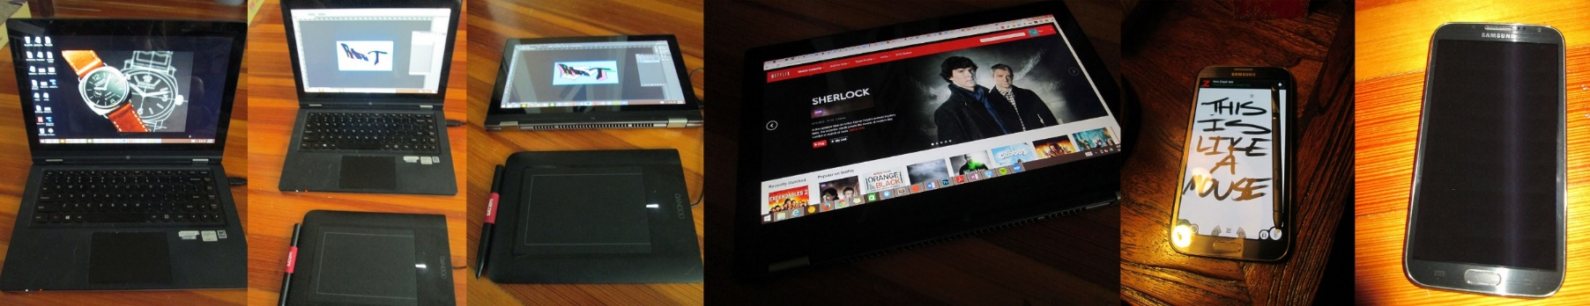
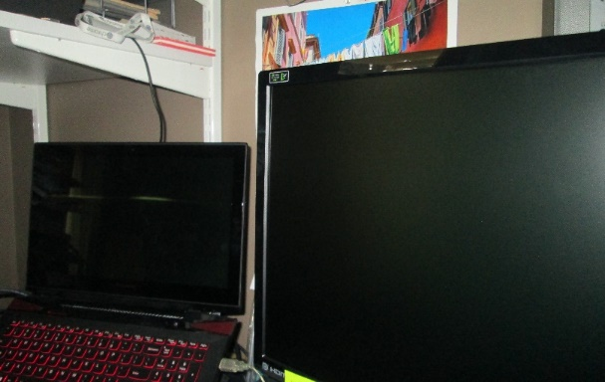
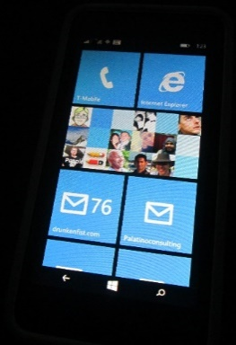
Now? An Explosion of Devices & Browsers
Notes:
These days? In any one day I personally might use one of the 8 different configurations shown here to access the web. For what it’s worth, this isn’t every device I have used in the past month. Toss in a MacBook Pro and a half a dozen other phones for the full list…
What are we looking at here?
A convertible laptop (a Lenovo Yoga to be precise) running Windows 8.1 and set up as a laptop. This is a traditional laptop that also has a touchscreen. It has a trackpad, and I occasionally run an external mouse on it.
The Lenovo Yoga, in laptop mode, with a Wacom tablet attached. This is basically two mice and a touchscreen
The Lenovo Yoga, in tablet mode, with a Wacom tablet attached. This is a fine-grained pointing device that works, effectively, like a mouse, even if the rest of the device is a tablet.
The Lenovo Yoga in tablet mode. In this configuration, the only input is touch. The trackpad, which is now folded to the back, is turned off.
The Galaxy Note II with the stylus out. This pen is as fine-grained as a mouse and offers hover capability. I often use this when I’m visiting a site that only has a desktop view.
A Samsung Galaxy Note II. This is a typical, if really big, smartphone.
A Windows 8.1 laptop set up as a workstation. The laptop is a touchscreen. The second monitor is not. I work on the large monitor so I’m generally confined to just a mouse and keyboard, even if I still have a touchscreen on one of my screens.
A Nokia 630 Windows Phone 8.
So, just looking at my devices, try to envision how much testing you would have to do to get coverage for all my different configuration. Also, how would you define me in many of these configurations- am I a touch user or a mouse user? And…. I haven’t even talked about the web browsers I use on all these devices.

Slide 7
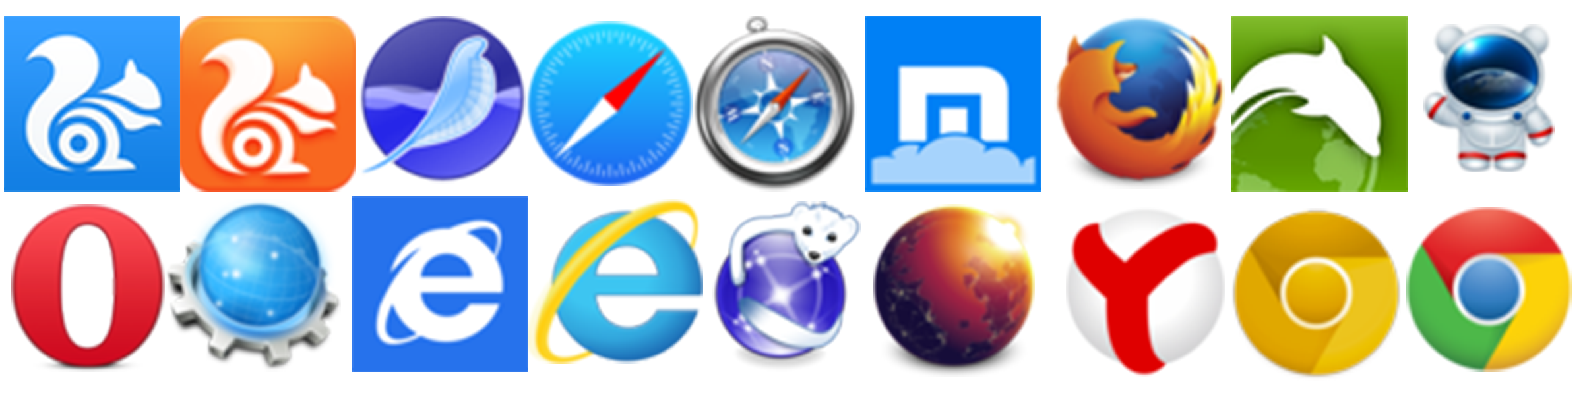
Browsers!
Notes:
As I prove, we have a lot of devices and form factors and…. A lot of new browsers. I made this graphic and I would have a hard time recounting all of these browsers.
For what it’s worth, I might use 6 of these in a day.

Slide 8
No Longer Just the Big Blue E
Resolutions from 240 x 320 to 3840 x 1080 (or more)
Pixel densities from 72ppi up past 300ppi
A broad range of input options (keyboard, stylus, finger, mouse)
A dozen or more major and hundreds of minor browser versions in the wild
A rapidly changing open web platform landscape
Notes:
The Web is no longer just the big blue E
We’ve got:
Resolutions from 240 x 320 to 3840 x 1080 (or more)
Pixel densities from 72ppi up past 300ppi
A broad range of input options (keyboard, stylus, gesture, touch, mouse)
A dozen or more major and hundreds of minor browser versions in the wild
A rapidly changing open web platform landscape

Slide 9
So… Let’s Make More Rules?
Initially, developers and designers tried to navigate this complicated new reality by creating new rules.
Notes:
Initially, to manage the changing web, developers and designers tried to navigate this complicated new reality by creating new rules.

Slide 10
New Rules? Not so Great.
As soon as a new rule was created, it would start to fall apart.
People built “iPhone” sites because the iPhone was the only mobile device worth targeting.
People test for touch APIs and assume that those users don’t have a mouse.
Notes:
The thing is, new rules don’t work with the complexity of the web today.
As soon as a new rule was created, it would start to fall apart.
People built “iPhone” sites because the iPhone was the only mobile device worth targeting.
People still test for touch APIs and assume that those users don’t have a mouse. As you’ve already seen with my gear, that’s a terrible assumption.

Slide 11
Blame Pesky Device Manufacturers & Browser Vendors
As Android’s huge growth over the past few years, and the presence of Chromebooks and Windows 8 laptops with both mouse and touch capabilities have proved, those new rules have a short shelf life.
Notes:
As Android’s huge growth over the past few years, and the presence of Chromebooks and Windows 8 laptops with both mouse and touch capabilities have proved, those new rules have a short shelf life.

Slide 12

Nothing could ever challenge the iPhone, right?
Notes:
Nothing could ever challenge the iPhone. It’s not like Android will ever have over 80% market share…
Right?

Slide 13
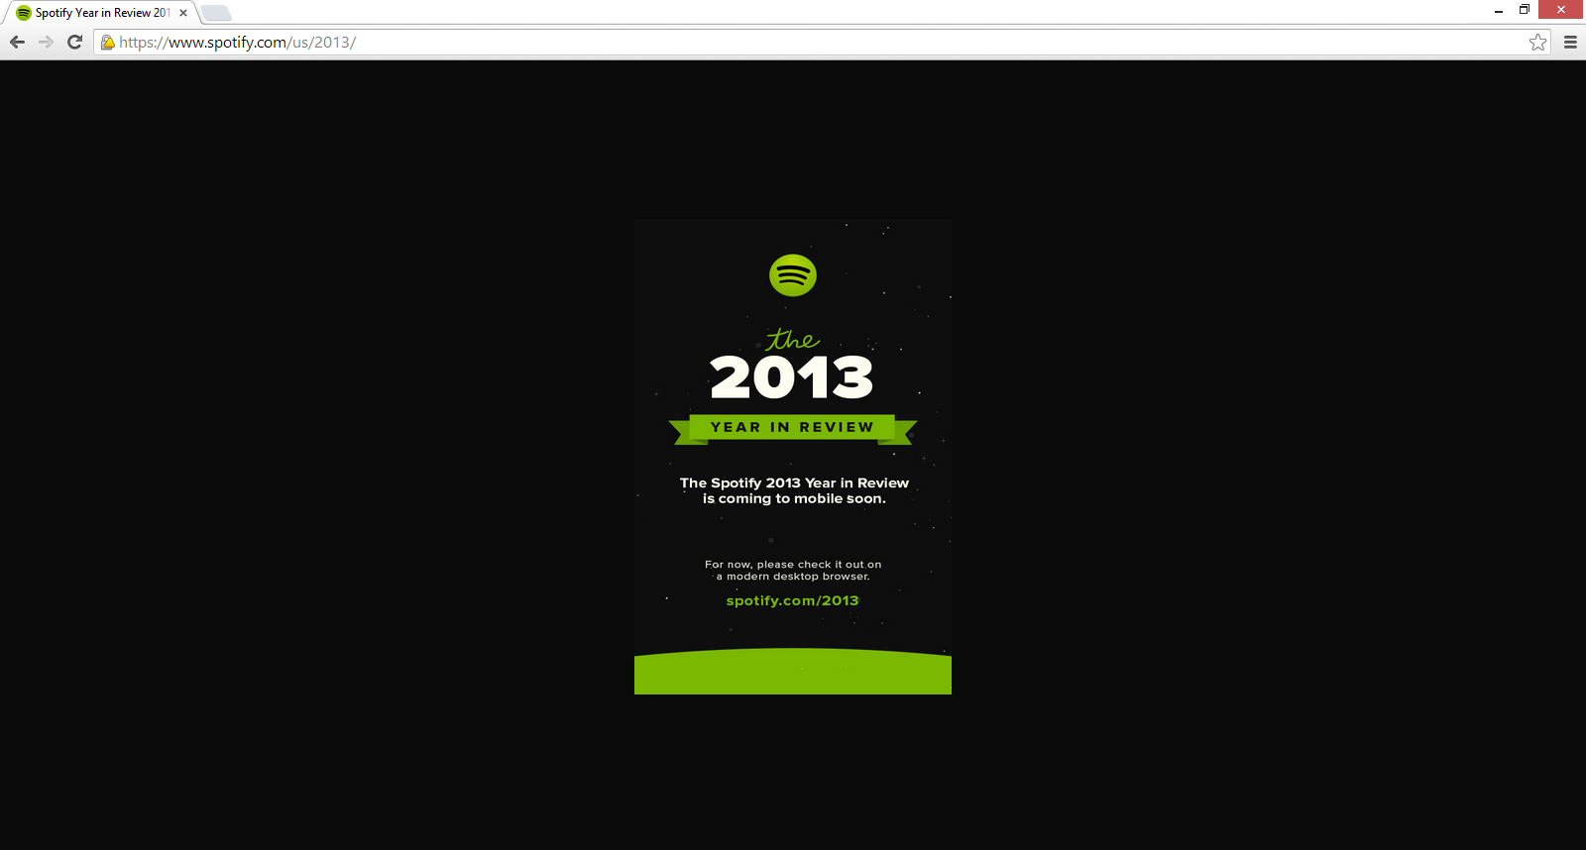
Modernizr.touch == true means you’ve got a phone?
Notes:
Or how about this one? You might not be able to read the screen shot, but this is Spotify telling me that they don’t have a “year in review site” available on for my mobile device.
Which is weird, since this screenshot was taken on my laptop.
What happened is, they used the simple Modernizr.touch test as a proxy to test if I was on a phone or tablet, not understanding that laptops can also return true for the Modernizr.touch test, as it did for me.

Slide 14
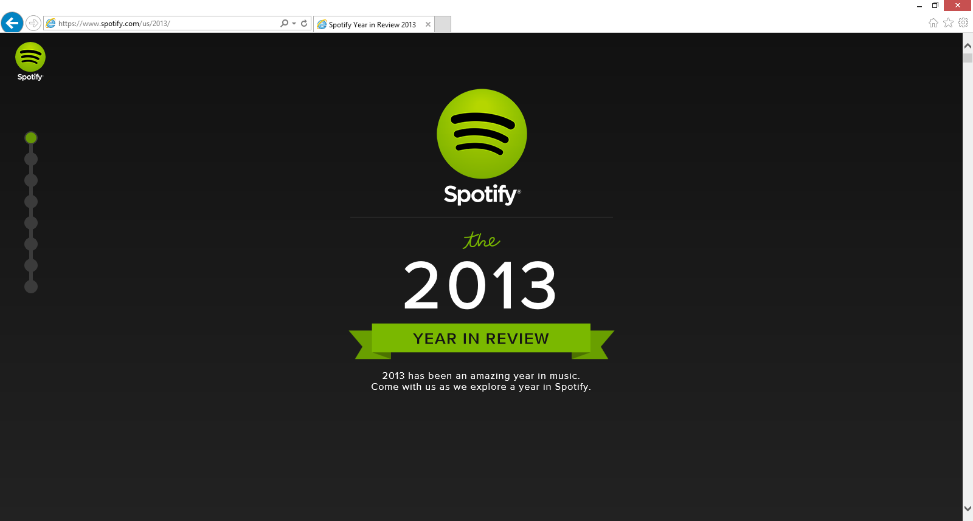
Modernizr.touch == false means you can’t interact with the screen?
Notes:
This is a screen shot from the same laptop, just in IE11, which doesn’t return true for Modernizr.touch as it uses a separate API called pointer events for handling user input.
So, in Chrome I was on a “mobile” device and in IE I wasn’t. Simplistic rules really aren’t the way to go, I guess.

Slide 15
One Size Fits All?
Even patterns like Responsive Web Design, which some people see as the solution for everything, can fall apart when faced with complicated application patterns, and, if you’re not careful, bandwidth limitations.
Notes:
Even patterns like Responsive Web Design, which some people see as the solution for everything, can fall apart when faced with complicated application patterns, and, if you’re not careful, bandwidth limitations.

Slide 16
So What Should We Do?
The best way to approach the web today is to forgo hard and fast rules and one-size-fits-all solutions and design for uncertainty.
This is your best bet for creating future proof web solutions.
Notes:
So what should we do?
The best way to approach the web today is to forgo simplistic rules and one-size-fits-all solutions and design for uncertainty.
This is your best bet for creating future proof web solutions.

Slide 17
Embracing Uncertainty

Slide 18
Embracing Uncertainty
What follows are a series of high level ideas that will allow you approach compatibility in a nimble way and will help you when you're faced with the web's uncertainty.
Notes:
What follows are a series of high level ideas that will allow you approach compatibility on the web in a nimble way and will help you when you're faced with the web's uncertainty.

Slide 19
Don't Blame the Web for being the Web

Slide 20
Don't Blame the Web for being the Web
The web is a diverse place that's getting more diverse every single day.
If you accept the web's diversity (and maybe even celebrate it) and you're getting angry about one thing (maybe Internet Explorer 8) or another (the stock Android Browser) just take a minute to remind yourself that this is just the way the web is.
Notes:
The first of these general concepts is: Don't Blame the Web for being the Web
This is a concept that helps me get through the day.
The web is a diverse place that's getting more diverse every single day.
If you accept the web's diversity (and maybe even celebrate it) and you find yourself getting angry about one thing (maybe Internet Explorer 8) or another (the stock Android Browser) just take a minute to remind yourself that this is just the way the web is.
Repeat after me: This is just the way the web is.
Since there’s competition in the browser space, there’s always going to be a bad browser. When the current bad browser goes away a new one takes it’s place at the bottom of the pile. You just have to accept that and move on with your life.

Slide 21
This is Just the Way the Web Is
Fixating on the web’s shortcomings does no one any good. We need to focus on what the web provides (billions of people,) do our best to make the web a better place and accept the diversity as the price of admission to reach billions of people.
Notes:
Fixating on the web’s shortcomings does no one any good. We need to focus on what the web provides (access to billions of people,) do our best to make the web a better place (I’m not saying we should ignore the problems, we just shouldn’t fixate on them) and accept the diversity as the price of admission to reach billions of people.

Slide 22

Notes:
Look at all those people…
That’s your audience. Should you get ad at them and insult them for using the tock android browser or an old version of iOS? No. Some of you do however. I think the web would be a better place and our collective blood pressure would drop if we just accepted them for what they are and do our best to give them a decent experience no matter what they’re running.

Slide 23
Identify and embrace your audience

Slide 24
Identify and embrace your audience
While you can look at web-scale statistics for browser and operating system market share to get some idea of where things are and where they’re going, the only metrics that truly matter are those for your audience.
Notes:
You would think this second general concept would go without saying, but…. You really need to Identify and embrace your audience
Do you know who your audience is? You’d be surprised how many clients I’ve had who couldn’t answer this very well at all.
While you can look at web-scale statistics for browser and operating system market share to get some idea of where things are, the only metrics that truly matter are those for your audience.

Slide 25
Who? What? Where?
Who are they? What do they use? Where do they live?
Knowing this information makes your life significantly easier.
Without knowing your specific audience you’re just guessing. Engineers shouldn’t guess.
Notes:
Who are they? What do they use? Which browsers and devices? Where do they live?
Knowing this information makes your life significantly easier and will make for a better experience for them.
Without knowing your specific audience you’re just guessing.

Slide 26
Act on the Info
If the majority of your audience is coming in on mobile, then you probably want to skip the multi-megabyte images and autoplay HD video you were planning on featuring.
Notes:
And you’ve got to act on the info….
If the majority of your audience is coming in on mobile, then you probably want to skip the multi-megabyte images and autoplay HD video you were planning on featuring on your homepage.
Actually… you should probably skip those features anyway, but I’ll leave that up to you.

Slide 27
It Can Make a Big Difference
Or, maybe you get a large percentage of your visits from some place halfway around the world.
For example, your servers are in Virginia and your audience is in Australia.
Time to make sure your CDN is up to snuff.
Notes:
For another example, maybe you get a large percentage of your visits from some place halfway around the world.
Say…. your servers are in Virginia and your audience is in Australia.
Time to make sure your CDN is up to snuff. You want to make sure your content is delivered in a geographically optimized way. Just the round trip between the two continents can add a second to the round trip for every request. No one wants that.

Slide 28
Test and Pray for the Best

Slide 29
Test and pray for the best
Once you've identified your audience, where they are and what they're using it's time to define the technical demographics you're going to target.
Notes:
This third general concept used to be much easier. Nowadays we’ve got to Test and Pray for the best.
Once you've identified your audience, where they are and what they're using it's time to define the technical demographics you're going to target with testing and active support.
You’re never going to test everything. The days of testing 95% of the web with one PC running IE6 and toggling between two screen resolutions are long gone.

Slide 30
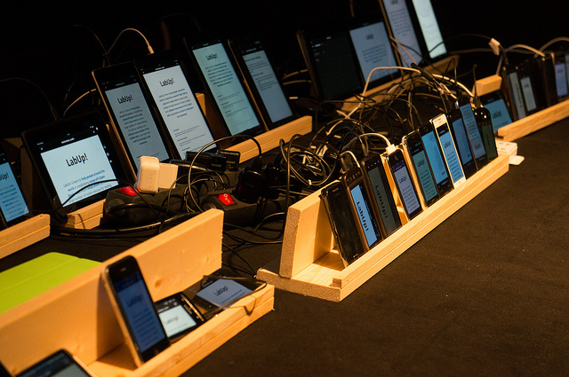
Photo by Andreas Dantz https://www.flickr.com/photos/szene/8220511232/
Notes:
Maybe you’ve got one of these setups at your office. If so… you can do pretty well.

Slide 31
Testing Could Look Like This:
Samsung Galaxy S3
Samsung Galaxy S4
Samsung Galaxy S5
Samsung Galaxy Note III
Samsung Galaxy Note 4
Nexus 5
Kindle Fire
Motorola Droid X (Android 2.3)
Google Nexus 7
Nokia Lumia 920
iPhone 4S
iPad 2G
iPhone 5s
iPhone 6
Chrome (latest) Mac, PC and a Chromebook
Firefox (latest) Mac and PC.
Opera (latest) Mac and PC
IE 8.0 on Windows XP
IE 9.0 on Windows 7
IE 10.0 Windows 7/8 - including a touch screen laptop
IE 11.0 Windows 7/8/8.1 - including a touch screen laptop
Safari 6.0
Notes:
Your testing and support matrix could look something like this. This is a pretty representative list of browsers and operating systems. This will get you pretty good, coverage. This is also a lot of devices to buy and maintain. If you can do it, you should. Be warned, this list changes!
If you can’t dedicate this much effort, and not many can, you can scale back, to…

Slide 32
Or Scaled Down to This
Samsung Galaxy S4
iPhone 6
iPad 2G
Motorola Droid X
Chrome (latest) Mac and PC
Firefox (latest) Mac and PC.
Opera (latest) Mac and PC
IE 8.0 on Windows XP
IE 9.0 on Windows 7
IE 10.0 Windows 7
IE 11.0 Windows 8
Safari 6.0
Notes:
Something like this… which is still a few different devices but at least it’s a manageable numberand it will give you coverage for the most likely browser and OS combinations.

Slide 33
Whatever your testing set-up looks like...
Test on as many real devices as early and as often as you can. It makes a big difference.
Try to have dedicated devices for everyone on your team to use.
Notes:
Test on as many real devices as early and as often as you can.
Try to have dedicated devices for everyone on your team to use. Not just the phones in your team’s pockets.

Slide 34
Focus on optimal, not absolute solutions

Slide 35
Focus on optimal, not absolute solutions
Your site is not an absolute thing. The best possible site you can have will be the best possible site for everyone that visits it. If that means it's a high DPI, 25MB monstrosity for a guy on a MacBook air in a coffee shop in Palo Alto or just a logo and an unordered list for someone on a-rented-by-the-minute feature phone in Lagos, then that's the way it is.
Notes:
This concept has been with me for many years. My prime example is the many arguments I’ve had against putting in the extra effort to add rounded corners in older IE.
These days you need to focus on optimal, not absolute solutions.
Your site is not an absolute thing. The best possible site you can have will be the best possible site for everyone that visits it. If that means it's a high DPI, 25MB monstrosity for a guy on a MacBook air in a coffee shop in Palo Alto or just a logo and an unordered list for someone on a-rented-by-the-minute phone in Lagos, then that's the way it is.
People are used to sites looking different on different devices so take advantage of it and provide them with the best possible experience for their particular setup.

Slide 36
Embrace Accessibility

Slide 37
Embrace Accessibility
If your site is accessible you're guaranteeing that you'll be able to reach the largest possible audience.
You're also doing the right thing.
Notes:
This concept is unfortunately something I have to call out, but people don’t focus enough on accessibility for the pure sake of it, so here we are.
On the modern web we need to Embrace Accessibility.
If your site is accessible you're guaranteeing that you'll be able to reach the largest possible audience.
You're also doing the right thing.
I can’t stress that enough. You should be doing this anyway.

Slide 38

Photo by Jeremy Keith https://www.flickr.com/photos/adactio/89778576/i
Notes:
In the real world accessibility techniques can be woven into the fabric of society. Some like this wine bottle, you might notice because it’s unexpected, but many you don’t because they’re everywhere.
The web falls short of that. Some people do a great job, but others don’t. We need to do a better job. For those of you who don’t immediately grasp the benefit for disabled users, accessibility techniques make the web better for all users. There’s really no good reason not to embrace accessibility.

Slide 39
Millions of Users are Directly Affected
Based on the 2010 US census, 56 million Americans were classified as having a disability. That's 18.7% of the population. Not all disabilities would hinder the ability of a user to access the web, but it still breaks down to millions of users.
And that’s just the US where stats are somewhat available.
Notes:
Based on the 2010 US census, 56 million Americans were classified as having a disability. That's 18.7% of the population. Not all disabilities would hinder the ability of a user to access the web, but it still breaks down to millions of users.
And that’s just the US where stats are somewhat available.
The US represents just a fraction of the population of web users. There are millions of disabled users worldwide.

Slide 40
Every User is Indirectly Affected
The following slides list some of the more obvious ways that accessibility techniques can help all users.
Notes:
And like I said, all users indirectly benefit.
The following slides list some of the more obvious ways that accessibility techniques can help all users.
If doing the right thing isn’t enough, maybe these benefits will get you on the accessibility technique train for good.

Slide 41
Accessibility Guidelines + the Multi-device Landscape
Provide text alternatives for all non-text content
Ensure that information and structure can be separated from presentation
Make all functionality operable via a keyboard interface
Provide mechanisms to help users find content
Notes:
These are pulled from theWeb Content Accessibility Guidelines (WCAG) 2.0
Provide text alternatives for all non-text content
If images fail to load or are loading slowly alternative text can provide crucial context to users. Transcriptions of video content can be great for people on low-bandwidth plans or low bandwidth situations.
Ensure that information and structure can be separated from presentation
Good structure for your code makes it much easier to translate into different formats for devices with different capabilities and needs.
Make all functionality operable via a keyboard interface
Do you test your site without a mouse? It can be a real eye opener. For the general web, a strong keyboard interface is a boon for power users.
Provide mechanisms to help users find content
Make links make sense, give a good sense of where users are within your site or application and give them multiple ways to reach content. The less you ask a mobile user to do to get to their important content, the better.

Slide 42
Accessibility Guidelines + the Multi-device Landscape
Help users avoid mistakes & make it easy to correct mistakes that do occur
Support compatibility with current and future user agents
Notes:
Help users avoid mistakes & make it easy to correct mistakes that do occur
It's hard to fill out forms on the web. The more help you can give users, the better. This is true for all users.
Support compatibility with current and future user agents
The fact that the first website ever made still works is a guiding principle here. Don't back yourself into a corner and you too can be sitting pretty in 2034.
I will say that getting a basic understanding of how assistive technologies work and how they may work in the future is a good idea to add onto the understanding of the browser and device market. Use a screen reader! There are browser plugins for Chrome and Firefox that I know of that make it (relatively) easy to test one out.

Slide 43
Don't Stop There
In addition to being a vital link for disabled users, all the WCAG guidelines are also going to make your site more robust for all users. These examples are just the most obvious ones.
Notes:
In addition to being a vital link for disabled users, all the web content accessibility guidelines are going to make your site more robust for all users. These examples are just the most obvious ones.

Slide 44
Lose Your Technology Biases

Slide 45
Lose your technology biases
Tech folks generally have great hardware and new, high powered smart phones and tablets. Most other people in the world don't. Tech folks tend to forget that.
Notes:
This general concept is one that drives me particularly nuts.
You’ve got to lose your technology biases.
Tech folks generally have great hardware and new, high powered smart phones and tablets. Most other people in the world don't. Tech folks tend to forget that.
For example…

Slide 46
The iPhone isn’t the only mobile experience
At the height of the iPhone's dominance as a mobile platform, it was typical to base mobile web designs on the interface and interaction model of the iPhone.
And then came Android.
Notes:
At the height of the iPhone's dominance as a mobile platform, it was typical to base mobile web designs on the interface and interaction model of the iPhone.
And then came Android.

Slide 47
Even Now…
Many designers and developers have never been hands-on with an Android device.
Notes:
Many designers and developers have never been hands-on with an Android device.

Slide 48
Where Do We Put the Back Button?
If your vision of the web is iPhone-centric, inserting a back button into your web UI seems like a good idea. The thing is, every Android device has a back button built in, either as a dedicated software button on screen or as a physical button on the device.
Notes:
As you probably know, here's only the one button on the iPhone so you need a software back button in apps to navigate. If your vision of the web is iPhone-centric, and for many people it still is, inserting a back button into your web UI seems like a good idea.
The thing is, every Android device has a back button built in, either as a dedicated software button on screen or as a physical button on the device. All of them. It's required and it also gets used all the time so a back button in the UI of a web app, for an Android user, is a foreign experience. You're just wasting precious pixels. But yet, people do it because the iOS experience is all they know.

Slide 49
Closed. Won't fix. Can't Reproduce.
"That animation is super fast on my machine.“
Another painful example of the trap tech folks fall into is with application performance.
Most people don't look critically at their application performance in enough devices to truly test performance.
Notes:
"That animation is super fast on my machine.“
Another painful example of the trap tech folks fall into is with JavaScript performance.
While there's a lot of talk about being jank free and the web performance community has grown to be a real force in the industry; the plain fact is most people don't look critically at their application performance in enough devices to truly test performance. There are underpowered mobile devices, old desktops and old browsers aplenty out there waiting to expose problems with your site.
It's said so often that it's a cliché, but the reality is it can "work on my machine" only to fail catastrophically on some other older hardware/browser combination.

Slide 50
Contrary to Popular Opinion Internet Explorer Does Exist
People don't test enough in Internet Explorer.
Whether it's Windows-based developers working all day in Firefox or Chrome or developers on a Mac not wanting to fire up Parallels, people don't test in IE early or often enough.
Notes:
One final bias that I’m sure you’ll all just adore….
Contrary to Popular Opinion Internet Explorer Does Exist
People don't test enough in Internet Explorer.
Whether it's Windows-based developers working all day in Firefox or Chrome or developers on a Mac not wanting to fire up Parallels, people don't test in IE early or often enough.
That's crazy.

Slide 51

Notes:
Really, people use it. Hundreds of millions of people.

Slide 52
Contrary to Popular Opinion Internet Explorer Does Exist
I know it's the bogeyman, but it remains a huge portion of the browser market with hundreds of millions of users
Yet, people treat it like an afterthought.
Notes:
I know it's the bogeyman, but it remains a huge portion of the browser market. Depending on where you look for your stats, it's got a larger market share than Firefox and Safari combined. Yet, people treat it like an afterthought.

Slide 53
This is Why You Hate IE
Since so many people save IE for later on in the development process, or downright ignore it, their only experience with the browser is one of shock and betrayal.
If IE was constantly sneaking up on me and punching me in the face because I wasn't paying attention, I'd be mad at it too.
Notes:
I have a theory that this behavior is at least part of the reason why people have such a visceral dislike of IE- including later versions which are actually quite easy work with. Since so many people save IE for later on in the development process, or downright ignore it, their only experience with the browser is one of shock and betrayal when bugs pop up.
If IE was constantly sneaking up on me and punching me in the face because I wasn't paying attention, I'd be mad at it too.

Slide 54
Embrace Empathy

Slide 55
Embrace Empathy
Don't blind yourself to what your audience actually is by assuming that they are just like you.
Try to get in their shoes instead of assuming everyone else is in yours.
Notes:
This concept runs through much of what we’ve already discussed, but I still like to call it out. We need to embrace empathy.
Don't blind yourself to what your audience actually is by assuming that they are just like you.
They're not. Your average experience at work, at home or on your phone is almost certainly an optimal view of your site. You’re an expert at using the web. Make sure you look at it, really look at it, in every scenario you can muster. Sure, we're all guilty of demoing code under the best possible circumstances. That's natural. The thing is, that demo is the ideal vision of your site run by an expert. The thing you're actually building, the down and dirty version, is for people with a completely different relationship with technology than yours.
Try to get in their shoes instead of assuming everyone else is in yours.

Slide 56
Lose Your Stack Biases

Slide 57
Lose your stack biases
Your users don't care if your stack is clever. What they care about is the speed, usability, look and feel, interactivity and features of your site. If your stack isn't adding to one of those then you might be going down the road to stack obsession.
Notes:
This is a new pet peeve that has cropped up over the past couple of years.
Lose your stack biases.
Your users don't care if your stack is clever. What they care about is the speed, usability, look and feel, interactivity and features of your site. If your stack isn't adding to one of those then you might be going down the road to stack obsession.

Slide 58
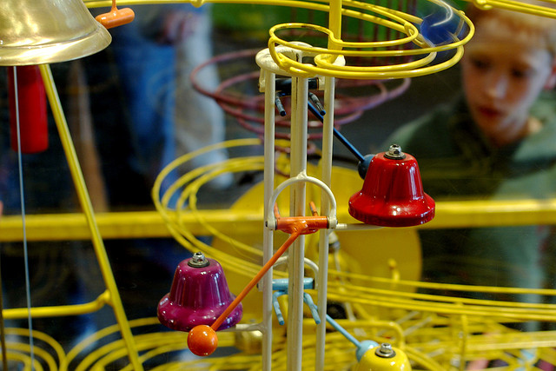
Photo by Jeff Kubina https://www.flickr.com/photos/kubina/278696130/
Notes:
But , my stack is so beautiful… you say.

Slide 59
Your Stack is Really Cool
At the end of the day developer comfort isn't the most important part of this equation. The experience of the users of your site trumps everything else. Or at least it should. To that end, doing things like pushing 1Mb of fancy framework JavaScript down the pipe on a site that's meant to be consumed on a mobile device over a potentially dicey connection is simply a terrible idea.
Notes:
IT is! Your stack is really cool.
The thing is, at the end of the day developer comfort isn't the most important part of this equation. The experience of the users of your site trumps everything else. Or at least it should. To that end, doing things like pushing 1Mb of fancy framework JavaScript down the pipe on a site that's meant to be consumed on a mobile device over a potentially dicey connection is simply a terrible idea.
It doesn’t’ matter how cool it is.

Slide 60
Don’t Turn HTML back in XHTML
While Front-end Model View Controller (MVC) style libraries and frameworks are great, these libraries and frameworks are really designed for application development- they shouldn't be used for every circumstance.
Notes:
While Front-end Model View Controller (MVC) style libraries and frameworks are great, these libraries and frameworks are really designed for application development- they shouldn't be used for every circumstance.

Slide 61
We Already Had This Figured Out
For example, don’t use one of these libraries in place of server side templates for a content site. One of the first lessons of web performance was that most of the performance hit on the page happened in the browser, not on the server. Templates on the server aren't a performance problem. Why, then, are we rushing headlong to push functionality that was handled perfectly well by the server down to the front end?
Notes:
For example, don’t use one of these libraries in place of server side templates for a content site. One of the first lessons of web performance was that most of the performance hit on the page happened in the browser, not on the server. Templates on the server aren't a performance problem. They’re also fragile since you have multiple dependencies that all have to function on the front end just to render content. Why, then, are we rushing headlong to push functionality that was handled perfectly well by the server down to the front end?
It doesn’t make any sense.

Slide 62
The Uncertain Web
Notes:
Concluding….

Slide 63
Question Your Assumptions
At this point, I'm assuming at least half of you think I'm an idiot.
If so, I must be onto something.
Whatever percentage of these concepts you agree with or feel like are applicable to you and your particular situation, I urge to question your assumptions. Your users will thank you.
Notes:
At this point, I'm assuming at least half of you think I'm an idiot.
If so, I must be onto something.
Whatever percentage of these concepts you agree with or feel like are applicable to you and your particular situation, I urge to question your assumptions. Your users will thank you.

Slide 64
Accept the Things You Can’t Control
The web has never been a static platform, no matter how much people might wish it were so. You just can't control who's going to request your content. You can't control the browser or device they're using and you certainly can't guarantee things like the operating system, screen resolution, bandwidth or available system fonts.
Notes:
The web has never been a static platform, no matter how much people might wish it were so. You just can't control who's going to request your content. You can't control the browser or device they're using and you certainly can't guarantee things like the operating system, screen resolution, bandwidth or available system fonts.

Slide 65
Today's web is a wild place.
Standards are changing on, in some cases, a daily or weekly basis; new devices are coming on-line at a furious pace and browser vendors are going at it tooth and nail. With an ecosystem like that, trying to collapse everything you do as a developer into something that can fit into a neat little box is a recipe for frustration.
Notes:
Standards are changing on, in some cases, a daily or weekly basis; new devices are coming on-line at a furious pace and browser vendors are going at it tooth and nail adding web platform features at a faster and faster pace trying to one-up the competition.. With an ecosystem like that, trying to collapse everything you do as a developer into something that can fit into a neat little box is a recipe for frustration.

Slide 66
Embrace Uncertainty
Embracing the ecosystem for the wild mess that it is and developing with an eye towards the uncertainty the web will throw at you is the best way to reach whoever might want to get at your site or application with whatever they have in their pocket or on their desktop- now and in the future.
Notes:
Embracing the ecosystem for the wild mess that it is and developing with an eye towards the uncertainty the web will throw at you is the best way to reach whoever might want to get at your site or application with whatever they have in their pocket or on their desktop- now and in the future.

Slide 67
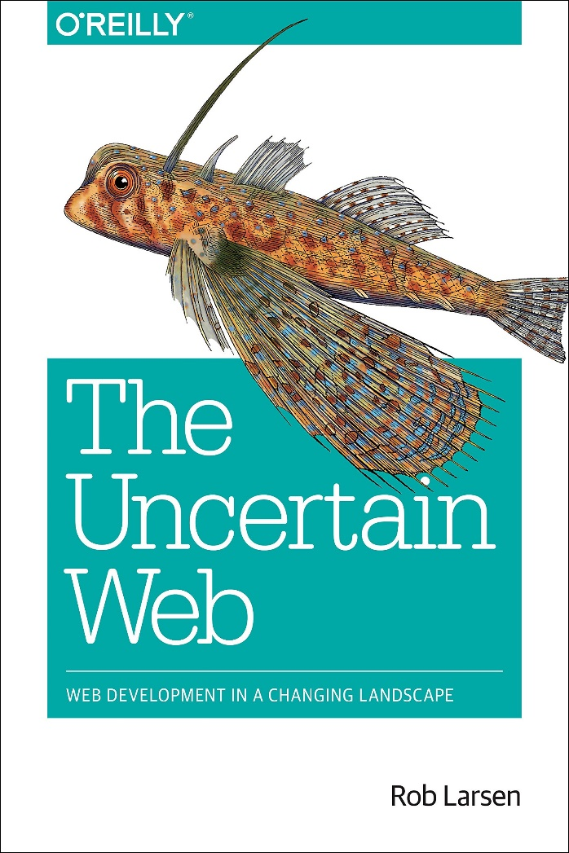
Thanks!
roblarsen on Github
Twitter: @robreact (art | culture | etc.) @roblarsenwww (tech)
Blog: htmlcssjavascript.com
Books: is.gd/rob_larsen_books
New book alert! The Uncertain Web
Early release: http://shop.oreilly.com/product/0636920032489.do
My company palatinoconsulting.com/

