Slide 1
Git and Github
Rob Larsen
rlarsen@eatonvance.com

Slide 2
About Git
The Git project describes Git like this:
Git is a free and open source distributed version control system designed to handle everything from small to very large projects with speed and efficiency. Git is easy to learn and has a tiny footprint with lightning fast performance. It outclasses SCM tools like Subversion, CVS, Perforce, and ClearCase with features like cheap local branching, convenient staging areas, and multiple workflows.
The important ideas for us are that it's distributed (which is an important conceptual barrier,) that it provides cheap local branching and that it works with multiple workflows.

Slide 3
About Git
“Distributed”
While we do use a central server provided by GitHub Enterprise to host our application code, there is nothing stopping us from also setting up a private Git server on AWS and also publishing code to that server.
You can have as many remotes as you like (endpoints that you can pull from and publish to- assuming you have permission) and it’s only by convention that any one remote server is more important than another. This makes Git very powerful and also presents a change of mindset from something like SVN which has a clearly defined “main” server. If you understand that all Git repositories, at a Git software level, are created equal, then you can begin to unlock the power of Git.
It also explains why merging doesn’t work the same way it does in SVN. Your changes are just as valid as theirs.
It’s a common frustration that people have- “why can’t I just get all the changes from the server and ignore mine”
Git is not designed that way. While, by convention, the stuff on the server is important, Git sees it as just another repo.

Slide 4
About Git
“Cheap local branching”
Unlike SVN there is no real penalty (either in terms of time or storage) in creating a branch in Git. In fact, it’s much easier to deal with merging and maintaining code in a large team if you create branches for all of your work. Branches create clean comparison points for the Git merge algorithm to work from. When people look at branching as a “bother” or a “hassle” or something separate from the main business of working with Git and just work in the Development branch they’re much more likely to run into tricky merge conflicts. There are no clean comparison points.
Remember- Git is designed for branching. If you’re not branching you’re not using Git properly.

Slide 5
About Git
How cheap is branching?
rlarsen@RLARSEN1 MINGW64 ~/Documents/GitHub/temp/sherpa-enterprise-data-ui (Development)
$ git checkout -b newbranch
Switched to a new branch 'newbranch‘

Slide 6
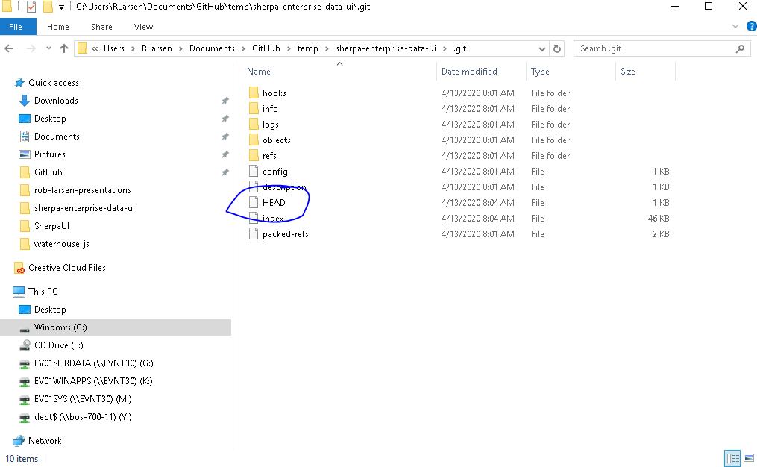
About Git
How cheap?

Slide 7
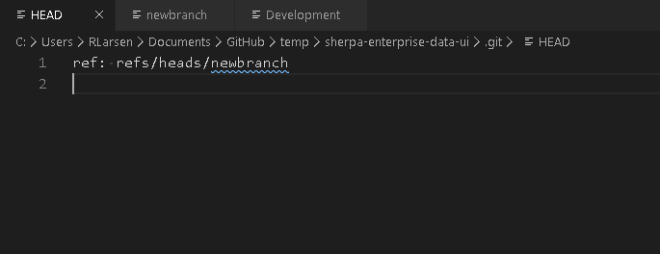
About Git
How cheap?

Slide 8
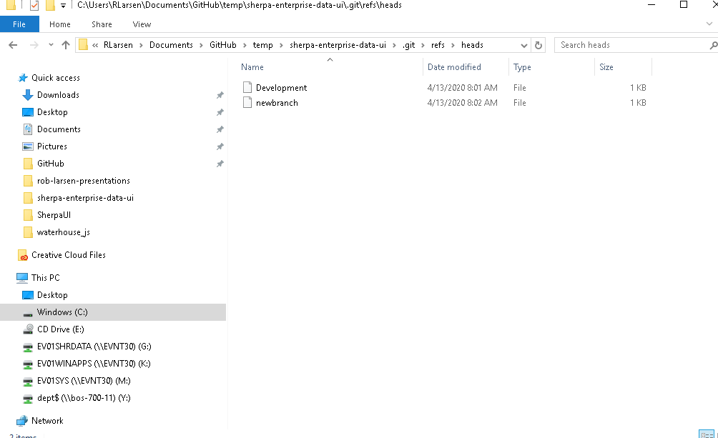
About Git
How cheap?

Slide 9
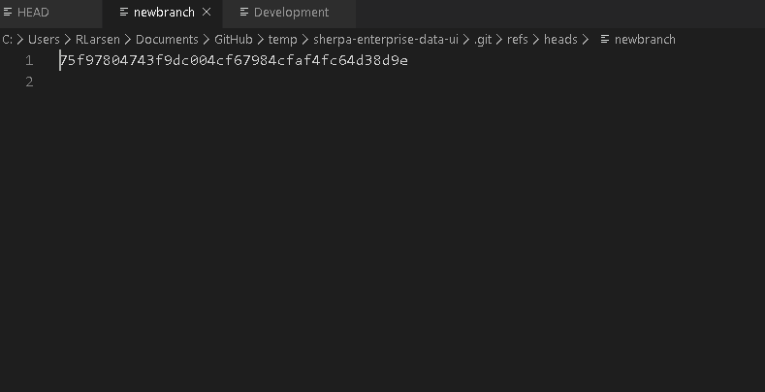
About Git
How cheap?

Slide 10
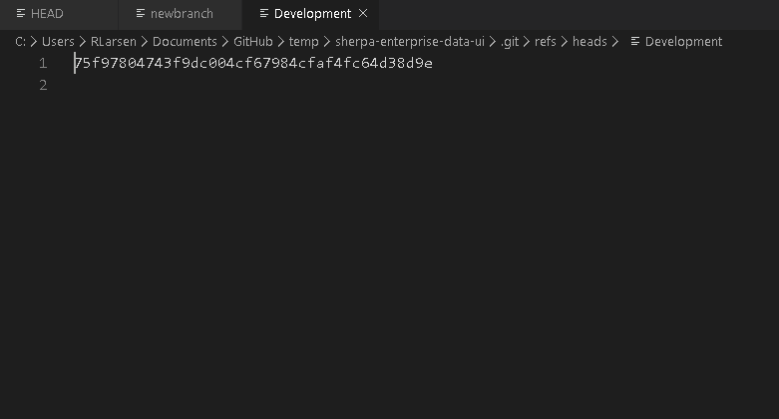
About Git
How cheap?

Slide 11
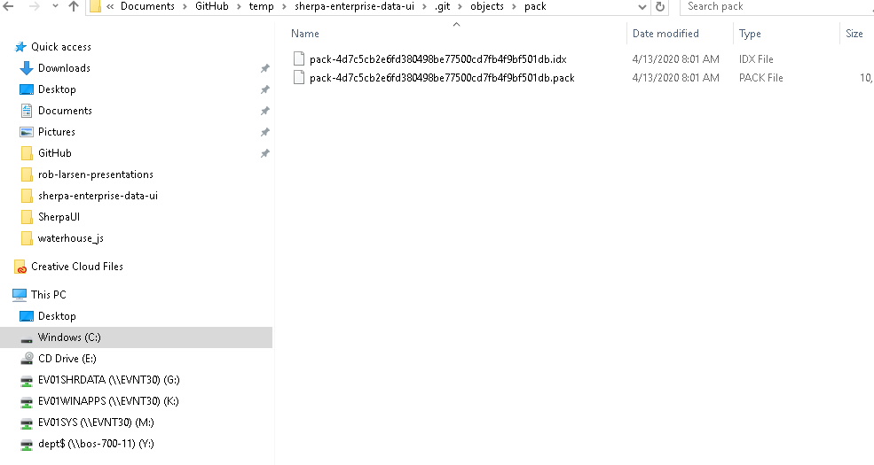
About Git
How cheap?

Slide 12
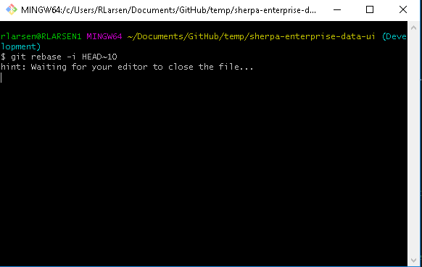
About Git
(This is advanced! But does this advanced command start to make more sense?)

Slide 13
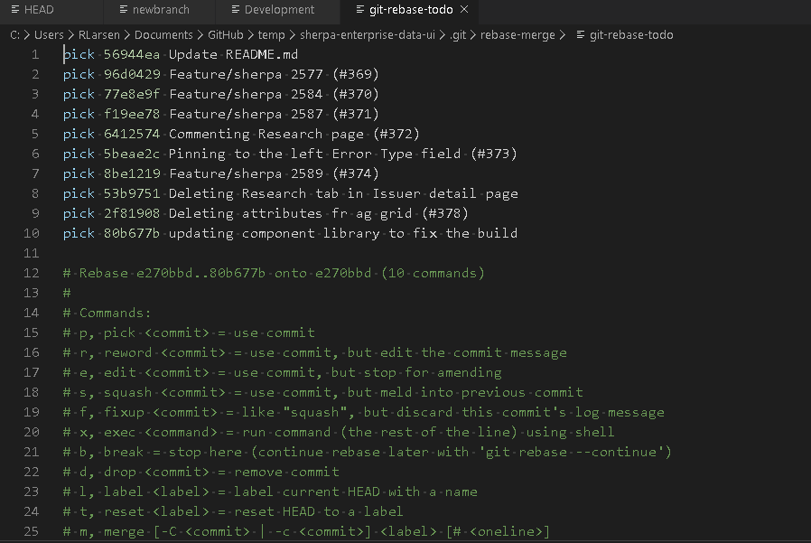
About Git
Rewriting history is just rewriting collection of commits which make up a branch- which is just pointing the history to different hashes/sets of changes stored in the index.

Slide 14
About Git
“Multiple Workflows”
We have a workflow that we use, but it’s not the only one and because of how flexible Git is, we can (and often have to) adjust our workflow to solve problems that arise during the development process. You can lay as much or as little process on top of Git as you want.

Slide 15
About GitHub
GitHub is not Git. Git is not GitHub. Git was created in 2005 by Linux Torvalds to aid in development of the Linux kernel. GitHub, the commercial enterprise, was founded in 2007 and has since built a sprawling ecosystem on top of Git. It is the home to most of the world's largest open source projects. It provides a number of very powerful tools built on top of Git to help with software development.
For our purposes, this means Pull Requests and Code Reviews (and may mean GitHub Actions at some point.)

Slide 16
Our Workflow
Once you've gotten an issue assigned to you or pulled an issue out of the backlog, it's time to work on your task. The Git process for that is in the following slides

Slide 17
Our Workflow
If you’ve never done this before, check to make sure your local repository is in a clean state. This example was run from Development, but you might be in another branch and you want to make sure you’re in a clean state
rlarsen@RLARSEN1 MINGW64 ~/sherpa-enterprise-data-ui (Development)
$ git status
On branch Development
Your branch is up to date with 'origin/Development'.
nothing to commit, working tree clean

Slide 18
Our Workflow
If your working tree is clean, then go onto the next step. If it’s not either Git stash your changes or commit them to your branch.
To get started, run:
git checkout Development
git pull
git checkout -b [branch name from options below]
bug/[JIRA Issue Name]
feature/[JIRA Issue Name]
[other]/[description of work] Used for refactoring, net new features, etc.

Slide 19
Our Workflow
As you work on your task, be sure to pull in the latest changes from Development often and push your code to your branch often. Because we will squash your commits in the pull request process, there's no real penalty for committing early and often.

Slide 20
Our Workflow
Working with Pull Requests
As soon as you have complete some work, commit your code and push your branch to GitHub. If your branch is called bug/SHERPA-1999 you would run the following commands:
git add .
git commit -m "these are my changes"
git push --set-upstream origin bug/SHERPA-1999

Slide 21
Our Workflow
Alternatively, you can set something like Visual Studio Code to be your default editor in git and can therefore more easily write longer commit messages. The custom is to keep the subject of a commit short and add more detail, if needed, in the description. This is easiest to do in a real text editor and VS Code is handy.
To set VS Code as your Git editor, edit your root .gitconfig (C:\Users\UserName\.gitconfig) to point to your VS Code installation
[core]
editor = 'C:\\Users\\UserName\\AppData\\Local\\Programs\\Microsoft VS Code\\Code.exe' --wait

Slide 22
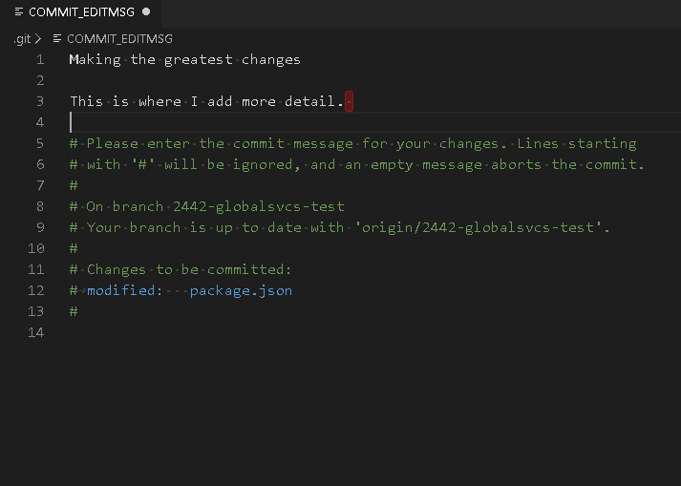
Our Workflow

Slide 23
Our Workflow
Once you have pushed your changes to GitHub, open a pull request.
There are two aspects of working with pull requests, one is as a developer and the other is as a reviewer. You're going to be expected to take part in both roles.

Slide 24
Our Workflow
Developer
Open pull request within GitHub
Enter short summary of work completed.
Assign team-sherpa as reviewers
Assign yourself as the assignee
If the code is "ready to review" then tag it that way and mention that the code is ready to review in Microsoft Teams
If it's not ready, tag is "work in progress" or add WIP to the title.
When you're ready for review, personally review files for the PR. Ensure there are no accidental files added to the PR.
At this point it should also be ready for testing. Build the code to our integration environment and move the ticket to testing so the product team can know to test it.
If the product team is not satisfied with your work and you need to continue to make changes, make sure you’re merging Development into your branch.
Once you have received one or more positive reviews and the code is approved by the product team. Squash and merge your PR and delete the branch.

Slide 25
Our Workflow
Reviewer
Review files changed and check for things like:
Merge conflicts
Confusing/Inefficient/unnecessary code
Undocumented/out of scope additions
Dependency modifications
Strange looking git history
Test the branch
git fetch origin
git checkout -b [branch name] origin/[branch name]
git merge Development
Ensure that it builds without errors
Ensure that the homepage, apps, and lists load and that you can create an app.
Approve or deny the pull request. If you deny it, ask questions. PRs should be the place where you as a reviewer learn about the code being written for the project and this is the best place to ask questions.

Slide 26
Our Workflow
The release happens through a PR into the master branch. Do not squash and merge into the master branch.

