Slide 1
CSS and Bootstrap
Rob Larsen
rlarsen@eatonvance.com

Slide 2
Goals
The goal of this presentation is to cover some fundamentals of CSS and Bootstrap. Many developers know about specific CSS properties and know the basic syntax of CSS. Many developers also know the most basic aspects of Bootstrap without knowing the overall structure of the project. This presentation will break both down to fundamentals. If you’re interested in learning about individual features or properties, there are resources available at the end of the presentation.

Slide 3
What is CSS?
Cascading Style Sheets (CSS) is a simple mechanism for adding style (e.g., fonts, colors, spacing) to Web documents.

Slide 4
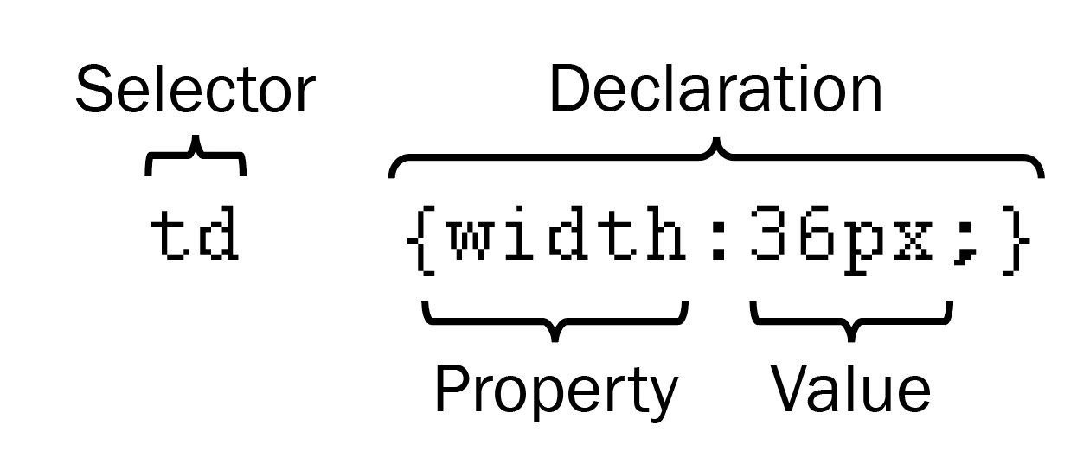
How Does CSS Work?
CSS works by allowing you to associate rules with the elements that appear in a web page. These rules govern how the content of those elements should be rendered. A CSS rule is made up of two parts:
The selector, which indicates which element or elements the declaration applies to (if it applies to more than one element, you can have a comma-separated list of several elements)
The declaration, which sets out how the elements referred to in the selector should be styled

Slide 5
How are the rules applied?
Source order matters. All things being equal, if a later rule appears that overrides and earlier rule then it is applied to the element. This is how themes and custom styles work in systems like Wordpress and Bootstrap work. You apply your style sheet after the system style is applied and your styles are the ones rendered in the browser.

Slide 6
How are the rules applied?
Specificity is the method by which browsers decide which CSS property values will be applied to an element.
Each CSS declaration has a weight, calculated by the number of each selector type in the matching selector.
Selector types, in order of increasing specificity
Type selectors and pseudo-elements (e.g., H1, P, DIV and P::before)
Class selectors, attribute selectors and pseudo-classes (e.g., .class-name, [type= “radio”] and :hover).
ID selectors (e.g., #myId).
Two exceptions to that basic formula (which are to be avoided) are inline styles set on an elements style attribute (which always override) and declarations marked !important.

Slide 7
How the weights are calculated
Thousands: The presence of any inline styles on the element scores 1000
Hundreds: Each ID selector in the overall selector scores 1 in this column
Tens: Each class selector, attribute selector, or pseudo-class scores 1 in this column
Ones: Score one in this column for each element or pseudo-element selector

Slide 8
How the weights are calculated
Examples
tree-root .angular-tree-component-rtl .toggle-children-wrapper-collapsed .toggle-children
0 3 1 (three classes and one element)
.ag-theme-balham input[class^=ag-]:not([type]):focus
0 4 1 (one class, one attribute selector, two pseudo-classes and one element)
.ag-theme-balham .ag-ltr .ag-cell.ag-cell-range-selected:not(.ag-cell-range-single-cell).ag-cell-range-left
0 6 0 (five classes and one pseudo class)

Slide 9
Why does this matter?
It’s an illustration of why layering multiple classes is the preferred method of applying styles to an element. You can always add more classes to a selector to mix and match anything you need. Overriding the previous selector is just a matter of adding a single class to the selector (dark-mode) and the weight is now 0 7 0 (which will override the previous 0 6 0)
.ag-theme-balham.dark-mode .ag-ltr .ag-cell.ag-cell-range-selected:not(.ag-cell-range-single-cell).ag-cell-range-left
So, instead of simply throwing !important everywhere and getting into an !important fight with yourselve (no one wants that) be more specific in your selectors.

Slide 10
Did you know?
I haven’t run into this here, but I’ve definitely seen developers who didn’t know that you can add multiple classes to an element
This is valid (and suggested!)
<div _ngcontent-ymr-c91="" id="filterPane" class="px-2 p-sm-0 bg-light overflow-hidden filters-left border-0">
(more on what some of those classed do in a little bit)

Slide 11
What Angular Gets Wrong (for us)
Angular, from the very beginning, was kinda sorta an implementation of Web Components. The idea of Web Components, as MDN writes it is:
“Web Components is a suite of different technologies allowing you to create reusable custom elements — with their functionality encapsulated away from the rest of your code — and utilize them in your web apps.”
Angular 2.0+ implemented the embraces encapsulation fully. The CSS you add to the component is scoped only to that component. This is good if you’re truly trying to keep the component separate- if you were publishing a single Angular component to the public web site, for example.
This is accomplished by using unique attribute selectors
<div _ngcontent-ymr-c90="" dropdown="" class="btn-group
</div>
.dropdown-toggle[_ngcontent-ymr-c90]::after{
display:none
}

Slide 12
What Angular Gets Wrong (for us)
This technique is better than IDs because it is truly unique, but can be overridden by an extra class of specificity. The problem with it is that any styles applied to that component are not available to any other elements in the application. In a strict Angular implementation this leads to a lot of code duplication.
CSS is designed for a global space and inheritance! Taking away the ability to inherit styles from the rest of the application is an anti-pattern for applications like ours. While we are creating “single page applications” they actually function more like sites and sharing styles across a whole site is a clear best practice.

Slide 13
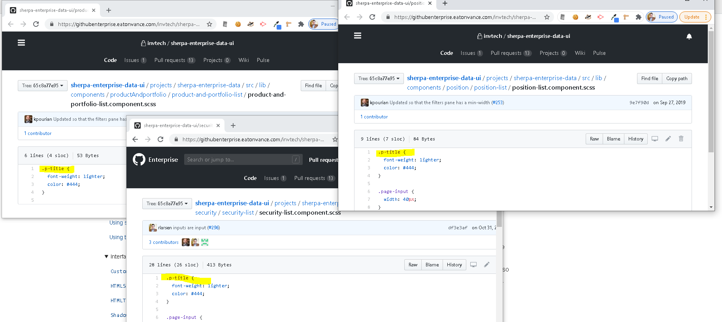
What Angular Gets Wrong (for us)

Slide 14
What Angular Gets Wrong (for us)
Each one of those .p-title classes would get rendered into the document along with an attribute selector, rendering each unique, but still redundant
<style>.p-title[_ngcontent-ymr-c90]{
font-weight: lighter;
color: #444;
}</style>
<style>.p-title[_ngcontent-ymr-c82]{
font-weight: lighter;
color: #444;
}</style>
<style>.p-title[_ngcontent-ymr-c79]{
font-weight: lighter;
color: #444;
}</style>

Slide 15
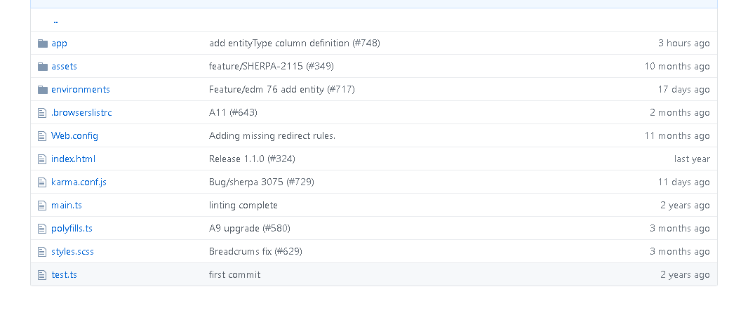
What We Do Instead

Slide 16
What We Do Instead
/* You can add global styles to this file, and also import other style files */
@import "../node_modules/ag-grid-community/dist/styles/ag-grid.css";
@import "../node_modules/ag-grid-community/dist/styles/ag-theme-balham.css";
@import "../node_modules/sherpa-component-library/sherpa-component-library.css";
/* global styles follow */

Slide 17
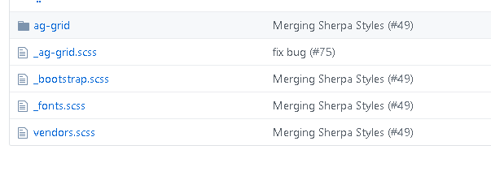
Sherpa Component Library Includes:
Bootstrap, font-awesome and ag-grid

Slide 18
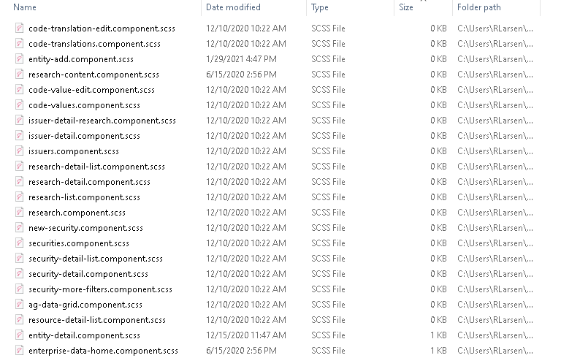
And then… we write very little!

Slide 19

The Components We’ve Created Help, But So Does Bootstrap

Slide 20
The Components We’ve Created Help, But So Does Bootstrap
“Bootstrap, the world’s most popular front-end open source toolkit, featuring Sass variables and mixins, responsive grid system, extensive prebuilt components, and powerful JavaScript plugins.”
Bootstrap is one of the top ten most starred projects on GitHub and was, for many years, the #1 starred project. There is significant documentation by the Bootstrap team itself and by the web at large. There is likely nothing you can do in Bootstrap that isn’t documented in five different ways and in 50 different languages.
We use it as the foundation of our components (they are composed of Bootstrap building blocks) and we build on top of the Bootstrap CSS to create our custom look and feel.
The Bootstrap components we use are delivered through an Angular wrapper, ngx-bootstrap. This presentation will talk about the styles.

Slide 21
Responsive Web Design
The control which designers know in the print medium, and often desire in the web medium, is simply a function of the limitation of the printed page. We should embrace the fact that the web doesn’t have the same constraints, and design for this flexibility. But first, we must accept the ebb and flow of things.
— John Allsopp
A Dao of Web Design

Slide 22
Responsive Web Design
The control which designers know in the print medium, and often desire in the web medium, is simply a function of the limitation of the printed page. We should embrace the fact that the web doesn’t have the same constraints, and design for this flexibility. But first, we must accept the ebb and flow of things.
— John Allsopp
A Dao of Web Design

Slide 23

Responsive Web Design

Slide 24
Responsive Web Design
Responsive Web Design was introduced on May 25, 2010 when Ethan Marcotte published the directly named article Responsive Web Design on A List Apart. In the article he outlines the conceptual and technical framework of RWD, namely using fluid layout grids and CSS3 media queries to create layouts that can adapt and respond to the characteristics of the device or user agent; stretching and shrinking to present layouts that work on a variety of screen sizes without prior knowledge of the device characteristics.

Slide 25
Bootstrap’s Responsive grid system
The following will all just come from the excellent Bootstrap docs! We use the Bootstrap grid for 99% of our layout.

Slide 26
Breakpoints
“Breakpoints are the triggers in Bootstrap for how your layout responsive changes across device or viewport sizes.”
Available Breakpoints:
Breakpoint | Class infix | Dimensions
X-Small | None | <576px
Small | sm | ≥576px
Medium | md | ≥768px
Large | lg | ≥992px
Extra large | xl | ≥1200px
Extra extra large | xxl | ≥1400px
Source Bootstrap Documentation

Slide 27
Containers
“Containers are a fundamental building block of Bootstrap that contain, pad, and align your content within a given device or viewport.“
“Containers are the most basic layout element in Bootstrap and are required when using our default grid system. Containers are used to contain, pad, and (sometimes) center the content within them. While containers can be nested, most layouts do not require a nested container.”
Bootstrap comes with three different containers:
.container, which sets a max-width at each responsive breakpoint
.container-fluid, which is width: 100% at all breakpoints
.container-{breakpoint}, which is width: 100% until the specified breakpoint
Source Bootstrap Documentation

Slide 28
Grid System - Example
<div class="container">
<div class="row">
<div class="col-sm">
One of three columns
</div>
<div class="col-sm">
One of three columns
</div>
<div class="col-sm">
One of three columns
</div>
</div>
</div>
Source Bootstrap Documentation

Slide 29
Grid System- How It Works
Our grid supports six responsive breakpoints. Breakpoints are based on min-width media queries, meaning they affect that breakpoint and all those above it (e.g., .col-sm-4 applies to sm, md, lg, xl, and xxl). This means you can control container and column sizing and behavior by each breakpoint.
Containers center and horizontally pad your content. Use .container for a responsive pixel width, .container-fluid for width: 100% across all viewports and devices, or a responsive container (e.g., .container-md) for a combination of fluid and pixel widths.
Rows are wrappers for columns. Each column has horizontal padding (called a gutter) for controlling the space between them. This padding is then counteracted on the rows with negative margins to ensure the content in your columns is visually aligned down the left side. Rows also support modifier classes to uniformly apply column sizing and gutter classes to change the spacing of your content.
Source Bootstrap Documentation

Slide 30
Grid System- How It Works
Columns are incredibly flexible. There are 12 template columns available per row, allowing you to create different combinations of elements that span any number of columns. Column classes indicate the number of template columns to span (e.g., col-4 spans four). widths are set in percentages so you always have the same relative sizing.
Gutters are also responsive and customizable. Gutter classes are available across all breakpoints, with all the same sizes as our margin and padding spacing. Change horizontal gutters with .gx-* classes, vertical gutters with .gy-*, or all gutters with .g-* classes. .g-0 is also available to remove gutters.
Source Bootstrap Documentation

Slide 31
Columns and Gutters
There are cookbooks for working with columns (https://getbootstrap.com/docs/5.0/layout/columns/) and gutters (https://getbootstrap.com/docs/5.0/layout/gutters/) for more complicated layouts.
Source Bootstrap Documentation

Slide 32
Layout Utility Classes Changing display
Use our display utilities for responsively toggling common values of the display property. Mix it with our grid system, content, or components to show or hide them across specific viewports.
.d-{value} for xs
.d-{breakpoint}-{value} for sm, md, lg, xl, and xxl.
Where value is one of
none
inline
inline-block
block
grid
table
table-cell
table-row
flex
inline-flex
Source Bootstrap Documentation

Slide 33
Layout Utility Classes Flexbox Utilities
Bootstrap is built with flexbox, but not every element’s display has been changed to display: flex as this would add many unnecessary overrides and unexpectedly change key browser behaviors. Most of our components are built with flexbox enabled.
Should you need to add display: flex to an element, do so with .d-flex or one of the responsive variants (e.g., .d-sm-flex). You’ll need this class or display value to allow the use of our extra flexbox utilities for sizing, alignment, spacing, and more.
Source Bootstrap Documentation

Slide 34
Layout Utility Classes Margin and Padding
Use the margin and padding spacing utilities to control how elements and components are spaced and sized. Bootstrap includes a six-level scale for spacing utilities, based on a 1rem value default $spacer variable. Choose values for all viewports (e.g., .me-3 for margin-right: 1rem in LTR), or pick responsive variants to target specific viewports (e.g., .me-md-3 for margin-right: 1rem —in LTR— starting at the md breakpoint).
Source Bootstrap Documentation

Slide 35
Layout Utility Classes Offsets
Offset classes
Move columns to the right using .offset-md-* classes. These classes increase the left margin of a column by * columns. For example, .offset-md-4 moves .col-md-4 over four columns.
<div class="container">
<div class="row">
<div class="col-md-4">.col-md-4</div>
<div class="col-md-4 offset-md-4">.col-md-4 .offset-md-4</div>
</div>
<div class="row">
<div class="col-md-3 offset-md-3">.col-md-3 .offset-md-3</div>
<div class="col-md-3 offset-md-3">.col-md-3 .offset-md-3</div>
</div>
<div class="row">
<div class="col-md-6 offset-md-3">.col-md-6 .offset-md-3</div>
</div>
</div>
Source Bootstrap Documentation

Slide 36
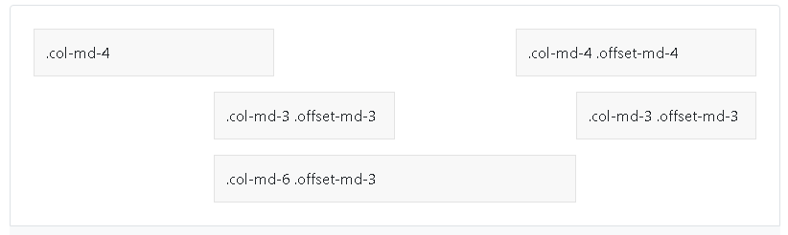
Layout Utility Classes Offsets
Source Bootstrap Documentation

Slide 37
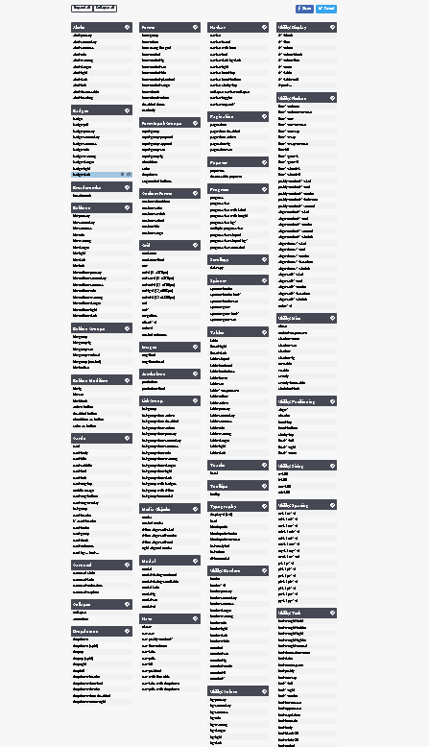
Utility Classes (So Many More)
https://hackerthemes.com/bootstrap-cheatsheet/

Slide 38
Utility Classes (So Many More)
Borders
Use border utilities to quickly style the border and border-radius of an element. Great for images, buttons, or any other element.
Colors
Convey meaning through color with a handful of color utility classes. Includes support for styling links with hover states, too
Interactions
Utility classes that change how users interact with contents of a website.
Overflow
Use these shorthand utilities for quickly configuring how content overflows an element.
Shadows
Add or remove shadows to elements with box-shadow utilities.
Text
Documentation and examples for common text utilities to control alignment, wrapping, weight, and more.
And many more!
Source Bootstrap Documentation

Slide 39
Utility Classes (So Many More)
Embracing Bootstrap is good for a few reasons-
You write less code
Everything is based on the same system so is consistent. One developer isn’t writing pixel values for margin while another is writing relative values like % or REM.
If you refrain from writing custom styles, you never have to worry about hunting for an instance of a color or a pixel definition of a layout. It’s all relative and all tied directly into the core Bootstrap system so you can make changes to the Bootstrap theme and everything just flows down to your app
You don’t actually need to know CSS. You just need to know what class you need for the thing you’re trying to accomplish. You don’t need to know what flexbox even is or what media queries are. You just follow the Bootstrap pattern and it just works
Source Bootstrap Documentation

Slide 40
Resources
MDN CSS - https://developer.mozilla.org/en-US/docs/Web/CSS
Bootstrap Docs - https://getbootstrap.com/
Ngx-bootstrap - https://valor-software.com/ngx-bootstrap/#/
Source Bootstrap Documentation

