Slide 1
Wild World Web
Web Development in a World of Ever-Changing Browsers, Platforms & Compatibilities

Slide 2

The Web a Dozen Years Ago

Slide 3
Just Click the Big Blue E
At the height of their dominance, Windows XP + Internet Explorer (5,5.5 and 6) was 95% of the web
Two screen resolutions mattered

Slide 4
Stagnation
We had rules instead of choices
Think: 960 pixel grids
We had a calcified specification & browser landscape
December 1997: HTML4.0 specification
Early 1998: XML 1.0 Standard
May 1998: CSS level 2 specification
December 1999: ECMASCript version 3.0
January 2000: XHTML 1.0
Internet Explorer 6 was released August 27, 2001
September 2001: SVG 1.0 W3C Recommendation

Slide 5
HTML + CSS + JavaScript Was Weird
You could learn all the differences between browsers
Lots of Flash
For some: HTML was good for embedding Flash & JavaScript was good for nothing

Slide 6


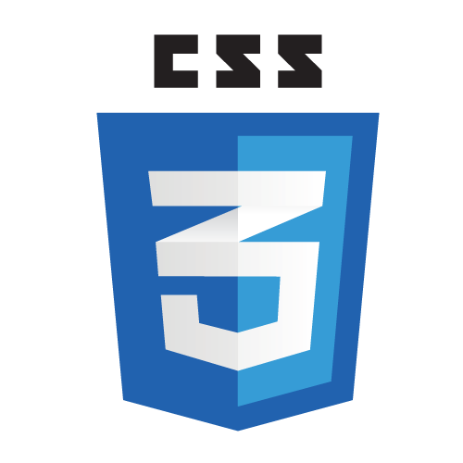


Thankfully Things Got Better

Slide 7
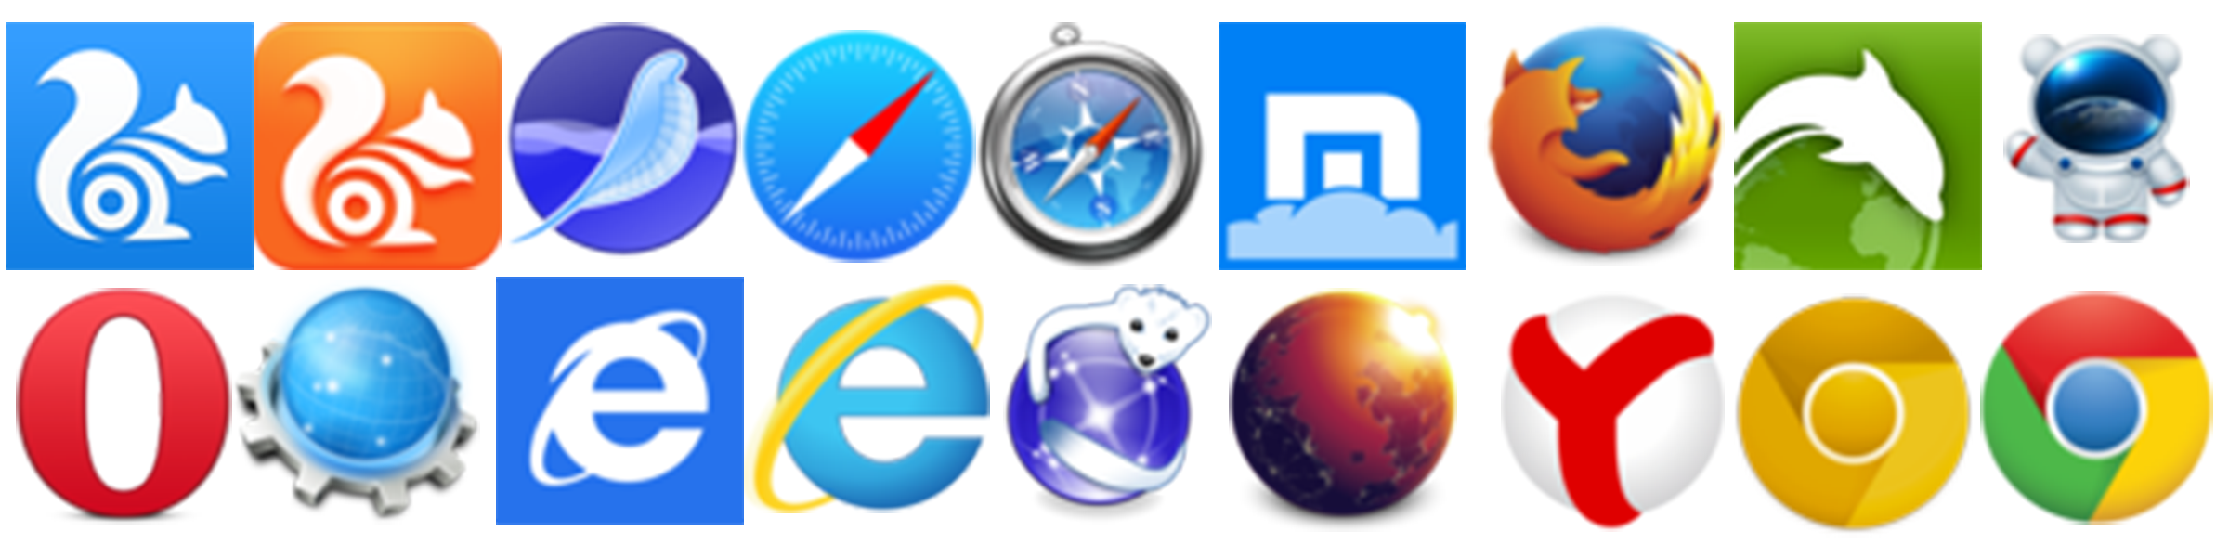
The Web Today Is Different

Slide 8
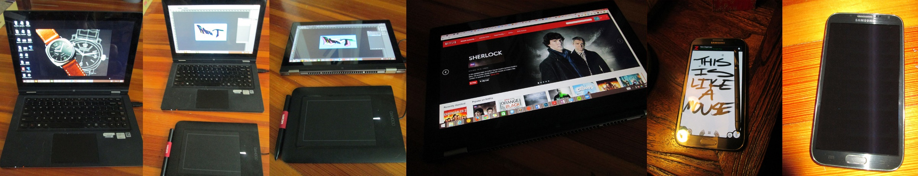
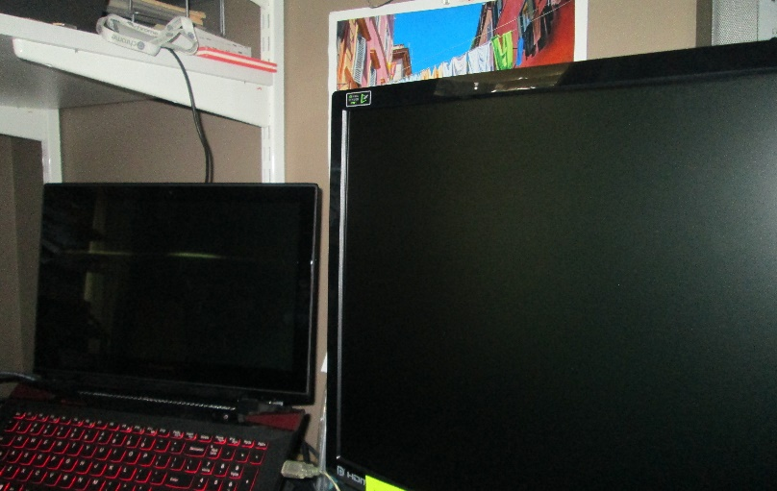
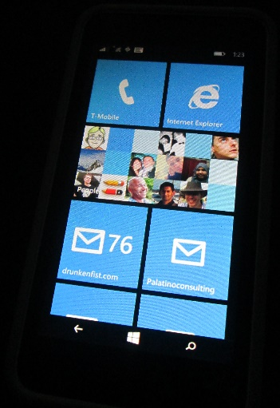
An Explosion of Devices and Browsers
I’d list out all the different modes I might use in a day but it might take a while.

Slide 9
The Web Today Looks a Little Different
Resolutions from 240 x 320 to 3840 x 1080 (or more)
Pixel densities from 72ppi up past 300ppi
A broad range of input options (keyboard, stylus, gesture, touch, mouse)
A dozen (or more) major and hundreds of minor browser versions in the wild
A rapidly changing open web platform landscape

Slide 10
Let’s Make More Rules?
Initially, developers and designers tried to navigate this new complicated reality by creating new rules.

Slide 11
Let’s Not!
The problem was, the goalposts kept moving. As soon as a new hard and fast rule was created, some new wrinkle would render it impotent. People designed and built “iPhone” sites, assuming that Apple’s dominance in the smartphone market was a permanent condition. They tested for touch capabilities and assumed that touch users would never have a mouse.

Slide 12
Rules Don’t Work
As Android’s huge growth over the past few years, and the presence of Chromebooks and Windows 8 laptops with both mouse and touch capabilities have proved, those new rules have a short shelf life.

Slide 13
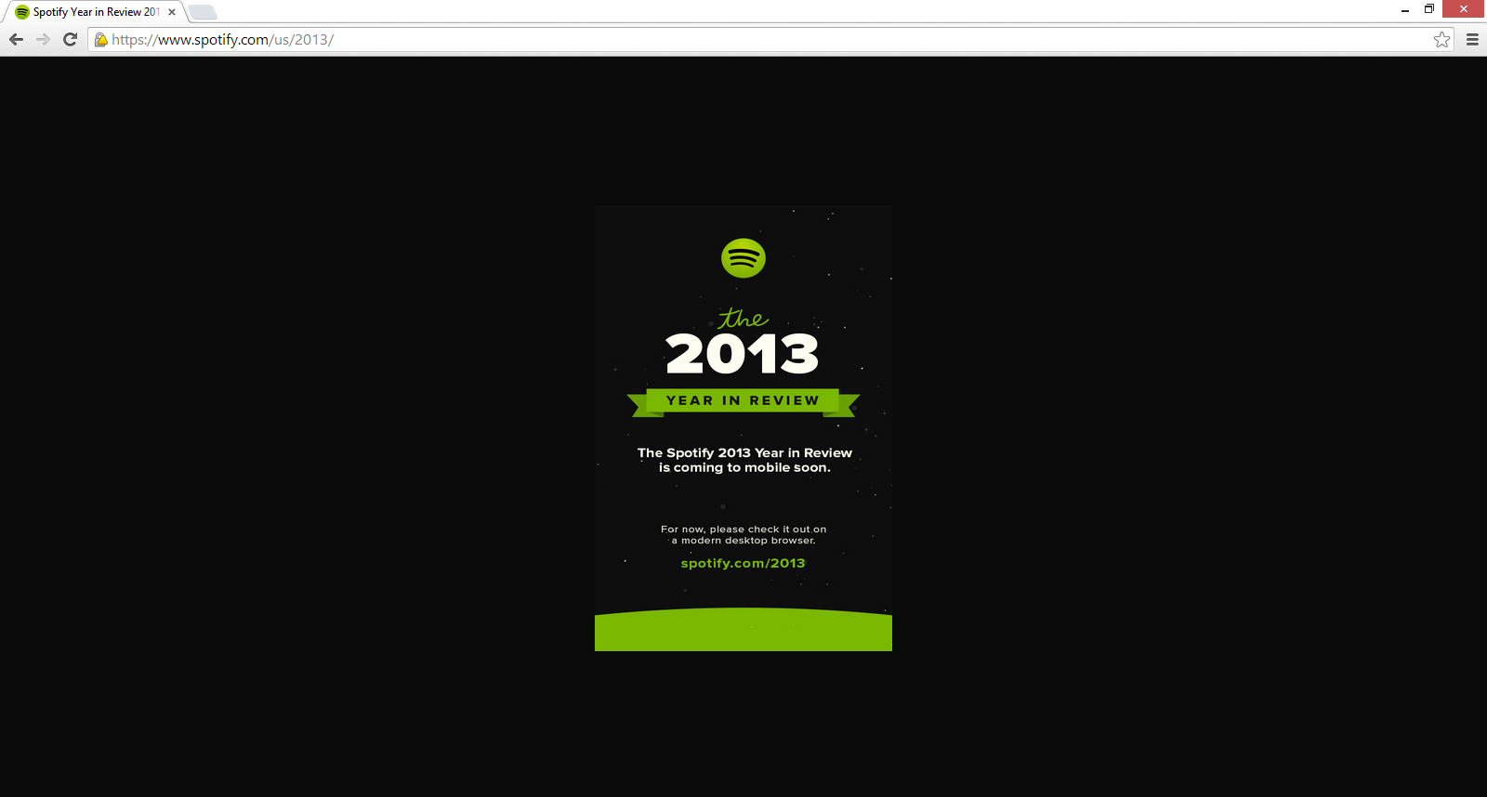
Rules Don’t Work

Slide 14
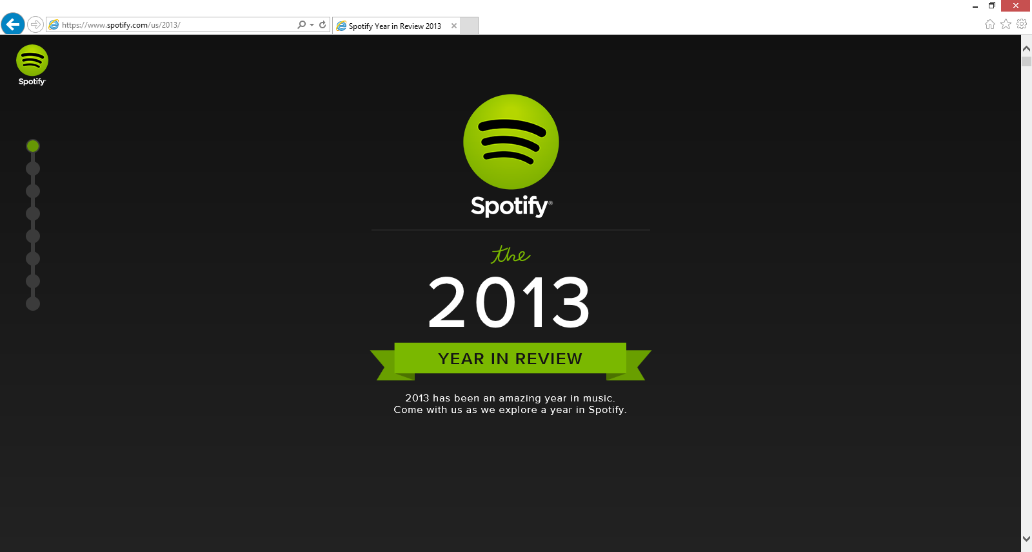
Rules Don’t Work

Slide 15
One Size Fits All?
Even patterns like Responsive Web Design (RWD), which some saw as a single solution for design and development moving forward fall apart when applied against complicated application patterns and the questions of bandwidth and the challenge of mobile performance.

Slide 16

One Size Fits All?

Slide 17
So What Are We Supposed to Do?
The best way to approach the web today is to forgo hard and fast rules and design for uncertainty.
This is the best bet for creating future proof web solutions.

Slide 18
The Web is Still Good News…
All of these devices, form factors, and browsers all share the open web platform: HTML, CSS and JavaScript.
If you seize on this shared platform and try to create the best possible experience for the broadest possible range of devices you‘ve got a heck of a lot of reach.

Slide 19
Embracing Uncertainty
What follows are a series of high level ideas that will allow you approach compatibility in a nimble way and will allow you to piece together your own solutions to these issues when you're faced with the web's uncertainty.

Slide 20
Don't Blame the Web for being the Web
The web is a diverse place that's getting more diverse every single day.
If you accept the web's diversity (and maybe even celebrate it) and you're getting angry about one thing (maybe Internet Explorer 8) or another (the stock Android Browser) just take a minute to remind yourself that this is just the way the web is.

Slide 21
Don't Blame the Web for being the Web
This is just the way the web is.

Slide 22
Identify and embrace your audience
While you can look at web-scale statistics for browser and operating system market share to get some idea of where things, the only metrics that truly matter are those for your audience.

Slide 23
Identify and embrace your audience
Who are they? What do they use? Where do they live?
Knowing this information makes your life significantly easier.

Slide 24
Identify and embrace your audience
If, for example, you're planning on leveraging SVG for data visualizations, and you still have big legacy IE audience you would want to look at Raphaël, which has built-in support for legacy IE rather than Snap.svg, the successor which solely leverages modern browser features.

Slide 25
Test and pray for the best
Once you've identified your audience, where they are and what they're using it's time to define the technical demographics you're going to target.

Slide 26
It Could Look Like This:
Samsung Galaxy S3
Samsung Galaxy S4
Samsung Galaxy S5
Samsung Galaxy Note III
Samsung Galaxy Note 4
Nexus 5
Kindle Fire
Motorola Droid X (Android 2.3)
Google Nexus 7
Nokia Lumia 920
iPhone 4S
iPad 2G
iPhone 5s
iPhone 6
Chrome (latest) Mac, PC and a Chromebook
Firefox (latest) Mac and PC.
Opera (latest) Mac and PC
IE 8.0 on Windows XP
IE 9.0 on Windows 7
IE 10.0 Windows 7/8 - including a touch screen laptop
IE 11.0 Windows 7/8/8.1 - including a touch screen laptop
Safari 6.0

Slide 27
Or Scaled Down to This
Samsung Galaxy S4
iPhone 6
iPad 2G
Motorola Droid X
Chrome (latest) Mac and PC
Firefox (latest) Mac and PC.
Opera (latest) Mac and PC
IE 8.0 on Windows XP
IE 9.0 on Windows 7
IE 10.0 Windows 7
IE 11.0 Windows 8
Safari 6.0

Slide 28
Whatever it is…
Test on as many real devices as early and as often as you can. You will be surprised.

Slide 29
Focus on optimal, not absolute solutions
Your site is not an absolute thing. There is no one true vision of it. The best possible site you can have will be the best possible site for everyone that visits it. If that means it's a high DPI, 25MB monstrosity for a guy on a Macbook air in a coffee shop in Palo Alto or just a logo and an unordered list for someone on a-rented-by-the-minute feature phone in Lagos, then that's the way it is.

Slide 30
Embrace Accessibility
Simply put, if your site is accessible you're guaranteeing that you'll be able to reach the largest possible audience. You're also doing the right thing.

Slide 31
If Doing the Right Thing Isn’t Enough…
Based on the 2010 US census, 56 million Americans were classified as having a disability. That's 18.7% of the population.
Notes:
With the understanding that individuals might have one or more class of disability, and that not all disabilities would hinder the ability of a user to access the web the following table shows the number of Americans with disabilities that might interfere with their use of the web.

Slide 32
Tens of Millions of People Are Directly Affected
Numbers for this are hard to come by, but even using these numbers as a rough guide you can estimate that there are millions of Americans that rely on the accessibility of sites to use the web. Getting numbers outside of the US is even more difficult, but the rest if the world is a lot bigger than the US, so millions in the US means many more millions in the rest of the world.

Slide 33
Class of Disability | % of Americans | Total # of Americans | Note
Visual | 3.3 | 8,077,000
Hearing | 3.1 | 7,572,000
Motor | 2.8 | 6,700,000 | Based on the number Americans with "difficulty grasping objects like a glass or pencil" as a rough analog for mouse use
Cognitive | 6.3 | 15,155,000 | Covers all mental disabilities

Slide 34
Every User is Indirectly Affected
The following slides list some of the ways that accessibility techniques can help all users.
Notes:
Video transcripts and other access

Slide 35
Provide text alternatives for all non-text content
If images fail to load or are loading slowly alternative text can provide crucial context to users.
Notes:
Video transcripts and other access

Slide 36
Ensure that information and structure can be separated from presentation
Good structure for your code makes it much easier to translate into different formats for devices with different capabilities and needs. This used to be a much bigger issue when people commonly used tables for layout, but it's still important now.
Notes:
You want your pages to make logical sense without styles and without JavaScript. If you can satisfy both of those requirements you're in really good shape. One way to test how well you've structured your content is to view the document's outline as defined by the HTML5 specification. If your document outline looks like a well-structured table of contents then you're probably on the right track.

Slide 37
Make all functionality operable via a keyboard interface
Understanding the way that people without a mouse use the web is an important (and neglected) exercise for everyone that makes web sites.
On the most basic level, making sure that common keyboard interactions behave in an effective, predictable way is very important. Tab order, skip links and staying away from keyboard traps are all important to keyboard users.
Notes:
Understanding the way that people without a mouse use the web is an important (and neglected) exercise for everyone that makes web sites. You really should be testing everything you do without a mouse and optimizing for keyboard navigation is one of the best things you can do for all of your users.
On the most basic level, making sure that common keyboard interactions behave in an effective, predictable way is very important. Tab order, skip links and staying away from keyboard traps are all important to keyboard users.
More advanced keyboard navigation is *great* for power users as well as being a boon to users who can't use a mouse.

Slide 38
Content can be paused by the user
The intent of this guideline is to ensure that visually impaired or cognitively-disabled users have time to digest your content.
Ensure that video, audio and time-based visualizations can be controlled by the user
Avoid automatically refreshing content after a set period of time or to allow that functionality to be turned off.
Notes:
Think of a news site which refreshes every couple of minutes for the possibility of breaking news (and to inflate page views) or a sports site that refreshes a page automatically to show updated scores.

Slide 39
Content can be paused by the user
Don't force updates down your user's throat. In addition to the accessibility concerns, all users can benefit from avoiding this practice. On mobile, for example, this rule is important for all users because battery life, bandwidth and processor time are all important factors in the overall mobile experience. You don't want to download unnecessarily updates, wasting kilobytes of data and battery life.

Slide 40
Provide mechanisms to help users find content
This is just good sense, of course, but is especially true when dealing with smaller screens. Make links make sense, give a good sense of where users are within your site or application and give them multiple ways to reach content. The less you ask a mobile user to do to get to their important content, the better.
Having a clearly labeled "contact us" link with a big fat button that takes them to a simple list which includes your telephone number is worth more for the customer's experience than pretty much anything else you can do on the web. You might have the most beautiful site in the world, but if your customer can't find your phone number you might as well have made your site out of sticks and glue. It's useless.

Slide 41


Slide 42
Help users avoid mistakes & make it easy to correct mistakes that do occur
It's hard to fill out forms on the web. The more help you can give users, the better. This is true for all users.
The more time and care you spend on your forms, the better off you'll be. Making it difficult for people to make errors, offering meaningful error messages and designing forms to lessen the user's cognitive load are going to directly affect your bottom line.
For example, offering inline validation (checking the form data for validity as they enter it) and providing help text in context can help users more confidently enter the correct information in form fields.

Slide 43
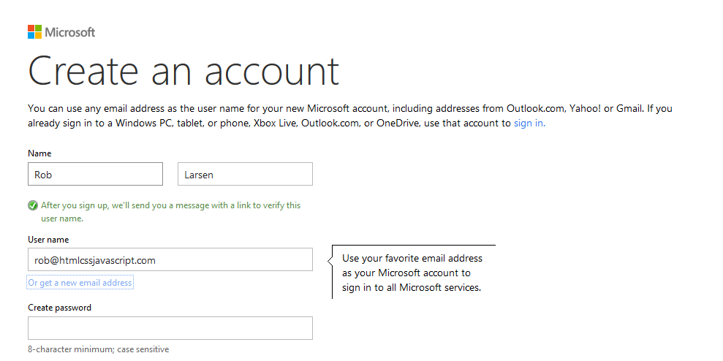

Slide 44
Support compatibility with current and future user agents
Support compatibility with current and future user agents (including assistive technologies)
The fact that the first website ever made still works is a guiding principle here. Don't back yourself into a corner and you'll be sitting pretty in 2025.
I will say that getting a basic understanding of how assistive technologies work and how they may work in the future is a good idea to add onto the understanding of the browser and device market.

Slide 45
Don't Stop There
All the WCAG guidelines are going to make your site more robust for all users. The previous were just a few cherrypicked examples that were obviously tied into some of the principles we're exploring here and had obvious benefit for all users.

Slide 46
Don't Stop There
Also, in addition to these existing rules, it's important to assess the compatibility and accessibility impact of new technologies and technology patterns. Issues like the 300ms delay for tap/click on touch devices (what it means to disable) and the use of icon fonts (which may or may not load in older browsers) are multi-faceted problems. You need to actively assess these issues as they surface or you could end up with an accessibility nightmare that bleeds across to all your users.

Slide 47
Lose your technology biases
Tech folks generally have great hardware and new, high powered smart phones and tablets. Most other people in the world don't. Tech folks tend to forget that.

Slide 48
The iPhone isn’t the only mobile experience
At the height of the iPhone's dominance as a mobile platform, it was typical to base mobile web designs on the interface and interaction model of the iPhone.
I wasn't a fan of that approach to begin with as I think the web should embrace the web, and not copy some other platform- especially one that's trying to strangle the web.
It became an even worse idea as the iPhone rapidly ceded the title of the dominant mobile platform to Google's Android.

Slide 49
Where Do We Put the Back Button?
There's only the one button on the iPhone so you need a software back button. If your vision of the web is iPhone-centric, inserting a back button into your web UI seems like a good idea. The thing is, every Android device has a back button built in, either as a dedicated software button on screen or as a physical button on the device. All of them. It's required and it also gets used all the time so a back button in the UI of a web app, for an Android user, is a foreign experience.
Notes:
There's only the one button on the iPhone so you need a software back button. If your vision of the web is iPhone-centric, inserting a back button into your web UI seems like a good idea. The thing is, every Android device has a back button built in, either as a dedicated software button on screen or as a physical button on the device. All of them. It's required and it also gets used all the time so a back button in the UI of a web app, for an Android user, is a foreign experience. You're just wasting precious pixels. But yet, people do it because the iOS experience is all they know.

Slide 50
Closed. Won't fix. Can't Reproduce.
"That animation is super fast on my machine.“
Another painful example of the trap tech folks fall into is with JavaScript performance.
Most people don't look critically at their application performance in enough devices to truly test performance.
You can easily trip long running script errors, freeze the screen and even crash the browser if you're not careful. If you think you're getting a second look from a user whose browser you just crashed, you've got another thing coming.
It's said so often that it's a cliché, but the reality is it can "work on my machine" only to fail on some other hardware/browser combination.
Notes:
"That animation is super fast on my machine.“
Another painful example of the trap tech folks fall into is with JavaScript performance.
While there's a lot of talk about being jank free and the web performance community has grown to be a real force in the industry; the plain fact is most people don't look critically at their application performance in enough devices to truly test performance. There are underpowered mobile devices, old desktops and old browsers aplenty out there waiting to expose problems with your site. You can easily trip long running script errors, freeze the screen and even crash the browser if you're not careful. If you think you're getting a second look from a user whose browser you just crashed, you've got another thing coming.
It's said so often that it's a cliché, but the reality is it can "work on my machine" only to fail on some other hardware/browser combination.

Slide 51
Contrary to Popular Opinion Internet Explorer Does Exist
People don't test enough in Internet Explorer.
Whether it's Windows-based developers working all day in Firefox or Chrome or developers on a Mac not wanting to fire up Parallels, people don't test in IE early or often enough.
That's crazy.
I know it's the bogeyman, but it remains a huge portion of the browser market. Depending on where you look for your stats, it's got a larger market share than Firefox and Safari combined. Yet, people treat it like an afterthought. This is less of a problem than it was six or seven years ago as IE's market share has halved, but it's still a major issue when you're ignoring hundreds of millions of potential customers.
Notes:
People don't test enough in Internet Explorer.
Whether it's Windows-based developers working all day in Firefox or Chrome or developers on a Mac not wanting to fire up Parallels, people don't test in IE early or often enough.
That's crazy.
I know it's the bogeyman, but it remains a huge portion of the browser market. Depending on where you look for your stats, it's got a larger market share than Firefox and Safari combined. Yet, people treat it like an afterthought. This is less of a problem than it was six or seven years ago as IE's market share has halved, but it's still a major issue when you're ignoring hundreds of millions of potential customers.
I've managed a lot of developers and projects over the years and I've had specific feedback on this issue about folks that worked for me on several different occasions. This is especially problematic as I've done a lot of consulting and agency work for health-care companies, financial services firms and law firms. There's a *lot* of Internet Explorer in those industries. As I mentioned previously, it's often the *only* browser allowed on internal networks.
Some people would blame IE for my crummy night, *because it's the bogeyman*. Two things about that thought. First, IE can't win. They lose when they don't follow the specification and they lose when they do. It's true. The ES3 specification didn't allow trailing commas in Object literals. Crazy that the IE implementation could be *to the specification.* Secondly, the developer is to blame because... he didn't test his code and checked it in. Blaming IE for that is like blaming the rain for getting you wet if you walk outside without an umbrella.
I think this behavior is at least part of the reason why people have such a visceral dislike of IE- including later versions which are actually quite easy work with. Since so many people save IE for later on in the development process, or downright ignore it, their only experience with the browser is one of shock and betrayal.
If IE was constantly sneaking up on me and punching me in the face because I wasn't paying attention, I'd be mad at it too.

Slide 52
Contrary to Popular Opinion Internet Explorer Does Exist
I think this behavior is at least part of the reason why people have such a visceral dislike of IE- including later versions which are actually quite easy work with. Since so many people save IE for later on in the development process, or downright ignore it, their only experience with the browser is one of shock and betrayal.
If IE was constantly sneaking up on me and punching me in the face because I wasn't paying attention, I'd be mad at it too.
Notes:
People don't test enough in Internet Explorer.
Whether it's Windows-based developers working all day in Firefox or Chrome or developers on a Mac not wanting to fire up Parallels, people don't test in IE early or often enough.
That's crazy.
I know it's the bogeyman, but it remains a huge portion of the browser market. Depending on where you look for your stats, it's got a larger market share than Firefox and Safari combined. Yet, people treat it like an afterthought. This is less of a problem than it was six or seven years ago as IE's market share has halved, but it's still a major issue when you're ignoring hundreds of millions of potential customers.
I've managed a lot of developers and projects over the years and I've had specific feedback on this issue about folks that worked for me on several different occasions. This is especially problematic as I've done a lot of consulting and agency work for health-care companies, financial services firms and law firms. There's a *lot* of Internet Explorer in those industries. As I mentioned previously, it's often the *only* browser allowed on internal networks.
Some people would blame IE for my crummy night, *because it's the bogeyman*. Two things about that thought. First, IE can't win. They lose when they don't follow the specification and they lose when they do. It's true. The ES3 specification didn't allow trailing commas in Object literals. Crazy that the IE implementation could be *to the specification.* Secondly, the developer is to blame because... he didn't test his code and checked it in. Blaming IE for that is like blaming the rain for getting you wet if you walk outside without an umbrella.
I think this behavior is at least part of the reason why people have such a visceral dislike of IE- including later versions which are actually quite easy work with. Since so many people save IE for later on in the development process, or downright ignore it, their only experience with the browser is one of shock and betrayal.
If IE was constantly sneaking up on me and punching me in the face because I wasn't paying attention, I'd be mad at it too.

Slide 53
Embrace Empathy
Don't blind yourself to what your audience actually is by assuming that they are just like you. They're not. Your average experience at work, at home or on your phone is almost certainly an optimal view of your site. Make sure you look at it, really look at it, in every scenario you can muster. Sure, we're all guilty of demoing code under the best possible circumstances. That's natural. The thing is, that demo is the ideal vision of your site. The thing you're actually building, the down and dirty version, is for people with a completely different relationship with technology than yours.
Try to get in their shoes instead of assuming everyone else is in yours.
You can acomplish this in a few ways. If your company does user testing or monitored usability sessions, sit in on them to see how your users actually interact with your site or application. This can be an incredible experience and is often only seen from the design or user experience side so ading a development voice is a big deal for all involved and can help you get a sense for what your users are all about.

Slide 54
Embrace Empathy
=== Lose your stack biases
I've done a lot of work creating standard, http://html5boilerplate.com/[baseline] https://github.com/h5bp/ant-build-script[tools] and https://github.com/isobar-idev/code-standards[documentation] for http://bp.sapient-lab.com/[front end development], so you'd think I'd be the first person to argue for setting up an optimal stack and sticking to it.
I'm actually not.
While I do think _limiting_ the number of available tools is useful (since having everything available to everyone is just crazy) I don't think, in this day and age, proscribing a definitive front end stack is useful.
I'm a proponent of using the right tool for the job, so the search for the "one stack to rule them all" seems like a waste of time to me. If you craft a perfect stack for creating single page apps and then end up building a bunch of page to page content sites, you've wasted time and resources with a stack that's not suited for the work you're doing.
Now, if you're building a single monolithic product or site, you will obviously settle on one stack, since you've just got the one thing to build. But if you're working on multiple projects or sites in a given year, limiting yourself to the "one stack" is the wrong way to go.
Your users don't care if you're stack is clever. They don't care how powerful your libraries are, how nifty your debugging tools are or how easily you can just whip up a demo. What they care about is the speed, usability, look and feel, interactivity and features. If your stack isn't adding to one of those then you might be going down the road to stack obsession.
Certainly having tools you're comfortable with is important, but at the end of the day developer comfort isn't the most important part of this equation. The experience of the users of your site trumps everything else. Or at least it should. To that end, doing things like pushing 1Mb of fancy framework JavaScript down the pipe on a site that's meant to be consumed on a mobile device over a potentially dicey connection is simply a terrible idea. It doesn't matter how easy it makes your life if no one is actually going to use the site you're going to build.
This stack obsession manifests itself in many ways. Here are some of them and ways you might want to short-circuit the impulse and better serve your users.
==== jQuery
I'm a big fan of jQuery. Its http://en.wikipedia.org/wiki/Fluent_interface[fluent interface] is a joy to work with, and it's done more than any other codebase to popularize JavaScript. Still, one of the important reasons to use jQuery, beyond the interface, is to smooth over cross browser differences in JavaScript implementations. While these aren't solely related to legacy Internet Explorer (Dave Methvin actually says that http://blog.methvin.com/2013/02/tragedy-of-webkit-commons.html["jQuery Core has more lines of fixes and patches for WebKit than any other browser"]) a lot of the main differences are, so depending on your target audience and the skill level of your team, you might be able to skip it. While jQuery started off as a lightweight alternative to beasts like Prototype, it's still around 30kb gzipped and minified. In order to save those bytes, it's an option to write raw JavaScript or potentially leverage a smaller, jQuery-like library like http://zeptojs.com/[Zepto.js] (10kb) instead. While it might seem like a small gain, if you're in the mindset of trying to save every possible byte, it is an option.
Personally, I stick with it because I like using it and worry about saving bytes in other places. 30kb will only be a noticeable download over the very worst connections (2g and/or crowded WiFi), so it's not a place where I would look to optimize.
.Use With Caution
[WARNING]
=====================================================================
Rick Waldron (TC39/Bocoup), Boris Zbarsky (Firefox), John-David Dalton (Microsoft) & Paul Irish (Chrome) actually put together a list of
https://docs.google.com/document/d/1LPaPA30bLUB_publLIMF0RlhdnPx_ePXm7oW02iiT6o/preview?sle=true[all the browser bugs the jQuery 2.* branch fixes]
=====================================================================
==== MVWhatever
One of the hottest areas of innovation on the front end over the past few years has been the creations of front-end Model View Controller (MVC) style libraries and frameworks. While many of them quibble about the acronym (MVVM,MVP) they all bring a common back-end pattern to the front end and enable a new approach to front end application development. http://angularjs.org/[Angular], http://backbonejs.org/[Backbone] and http://emberjs.com/[Ember] are all popular entries in this space. They are powerful alternatives to the DOM-centric approach of libraries like jQuery and the general DOM based application development we've been practicing for many years. Personally, I've spent the last couple of years working with Angular regularly and I love it. It's fun, incredibly powerful and has a strong, Google-backed community surrounding it.
The thing is, these libraries and frameworks are really designed for *application* development so, while these are super powerful tools, they shouldn't be grabbed for every circumstance.
For example, using one of these libraries in place of tried and true server side templating for a content site doesn't make sense. While it's very much the same sort of pattern (variables from some data source are plugged into some sort of text based templating engine) there are no real benefits to doing it on the front end.
When we first started learning about web performance, one of the fundamental lessons was that most of the performance hit on page happened in the browser, not on the server. Templating on the server wasn't performance a problem for people.
Why, then, are we rushing headlong to push functionality that was handled perfectly well by the server down to the front end? Why, when the goal is to simplify and lighten the payload in the front end are we willingly passing a task that was solved 15 years ago on the server to the browser? Having to download a framework as well as any other dependencies is going to slow your site down. Downloading Ajax requests with the content data, parsing it and inserting it into the DOM is also a performance penalty. We've learned to minimize the number of DOM traversals and manipulations. Why add more when the server can send a rendered page on the back of one HTTP request? It doesn't make sense.
Also, if, for some reason one of the JavaScript resources doesn't load, someone visits with an old browser, or someone visits with JavaScript turned off, you might end up with nothing but a blank page. That's just awful.
Use these powerful frameworks responsibly.

Slide 55
One EyeKeep At Least on the Cutting Edge
While "HTML5" is the buzzword of all buzzwords, the http://www.w3.org/TR/html5/[specification] you can go read is actually an older snapshot of what WHATWG editor Ian Hickson calls the http://www.whatwg.org/specs/web-apps/current-work/multipage/["living standard."] The work happening at the WhatWG is ongoing, important and is often solving problems that are keeping us up at night, right now.

Slide 56
Keep At Least One Eye on the Cutting Edge
While "HTML5" is the buzzword of all buzzwords, the http://www.w3.org/TR/html5/[specification] you can go read is actually an older snapshot of what WHATWG editor Ian Hickson calls the http://www.whatwg.org/specs/web-apps/current-work/multipage/["living standard."] The work happening at the WhatWG is ongoing, important and is often solving problems that are keeping us up at night, right now.

Slide 57
(or Keep Your Resume Up to Date)
If you work somewhere that doesn't allow you even enough time to monitor the subject lines on these mailing lists and you're still relied upon to stay, to quote many a job description, "up-to-date with the latest technologies," then it might be time to have a talk with your boss. If there was any time to stay ahead of the curve it's right now.

Slide 58
Spread Your Wings (and Question Your Assumptions)
Hopefully this chapter has already gotten you thinking about he way you've approached web development up until now. I'm assuming at least half of you think I'm an idiot. If so, I must be onto something. Whatever percentage of these concepts you agree with or feel like are applicable to you and your particular situation, the biggest takeaway is the urge to question your assumptions. The things you hand-wave away _might_ just be fine. Or they may be a problem causing some percentage of your users to have a crummy experience. You can know the difference unless you take a second to really understand the issue.

