Slide 1
Wild World Web
Web Development in a World of Ever-Changing Browsers, Platforms & Compatibilities

Slide 2

The Web 10 Years Ago

Slide 3

The Web Today

Slide 4
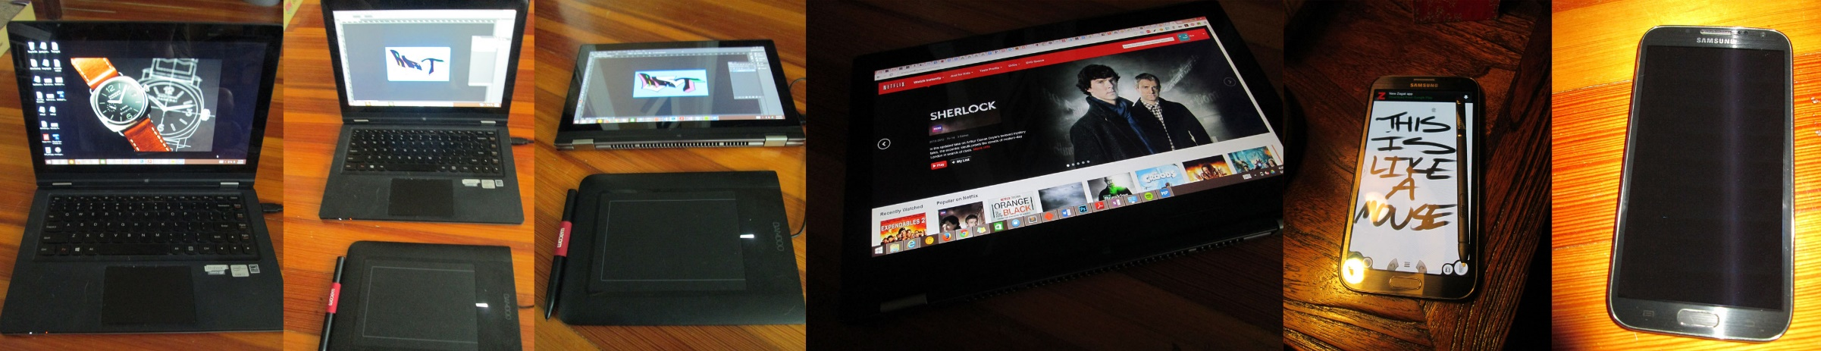
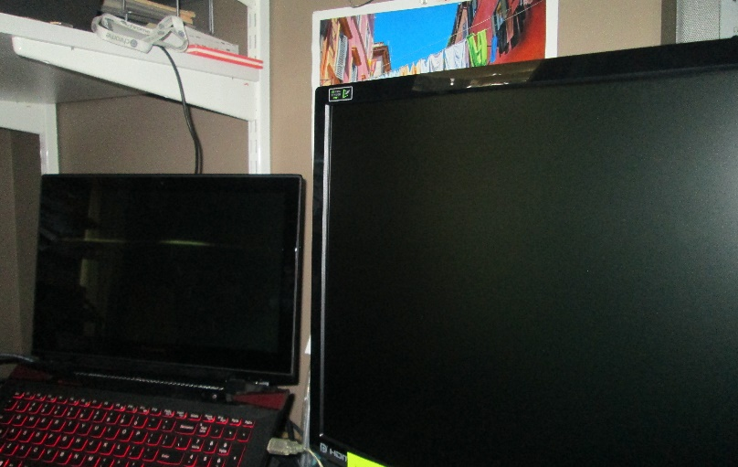
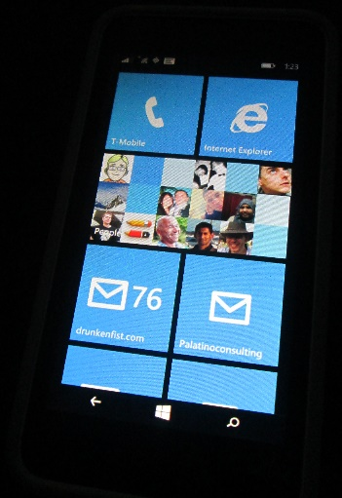
The Web Today

Slide 5
The Web Today

Slide 6
I want to wrap the whole web up in a big, inclusive bear hug

