Slide 1
Wild World Web
Web Development in a World of Ever-Changing Browsers, Platforms & Compatibilities

Slide 2

The Web a Dozen Years Ago

Slide 3
A Big Blue E
At the height of their dominance, Windows XP + Internet Explorer (5,5.5 and 6) was 95% of the web
Two screen resolutions mattered
800 x 600
1024 x 768

Slide 4
Stagnation
We had rules instead of choices
Think: 960 pixel grids
We had a calcified specification & browser landscape
December 1997: HTML4.0 specification
Early 1998: XML 1.0 Standard
May 1998: CSS level 2 specification
December 1999: ECMASCript version 3.0
January 2000: XHTML 1.0
Internet Explorer 6 was released August 27, 2001
September 2001: SVG 1.0 W3C Recommendation

Slide 5
HTML + CSS + JavaScript Was Weird
You could hold many cross-browser differences in your head
Lots of Flash
For some: HTML was good for embedding Flash & JavaScript was good for nothing

Slide 6


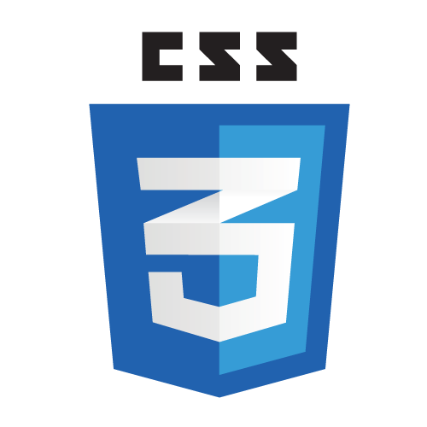


Thankfully Things Got Better

Slide 7
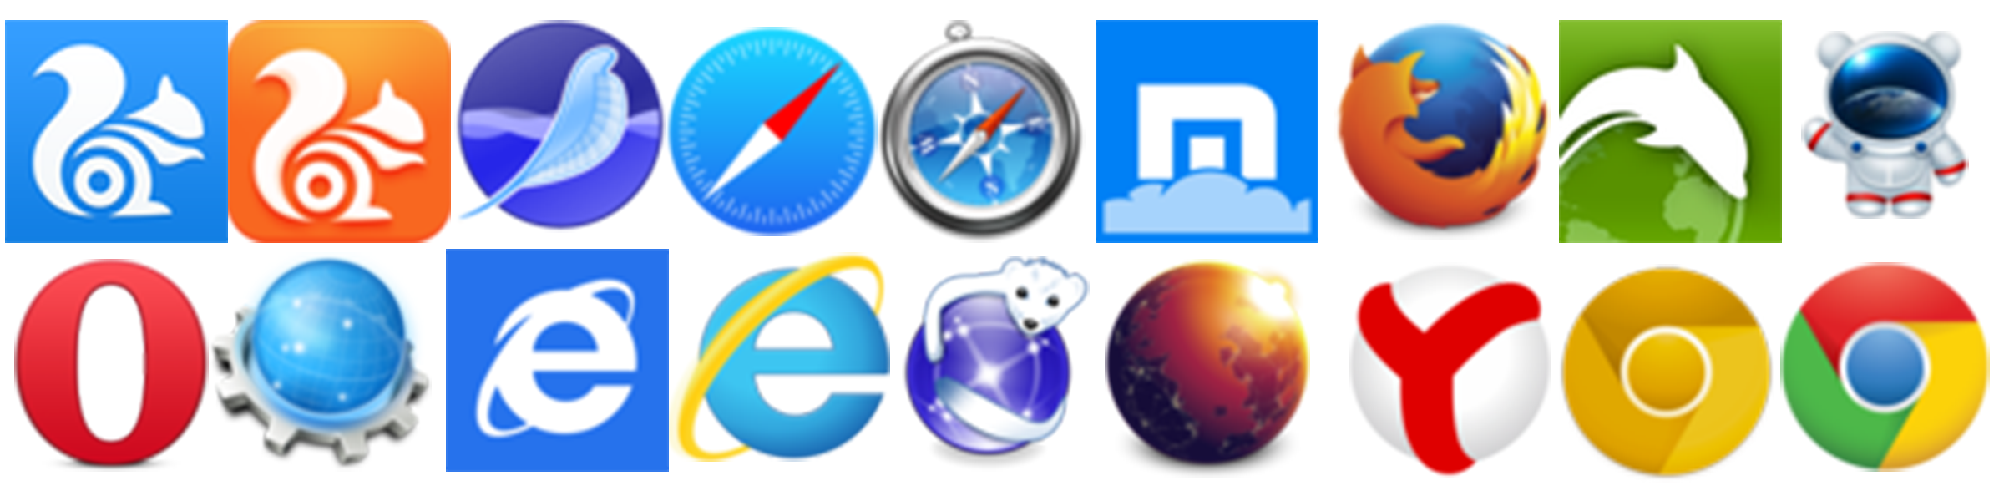
The Web Today Is Different

Slide 8
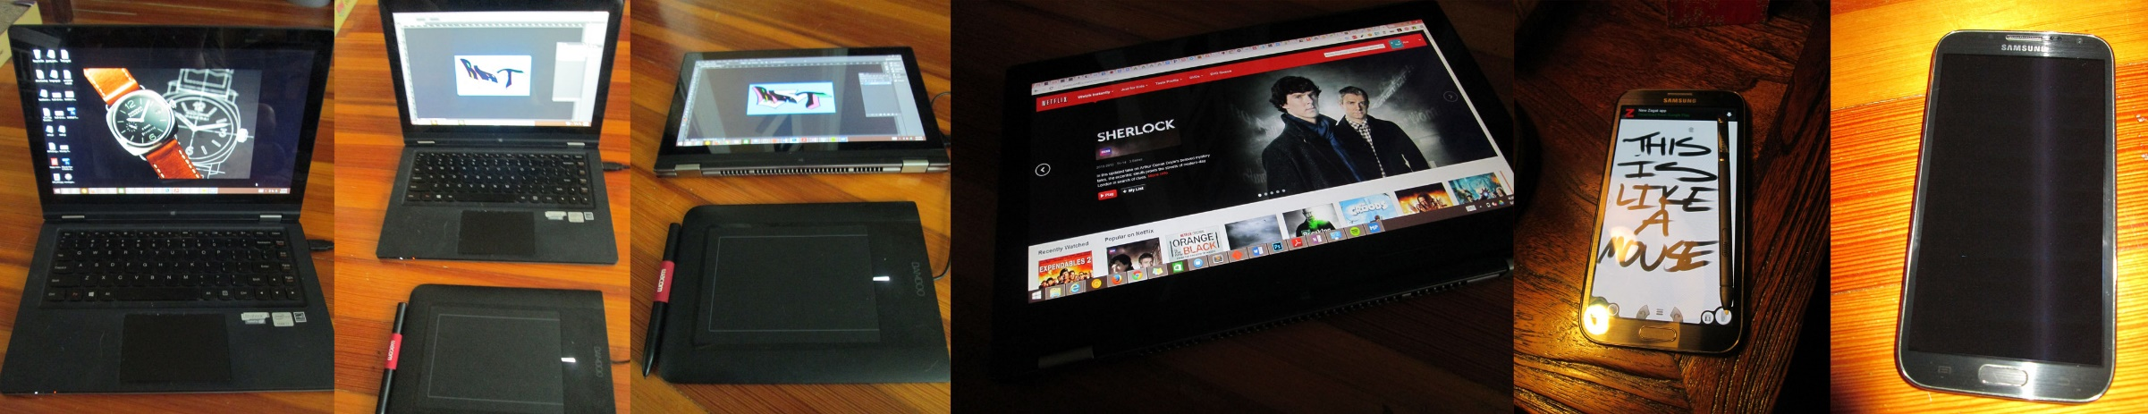
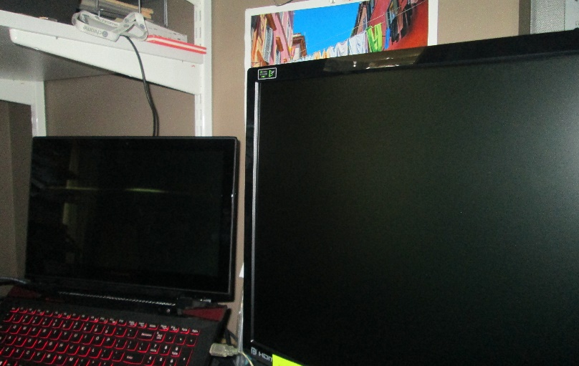
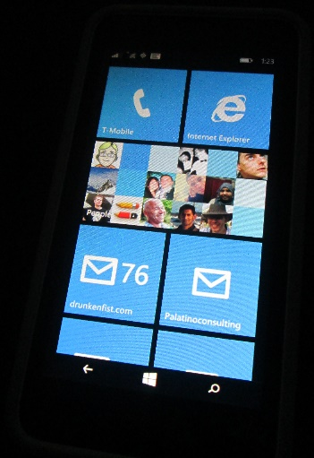
An Explosion of Devices and Browsers
I’d list out all these different modes but then we’d be here all day.

Slide 9
The Web Today
Resolutions from 240 x 320 to 3840 x 1080 (or more)
Pixel densities from 72ppi up past 300ppi
A broad range of input options (keyboard, stylus, gesture, touch, mouse)
A dozen (or more) major and hundreds of minor browser versions in the wild
A rapidly changing open web platform landscape

Slide 10
Let’s Make More Rules
Initially, developers and designers tried to navigate this new reality by creating new rules.

Slide 11
Let’s Not!
The problem was, the goalposts kept moving. As soon as a new hard and fast rule was created, some new wrinkle would render it impotent. People designed and built “iPhone” sites, assuming that Apple’s dominance in the smartphone market was a permanent condition. They tested for touch capabilities and assumed that touch users would never have a mouse.

Slide 12
The Web Today
As Android’s huge growth over the past few years, and the presence of Chromebooks and Windows 8 laptops with both mouse and touch capabilities have proved, those new rules have a short shelf life.

Slide 13
The Web Today
Even patterns like Responsive Web Design (RWD), which some saw as a single solution for design and development moving forward fall apart when applied against complicated application patterns and the questions of bandwidth and the challenge of mobile performance.

Slide 14
Embrace Uncertainty
The best way to approach the web today is to forgo hard and fast rules and design for uncertainty.
This is the best bet for creating future proof web solutions.

Slide 15
The Great Opportunity
All of these devices, form factors, and browsers all share the open web platform: HTML, CSS and JavaScript.
If you seize on this shared platform and try to create the best possible experience for the broadest possible range of devices you're going to be able to reach users in every nook and cranny of the globe.

Slide 16
Embracing Uncertainty
What follows are a series of high level ideas that will allow you approach compatibility in a nimble way and will allow you to piece together your own solutions to these issues when you're faced with the web's uncertainty.

Slide 17
Don't Blame the Web for being the Web
The web is a diverse place that's getting more diverse every single day.
If you accept the web's diversity (and maybe even celebrate it) and you're getting angry about one thing (maybe Internet Explorer 8) or another (the stock Android Browser) just take a minute to remind yourself that this is just the way the web is.

Slide 18
Identify and embrace your audience
While you can look at web-scale statistics for browser and operating system market share to get some idea of where things, the only metrics that truly matter are those for your audience.

Slide 19
Identify and embrace your audience
Knowing this information makes your life significantly easier.
If, for example, you're planning on leveraging SVG for data visualizations, and you still have big legacy IE audience you would want to look at Raphaël, which has built-in support for legacy IE rather than Snap.svg, the successor which solely leverages modern browser features.

Slide 20
Test and pray for the best
Once you've identified your audience, where they are and what they're using it's time to define the technical demographics you're going to target.

Slide 21
Test and pray for the best
Samsung Galaxy S3
Samsung Galaxy S4
Samsung Galaxy S5
Samsung Galaxy Note III
Samsung Galaxy Note 4
Nexus 5
Kindle Fire
Motorola Droid X (Android 2.3)
Google Nexus 7
Nokia Lumia 920
iPhone 4S
iPad 2G
iPhone 5s
iPhone 6
Chrome (latest) Mac, PC and a Chromebook
Firefox (latest) Mac and PC.
Opera (latest) Mac and PC
IE 8.0 on Windows XP
IE 9.0 on Windows 7
IE 10.0 Windows 7/8 - including a touch screen laptop
IE 11.0 Windows 7/8/8.1 - including a touch screen laptop
Safari 6.0

Slide 22
Test and pray for the best
Samsung Galaxy S4
iPhone 6
iPad 2G
Motorola Droid X
Chrome (latest) Mac and PC
Firefox (latest) Mac and PC.
Opera (latest) Mac and PC
IE 8.0 on Windows XP
IE 9.0 on Windows 7
IE 10.0 Windows 7
IE 11.0 Windows 8
Safari 6.0

Slide 23
Focus on optimal, not absolute solutions
Your site is not an absolute thing. There is no one true vision of it. The best possible site you can have will be the best possible site for everyone that visits it. If that means it's a high DPI, 25MB monstrosity for a guy on a Macbook air in a coffee shop in Palo Alto or just a logo and an unordered list for someone on a-rented-by-the-minute feature phone in Lagos, then that's the way it is.

Slide 24
Embrace Accessibility
Simply put, if your site is accessible you're guaranteeing that you'll be able to reach the largest possible audience. You're also doing the right thing. It's not all that difficult to create accessible sites and the benefit for people with disabilities is enormous.
You should be doing this anyway, seriously.

Slide 25
Embrace Accessibility
Based on the 2010 http://www.census.gov/prod/2012pubs/p70-131.pdf[US census], fifty six million Americans were classfified as having a disability. That's 18.7% of the total population. Not all disabilities would hinder the ability of a user to access the web, but taking a look at some of the deeper data we can start to see some numbers emerge. With the understanding that inviduals might have one or more class of disability, the following table shows the number of Americans with disabilities that might interfere with their use of the web. Numbers for this are hard to come by, but even using these numbers as a rough guide you can estimate that there are millions of Americans that rely on the accessibility of sites to use the web.
[options="header"]
|===========================
|Class of Disability|% of Americans|Total # of Americans|Note|
|Visual|3.3|8,077,000||
|Hearing|3.1|7,572,000||
|Motor|2.8|6,700,000| Based on the number Americans with "difficulty grasping objects
like a glass or pencil" as a rough analog for mouse use|
|Cognitive|6.3|15,155,000|Covers all mental disabilities|
|===========================

Slide 26
Embrace Accessibility
Provide text alternatives for all non-text content
If images fail to load or are loading slowly alternative text can provide crucial context to users. Unfortunately the behavior of this feature is cranky on mobile. This text is displayed almost universally on the desktop. The behavior of mobile browsers is varied. The following screen shot shows, Firefox, iOS Safari, Chrome, Opera Mini, and Opera displaying a page with a broken image. Only two of the five display the alternative text. This is a defect that needs to be corrected. The original bug, with https://bugs.webkit.org/show_bug.cgi?id=5566[WebKit], took eight years to fix (too late for the iPhone and stock Android browser in these screen shots.) Hopefully the related https://code.google.com/p/chromium/issues/detail?id=773[Blink issue] will be fixed sooner rather than later (and fix Opera and Chrome.)

Slide 27
Embrace Accessibility
Ensure that information and structure can be separated from presentation
Good structure for your code makes it much easier to translate into different formats for devices with different capabilities and needs. This used to be a much bigger issue when people commonly used tables for layout, but it's still important now. You want your pages to make logical sense without styles and without JavaScript. If you can satisfy both of those requirements you're in really good shape. One way to test how well you've structured your content is to view the document's http://gsnedders.html5.org/outliner/[outline] as defined by the HTML5 specification. If your document outline looks like a well-structured table of contents then you're probably on the right track.

Slide 28
Embrace Accessibility
Make all functionality operable via a keyboard interface
Understanding the way that people without a mouse use the web is an important (and neglected) exercise for everyone that makes web sites. You really should be testing everything you do without a mouse and optimizing for keyboard navigation is one of the best things you can do for all of your users. This can manifest itself in a couple of of ways. On the most basic level, making sure that common keyboard interactions behave in an effective, predicatible way is very important. Tab order, skip links and staying away from keyboard traps are all important to keyboard users. More advanced keyboard navigation is *great* for power users as well as being a boon to users who can't use a mouse. My GMail workflow is almost all keyboard driven. I crank through email like a demon. Many other big sites also have rich keyboard options built into their interface. Type "?" on any of your favorite sites to see if they, too have keyboard shortcuts defined. Here's the overlay showing Github's rich selection of keyboard shortcuts
Satisfying this requirement also helps you think in beneficial ways about your site interaction model and the way that people can get to your content. If you simplify the paths users take to get to your content to satisfy the demands of a keyboard user by avoiding complex mouse movements to activate content and unclear interactive elements you will make it much easier for users of all stripes to use your site. This includes those on small screens and those using an imprecise "pointer" (their finger) to access your interface.

Slide 29
Embrace Accessibility
Content can be paused by the user unless the timing or movement is part of an activity where timing or movement is essential
The intent of this guideline is to ensure that visually impaired or cognitively-disabled users have time to digest your content. This can manifest itself in different ways. The http://www.w3.org/TR/UNDERSTANDING-WCAG20/time-limits-no-exceptions.html[success guidelines] talk about using turn based games and having no time limit on on-line tests. Additionally, ensuring that video, audio and time-based visualizations can be controlled by the user is an important component of this guideline.
A very common example I like to share is to avoid automatically refreshing content after a set period of time or to allow that functionality to be turned off. Think of a news site which refreshes every couple of minutes for the possibilyt of breaking news (and to inflate page views) or a sports site that refreshes a page automatically to show updated scores.
Simply put, don't force updates down your user's throat. In addition to the accessibilty concerns, all users can benefit from avoiding this practice. On mobile, for example, this rule is important for all users because battery life, bandwidth and processor time are all important factors in the overall mobile experience. You don't want to download unnecessarily updates, wasting kilobytes of data and battery life.

Slide 30
Embrace Accessibility
Provide mechanisms to help users find content, orient themselves within it, and navigate through it
This is just good sense, of course, but is especially true when dealing with smaller screens. Make links make sense, give a good sense of where users are within your site or application and give them multiple ways to reach content. The less you ask a mobile user to do to get to their important content, the better. I know the flashy demos of the latest iPhone or Galaxy phone make everything look like a magical trip through a land populated by magical tech fairies and black turtle-necked elves (all to a catchy college radio soundtrack) but it's hard to do things on a phone sometimes. Operating a phone with one hand, in the cold, while on the move, trying to get to an appointment on time? Yeah, that's exactly the time you want to have to sort through some random noise on a page looking for the "contact us" link.
For someone living that experience, _and we've all lived it_, having a clearly labeled "contact us" link with a big fat button that takes them to a simple list which includes your telephone number is worth more for the customer's experience than pretty much anything else you can do on the web. You might have the most beautiful site in the world, but if your customer can't find your phone number you might as well have made your site out of sticks and glue. It's useless.
http://usa.giv/[USA.gov] handles this without any fuss, providing a clearly labeled +tel+ protocol link at the very top of their homepage in responsive mode. There's no mystery here how to get in touch with them and the telephone link is available without a second click.
.An easy to use phone link on USA.gov
image::images/unwb_02in09.png[]

Slide 31
Embrace Accessibility
Help users avoid mistakes and make it easy to correct mistakes that do occur
It's hard to fill out forms on the web. The more help you can give users, the better. This is true for all users.
What's interesting is that the work that's become the HTML5 specification actually started life as work on forms and a large segment of the new specification is build upon new form inputs, APIs, elements and attributes. You wouldn't know it looking at the demos and articles written about the open web platform or in the slow support for these new features even in the best browsers. Forms are generally neglected as a drudgery, even by browser vendors. Adding a new input for telephone numbers isn't nearly as sexy as adding WebGL and coding a JavaScript port of Quake. The thing is, people make money on the web with forms- filling them out for a status update or tweet or to buy a book on Amazon.
The more time and care you spend on your forms, the better off you'll be. Making it difficult for people to make errors, offering meaningful error messages and designing forms to lessen the user's cognitive load are going to directly affect your bottom line.
For example, offering inline validation (checking the form data for validity as they enter it) and providing help text in context can help users more confidently enter the correct information in form fields. This screen shot from the Microsoft account sign up for shows both of these in action.
.Creating a Microsoft account with ilnine validation and contextual help
image::images/unwb_02in10.png[]

Slide 32
Embrace Accessibility
==== Support compatibility with current and future user agents (including assistive technologies)
I hope you recognize this concept at this point. This is, basically, the point of the book. I want you to produce sites that will work on everything that understands HTML now and in the future.
The fact that the http://info.cern.ch/hypertext/WWW/TheProject.html[first website ever made still works] is a guiding principle here. Don't back yourself into a corner and you'll be sitting pretty in 2025.
I will say that getting a basic understanding of how assistive technologies work and how they may work in the future is a good idea to add onto the understanding of the browser and device market. You _can_ implement these rules without testing. The web is full of active guidelines and conformance checkers for building accessible sites, but it makes a big difference when you really understand how these markup and code patterns actually interact with assistive technologies.

Slide 33
Embrace Accessibility
==== Don't Stop There
*All* the WCAG guidelines are going to make your site more robust for all users. The previous were just a few cherrypicked examples that were obviously tied into some of the principles we're exploring here and had obvious benefit for all users.
Also, in addition to these existing rules, it's important to assess the compatibility and accessibility impact of new technologies and technology patterns. Issues like the http://timkadlec.com/2013/11/Avoiding-the-300ms-click-delay-accessibly/[300ms delay for tap/click on touch devices] (to disable or not disable) and the use of https://github.com/FortAwesome/Font-Awesome/issues/2269[icon fonts] which may or may not load in older browsers are multi-faceted problems. You need to actively assess these issues as they surface or you could end up with an accessibility nightmare that bleeds across to all your users.

Slide 34
Lose your technology biases
Tech folks generally have great hardware and new, high powered smart phones and tablets. Most other people in the world don't. Tech folks tend to forget that.

Slide 35
Lose your technology biases
==== The iPhone is the only mobile experience
At the height of the iPhone's dominance as a mobile platform, it was typical to base mobile web designs on the interface and interaction model of the iPhone.
I wasn't a fan of that approach to begin with as I think the web should embrace the web, and not copy some other platform- especially one that's trying to *strangle* the web.
It became an even worse idea as the iPhone rapidly ceded the title of the dominant mobile platform to Google's Android. Nowadays with Android up over an eye-watering 80% and iOS is treading water, iPhone style web interfaces are obvious byproducts of a bygone era.
Let me share one specific example of why this was a problem beyond the overall awkwardness of serving iOS style designs to people who are on some other OS. Knowing the design tribe's deserved allegiance to Apple I'm sure the following has happened more than the few times I've seen it.
As you probably know, iOS applications insert a back button into the application UI. There's only the one button on the iPhone so you need a software back button to navigate. In a world where the iPhone is the only game in town, inserting a back button into your web UI is therefore a good idea. The thing is, the world is pretty blanketed in Android phones right now and every Android device has a back button built in, either as a dedicated software button on screen or as a physical button on the device. All of them. It's required and it also gets used _all the time_ so a back button in the UI of a web app, for an Android user, is a foreign experience. You're just wasting precious pixels. But yet, people do it because the iOS experience is all they know.

Slide 36
Lose your technology biases
==== Closed. Won't fix. Can't Reproduce.
"That animation is super fast on my machine."
Another painful example of the trap tech folks fall into is with JavaScript performance.
While there's a lot of talk about being http://jankfree.org/["jank free"] and the web performance community has grown to be a real force in the industry; the plain fact is most people don't look critically at their application performance in enough devices to truly get a sense of how it runs. As we've discussed there are underpowered mobile devices, old desktops and old browsers aplenty out there waiting to expose problems with your site. And really, with some of these set-ups it's not just a question of poor performance. You can easily trip http://www.nczonline.net/blog/2009/01/05/what-determines-that-a-script-is-long-running/[long running script errors], freeze the screen and even crash the browser if you're not careful. If you think you're getting a second look from a user whose browser you just crashed, you've got another thing coming.
Now, obviously, there are simple code optimization issues you can run into when working in JavaScript that can cause problems no matter what your setup is. Even in the latest Chrome, you can do things in one pattern that might be http://jsperf.com/for-loop-vs-for-in-loop[ten, twenty or even one hundred times slower] than a different pattern that produces the same output. It's just that any of the latest generation browsers are so fast that, coupled with good hardware, they're going to mask problems that older browsers or crummy hardware will choke on. It's said so often that it's a cliche, but the reality is it can "work on my machine" only to fail on some other hardware/browser combination.

Slide 37
Lose your technology biases
Contrary to Popular Opinion Internet Explorer Does Exist
This has driven me nuts for more than 10 years. People don't test enough in Internet Explorer.
Trust me on this. Whether it's Windows-based developers working all day in Firefox or Chrome or developers on a Mac not wanting to fire up Parallels, people don't test in IE early or often enough.
That's crazy.
I know it's the bogeyman, but it remains a huge portion of the browser market. Depending on where you look for your stats, it's got a larger market share than Firefox and Safari combined. Yet, people treat it like an afterthought. This is less of a problem than it was six or seven years ago as IE's market share has halved, but it's still a major issue when you're ignoring hundreds of millions of potential customers.
I've managed a lot of developers and projects over the years and I've had specific feedback on this issue about folks that worked for me on several different occasions. This is especially problematic as I've done a lot of consulting and agency work for health-care companies, financial services firms and law firms. There's a *lot* of Internet Explorer in those industries. As I mentioned previously, it's often the *only* browser allowed on internal networks.
Some people would blame IE for my crummy night, *because it's the bogeyman*. Two things about that thought. First, IE can't win. They lose when they don't follow the specification and they lose when they do. It's true. The ES3 specification didn't allow trailing commas in Object literals. Crazy that the IE implementation could be *to the specification.* Secondly, the developer is to blame because... he didn't test his code and checked it in. Blaming IE for that is like blaming the rain for getting you wet if you walk outside without an umbrella.
I think this behavior is at least part of the reason why people have such a visceral dislike of IE- including later versions which are actually quite easy work with. Since so many people save IE for later on in the development process, or downright ignore it, their only experience with the browser is one of shock and betrayal.
If IE was constantly sneaking up on me and punching me in the face because I wasn't paying attention, I'd be mad at it too.

Slide 38
Embrace Empathy
Don't blind yourself to what your audience actually is by assuming that they are just like you. They're not. Your average experience at work, at home or on your phone is almost certainly an optimal view of your site. Make sure you look at it, really look at it, in every scenario you can muster. Sure, we're all guilty of demoing code under the best possible circumstances. That's natural. The thing is, that demo is the ideal vision of your site. The thing you're actually building, the down and dirty version, is for people with a completely different relationship with technology than yours.
Try to get in their shoes instead of assuming everyone else is in yours.
You can acomplish this in a few ways. If your company does user testing or monitored usability sessions, sit in on them to see how your users actually interact with your site or application. This can be an incredible experience and is often only seen from the design or user experience side so ading a development voice is a big deal for all involved and can help you get a sense for what your users are all about.

Slide 39
Embrace Empathy
=== Lose your stack biases
I've done a lot of work creating standard, http://html5boilerplate.com/[baseline] https://github.com/h5bp/ant-build-script[tools] and https://github.com/isobar-idev/code-standards[documentation] for http://bp.sapient-lab.com/[front end development], so you'd think I'd be the first person to argue for setting up an optimal stack and sticking to it.
I'm actually not.
While I do think _limiting_ the number of available tools is useful (since having everything available to everyone is just crazy) I don't think, in this day and age, proscribing a definitive front end stack is useful.
I'm a proponent of using the right tool for the job, so the search for the "one stack to rule them all" seems like a waste of time to me. If you craft a perfect stack for creating single page apps and then end up building a bunch of page to page content sites, you've wasted time and resources with a stack that's not suited for the work you're doing.
Now, if you're building a single monolithic product or site, you will obviously settle on one stack, since you've just got the one thing to build. But if you're working on multiple projects or sites in a given year, limiting yourself to the "one stack" is the wrong way to go.
Your users don't care if you're stack is clever. They don't care how powerful your libraries are, how nifty your debugging tools are or how easily you can just whip up a demo. What they care about is the speed, usability, look and feel, interactivity and features. If your stack isn't adding to one of those then you might be going down the road to stack obsession.
Certainly having tools you're comfortable with is important, but at the end of the day developer comfort isn't the most important part of this equation. The experience of the users of your site trumps everything else. Or at least it should. To that end, doing things like pushing 1Mb of fancy framework JavaScript down the pipe on a site that's meant to be consumed on a mobile device over a potentially dicey connection is simply a terrible idea. It doesn't matter how easy it makes your life if no one is actually going to use the site you're going to build.
This stack obsession manifests itself in many ways. Here are some of them and ways you might want to short-circuit the impulse and better serve your users.
==== jQuery
I'm a big fan of jQuery. Its http://en.wikipedia.org/wiki/Fluent_interface[fluent interface] is a joy to work with, and it's done more than any other codebase to popularize JavaScript. Still, one of the important reasons to use jQuery, beyond the interface, is to smooth over cross browser differences in JavaScript implementations. While these aren't solely related to legacy Internet Explorer (Dave Methvin actually says that http://blog.methvin.com/2013/02/tragedy-of-webkit-commons.html["jQuery Core has more lines of fixes and patches for WebKit than any other browser"]) a lot of the main differences are, so depending on your target audience and the skill level of your team, you might be able to skip it. While jQuery started off as a lightweight alternative to beasts like Prototype, it's still around 30kb gzipped and minified. In order to save those bytes, it's an option to write raw JavaScript or potentially leverage a smaller, jQuery-like library like http://zeptojs.com/[Zepto.js] (10kb) instead. While it might seem like a small gain, if you're in the mindset of trying to save every possible byte, it is an option.
Personally, I stick with it because I like using it and worry about saving bytes in other places. 30kb will only be a noticeable download over the very worst connections (2g and/or crowded WiFi), so it's not a place where I would look to optimize.
.Use With Caution
[WARNING]
=====================================================================
Rick Waldron (TC39/Bocoup), Boris Zbarsky (Firefox), John-David Dalton (Microsoft) & Paul Irish (Chrome) actually put together a list of
https://docs.google.com/document/d/1LPaPA30bLUB_publLIMF0RlhdnPx_ePXm7oW02iiT6o/preview?sle=true[all the browser bugs the jQuery 2.* branch fixes]
=====================================================================
==== MVWhatever
One of the hottest areas of innovation on the front end over the past few years has been the creations of front-end Model View Controller (MVC) style libraries and frameworks. While many of them quibble about the acronym (MVVM,MVP) they all bring a common back-end pattern to the front end and enable a new approach to front end application development. http://angularjs.org/[Angular], http://backbonejs.org/[Backbone] and http://emberjs.com/[Ember] are all popular entries in this space. They are powerful alternatives to the DOM-centric approach of libraries like jQuery and the general DOM based application development we've been practicing for many years. Personally, I've spent the last couple of years working with Angular regularly and I love it. It's fun, incredibly powerful and has a strong, Google-backed community surrounding it.
The thing is, these libraries and frameworks are really designed for *application* development so, while these are super powerful tools, they shouldn't be grabbed for every circumstance.
For example, using one of these libraries in place of tried and true server side templating for a content site doesn't make sense. While it's very much the same sort of pattern (variables from some data source are plugged into some sort of text based templating engine) there are no real benefits to doing it on the front end.
When we first started learning about web performance, one of the fundamental lessons was that most of the performance hit on page happened in the browser, not on the server. Templating on the server wasn't performance a problem for people.
Why, then, are we rushing headlong to push functionality that was handled perfectly well by the server down to the front end? Why, when the goal is to simplify and lighten the payload in the front end are we willingly passing a task that was solved 15 years ago on the server to the browser? Having to download a framework as well as any other dependencies is going to slow your site down. Downloading Ajax requests with the content data, parsing it and inserting it into the DOM is also a performance penalty. We've learned to minimize the number of DOM traversals and manipulations. Why add more when the server can send a rendered page on the back of one HTTP request? It doesn't make sense.
Also, if, for some reason one of the JavaScript resources doesn't load, someone visits with an old browser, or someone visits with JavaScript turned off, you might end up with nothing but a blank page. That's just awful.
Use these powerful frameworks responsibly.

Slide 40
One EyeKeep At Least on the Cutting Edge
While "HTML5" is the buzzword of all buzzwords, the http://www.w3.org/TR/html5/[specification] you can go read is actually an older snapshot of what WHATWG editor Ian Hickson calls the http://www.whatwg.org/specs/web-apps/current-work/multipage/["living standard."] The work happening at the WhatWG is ongoing, important and is often solving problems that are keeping us up at night, right now.

Slide 41
Keep At Least One Eye on the Cutting Edge
While "HTML5" is the buzzword of all buzzwords, the http://www.w3.org/TR/html5/[specification] you can go read is actually an older snapshot of what WHATWG editor Ian Hickson calls the http://www.whatwg.org/specs/web-apps/current-work/multipage/["living standard."] The work happening at the WhatWG is ongoing, important and is often solving problems that are keeping us up at night, right now.

Slide 42
(or Keep Your Resume Up to Date)
If you work somewhere that doesn't allow you even enough time to monitor the subject lines on these mailing lists and you're still relied upon to stay, to quote many a job description, "up-to-date with the latest technologies," then it might be time to have a talk with your boss. If there was any time to stay ahead of the curve it's right now.

Slide 43
Spread Your Wings (and Question Your Assumptions)
Hopefully this chapter has already gotten you thinking about he way you've approached web development up until now. I'm assuming at least half of you think I'm an idiot. If so, I must be onto something. Whatever percentage of these concepts you agree with or feel like are applicable to you and your particular situation, the biggest takeaway is the urge to question your assumptions. The things you hand-wave away _might_ just be fine. Or they may be a problem causing some percentage of your users to have a crummy experience. You can know the difference unless you take a second to really understand the issue.

