Slide 1
Wild World Web
Web Development in a World of Ever-Changing Browsers, Platforms & Compatibilities

Slide 2

The Web 10 Years Ago

Slide 3
The Web 10 Years Ago
Win XP + Internet Explorer 6 + (1024 x 768 resolution) + (800 x 600 resolution) = 90% of the web

Slide 4

The Web Today

Slide 5
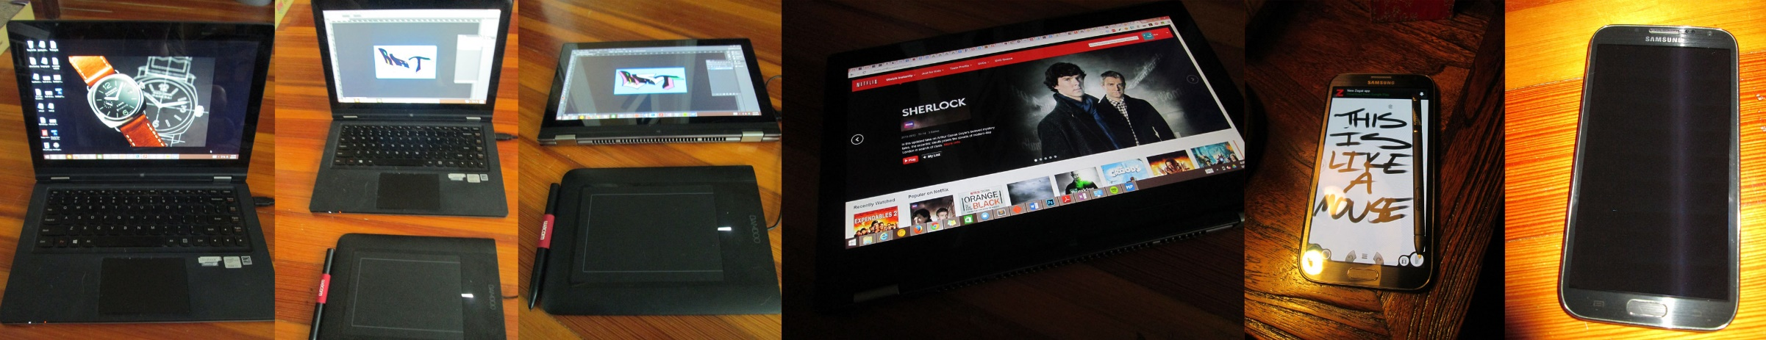
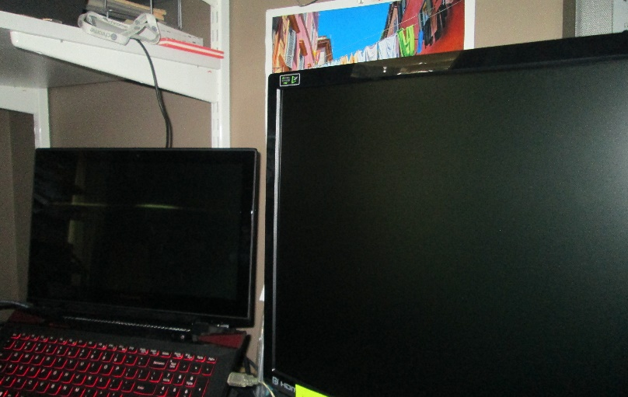
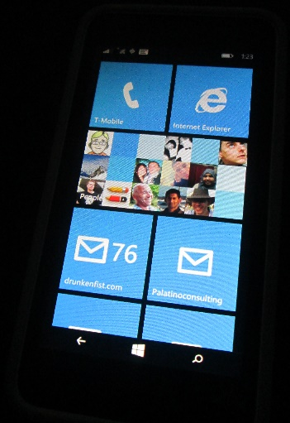
The Web Today

Slide 6
The Web Today
Resolutions from 240 x 320 to 3840 by 1080
Pixel densities from 72ppi up past 300ppi
A broad range of input options (keyboard, stylus, gesture, touch, mouse)
More major and minor browsers versions in the wild than any person can count

Slide 7
I want to wrap the whole web up in a big, inclusive bear hug

