Slide 1
CSS and Bootstrap
Rob Larsen
rlarsen@eatonvance.com

Slide 2
Goals
The goal of this presentation is to cover some fundamentals of CSS and Bootstrap. Many developers know about specific CSS properties and know the basic syntax of CSS. Many developers also know the most basic aspects of Bootstrap without knowing the overall structure of the project. This presentation will break both down to fundamentals. If you’re interested in learning about individual features or properties, there are resources available at the end of the presentation.

Slide 3
What is CSS?
Cascading Style Sheets (CSS) is a simple mechanism for adding style (e.g., fonts, colors, spacing) to Web documents.

Slide 4
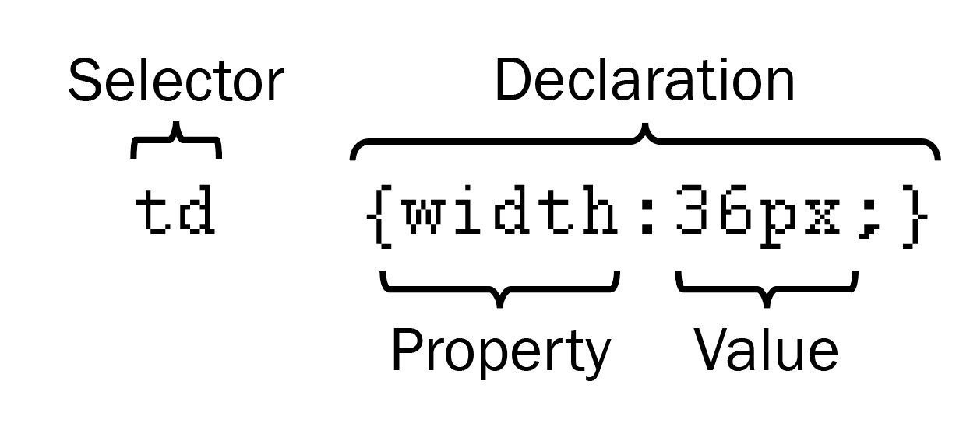
How Does CSS Work?
CSS works by allowing you to associate rules with the elements that appear in a web page. These rules govern how the content of those elements should be rendered. A CSS rule is made up of two parts:
The selector, which indicates which element or elements the declaration applies to (if it applies to more than one element, you can have a comma-separated list of several elements)
The declaration, which sets out how the elements referred to in the selector should be styled

Slide 5
How are the rules applied?
Source order matters. All things being equal, if a later rule appears that overrides and earlier rule then it is applied to the element. This is how themes and custom styles work in systems like Wordpress and Bootstrap work. You apply your style sheet after the system style is applied and your styles are the ones rendered in the browser.

Slide 6
How are the rules applied?
Specificity is the method by which browsers decide which CSS property values will be applied to an element.
Each CSS declaration has a weight, calculated by the number of each selector type in the matching selector.
Selector types, in order of increasing specificity
Type selectors and pseudo-elements (e.g., H1, P, DIV and P::before)
Class selectors, attribute selectors and pseudo-classes (e.g., .class-name, [type= “radio”] and :hover).
ID selectors (e.g., #myId).
Two exceptions to that basic formula (which are to be avoided) are inline styles set on an elements style attribute (which always override) and declarations marked !important.

Slide 7
How the weights are calculated
Thousands: The presence of any inline styles on the element scores 1000
Hundreds: Each ID selector in the overall selector scores 1 in this column
Tens: Each class selector, attribute selector, or pseudo-class scores 1 in this column
Ones: Score one in this column for each element or pseudo-element selector

Slide 8
How the weights are calculated
Examples

Slide 9
The Fundamental Workflow
Tools
75% Command Line + 25% GitHub Desktop
Any tools you use call the exact same commands, using the exact same binary. If you understand the command you want to run and can figure out how to do it in your tool, go nuts. That said, the command line is the only place where you will never run out of functionality.

Slide 10
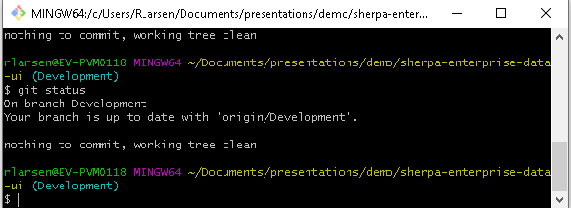
The Fundamental Workflow
git status
“Displays paths that have differences between the index file and the current HEAD commit, paths that have differences between the working tree and the index file, and paths in the working tree that are not tracked by Git (and are not ignored by gitignore[5]). The first are what you would commit by running git commit; the second and third are what you could commit by running git add before running git commit.”

Slide 11
The Fundamental Workflow
git status is your best friend.

Slide 12
The Fundamental Workflow
Git checkout
“Updates files in the working tree to match the version in the index or the specified tree. If no pathspec was given, git checkout will also update HEAD to set the specified branch as the current branch.
git checkout [<branch>]
To prepare for working on <branch>, switch to it by updating the index and the files in the working tree, and by pointing HEAD at the branch. Local modifications to the files in the working tree are kept, so that they can be committed to the <branch>.
git checkout -b|-B <new_branch> [<start point>]
Specifying -b causes a new branch to be created as if git-branch[1] were called and then checked out. In this case you can use the --track or --no-track options, which will be passed to git branch. As a convenience, --track without -b implies branch creation; see the description of --track below.”

Slide 13
The Fundamental Workflow
What is HEAD?
“The HEAD in Git is the pointer to the current branch reference, which is in turn a pointer to the last commit you made or the last commit that was checked out into your working directory. That also means it will be the parent of the next commit you do. It's generally simplest to think of it as HEAD is the snapshot of your last commit.”

Slide 14
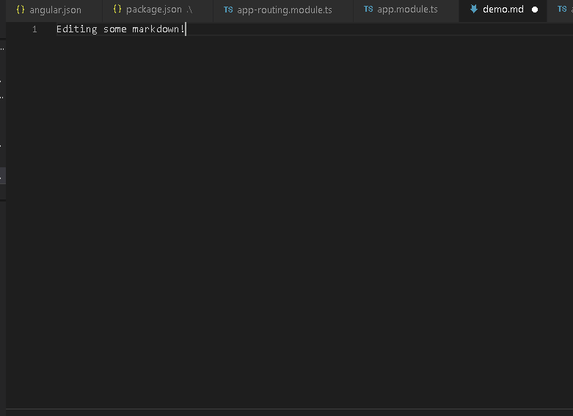
The Fundamental Workflow
code demo.md

Slide 15
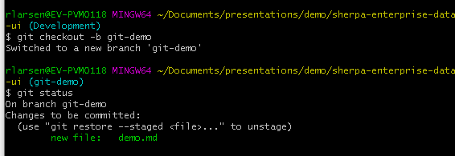
The Fundamental Workflow
Git checkout

Slide 16
The Fundamental Workflow
git add
“This command updates the index using the current content found in the working tree, to prepare the content staged for the next commit. It typically adds the current content of existing paths as a whole, but with some options it can also be used to add content with only part of the changes made to the working tree files applied, or remove paths that do not exist in the working tree anymore.
The "index" holds a snapshot of the content of the working tree, and it is this snapshot that is taken as the contents of the next commit. Thus after making any changes to the working tree, and before running the commit command, you must use the add command to add any new or modified files to the index.”

Slide 17
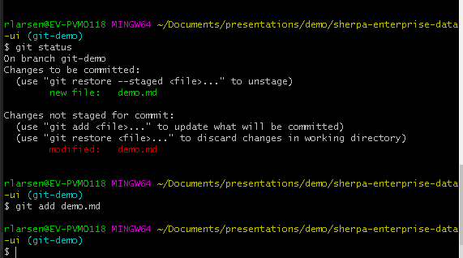
The Fundamental Workflow

Slide 18
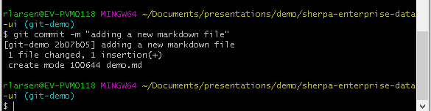
The Fundamental Workflow
git commit
“Create a new commit containing the current contents of the index and the given log message describing the changes. The new commit is a direct child of HEAD, usually the tip of the current branch, and the branch is updated to point to it (unless no branch is associated with the working tree, in which case HEAD is "detached" as described in git-checkout[1]).”

Slide 19
The Fundamental Workflow
git push
“Updates remote refs using local refs, while sending objects necessary to complete the given refs.”

Slide 20
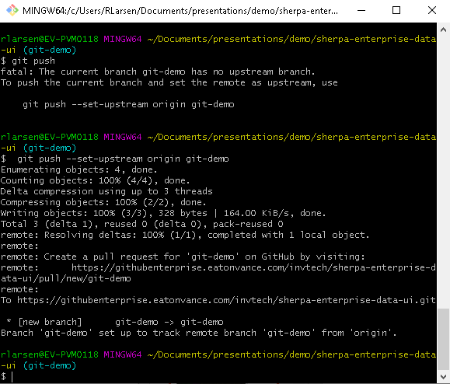
The Fundamental Workflow

Slide 21
Cheap local branching
How cheap is branching?
rlarsen@RLARSEN1 MINGW64 ~/Documents/GitHub/temp/sherpa-enterprise-data-ui (Development)
$ git checkout -b newbranch
Switched to a new branch 'newbranch‘

Slide 22
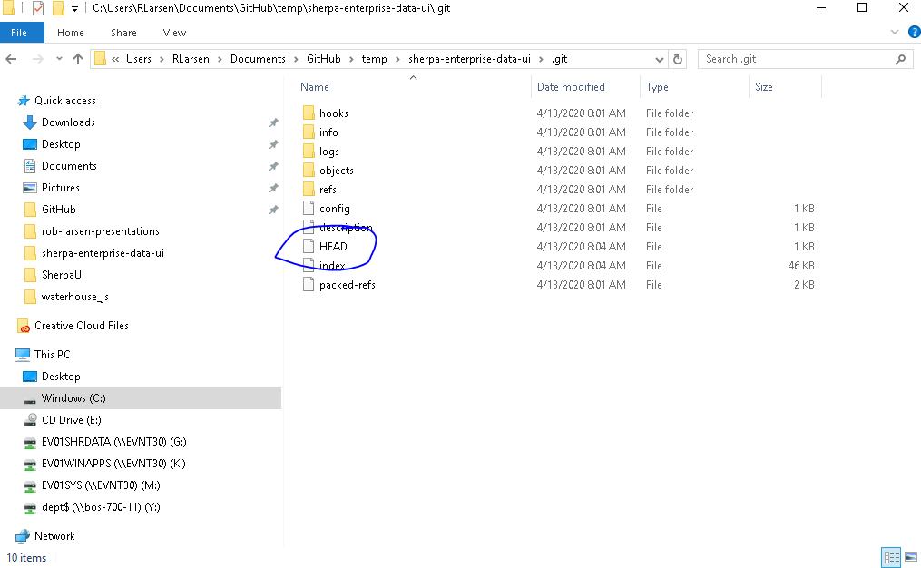
Cheap local branching
How cheap?

Slide 23
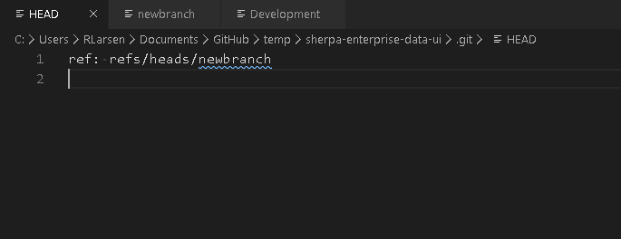
Cheap local branching
How cheap?

Slide 24
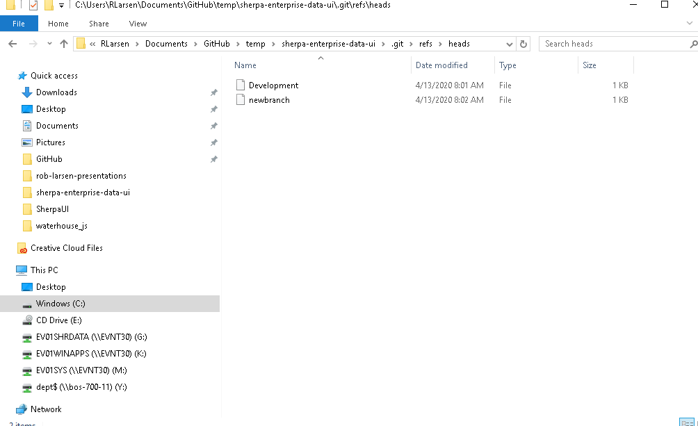
Cheap local branching
How cheap?

Slide 25
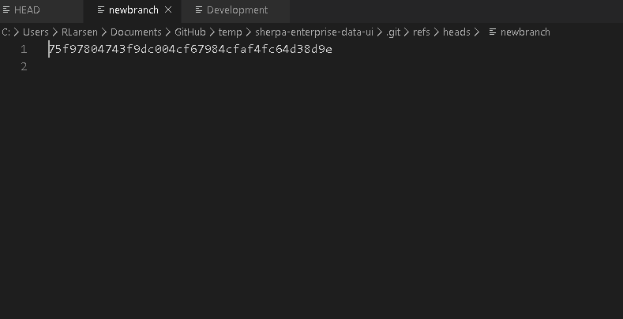
Cheap local branching
How cheap?

Slide 26
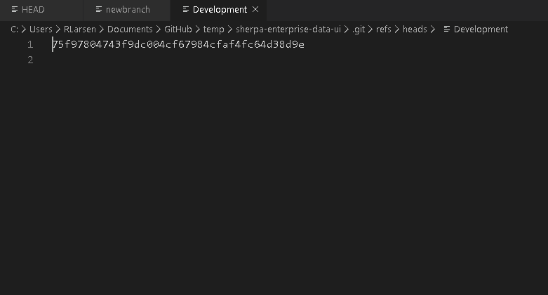
Cheap local branching
How cheap?

Slide 27
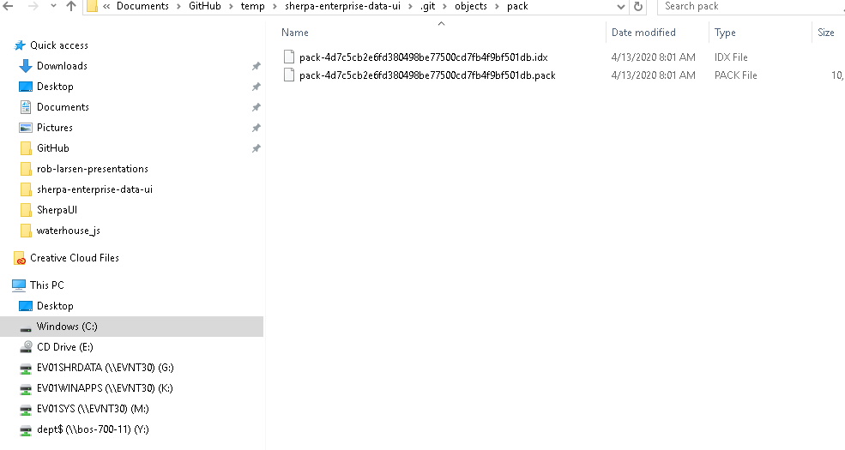
Cheap local branching
How cheap?

Slide 28
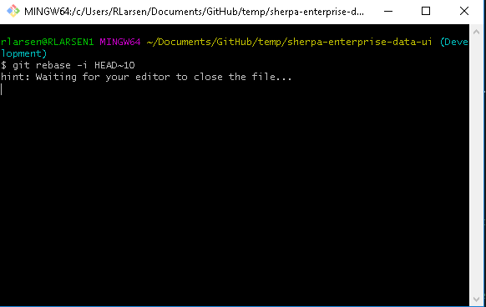
Interactive Rebase, Demystified
(This is advanced! But does this advanced command start to make more sense?)

Slide 29
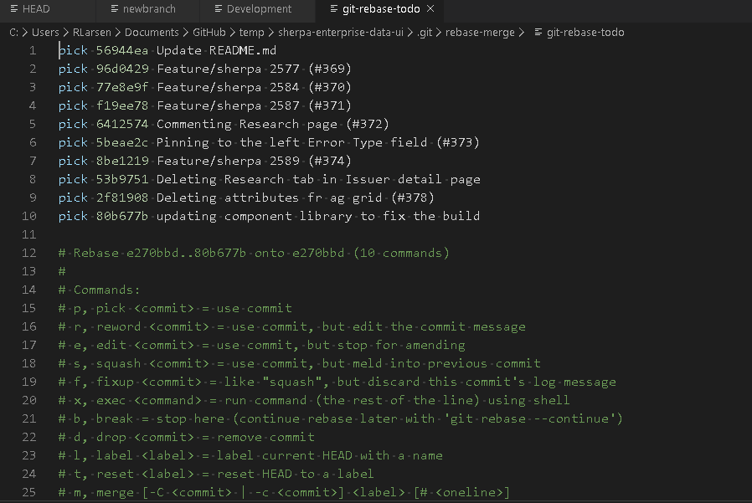
Interactive Rebase, Demystified
Rewriting history is just rewriting collection of commits which make up a branch- which is just pointing the history to different hashes/sets of changes stored in the index (in some cases you might have to redo merges, but still- it’s just refs)

Slide 30
Multiple Workflows
We have a workflow that we use, but it’s not the only one and because of how flexible Git is, we can (and often have to) adjust our workflow to solve problems that arise during the development process. You can lay as much or as little process on top of Git as you want.

Slide 31
About GitHub
GitHub is not Git. Git is not GitHub. Git was created in 2005 by Linux Torvalds to aid in development of the Linux kernel. GitHub, the commercial enterprise, was founded in 2007 and has since built a sprawling ecosystem on top of Git. It is the home to most of the world's largest open source projects. It provides a number of very powerful tools built on top of Git to help with software development.
For our purposes, this means things like Pull Requests, Code Reviews and GitHub Actions (near future)

Slide 32
Our Workflow
Once you've gotten an issue assigned to you or pulled an issue out of the backlog, it's time to work on your task. The Git process for that is in the following slides

Slide 33
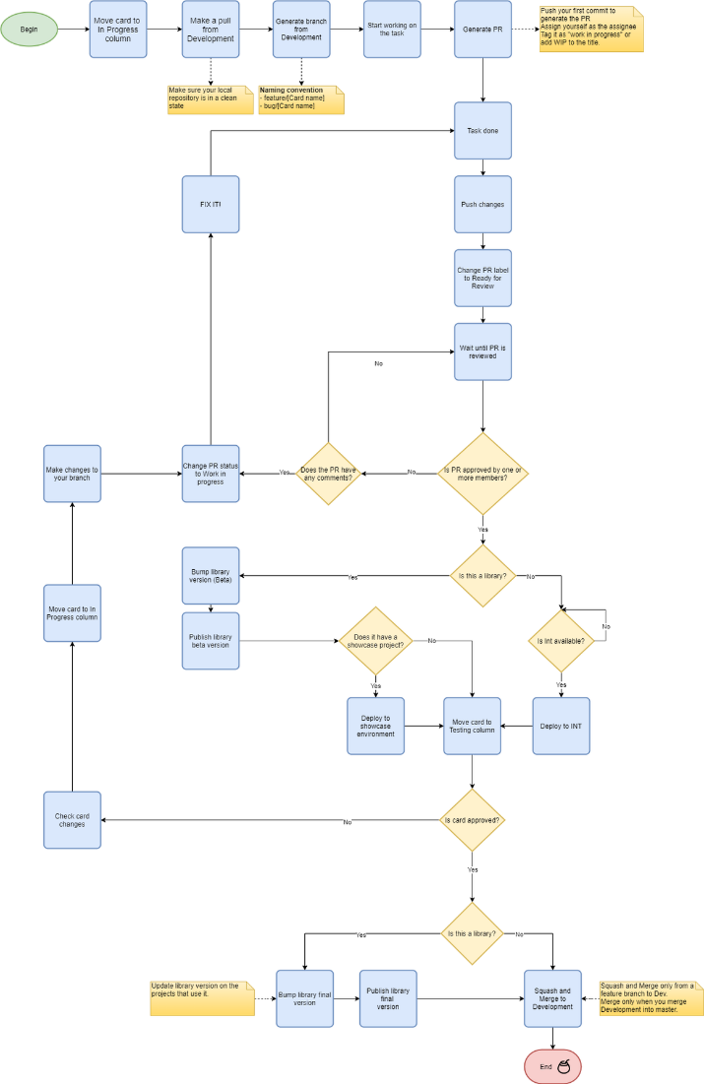
Our Workflow
https://eatonvance.atlassian.net/wiki/spaces/SHER/pages/834699276/Feature+Workflow

Slide 34
Our Workflow
If you’ve never done this before, check to make sure your local repository is in a clean state. This example was run from Development, but you might be in another branch and you want to make sure you’re in a clean state
rlarsen@RLARSEN1 MINGW64 ~/sherpa-enterprise-data-ui (Development)
$ git status
On branch Development
Your branch is up to date with 'origin/Development'.
nothing to commit, working tree clean

Slide 35
Our Workflow
If your working tree is clean, then go onto the next step. If it’s not either Git stash your changes or commit them to your branch.
To get started, run:
git checkout Development
git pull
git checkout -b [branch name from options below]
bug/[JIRA Issue Name]
feature/[JIRA Issue Name]
[other]/[description of work] Used for refactoring, net new features, etc.

Slide 36
Our Workflow
As you work on your task, be sure to pull in the latest changes from Development often and push your code to your branch often. Because we will squash your commits in the pull request process, there's no real penalty for committing early and often.

Slide 37
Our Workflow
Working with Pull Requests
As soon as you have complete some work, commit your code and push your branch to GitHub. If your branch is called bug/SHERPA-1999 you would run the following commands:
git add .
git commit -m "these are my changes"
git push --set-upstream origin bug/SHERPA-1999

Slide 38
Our Workflow
Alternatively, you can set something like Visual Studio Code to be your default editor in git and can therefore more easily write longer commit messages. The custom is to keep the subject of a commit short and add more detail, if needed, in the description. This is easiest to do in a real text editor and VS Code is handy.
To set VS Code as your Git editor, edit your root .gitconfig (C:\Users\UserName\.gitconfig) to point to your VS Code installation
[core]
editor = 'C:\\Users\\UserName\\AppData\\Local\\Programs\\Microsoft VS Code\\Code.exe' --wait

Slide 39
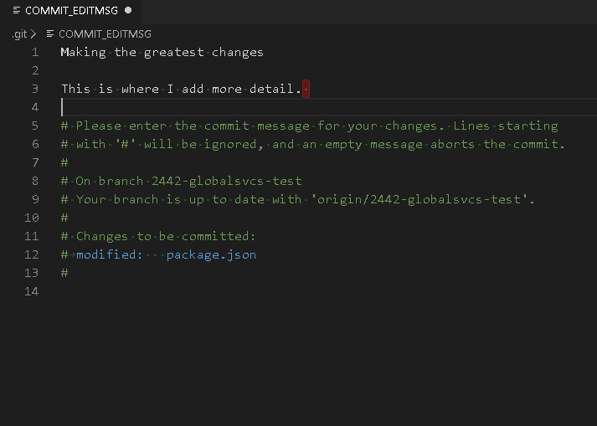
Our Workflow

Slide 40
Our Workflow
Once you have pushed your changes to GitHub, open a pull request.
There are two aspects of working with pull requests, one is as a developer and the other is as a reviewer. You're going to be expected to take part in both roles.

Slide 41
Our Workflow
Developer
Open pull request within GitHub
Enter short summary of work completed.
Assign team-sherpa as reviewers
Assign yourself as the assignee
If the code is "ready to review" then tag it that way and mention that the code is ready to review in Microsoft Teams
If it's not ready, tag is "work in progress" or add WIP to the title.
When you're ready for review, personally review files for the PR. Ensure there are no accidental files added to the PR.
At this point it should also be ready for testing. Build the code to our integration environment and move the ticket to testing so the product team can know to test it.
If the product team is not satisfied with your work and you need to continue to make changes, make sure you’re merging Development into your branch as you continue to work on your issue
Once you have received one or more positive reviews and the code is approved by the product team. Squash and merge your PR and delete the branch.

Slide 42
Our Workflow
Reviewer
Review files changed and check for things like:
Merge conflicts
Confusing/Inefficient/unnecessary code
Undocumented/out of scope additions
Dependency modifications
Strange looking git history
Test the branch
git fetch origin
git checkout -b [branch name] origin/[branch name]
git merge Development
Ensure that it builds without errors
Ensure that the homepage, apps, and lists load and that you can create an app.
Approve or deny the pull request. If you deny it, ask questions. PRs should be the place where you as a reviewer learn about the code being written for the project and this is the best place to ask questions.

Slide 43
Our Workflow
The release happens through a PR into the master branch. Do not squash and merge into the master branch.

