Slide 1
HTML5 From the Front Lines
What to Embrace Today (and What to Avoid)| 2011.11.1

Slide 2
What We’re Going to Talk About
Introduction
General Support Strategies
Working With HTML5 Today

Slide 3
Introduction

Slide 4
Who?
12 Years of HTML CSS JavaScript
Senior Specialist, Platform Sapient Global Markets
  1+ week on the job
  Job #1: Build a world class front end engineering team
Previously at Isobar, the Brand Experience and Cramer.
  I’ve worked with companies like Adidas, Reebok, Motorola, Harvard Kennedy School and Boston’s Museum of Science
Mobile Web App Cookbook (Manning)
  Due out in mid-2012
Open Source: HTML5 Boilerplate , etc.
Twitter: @robreact
Blog @ HTML + CSS + JavaScript http://htmlcssjavascript.com/

Slide 5
Experience With Emerging Web Technologies
(Like everyone) I’ve been experimenting with these technologies as soon as they show up in a browser
Additionally I’ve also been implementing a laundry list of these technologies in large scale production sites for the last couple of years
  Semantic elements
  Geolocation
  Canvas 2d API
  Web Storage
  Audio/Video
  History
  More…
While I am biased about what technologies I prefer to use, I have to ship so my preferences take a back seat to solving problems.

Slide 6

Just So You Know Where I Stand: “HTML5” as a Blanket Marketing Term Doesn’t Bother Me
"HTML5 is anything you want it to be as long as it's new and cool.“ – Peter Paul Koch
  http://www.quirksmode.org/blog/archives/2010/01/html5_means_wha.html

Slide 7
Technology People Will Figure Out the Difference
Non-technical people just need to be excited so that we can implement this new stuff. Whatever works.
See: Saying “Ajax” for pure-browser animations… Back in my day we called that DHTML

Slide 8
A Generic HTML5 Support Strategy

Slide 9
Before You Write a Line of Code
Don’t Back Yourself Into a Corner!
  No Flash support in iOS doesn’t you mean can’t use Flash at all. It just means you can’t use Flash for iOS.

Slide 10
Set Reasonable Support Targets and Communicate Them Early and Often
This is as important for legacy browsers as it is for the latest/greatest desktop or mobile browsers
Saying “this could be a problem” or “we can’t support this 100% in browser x, we should come up with a different strategy if that browser matters” makes you look like you know what you’re doing. Saying, “Sorry boss, this won’t work in your mother’s favorite web browser” doesn’t.

Slide 11
On the Desktop
“old IE” will never work as well as the latest Chrome or Firefox. Slower JS engine + polyfills (often in other technologies like VML)
Some things just aren’t going to be worth the effort for wide support (many CSS3 modules fall into this category) Again. Set expectations early

Slide 12
On Mobile Devices
Be very specific about the devices you’re going to support
    (just in case you missed it the first time)
Be very specific about the devices you’re going to support
Have the budget in place and plan to buy the devices (you’d be surprised…)
“Webkit” on mobile probably doesn’t mean what you think it means so don’t make any assumptions about what will and will not work because you tested it in Safari. (See the first two points again.)

Slide 13
REMEMBER
Your site or app doesn’t have to be exactly the same in every browser. The more people you convince of this the happier you will be- the happier we’ll all be…

Slide 14
(Really) Use Modernizr
They say “Modernizr is the right micro-library to get you up and running with HTML5 & CSS3 today. “
  Allows for scripting and styling of new HTML5 elements in older versions of IE
  Tests for over 40 emerging web features
  Creates Modernizr JS Object that contains the results of these tests as boolean properties (e.g. if (Modernizr.geolocation) { … })
  Adds classes to the html element that expose what features are and are not supported
  Adds a script loader
  Doesn’t actually add any functionality. No matter what the name implies.

Slide 15
(Really) Use Modernizr
Some people include Modernizr and all they actually use it for is supporting HTML5 semantic element in legacy versions of Internet Explorer
  If that’s all you need, use this (HTML5Shiv/m):
  /*@cc_on'abbr article aside audio canvas details figcaption figure footer header hgroup mark meter nav output progress section summary subline time video'.replace(/\w+/g,function(n){document.createElement(n)})@*/
  Leave the rest of the code at home.
The CSS classes and the Modernizr object (and optional loader) are much more important when using emerging technologies

Slide 16
The Final Piece: Cross Browser Polyfills
This is where the modernizing happens
The people who write these are heroes
Here’s the big list:
  https://github.com/Modernizr/Modernizr/wiki/HTML5-Cross-browser-Polyfills

Slide 17
From the Front Lines
Part One: Select Core Technologies In Depth

Slide 18
About This Section
Introduce the feature
Support (thanks to caniuse.com)
Verdict & Polyfills (warning: potential shades of gray)
For a full rundown on the components of the emerging technology landscape, see my article HTML5, CSS3, and related technologies
(http://www.ibm.com/developerworks/web/library/wa-webstandards/index.html)

Slide 19
New Semantic Elements
Examples: Header, Footer, Section, and Aside
  Based on common usage patterns found during a web census conducted by editor Ian Hickson.
    <div id=“header”></div><div id=“footer”></div>, etc.
Others like hgroup, mark, time, and figure were logical additions

Slide 20
New Semantic Elements : Support
Supported in all browsers except IE6,7,8 owing to the way unknown HTML elements are handled

Slide 21
New Semantic Elements : Verdict and Polyfills
It’s worth it now. Every site I’ve built over the past two+ years has used the new semantic/structural elements. While there’s no native support in older versions of IE, the solutions for support are solid and relatively painless. The one piece that’s come up as a problem is the creation of dynamic html5 elements in IE, but even that is solved- especially now with jQuery 1.7+ baking a solution into the library
Modernizr
HTML5 Shim(v)
InnerShiv for dynamic content in IE http://jdbartlett.com/innershiv/
jQuery 1.7 wraps an optimized dynamic solution into the core
Also, test against the new outlining algorithm:
  http://gsnedders.html5.org/outliner/

Slide 22
An Outline Generated From HTML5 Markup
Document uses sectioning elements and multiple H1s
Front-end Code Standards & Best Practices
  Overview
  General Guidelines
    Pillars of Front-end Development
    General Practices
      Indentation
      Readability vs Compression
  Markup
    HTML5
      Template
    Doctype
      Character Encoding
    General Markup Guidelines
      Quoting Attributes
  CSS
    General Coding Principles
    CSS Box Model
    CSS Validation
    CSS Formatting
      Alphabetize
    Classes vs. IDs
    Naming Conventions for Selectors
    [snipped outline from http://na.isobar.com/standards/ )

Slide 23
Canvas 2D API
The Canvas 2D context provides a scriptable interface for drawing two-dimensional images and bitmaps in the browser.
One of the earliest stars of the HTML5 era
There are some excellent resources available already. One I’ve been knee deep in recently:
JavaScript InfoVis Toolkit http://thejit.org/

Slide 24
Canvas 2D API : Support
Supported in all major browsers except IE 6, 7, 8

Slide 25
Canvas 2D API: Verdict and Polyfills
With the understanding that there will be issues with more dynamic Canvas animations (in IE, in legacy versions of supporting browsers, on mobile and similarly underpowered machines), you can use Canvas right now.
Flash Canvas http://flashcanvas.net/
  This is one of the best reasons to keep the door open for Flash. It’s faster than excanvas and supports 70% of the Canvas spec, which is competitive with the support levels in modern browsers
Excanvas http://code.google.com/p/explorercanvas/
  The original

Slide 26
Geolocation
The Geolocation API is a standard interface for retrieving the geographical location of a device. It provides a window.geolocation object that in turn provides methods that figure out a device's location through the use of location information servers. Location information is pulled from a variety of sources, including IP address, device GPS, Wi-Fi and Bluetooth MAC address, radio-frequency ID (RFID), and Wi-Fi connection location.

Slide 27
Geolocation: Support
Supported in all major browsers except IE6 , 7, 8 and Safari 3.2 and 4.0

Slide 28
Geolocation: Verdict and Polyfills
Between the ability to design to it (e.g. fall back to a simple text field labeled “location”) and the available polyfill techniques geolocation can be used today.
Polyfills aren’t as good as, say, device GPS, but they can do the job.
From WebShims
  https://github.com/aFarkas/webshim/blob/master/src/shims/geolocation.js
Also: yqlgeo.js
  https://github.com/codepo8/YQL-Geo-Library/blob/master/yqlgeo.js

Slide 29
Audio/Video
Playing audio and video in the browser is such a common event that it's easy to forget that, for most of the history of the web, there was no native method for doing so.
Enter the new HTML5 audio and video elements.
From a specification perspective, the inclusion of browser-native APIs for playing audio and video is straightforward. Anyone familiar with the way the replaced elements like IMG work will understand how to embed video and audio.
There’s a tag, a source and some attributes.
With methods like play() and pause() the basics of the API are pretty easy to pick up

Slide 30
Audio/Video:
<-- the HTML -->
<video src="_assets/video/sample.webm" controls autoplay width="400" height="300" id="video-sample" data-description="sample web video"> your browser does not support the video tag
</video>
< button id=“toggle”></button>
//the JavaScript
var video = document.getElementById("video-sample"),
toggle = document.getElementById("video-toggle");
toggle.onclick = function() {
if (video.paused) {
video.play();
toggle.className="playing"
} else {
video.pause();
toggle.className="paused"
}
};

Slide 31
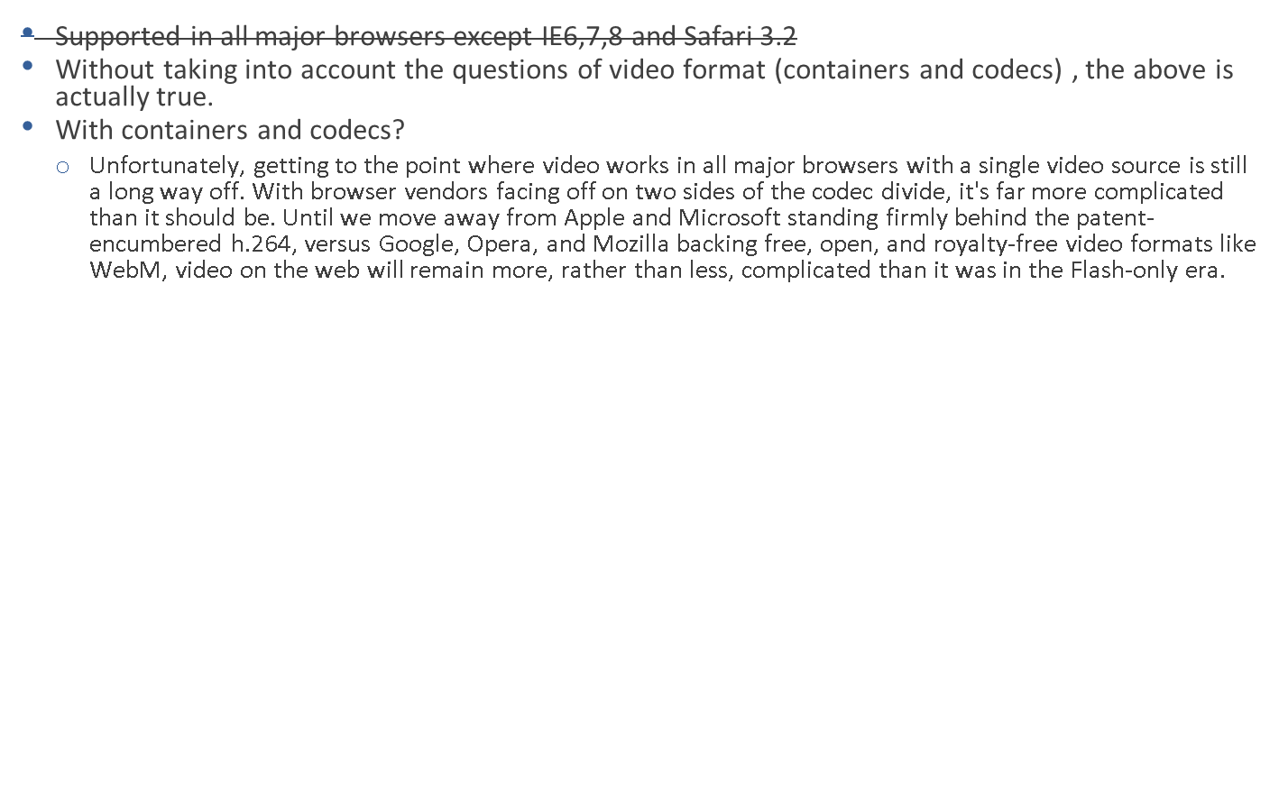
Audio/Video: Support

Slide 32
Is Audio Any Better?
No. In the audio space OGG Vorbis plays the role of WebM and MP3 plays the role of MPEG4/h.264 with the same factions

Slide 33
Audio/Video : Verdict and Polyfills
The good news is, the people that serve video for a living have put together solutions that will work on any device seamlessly. Use them.
There are also nice solutions if you want to go it alone
Video for Everybody
  A no-javascript solution that uses a series of clever fallbacks to present the best video solution in different browsers and devices. Doesn’t work in Android < 2.3
MediaElement.js http://mediaelementjs.com/
  <video>, flash, silverlight
Video.js http://videojs.com/
  Built on Video for Everybody, adds more device support with JavaScript
Audio follows a similar support strategy (Flash fallback)
SoundManager2 http://www.schillmania.com/projects/soundmanager2/
jPlayer http://github.com/happyworm/jPlayer

Slide 34
Web Storage
The Web Storage specification defines an API for persistent data storage of key-value pairs in web browsers. This specification is similar to, but greatly improves upon, the functionality currently offered by cookies.
Cookes
  Cookies are limited to 4k
  We try to avoid them for performance. Web storage removes the cookie overhead on every request
  Cookies are annoying to code. I’ve been doing this for a long time and I tolerate them with gritted teeth.
Storage takes two forms: sessionStorage and localStorage. Each provides similar methods for managing items (setItem(), removeItem(), and getItem()) and for clearing the entire storage (clear()). Session storage is designed to hold information for just the current browsing session. Local storage is meant for longer-term storage of site preferences or other user data. There's also a storage event that can be listened to, for purposes of monitoring and reacting to storage activity.

Slide 35
Web Storage: Support
Supported in all major browsers except IE6,7

Slide 36
Web Storage : Verdict and Polyfills
The support landscape is good and there are multiple polyfill options
storage polyfill https://gist.github.com/350433
Amplify.js http://amplifyjs.com/api/store/
PersistJS http://pablotron.org/?cid=1557
Also:
Lawnchair http://westcoastlogic.com/lawnchair/
“A Lawnchair is sorta like a couch except smaller and outside. Perfect for HTML5 mobile apps that need a lightweight, adaptive, simple and elegant persistence solution. “
Keep in mind- data is store unencrypted on disk
http://www.nczonline.net/blog/2010/04/13/towards-more-secure-client-side-data-storage/

Slide 37
From the Front lines
Part Two: The Lightning Round

Slide 38
Lighting Round: Form elements and input types
HTML5 provides several new form elements to better reflect common input tasks. Formats like Email and URL can now be indicated to the browser in a meaningful way.
  These are safe to use now even if support is limited since browsers just default to type=“text”
  http://www.miketaylr.com/code/input-type-attr.html
Completely new form inputs include range (for a slider), date (for a date picker), and color (for a color picker).
  Support here is miserable
  http://www.miketaylr.com/code/html5-forms-ui-support.html

Slide 39
Lightning Round: WebGL
The Web-based Graphics Library (WebGL) enhances JavaScript with the ability to create interactive, three-dimensional graphics in the browser. WebGL is a context of the canvas HTML element. The specification went to Version 1.0 on 3 March 2011 and is managed by the nonprofit Khronos Group.
WebGL is very exciting, BUT…
There’s no hint of support in Internet Explorer
  For older versions the polyfill path translates the 3d context of WebGL to Canvas 2D API and then would use Flash Canvas or Excanvas to render
  There’s also a commercial plugin for Internet Explorer http://iewebgl.com/Default.aspx
Even supporting browsers require up-to-date drivers and decent hardware
  No mobile support
  http://blog.mozilla.com/bjacob/2011/03/28/do-users-actually-get-hardware-acceleration/

Slide 40
Lightning Round: History API
One of the consistent usability issues of the Ajax era is the way Ajax-heavy applications break the standard history stack. The History API adds the ability to add entries to the browser history and respond properly when the user clicks the back button.
  No current IE support (it’s coming in 10,) buggy in Safari
  Polyfill with History.js
  history.pushState , history.replaceState, and the popstate event

Slide 41
Lightning Round: SVG
Probably the strangest technology to be roped into the HTML5 catch-all is Scalable Vector Graphics (SVG.) SVG is a vector graphics grammar defined in XML. The SVG specification has been under development by the W3C since 1999, so including it as either "new" or part of HTML5 is a stretch. But yet… people do.
Still, newfound excitement for SVG is justified as there's now some real traction for the standard. There's some level of support now available in the latest versions of all the major browsers and an API for older Internet Explorer versions presented by Raphael.js.
  Aside: SVG Objects are DOM Objects. That makes them easier to script.
http://raphaeljs.com/
Also...I’m a fan of HighCharts
http://www.highcharts.com/

Slide 42
Thank You!

