Slide 2
Keeping The Web Alive
Big 🙏 to
Web Standards Project (WaSP)
A List Apart
Peter Paul Koch
Eric Meyer

Slide 3
The WHATWG
The WHATWG was born at the W3C Workshop on Web Applications and Compound Documents in June, 2004. This W3C meeting was organized around the new (at the time) W3C activity in the web application space and included representatives from all the major browser vendors as well as other interested parties. There, in the first, ten-minute presentation of session 3 on the first day of the two day event, representatives from Mozilla and Opera presented a joint paper describing their vision for the future of web application standards. This position paper was authored in response to the slow general pace of innovation at the W3C and the W3C’s focus on XML based technologies like xHTML over HTML. It presented a set of seven guiding design principles for web application technologies. Because these principles have been followed so closely and have driven so much of what’s gone into the specifications over the last several years, they’re repeated in full below. Some were driven by the mistakes of xHTML ("Users should not be exposed to authoring errors") others were driven by good sense ("practical use" and the desire for an "open process.") All have been visible in the process in the intervening years.

Slide 4
New Standards Were Born
Web Forms 2.0: An incremental improvement of HTML4.01′s forms.
Web Apps 1.0: Features for Application Development in HTML.
Web Controls 1.0: A specification describing mechanisms for creating new interactive widgets.
Web Controls has since gone dormant, but the other two, Web Forms and Web Apps eventually formed the foundation of the HTML5 specification.

Slide 5
AJAX
On 18 February 2005, Jesse James Garrett, co-founder and president of design consultancy Adaptive Path, wrote an article entitled “Ajax: A New Approach to Web Applications.” In it, he described a new, at the time, trend in apps like Gmail and Google Maps that focused on smooth application like experiences. He coined the term Ajax to describe it and called the pattern “a fundamental shift in what’s possible on the Web.”

Slide 6
Current standards development landscape
HTML and related APIs Main development of what's referred to as the "living standard" happens with the WHATWG (https://whatwg.org/) This work is an ongoing extension of the work done for HTML5. See: https://github.com/whatwg
CSS CSS development has been broken down into smaller modules. CSS 2.0 was a monolithic specification that covered everything to do with CSS. For CSS3 the decision was made to break down the specification into specific features. This means there are some modules further along in the development process than others. The W3C's big list of modules is available here http://www.w3.org/TR/2001/WD-css3-roadmap-20010523/#module.
ECMAScript ECMAScript mailing list https://esdiscuss.org/1 is where all the action happens.

Slide 7
ES6 Features
Constants
Constants
Scoping
Block-Scoped Variables
Block-Scoped Functions
Arrow Functions
Expression Bodies
Statement Bodies
Lexical this
Extended Parameter Handling
Default Parameter Values
Rest Parameter
Spread Operator
Template Literals
String Interpolation
Custom Interpolation
Raw String Access

Slide 8
ES6 Features
Extended Literals
Binary & Octal Literal
Unicode String & RegExp Literal
Enhanced Regular Expression
Regular Expression Sticky Matching
Enhanced Object Properties
Property Shorthand
Computed Property Names
Method Properties

Slide 9
ES6 Features
Destructuring Assignment
Array Matching
Object Matching, Shorthand Notation
Object Matching, Deep Matching
Object And Array Matching, Default Values
Parameter Context Matching
Fail-Soft Destructuring
Modules
Value Export/Import
Default & Wildcard

Slide 10
ES6 Features
Classes
Class Definition
Class Inheritance
Class Inheritance, From Expressions
Base Class Access
Static Members
Getter/Setter
Symbol Type
Symbol Type
Global Symbols
Iterators
Iterator & For-Of Operator

Slide 11
ES6 Features
Generators
Generator Function, Iterator Protocol
Generator Function, Direct Use
Generator Matching
Generator Control-Flow
Generator Methods
Map/Set & WeakMap/WeakSet
Set Data-Structure
Map Data-Structure
Weak-Link Data-Structures
Typed Arrays
Typed Arrays

Slide 12
ES6 Features
New Built-In Methods
Object Property Assignment
Array Element Finding
String Repeating
String Searching
Number Type Checking
Number Safety Checking
Number Comparison
Number Truncation
Number Sign Determination

Slide 13
ES6 Features
Promises
Promise Usage
Promise Combination
Meta-Programming
Proxying
Reflection

Slide 14
ES6 Features
Internationalization & Localization
Collation
Number Formatting
Currency Formatting
Date/Time Formatting
Internationalization & Localization
Date/Time Formatting
Format date/time with localized ordering and separators.
Thanks: http://es6-features.org/

Slide 15
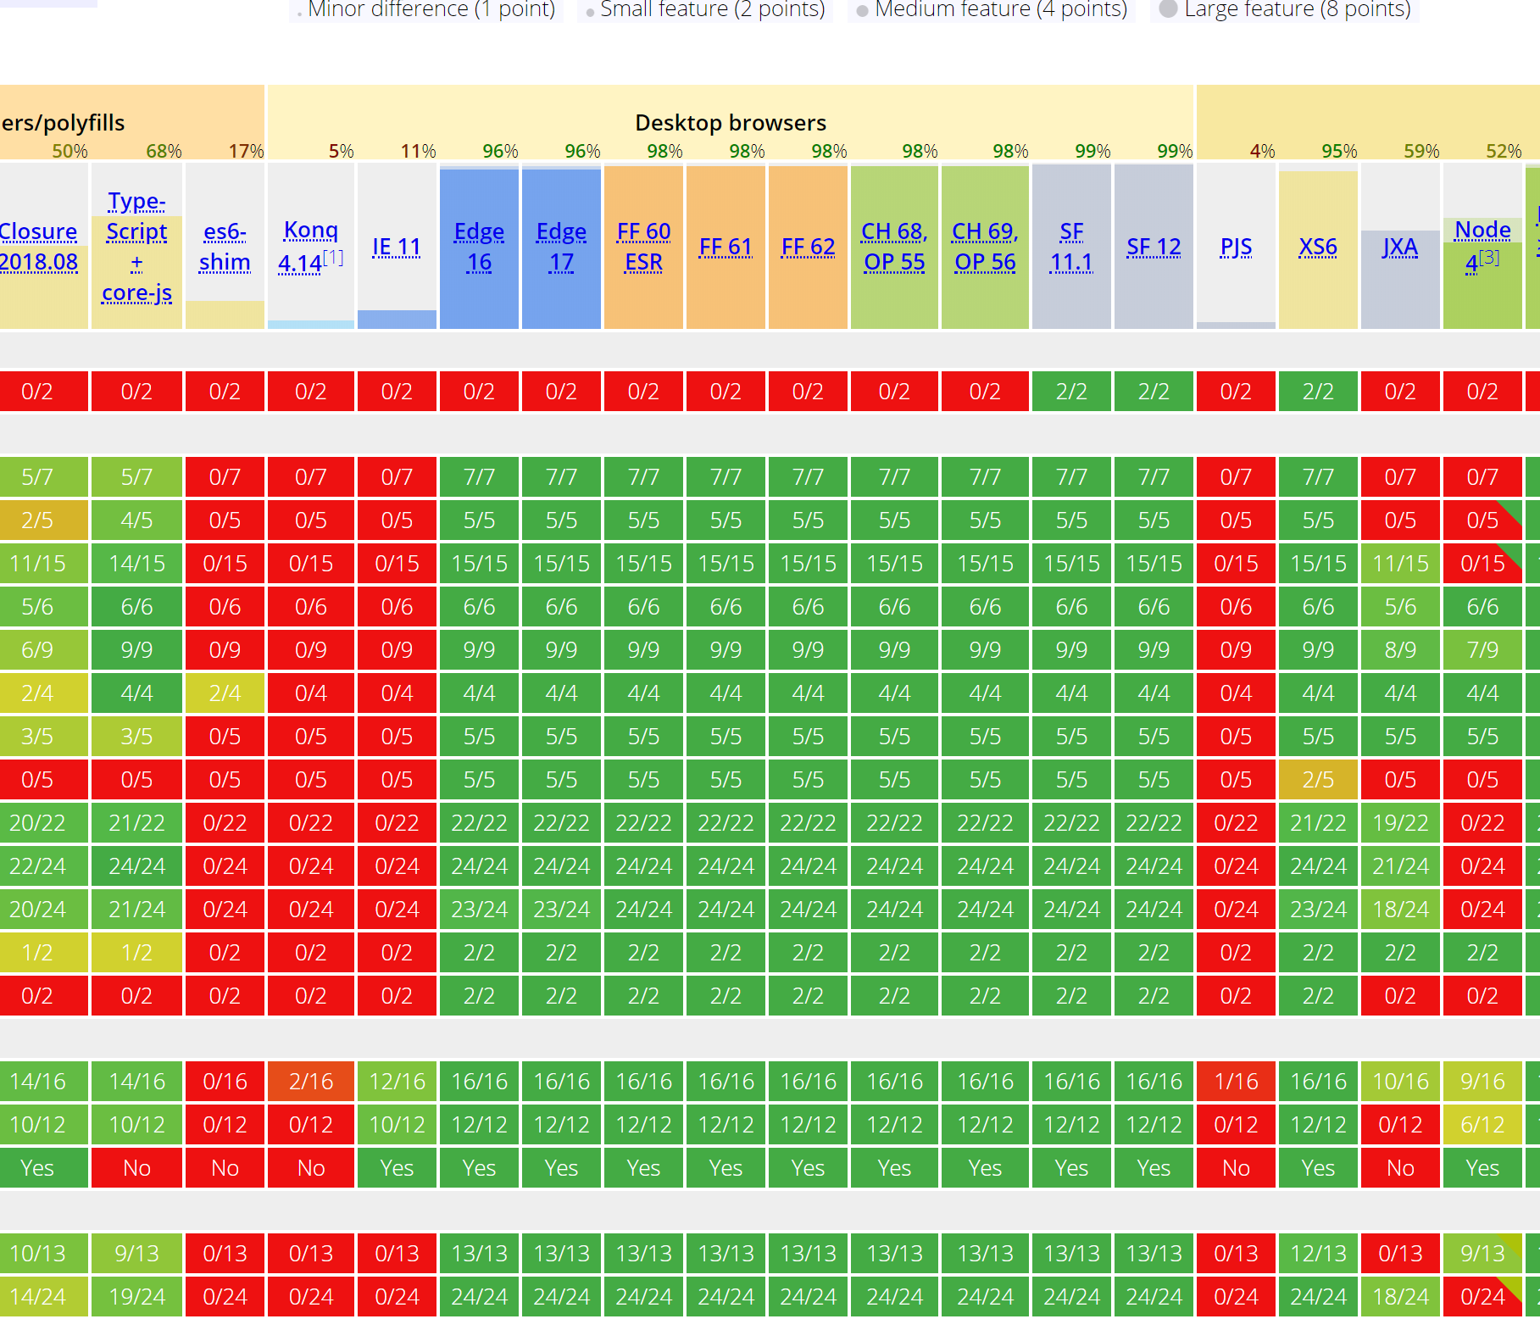
ES6 https://kangax.github.io/compat-table/es6/

Slide 16

ES6 https://kangax.github.io/compat-table/es6/

Slide 17

ES6 https://kangax.github.io/compat-table/es6/

Slide 18
Enter Transpilers
Babel (https://babeljs.io/)
Also TypeScript (https://www.typescriptlang.org/)

