Slide 2
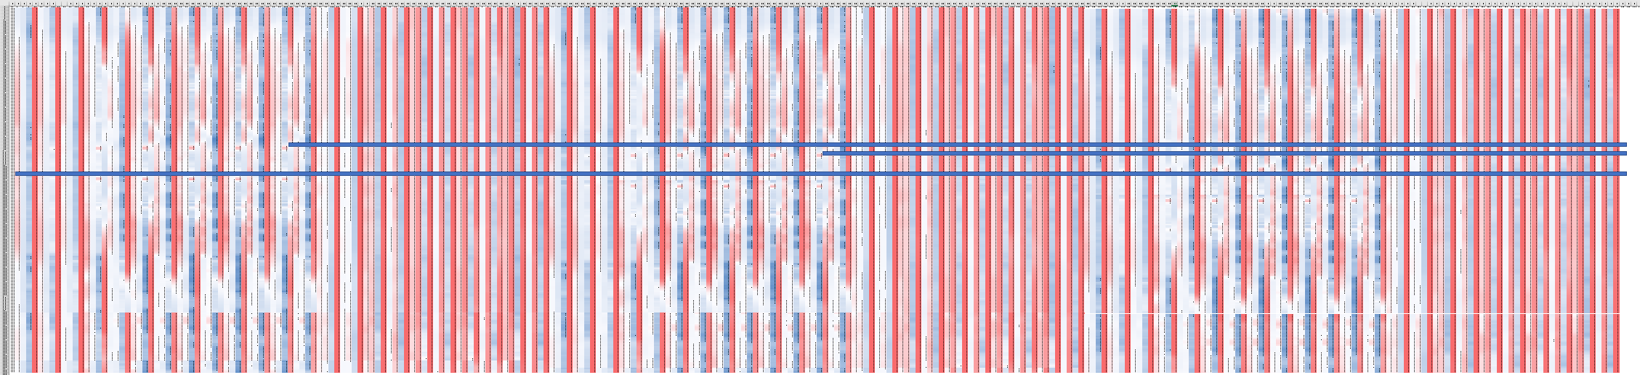
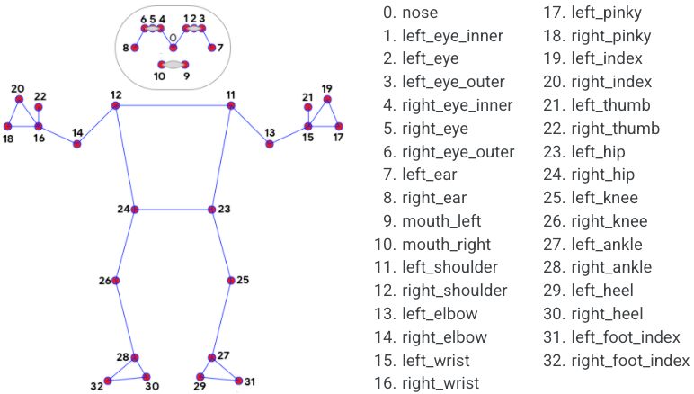
Accounting for Dynamics
Vid1
Vid2
Current Frame
Current Frame - 5
Current Frame - 15

