Slide 1
The Forge Interview
Christian Robles
October 2023

Slide 2
Contents
Feedback
Project
Q&A

Slide 3
Feedback

Slide 4
Feedback
Framework Design
Thin, 1 abstraction away from underlying type
DX-like, easy to learn with Vulkan background
Function linking system easy to use/extend, minorly inconvenient to find implementations

Slide 5
Feedback
“Render Targets”/addRenderTarget
Very convenient for common use cases
Internally complex
Overrides format choice (R8_UINT -> R8_TYPELESS)
Expected this to be handled by ResourceLoader
Transition barriers, descriptor sets, pipelines, root signatures, buffers, shaders…
Easy to use with ample examples
Might have had similar experience if I’d had to modify

Slide 6
Feedback
FSL
FSL generally easy to use but coarse documentation makes small syntax issues slow to remedy. Similar to HLSL but not exact
Broad set of examples covers most needs
Wave Ops feature set unclear – WaveActiveMax but not WaveActiveMin, WaveGetLaneIndex but not WaveGetLaneCount

Slide 7
Feedback
Nice to have: Clang format
Subjective: Cmake, Handle system

Slide 8
Project

Slide 9
Project Overview
Scoping/topic selection
NAS Theory
NAS Implementation
Optionals
Issues

Slide 10
What to make?
Coverage over common systems (shaders, pipelines, UI, etc)
Aim for 1 week ramp up + 2 weeks work + 1 week flex/wrap up
Focus on what I know, implement something new

Slide 11
What I was working on
During MSc: light transport algorithms -> purpose-built research-oriented CPU path tracers
Wanted to build a GPU rendering platform to use as testbed
Multi year project
Performant architecture before focusing on effects

Slide 12
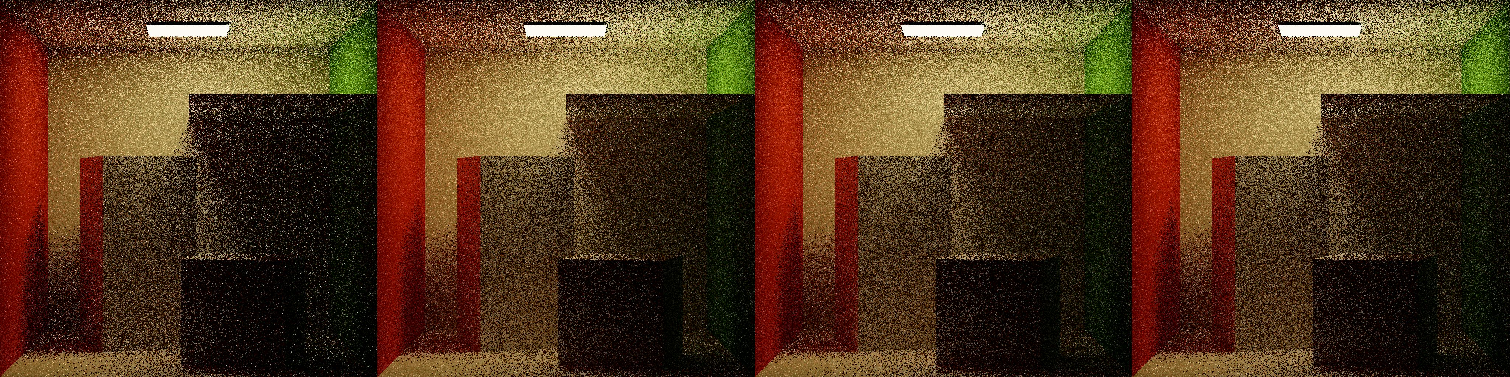
Interest in VRS
Topical similarities to Directed Research project
Works with visibility buffer
Established industry support implies broad hardware support
(Wolfenstein II, Gears 5, CoD MW(2020))

Slide 13
Research
Tier 2 Variable Rate Shading in Gears 5, Ms Game Dev 2021 https://www.youtube.com/watch?v=-exWLpgnOJ4
Software-based Variable Rate Shading in Call of Duty: Modern Warfare (2020) https://research.activision.com/publications/2020-09/software-based-variable-rate-shading-in-call-of-duty--modern-war
Visually Lossless Content and Motion Adaptive Shading in Games, Ley Y. et al, NVIDIA 2019 http://leiy.cc/publications/nas/nas-pacmcgit.pdf
Software VRS with Visibility Buffer Rendering, John Hable 2021 http://filmicworlds.com/blog/software-vrs-with-visibility-buffer-rendering/

Slide 14
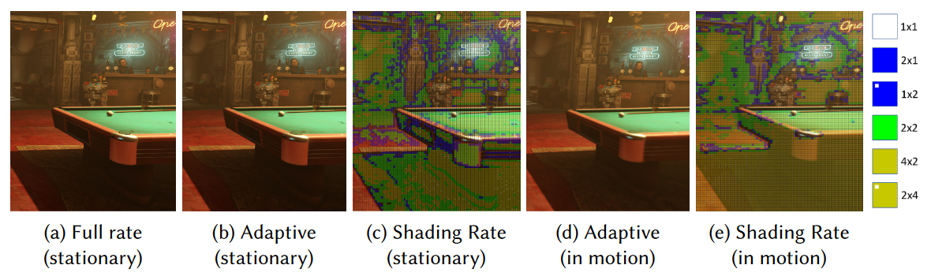
Nvidia Adaptive Shading (NAS) Quick View
Tier-2 Hardware VRS
Goal: improve performance with no loss in perceived quality

Slide 15
Why Hardware VRS
Pros:
Minimal changes to render pipeline
Opportunity to extend SDK
No existing hardware VRS example
Cons:
Have to update platform dependencies (Win SDK version, command list version)

Slide 16
Why NAS
Spending “error budget” clever approach
Multifaceted – image-based and motion-adaptive shading
Efficient – optimized thread group assignment and closed-form error equations
Publication & reference repo

Slide 17
NAS Introduction
Goal: maximize shading rate reduction while keeping error below perceptible threshold
Analyze previous frame with loss estimator
Predict error in current frame under reduced shading rates and motion velocity
Pick lowest shading rate under perception threshold

Slide 18
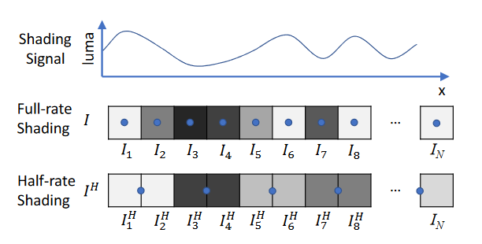
Loss Estimator
Block error can be evaluated using L1 (average absolute), L2 (RMSE) , or L∞ (max) norms
Paper uses L2 to simplify derivation, implementation uses L∞ for fastest computation

Slide 19
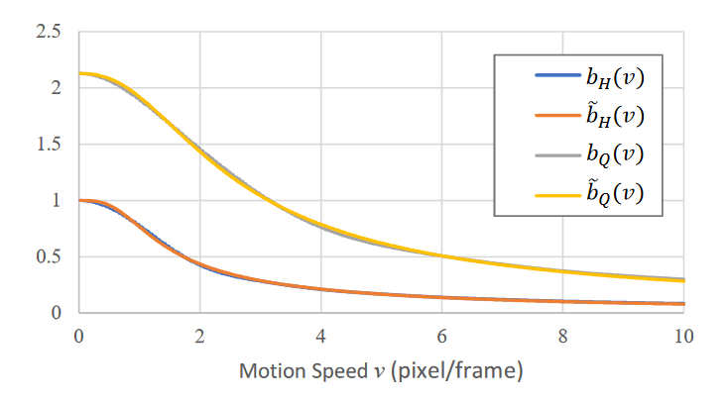
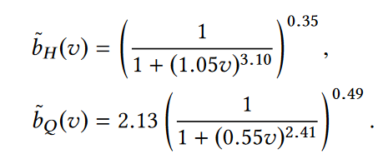
Motion Adaptation
Motion reduces perceived error
Velocity vector (previous frame reprojection)
Closed-form motion error scaling parameters derived from frequency analysis

Slide 20
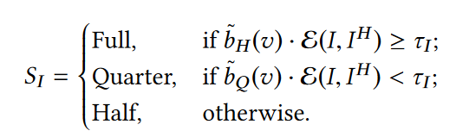
Shading Rate Selection
Tuning parameters
Brightness Sensitivity – raises average luma (more reduction in dim regions)
Error sensitivity – error threshold τ
Motion sensitivity – increases motion scaling

Slide 21
Implementation - Framework
D3D12
Added cmdSetShadingRateImage
Added gpu setting query for VRS tile size
Updated addRenderTarget to allow shading rate images by texture creation flag

Slide 22
Implementation
Uber pixel shader -> single threaded compute shaders -> thread groups & wave ops
NAS Data Surface
Shading Rate Image
Shading Rate Overlay
Present Debug View

Slide 23
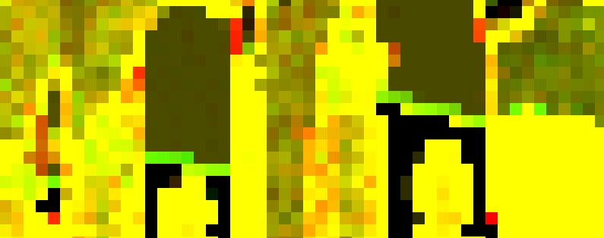
Implementation
NAS Data Surface Compute Shader
Performed at end of current frame
Inputs: current frame, brightness sensitivity
1 dispatch per VRS tile
8*4 threads * 8 samples per thread = 256 samples = 16 * 16 block
Computes estimated Qtr/Half rate block error from last frame result
Outputs: float2 X,Y error estimate UAV

Slide 24

Implementation
Shading Rate Compute Shader
Performed just before shading pass
Inputs: NAS Data Surface, Depth Image, reprojection params, sensitivities
1 dispatch per VRS tile
8*4 threads * 8 samples per thread = 256 samples = 16 * 16 block
Computes motion adaptation and checks adapted error against threshold
Outputs: uint shading rate value UAV

Slide 25

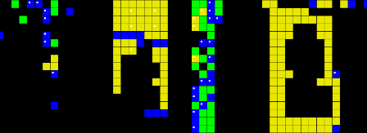
Implementation
Shading Rate Overlay Fragment Shader
Performed immediately after shading rate image
Inputs: Shading rate image
Visualizes shading rate

Slide 26
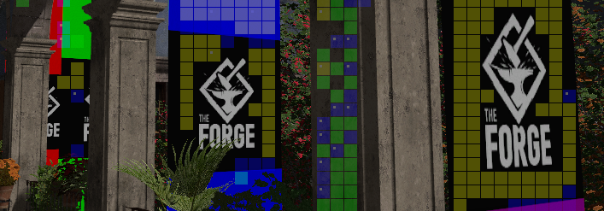
Implementation
Present Shader
Extended to view VRS debug images
Inputs: NAS data, Shading Rate Image, Shading Rate Overlay, debug view mode

Slide 27
Optionals
Shading rate smoothing
Error stabilization (flicker reduction)
Material based shading rate adaptation (aliasing from bright specular highlights)

Slide 28
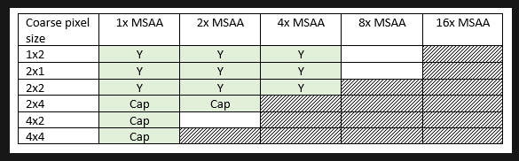
Issues
No recommended values for parameters or recommendations on how to select values
NAS data surface produces wrong error at partially covered tiles – many samples eval. 0 -> very small average -> boosts error estimate
MSAA support matrix not honored in VRS rate selection

Slide 29
Results/Demo

Slide 30
Q&A

Slide 31
Thank you!

