Slide 1
Options Pricing through Computational Methods
Robert Petty
Utah State University
Financial Economics

Slide 2
Why?
Black-Scholes assumptions
Most real world options are American

Slide 3
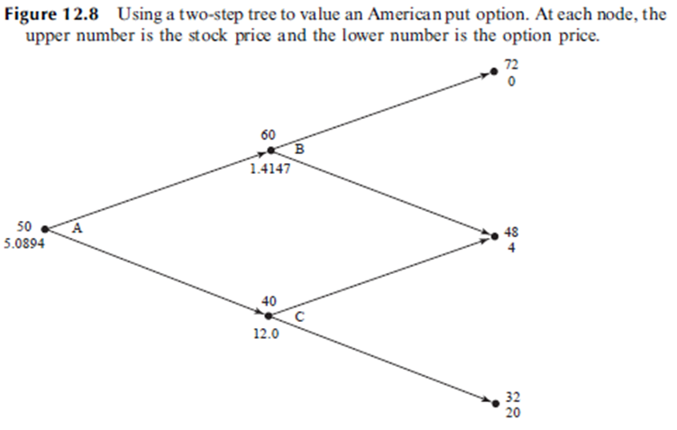
Binomial Trees
Pros:
Computationally Fast
Both European & American
Cons:
Vanilla Options only
Must use many time-steps

Slide 4
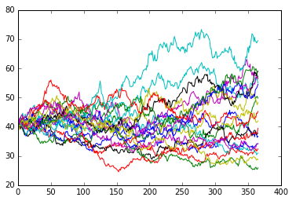
Monte Carlo
Pros:
flexibility in time-steps
Allows for some exotic options
Cons:
Slow
Monte Carlo alone cannot price American options

Slide 5
Longstaff-Schwartz
Pros:
American Options
Exotic options
Cons:
Very slow
High Memory consumption

Slide 6
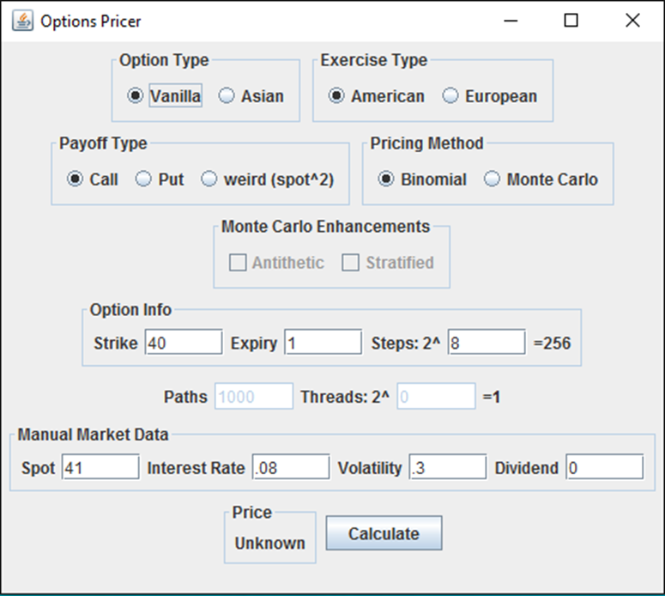
Java Application
Compiled language
fast
GUI is easy for users
OOP is flexible for developers

Slide 7
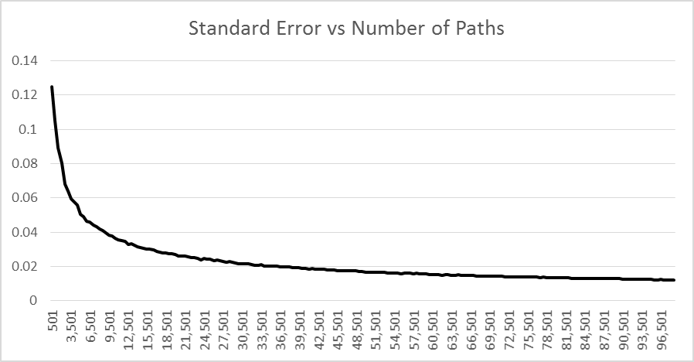
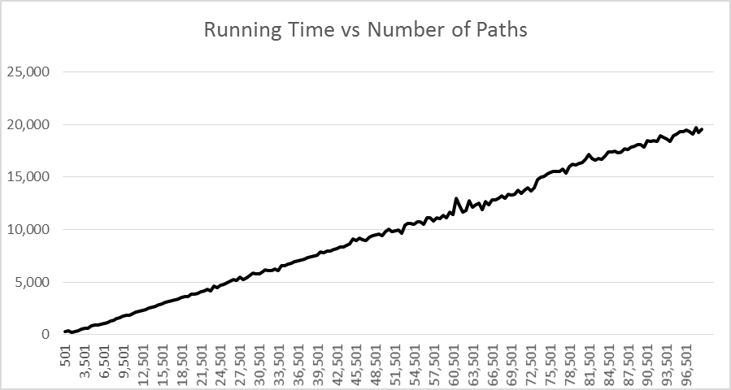
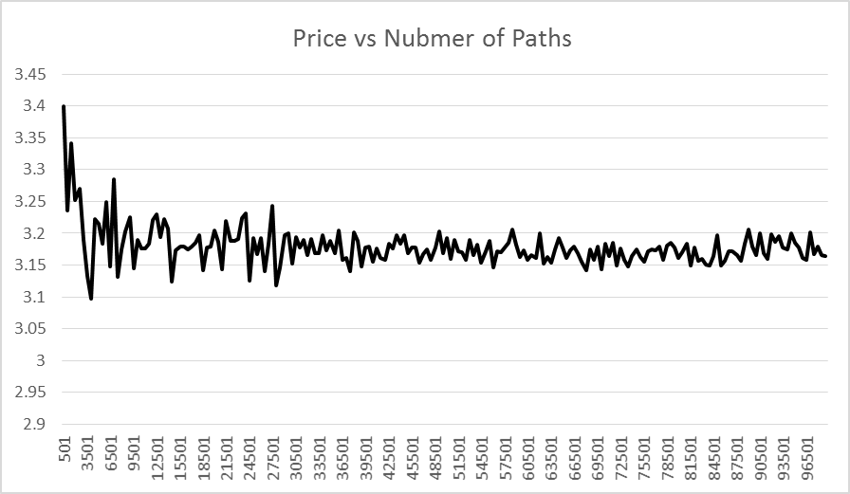
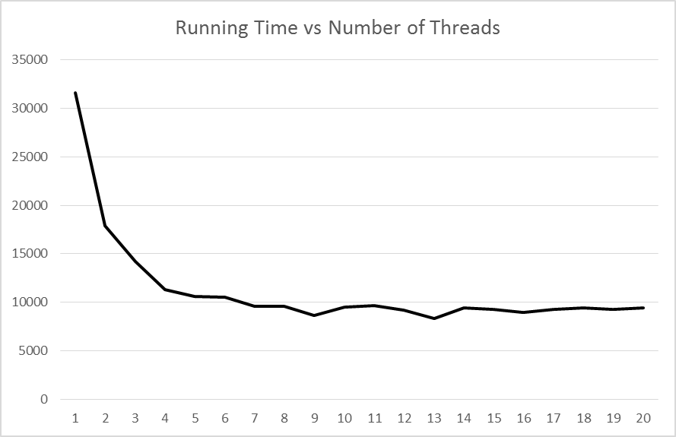
Test Results

Slide 8
Questions?

