Slide 1
I2C multi-bus controller organization
Demultiplexer commands (synchronization) and packets of bus controller commands.
Control output (low overhead)
Host write FIFO
Local command generation
Local write FIFO
Demultiplexer
Triggering
Bus controller commands: start_read, etc.
Bus 0
Bus 1
Bus 2
Status packets
Multiplexer
Host read FIFO

Slide 2
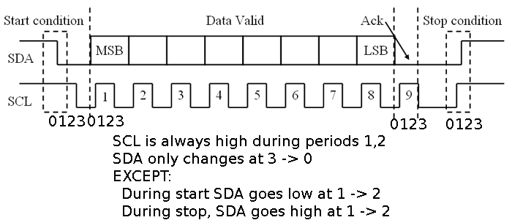
I2C bus timing
Each bit period is divided into four phases 0 .. 3
State transitions are usually clocked off of the leading edge of one of these phases.

Slide 3
I2C bus state machine
start_write
start_read
Exit on empty
See
Next slide
Trigger delay 1
CMD wait
Trigger delay 2
stop
sequence
TX stop wait
Trigger delay 3
Sequence arg load
TX stop

Slide 4
I2C bus state (read/write)
CMD wait
The first states of reading and writing are in common, with some parts conditional on whether the command is read or write.
start_write
start_read
load
start
address
RX data
TX data
address ACK
RX data 1
wait
TX data ACK
RX data ACK

Slide 5
States for I2C bus state machine
This is copied from the LabView documentation for i2c_controller.ctl
CMD wait: Waiting for command on write FIFO.
load: State when loading arguments to read/write command.
start: Sending start bit for I2C read/write.
address: Sending address for read/write.
address ACK: waiting for ACK on read/write address.
wait: waiting to read/write next byte.
TX data: writing data byte.
TX data ACK: waiting for ACK on write data.
stop wait: waiting to send stop.
stop: sending stop bit.
RX data: reading data byte.
RX data 1: saving read byte.
RX data ACK: waiting for ACK on read data.
Sequence arg load: loading argument for sequence command.
Trigger delay 1: preparing to stop, waiting for argument to load.
Trigger delay 2: waiting for status machine to start
Trigger delay 3: waiting for status to be saved.

